Slide 1
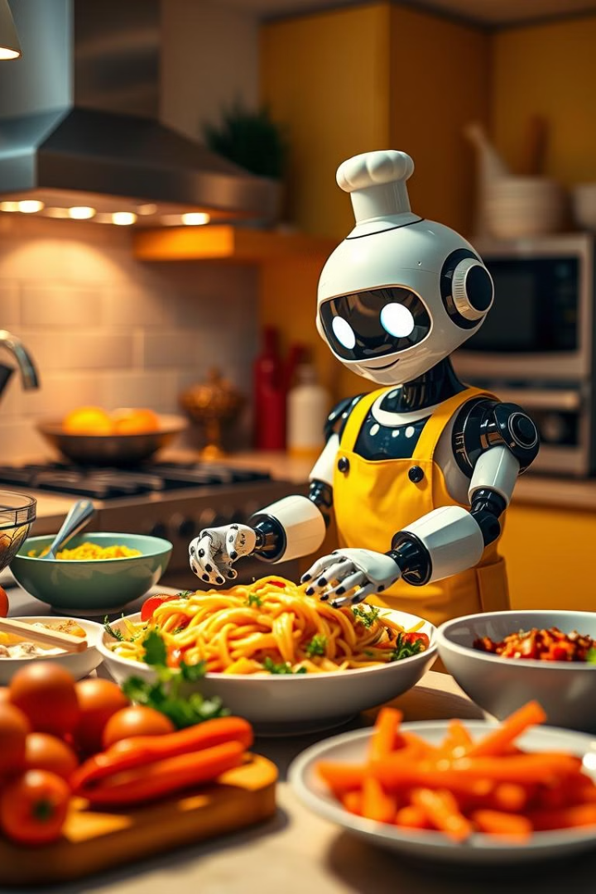
Flavor Fusion: AI-Driven Recipe Blogging
Discover Flavor Fusion, a web app using Google's Generative AI.
Create unique recipe blogs effortlessly.
Input your topic and word count, and let AI generate detailed content.
Enjoy a programmer joke while your recipe is crafted.

Slide 2




Effortless Recipe Creation
Flavor Fusion simplifies recipe blogging.
No more writer's block or tedious research.
AI handles content generation, saving time and effort.
Enter Topic
Input your desired recipe topic.
Set Word Count
Specify the desired length of your blog.
Generate Content
AI creates detailed and engaging content.

Slide 3
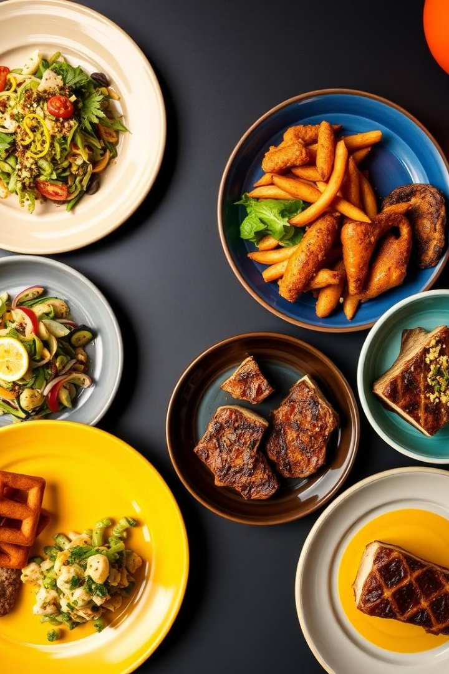
Customized Recipe Blogs
Tailor recipe blogs to specific tastes.
AI adapts to diverse culinary themes and styles.
From vegan delights to hearty classics, create it all.
1
Diverse Themes
2
Adaptable Styles
Explore various culinary themes.
Customize blog writing to fit your preference.
3
Vegan to Classic
Cater to a range of dietary preferences.

Slide 4
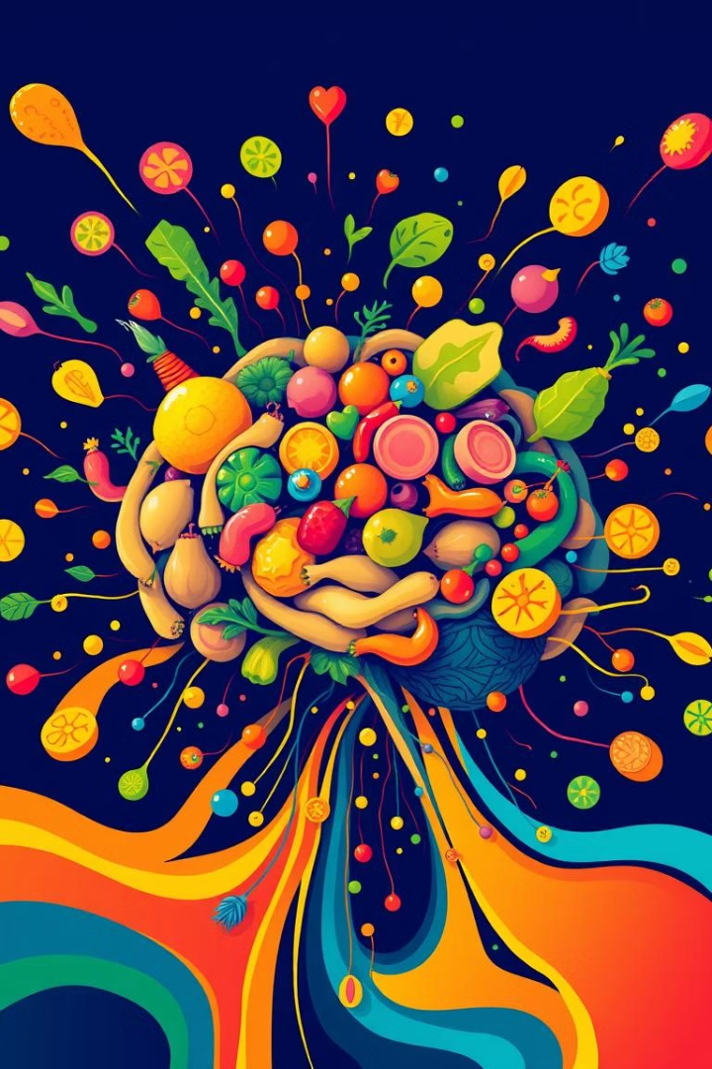



AI-Powered Content Generation
Leverage the power of Google's Generative AI.
Experience cutting-edge technology in recipe creation.
Get high-quality, original content every time.
AI Assistance
Culinary Tech
High Quality
Let the AI generate new ideas for you.
New ways to be creative in the kitchen.
Get the most innovative new content.

Slide 5
A Dash of Humor
Enjoy a programmer joke while you wait.
A fun way to lighten up the content creation process.
Because every good recipe needs a little levity.
Programming Humor
Lighten the Mood
Enjoy a coding joke.
Add some fun to recipe writing.

Slide 6

Engage Your Audience
Create content that resonates with food lovers.
Attract readers with detailed, engaging recipes.
Build a loyal following with Flavor Fusion's help.
Resonate
Attract
Craft targeted content.
Draw in more readers.
Build
Foster audience loyalty.

Slide 7

The Future of Recipe Blogging
Flavor Fusion is transforming content creation.
Embrace the power of AI in the culinary world.
Stay ahead of the curve with innovative technology.
Innovation
The Future
New AI recipe writing tools.
More AI-powered content.
1
2
3
Transformation
Changing food blogging.

Slide 8
Key Takeaways
Flavor Fusion simplifies recipe blogging.
AI generates customized content.
Engage audiences with high-quality recipes.
Add humor to the writing process.
Transform content creation with AI.

