Slide 1
Group 5: NLP Challenge
Team Members :
Cristina, Gulmehak, Iswarya, and Tiago

Slide 2
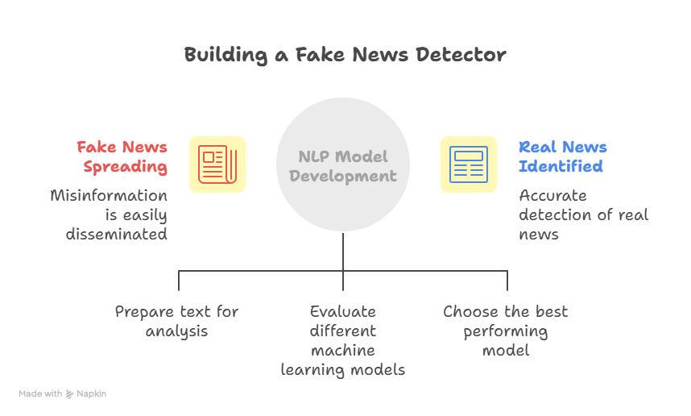
OVERVIEW
Objective: Build a model to classify news as real (1) or fake (0) using NLP.
Scope:
Data preprocessing and text cleaning.
Model experimentation with multiple classifiers.
Selection of best-performing model for final predictions.
Key Milestones:
Implemented full preprocessing pipeline (tokenization, stopword removal, lemmatization, stemming).
Compared Count Vectorizer and TF-IDF approaches.
Evaluated models on training and validation datasets.

Slide 3
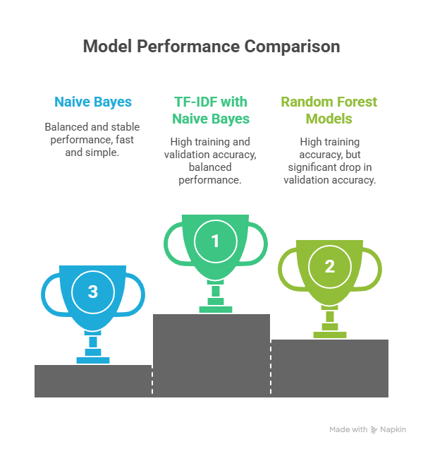
EXECUTIVE SUMMARY
Final Model:
TF-IDF + NAIVE BAYES
Training accuracy: 0.94%
Validation accuracy: 0.93%
Other models:
Count Vector + Multinomial (base model)
Count Vector + Random Forest
TF-IDF + Random Forest

Slide 4
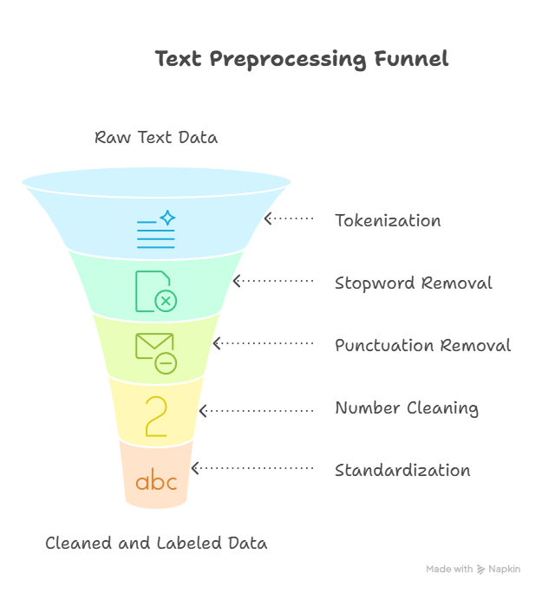
METHODS OF PREPROCESSING
Applied a custom preprocessing function to the entire dataset to clean and normalize text before modeling, it performs the following steps:
Tokenization
Stopword Removal
Punctuation & Number Removal
Cleaning
Lemmatization
Stemming
Addition of headers (labels and text)
Dataset Splitting

Slide 5
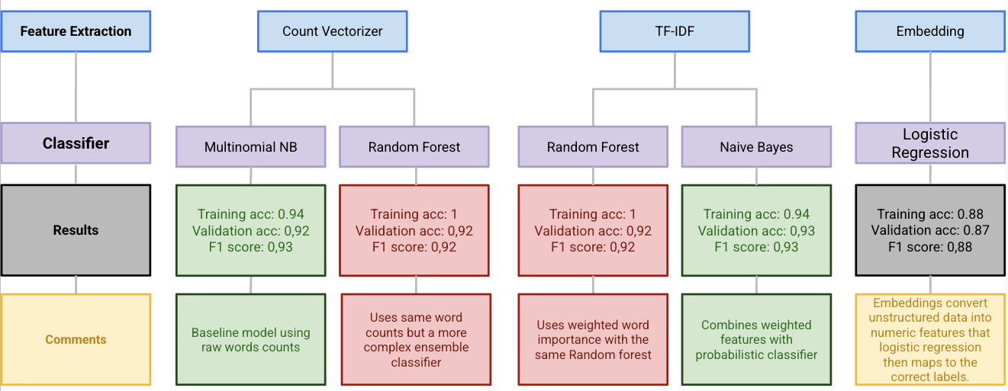
MODEL METHODS

Slide 6
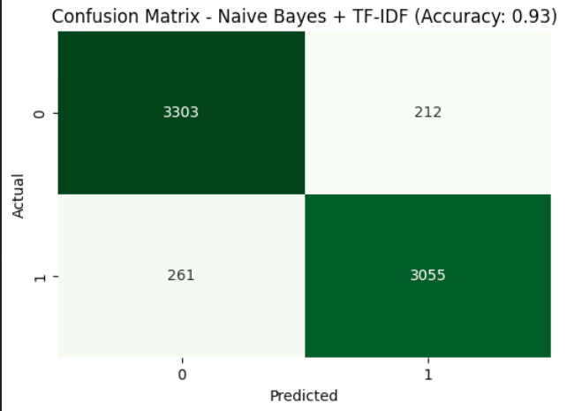
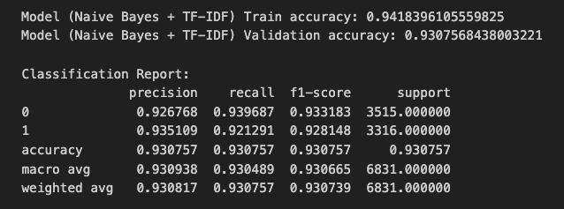
SELECTED MODEL
Final Model:
TF-IDF + NAIVE BAYES
Training accuracy: 0.94%
Validation accuracy: 0.93%
No Overfitting ! 😀🎉

Slide 7
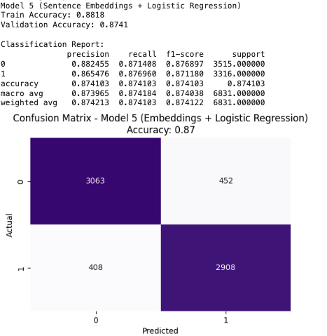
EMBEDDING
Embedding + Logistical Regression:
Embedding works better with math dependent classes.
Training accuracy: 0.88%
Validation accuracy: 0.87%
Preprocessing: Same as other models until tokenization.
Pretrain model: all-MiniLM-L6-v2.
Lightweight semantic embeddings.
Performs close to BERT-base in accuracy, but runs much faster.

Slide 8
CHALLENGES
Selected Models
Model 1 (Count Vectorizer + Naïve Bayes)
Model 4 (TF-IDF + Naïve Bayes)
Strong and stable validation performance with no obvious overfitting
Discarded Models
Models 2 & 3 (Random Forest ones)
Near-Perfect Training Accuracy (1.0) but Validation Accuracy dropped noticeably, showing signs of overfitting
Memorized training data instead of generalizing to unseen text.
So why Naïve Bayes?
Less prone to overfitting with this dataset
Faster training, interpretable
Frequency-based representations (TF-IDF/Count Vectorizer) allow Naïve Bayes to leverage direct term occurrence patterns efficiently.
What about embeddings?
Embeddings, while richer in semantic meaning, usually perform best in context-heavy or numerical tasks (e.g., similarity, clustering, ranking)

Slide 9
TAKEAWAYS
Insights:
TF-IDF highlights key discriminative words.
Naive Bayes efficiently handles sparse textual data.
Combining both yields optimal performance with low complexity.
Lessons Learned:
Proper preprocessing greatly improves text model accuracy.
Simpler models can outperform complex ones when tuned correctly.
Embedding works better with math dependent classes.NB!
NB! We only tried one ligtweight pretrain model, perhaps another model could yield better results.

Slide 10
SUMMARY
TF-IDF highlights the most informative words, improving how the model distinguishes between real and fake news.
Naive Bayes efficiently models word probabilities and works well with sparse, high-dimensional TF-IDF features.
The combination achieves strong generalization (0.93 validation accuracy) while avoiding overfitting seen in Random Forest models.

Slide 11
THANK YOU
*for your time!

