Slide 1

Academic Session 2025-26
EVEN Semester Jan-Jun 2026
UNIVERSITY INSTITUTE OF ENGINEERING
DEPARTMENT OF COMPUTER SCIENCE AND ENGINEERING
BTECH CSE – CS 201
SEMESTER: 6TH
CLOUD COMPUTING
(23CSH-307)
Unit No. 2 Chapter No. 3 Lecture No. 18
Topic : Introduction to serverless (FaaS), benefits (no ops, cost efficiency),
limitations (cold starts, execution limits), use cases.
Sanjay Tiwari, E18823 Senior Technical Trainer

Slide 2
Recap
Dynamic Resolution: Service registry enables dynamic discovery of microservices, while registry patterns fundamentally support scalability in distributed systems.
Decoupling Systems: Service discovery eliminates hard-coded service dependencies.
Centralized Routing: An API Gateway provides a centralized entry point for services; routing through the gateway simplifies client interactions.
Traffic Management: Security policies protect services from unauthorized access, and throttling controls traffic to prevent service overload. These components are essential for building scalable architectures.

Slide 3
1
Learning Objectives
Serverless and FaaS Concepts
Benefits of Serverless Computing
Limitations and Constraints
Serverless Use Cases

Slide 4
Introduction to Serverless Computing
Infrastructure Abstraction: Serverless computing eliminates server management tasks; the infrastructure lifecycle is entirely handled by the cloud provider.
Execution Paradigm: Developers deploy code purely as functions, and execution is triggered dynamically by events or requests.
Workload Characteristics: It enforces stateless execution by default and is strictly designed for short-lived workloads.
Economic Model: Scaling is transparent to developers, and billing is tightly tied to exact execution usage.

Slide 5
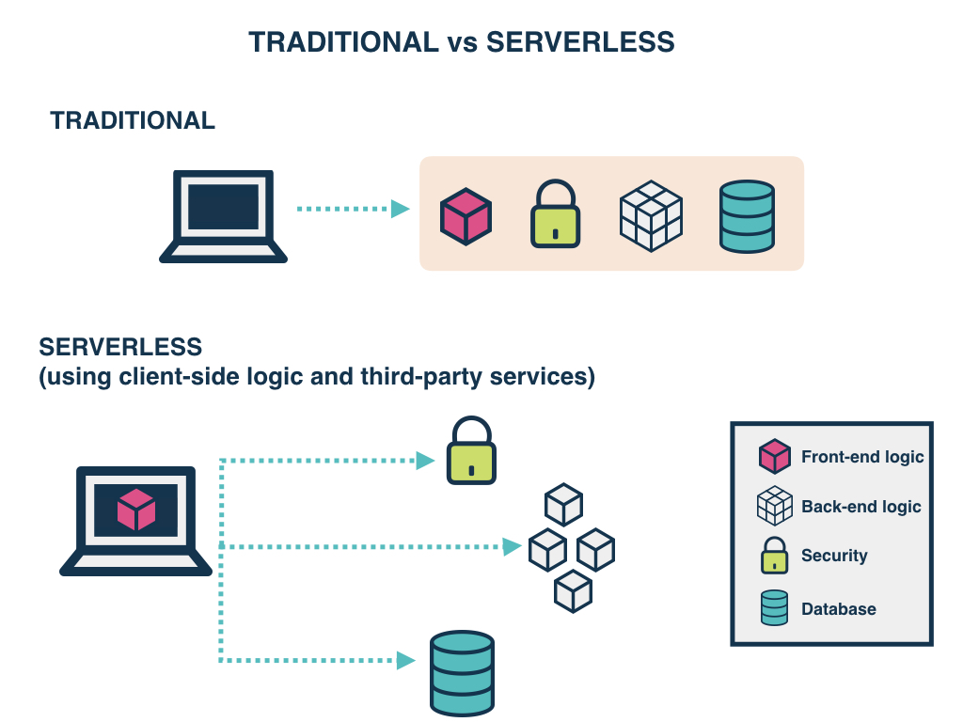
Traditional vs Serverless
Source: Innomize

Slide 6
Function as a Service (FaaS) Architecture
The Serverless Implementation: FaaS is the core implementation of the serverless model.
Granular Logic: Functions encapsulate single responsibilities and enable highly fine-grained application logic.
Transient Execution: Functions are executed in isolated runtime environments where they are automatically instantiated and destroyed; there is no persistent execution environment.
Runtime Support: The platform provides managed runtime versions and natively supports multiple programming languages.

Slide 7
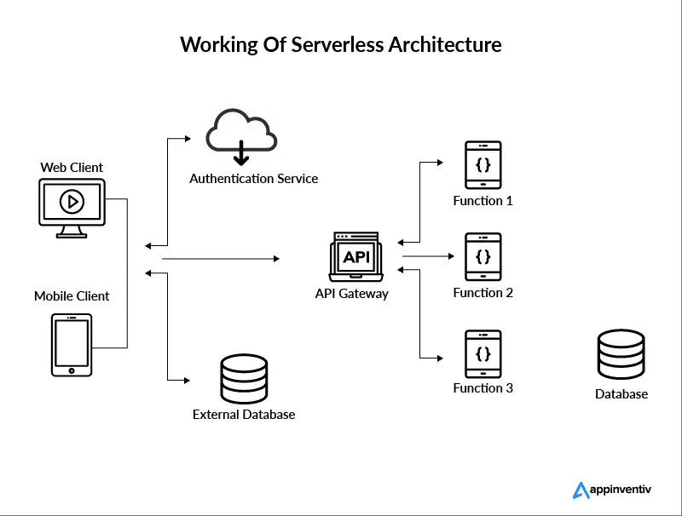
FaaS
Source: Appinventiv

Slide 8
Architectural Characteristics of FaaS
Invocation and State: Relies on an event-driven invocation model coupled with a strict stateless execution pattern.
Elasticity: Offers horizontal scaling per request and relies on a fully managed runtime and OS.
Resilience: Features built-in fault tolerance and high availability by design, enabling rapid deployment and continuous updates.
Financial Granularity: Ensures granular billing directly at the function level.

Slide 9
The "No-Ops" Benefit (Operational Abstraction)
Elimination of Maintenance: No server provisioning, operating system management, or capacity planning is required.
Security and Recovery: There is no need for manual patching or security updates, as the platform automatically handles fault recovery.
Organizational Agility: This model reduces DevOps overhead significantly and simplifies operational responsibility, making it ideal for lean development teams.

Slide 10
Economic Benefit: Cost Efficiency
Usage-Based Billing: Organizations pay only for function execution; billing is calculated based on time and memory consumed during the run.
Zero Idle Cost: There is no cost during idle periods, which fundamentally eliminates over-provisioning waste.
Financial Control: This offers fine-grained cost control and scales cost linearly with demand.
Practical Scenario: An application generating monthly financial reports runs for exactly 10 minutes on the last day of the month. With traditional servers, the company pays for 30 days of idle uptime. With serverless, they incur zero idle cost and only pay for those 10 minutes of execution.

Slide 11
Architectural Limitation: The "Cold Start" Problem
Initialization Latency: A cold start occurs when a function is invoked after inactivity. Because the runtime container must initialize, it adds noticeable latency to the first request.
Performance Impact: This drastically affects performance-sensitive applications, though it is more visible in low-traffic systems.
The Trade-off: The severity depends on the language and platform. It can be reduced by keeping functions warm, but it remains the fundamental trade-off for achieving zero idle cost.
Practical Scenario: If an e-commerce API is built on FaaS and receives no traffic overnight, the very first user who visits the site in the morning experiences a "cold start." Their request takes 3 seconds while the platform provisions the container, whereas subsequent users experience millisecond responses.

Slide 12
Structural Limitations: Execution Limits and Complexity
Time and Resource Quotas: The platform enforces a maximum execution time and strictly predefines memory and CPU quotas.
Processing Constraints: No background processing is allowed; therefore, long tasks require architectural redesign and task decomposition.
Operational Complexity: Developers face stateless execution complexity and increased debugging complexity, compounded by vendor-specific implementations and limited runtime customization.
Workload Boundary: These platform-dependent restrictions apply broadly, meaning FaaS is not ideal for compute-heavy workloads.

Slide 13
Strategic Applicability: Ideal Use Cases
System Workloads: Highly suited for event-driven data processing, backend APIs, IoT event handling, and scheduled automation tasks.
Traffic Patterns: Ideal for systems experiencing unpredictable or bursty traffic and workloads that require short execution times.
Business Initiatives: Optimal for cost-sensitive applications, lightweight business logic, rapid proof-of-concept systems, and innovation projects where minimal operational management is desired.

Slide 14
Strategic Applicability: Non-Ideal Scenarios
Duration and State: Not suitable for long-running batch jobs, continuous background services, or complex stateful applications.
Compute Constraints: Inefficient for high-performance computing workloads and heavy CPU/GPU workloads.
System Requirements: Highly problematic for ultra-low latency systems, complex legacy migrations, or any scenario where tight OS-level control is strictly needed.

Slide 15
Summary of the Lecture
Infrastructure Paradigm: Serverless fundamentally abstracts infrastructure completely, and FaaS enables an event-driven execution model.
Primary Advantages: A No-Ops approach reduces operational burden, and aggressive cost efficiency serves as a key advantage.
Primary Constraints: Cold starts severely affect initial latency, and strict execution limits constrain specific workloads.
Conclusion: Serverless is best suited for short-lived, independent functional tasks and represents a core paradigm of the modern cloud.

Slide 16
10
Faculty-curated videos, NPTEL, Coursera, LinkedIn, or other relevant learning resources
Cloud Computing: https://onlinecourses.nptel.ac.in/noc21_cs14/preview
Cloud Computing: https://onlinecourses.nptel.ac.in/noc26_cs55/preview
Google Cloud Computing Foundations: https://onlinecourses.nptel.ac.in/noc20_cs55/preview
Google Cloud Computing Foundations: https://onlinecourses.nptel.ac.in/noc24_cs131/preview

Slide 17
Next Lecture
7
DevOps culture, Continuous Integration (CI), Continuous Delivery/Deployment (CD), pipeline stages (source, build, test, deploy).

Slide 18
8
Quiz/ FAQ’s
1. What is serverless computing?
2. What is FaaS in serverless architecture?
3. Why is serverless considered no-ops?
4. What causes cold starts in serverless?
5. Is serverless suitable for all applications?

Slide 19
9
References/ Articles/ Videos
https://aws.amazon.com/serverless/
https://learn.microsoft.com/en-us/azure/azure-functions/functions-overview
https://cloud.google.com/serverless
https://www.ibm.com/topics/serverless
https://www.redhat.com/en/topics/cloud-native-apps/what-is-serverless

Slide 20
11
Class-Wise Feedback

Slide 21
12
Thank You
For queries
Email: sanjay.e18823@cumail.in

