Slide 1

Academic Session 2025-26
EVEN Semester Jan-Jun 2026
UNIVERSITY INSTITUTE OF ENGINEERING
DEPARTMENT OF COMPUTER SCIENCE AND ENGINEERING
BTECH CSE – CS 201
SEMESTER: 6TH
CLOUD COMPUTING
(23CSH-307)
Unit No. 2 Chapter No. 2 Lecture No. 17
Topic : Service registry patterns, client- side vs. server-side discovery,
role of API Gateway in microservices (routing, security,
throttling).
Sanjay Tiwari, E18823 Senior Technical Trainer

Slide 2
Recap
Application Packaging: Containers provide lightweight and efficient packaging by bundling applications with their dependencies for consistent execution.
The Orchestration Imperative: While Docker standardizes container usage, orchestration is necessary when managing containers at scale.
Platform Trade-offs: Kubernetes offers powerful orchestration features, whereas ECS provides a simplified approach to container management.
System Reliability: These technologies support distributed architectures and ensure the reliability, scalability, and availability of cloud-native systems.

Slide 3
1
Learning Objectives
Service Registry Concepts
Service Discovery Mechanisms
Client-Side vs Server-Side Discovery
Role of API Gateway

Slide 4
Service Registry Overview
The Central Directory: A service registry acts as a central directory that stores the names and locations of all service instances.
Dynamic Adaptation: It handles dynamic IP and port changes, making it essential in dynamic environments where services scale frequently.
Health and State: The registry supports service registration, handles deregistration, and actively keeps track of healthy services.
Architectural Decoupling: By centralizing service metadata, it reduces hard-coded dependencies and enables loose coupling across the system.

Slide 5
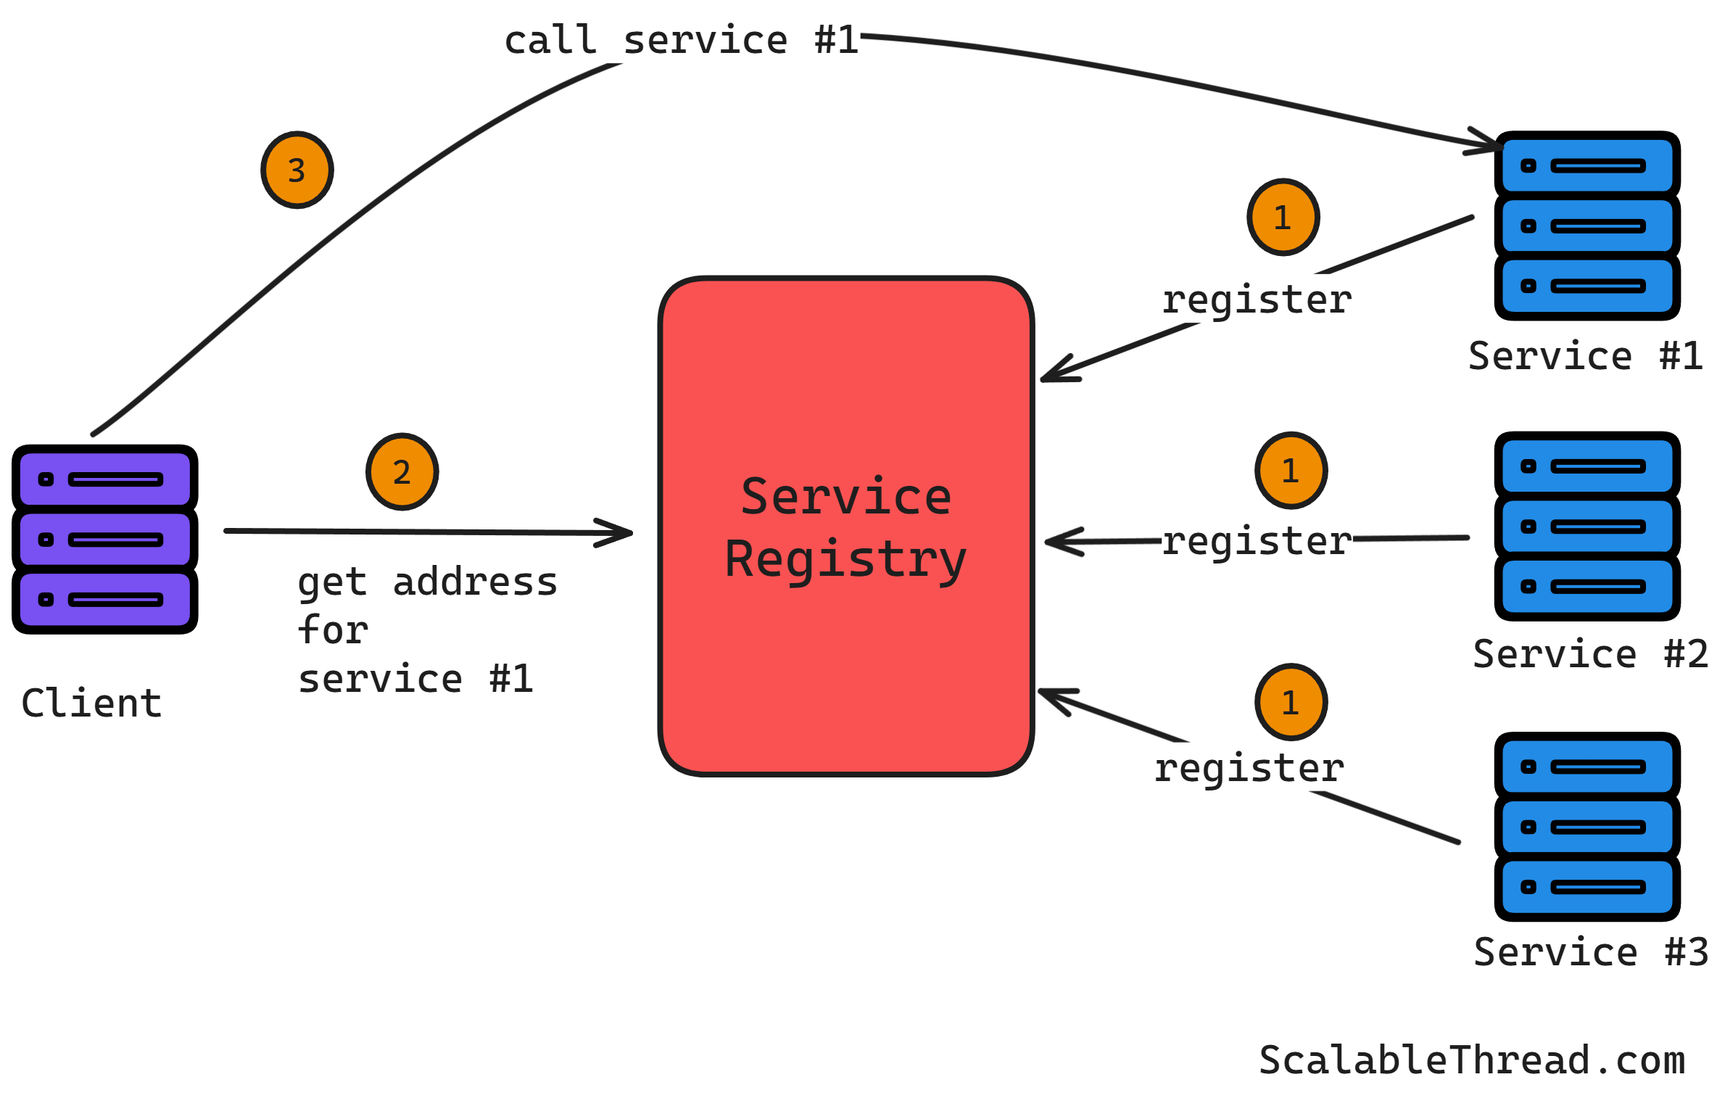
Service Registry Overview
Source: Scalable Thread

Slide 6
Service Registration Patterns
Self-Registration Pattern: A service provides its own metadata and registers itself at startup. It sends periodic health updates and deregisters on shutdown. This requires service-side logic but directly reflects the service state.
Third-Party Registration Pattern: An external component handles registration centrally, and services remain completely unaware of the registry. Health checks are performed externally. This is useful when services cannot modify code, though it requires additional infrastructure.

Slide 7
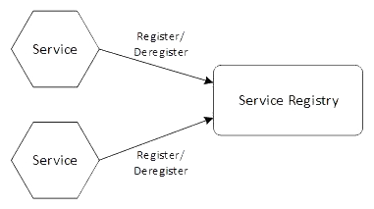
Self Registration Pattern
Source: O’Reilly

Slide 8
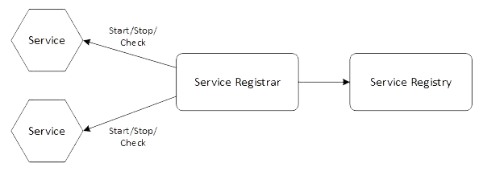
Third-Party Registration Pattern
Source: O’Reilly

Slide 9
Service Discovery Mechanisms
The Discovery Process: Service discovery is the fundamental process of locating service instances utilizing the registry as an information source.
Dynamic Communication: By avoiding fixed endpoints, it enables fault-tolerant inter-service communication even in highly dynamic scaling scenarios.

Slide 10
Client-Side Service Discovery
Direct Interaction: The client queries the service registry directly and selects the appropriate service instance.
Client Autonomy: Load balancing logic resides within the client, allowing for direct communication with the backend service.
Trade-offs: This approach provides more control and flexibility for the client. However, it requires client-side intelligence and custom libraries, which increases client complexity and system coupling.

Slide 11
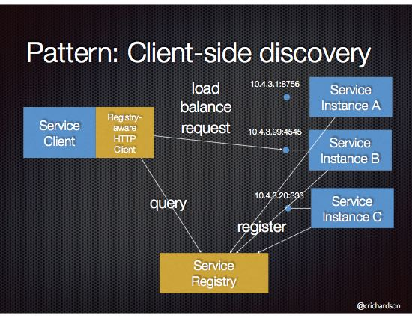
Client-Side Service Discovery
Source: Microservices.io

Slide 12
Server-Side Service Discovery
Intermediary Routing: The client sends a request to an intermediary, which then queries the registry and handles routing externally.
Client Simplicity: Because the client is unaware of service locations, this heavily simplifies client implementation and logic.
Trade-offs: It provides centralized load balancing and centralizes routing logic, making changes easier to manage. However, it requires additional infrastructure to operate.

Slide 13
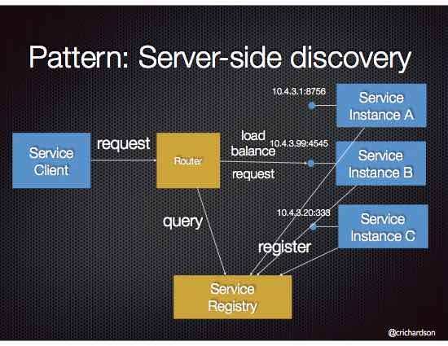
Server-Side Service Discovery
Source: Microservices.io

Slide 14
Introduction to API Gateways
The Single Entry Point: An API Gateway acts as a single entry point for clients, effectively routing requests to the proper backend services.
Topological Abstraction: It abstracts the internal service structure and hides the internal service topology from the outside world.
Security & Simplicity: This pattern reduces direct service exposure, centralizes cross-cutting concerns, and significantly simplifies client interaction.

Slide 15
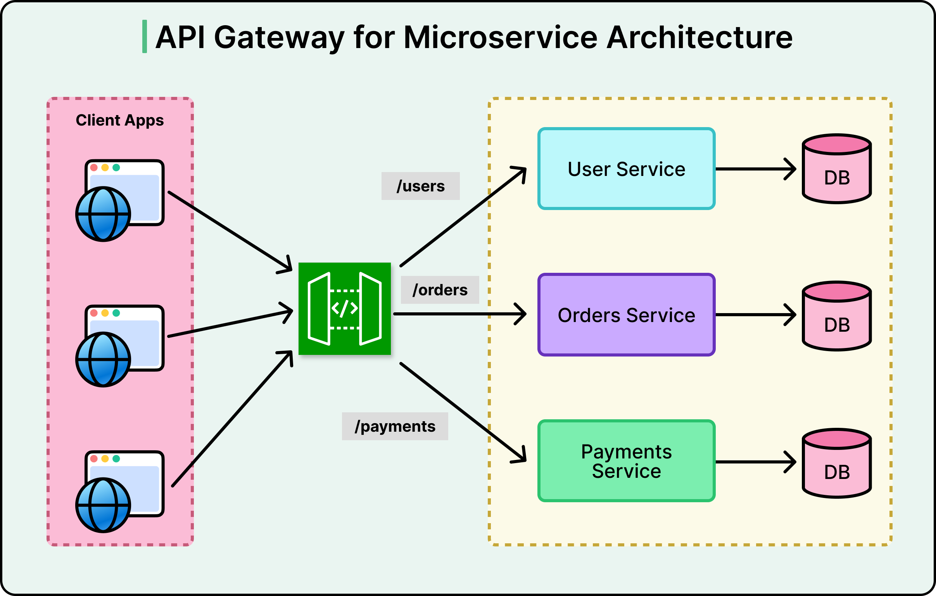
API Gateways
Source: ByteByteGo

Slide 16
API Gateway Capabilities: Routing
Traffic Direction: The gateway intelligently directs requests to the correct service.
Advanced Routing Protocols: It supports advanced techniques like path-based routing and version-based routing.
Network Optimization: It enables request aggregation to combine multiple internal calls into one, which simplifies client communication.
Adaptability: The gateway supports dynamic service changes and significantly improves request management.

Slide 17
API Gateway Capabilities: Security & Throttling
Access Control: The gateway acts as a security shield, handling authentication and authorization while enforcing access control policies.
Backend Protection: It protects backend services by preventing abuse and overload.
Traffic Management: It limits request rates (throttling), enables API key management, and supports traffic shaping.
System Integrity: Collectively, these measures drastically improve overall system stability.

Slide 18
Summary of the Lecture
6
Dynamic Environments: Service registries enable dynamic discovery, which fundamentally removes hard-coded dependencies and supports scalability.
Discovery Trade-offs: Client-side and server-side discovery offer distinct architectural trade-offs regarding complexity and flexibility.
Centralized Access: The API Gateway centralizes access, utilizing advanced routing to simplify client interaction.
System Reliability: Implementing security and throttling at the gateway protects internal services, making these patterns essential for scalable microservices.

Slide 19
10
Faculty-curated videos, NPTEL, Coursera, LinkedIn, or other relevant learning resources
Cloud Computing: https://onlinecourses.nptel.ac.in/noc21_cs14/preview
Cloud Computing: https://onlinecourses.nptel.ac.in/noc26_cs55/preview
Google Cloud Computing Foundations: https://onlinecourses.nptel.ac.in/noc20_cs55/preview
Google Cloud Computing Foundations: https://onlinecourses.nptel.ac.in/noc24_cs131/preview

Slide 20
7
Next Lecture
Introduction to serverless (FaaS), benefits (no ops, cost efficiency), limitations (cold starts, execution limits), use cases

Slide 21
8
Quiz/ FAQ’s
1. What is a service registry in microservices?
2. What is the difference between client-side and server-side service discovery?
3. Why is service discovery important in microservices?
4. What is the main role of an API Gateway?
5. Why is throttling implemented at the API Gateway?

Slide 22
9
References/ Articles/ Videos
Martin Fowler – Service Registry and Discovery https://martinfowler.com/articles/microservices.html
Microsoft – API Gateway Pattern https://learn.microsoft.com/en-us/azure/architecture/patterns/api-gateway
AWS – Service Discovery Overview https://docs.aws.amazon.com/cloud-map/latest/dg/what-is-cloud-map.html
Red Hat – API Gateway in Microservices https://www.redhat.com/en/topics/microservices/what-is-an-api-gateway

Slide 23
11
Class-Wise Feedback

Slide 24
12
Thank You
For queries
Email: sanjay.e18823@cumail.in

