Slide 1
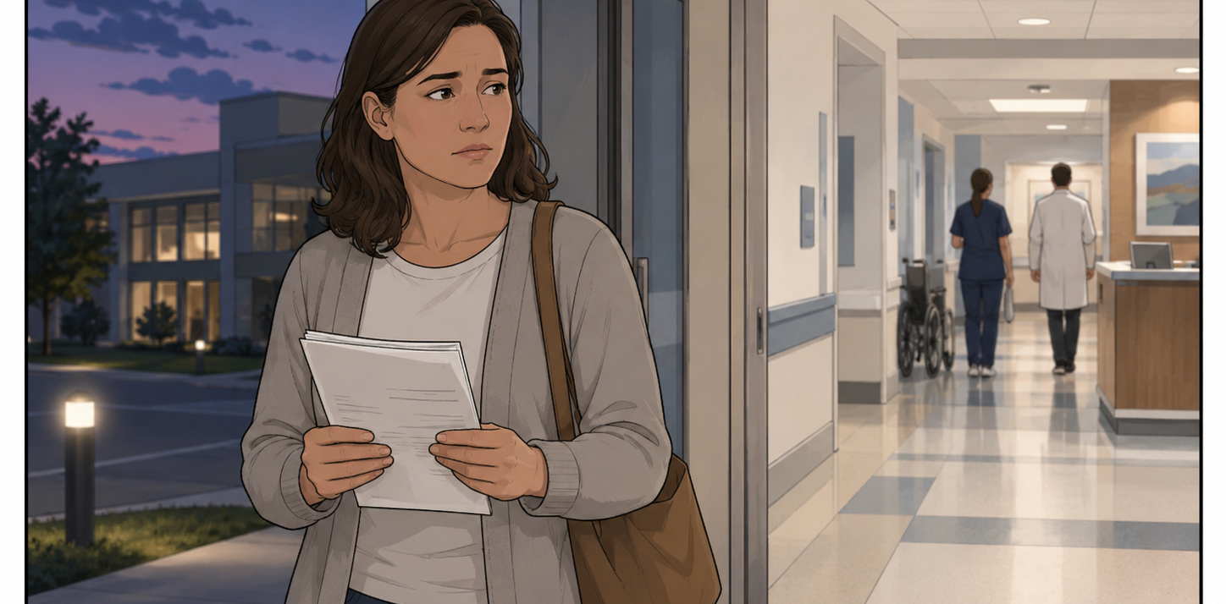
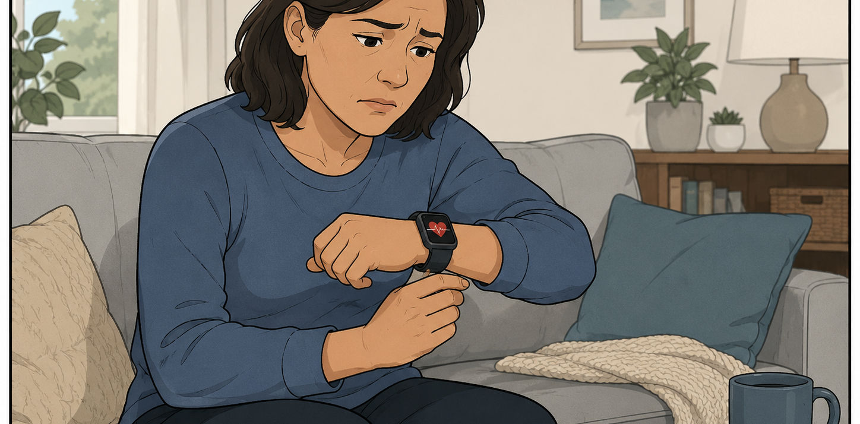
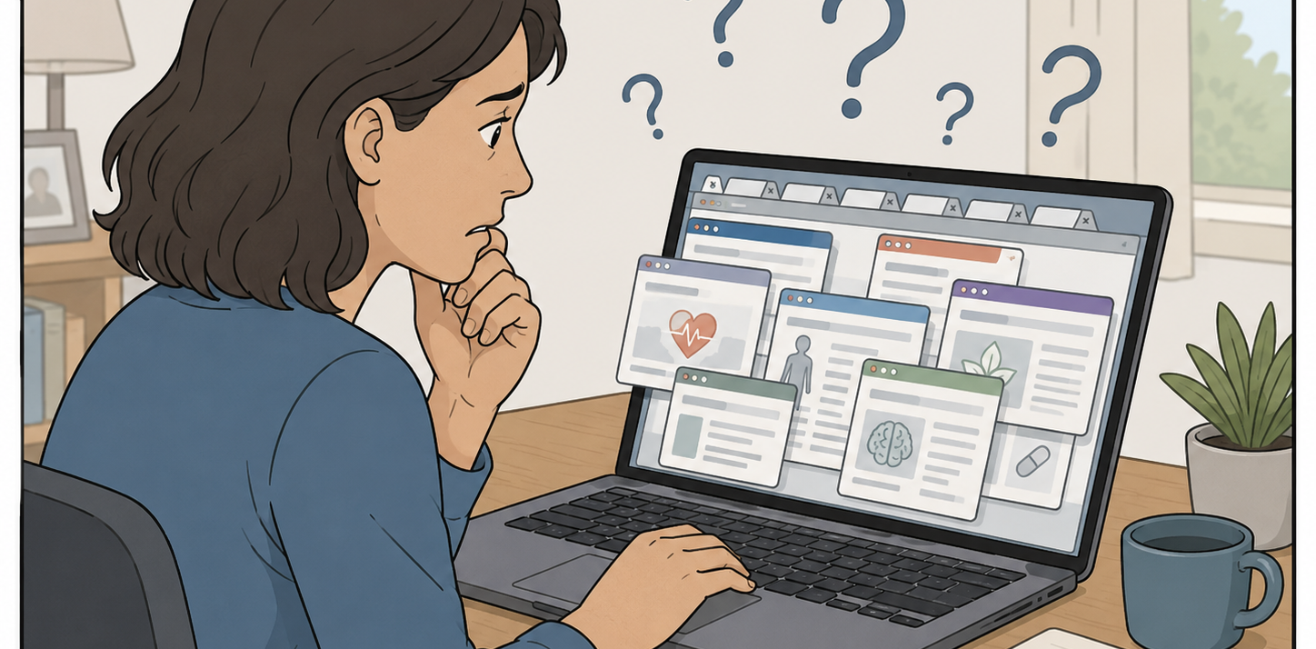
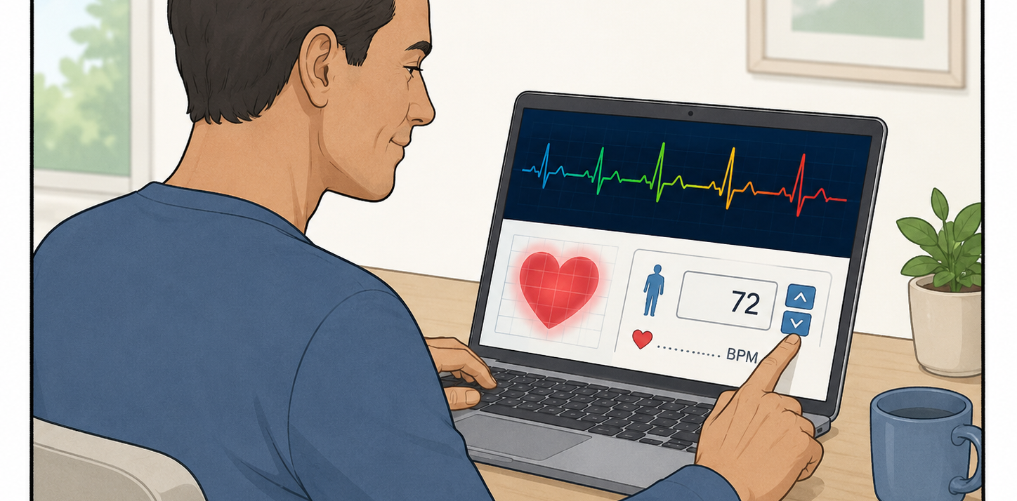
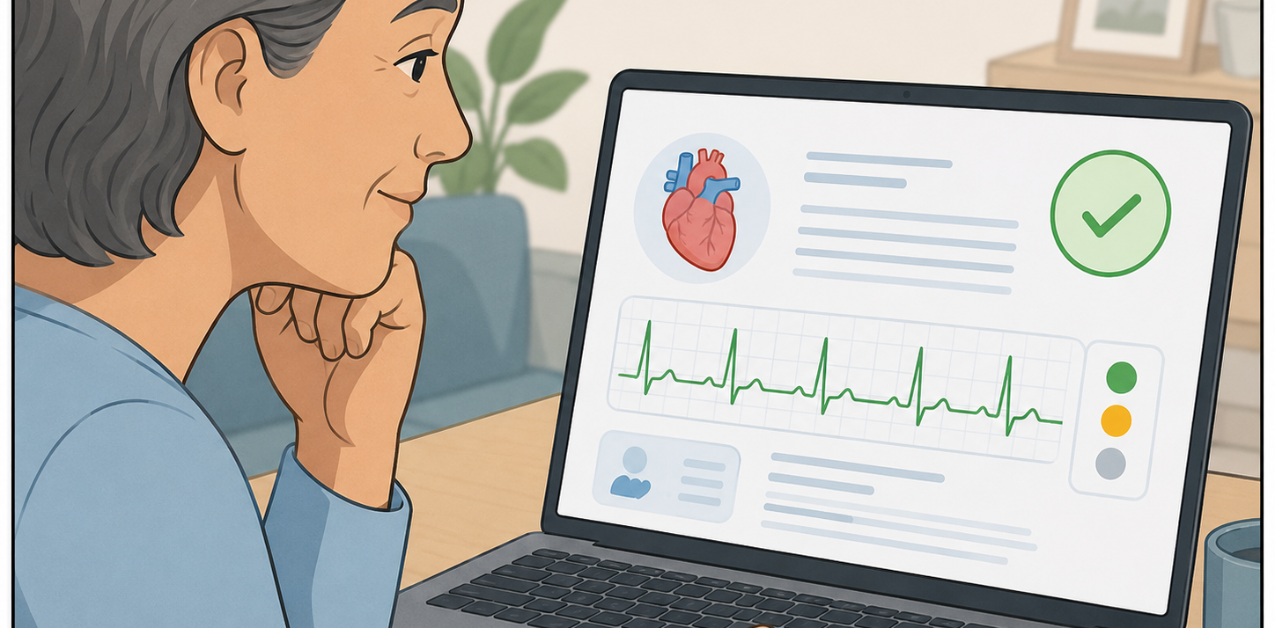
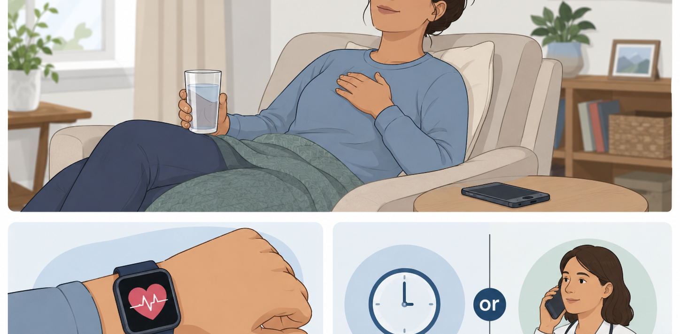
HeartWise: Understanding Heart Rate After an ED Visit
User: recently discharged patient • Need: interpret BPM without panic • Solution: visual + plain-language guidance
1. ED discharge
2. High BPM at home
3. Online confusion
The patient leaves the ED with instructions to monitor symptoms, but still feels unsure about what heart rate numbers mean.
At home, a wearable shows 118 bpm. The raw number feels scary because there is no context.
Searching online gives conflicting explanations and increases anxiety instead of helping.
4. Opens HeartWise
5. Understands result
6. Safer next step
The patient enters the BPM into HeartWise and sees an EKG-style visual response.
HeartWise labels the reading as elevated and explains it in calm, plain language.
The patient rests, rechecks later, and knows when to contact a clinician or seek urgent care.
Design guardrail: educational only, not diagnostic. Symptoms and clinical context always matter.

