Slide 1
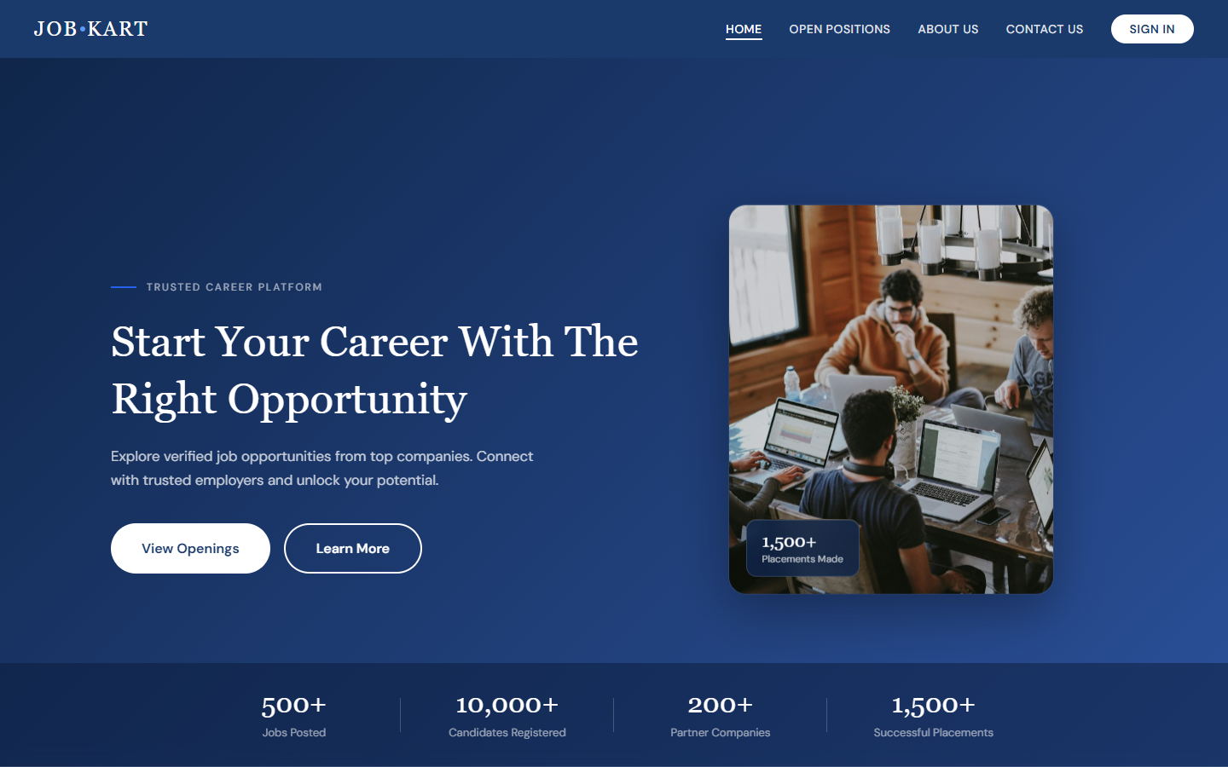
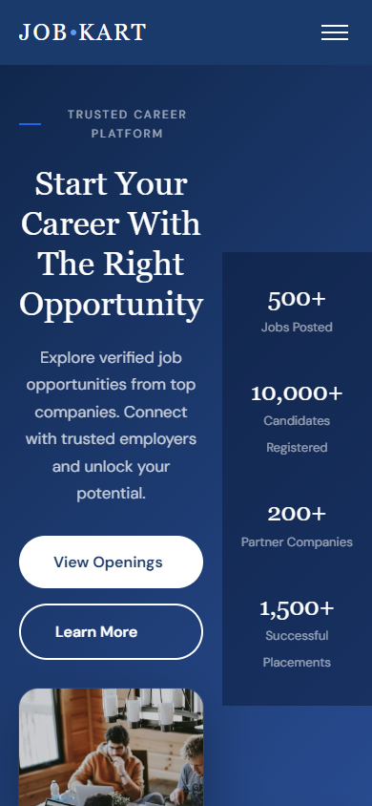
FULL-STACK PROJECT PRESENTATION
job-kart.org
JOB·KART
Empowering Careers, Simplifying Hiring
A full-stack job-portal platform connecting verified talent with India's top employers — built on the MERN-style stack.
MongoDB
Express.js 5
Node.js
JWT Auth
Vanilla JS
PRESENTED BY
Tusar Kumar Mahakud
Swadhin Panigrahi
Tannu Kumari
Subhrakant Senapati
TM
SP
TK
SS
Regd No. 2301289131
Regd No. 2301289125
Regd No. 2301289130
Regd No. 2301289122
Mobile-first UX
Guide: — · Session 2024–26 · 2026
01 / 07

Slide 2
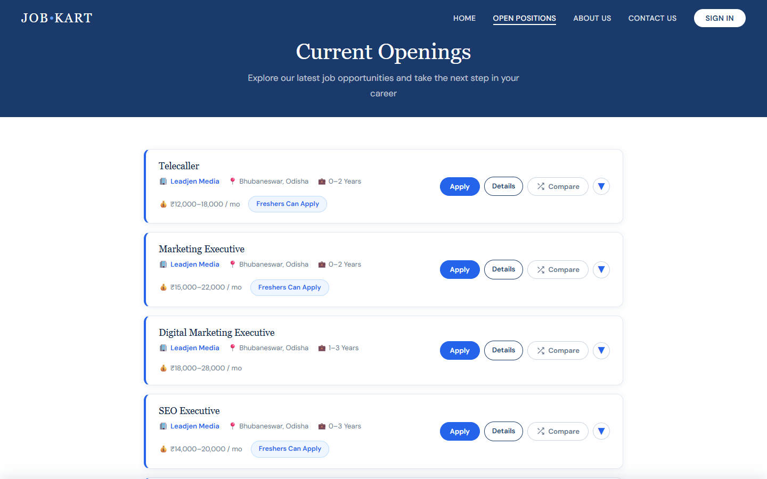
01 — PROBLEM STATEMENT & MOTIVATION
Hiring is fragmented, opaque and slow
Motivation: students chase scattered postings while recruiters juggle spreadsheets — JOB·KART was built to fix both sides of this broken loop.
job-kart.org
⌖ Scattered Listings
? Zero Transparency
Openings are spread across dozens of boards and groups — no single, verified source of truth for job seekers.
Candidates apply into a void: no status, no timeline, no feedback loop after clicking apply.
≡ Manual Screening
⚑ Employer Trust Gap
18 live roles · 7 companies · 0 status updates after applying
Recruiters drown in unstructured CVs and spreadsheets, tracking who is applied, shortlisted or hired.
Postings reveal little about companies — no profiles, culture or verified employee reviews to rely on.
WHY IT MATTERS
India's hiring market serves millions of job-seekers every year — every missing status update and every manual spreadsheet multiplies wasted effort on both sides of the desk.
JOB·KART | Empowering Careers, Simplifying Hiring
02 / 07

Slide 3
02 — OBJECTIVES
What the project set out to achieve
01
Unified verified marketplace
02
Transparent application tracking
One trusted platform aggregating verified openings from real companies.
A real-time status pipeline — Applied → Under Review → Selected — for every candidate.
03
Efficient hiring workflow
04
Insightful dashboards
Visual pipeline and screening tools that replace manual spreadsheet tracking for recruiters.
Live analytics charts for applications, hiring status and per-job performance.
05
Secure role-based access
06
Lightweight responsive UX
JWT authentication with candidate/recruiter separation and hashed credentials.
Framework-free, mobile-first interface with dark mode and zero build step.
Scope: full-stack web application — REST API + responsive frontend + cloud database, deployable on Vercel.
03 / 07

Slide 4
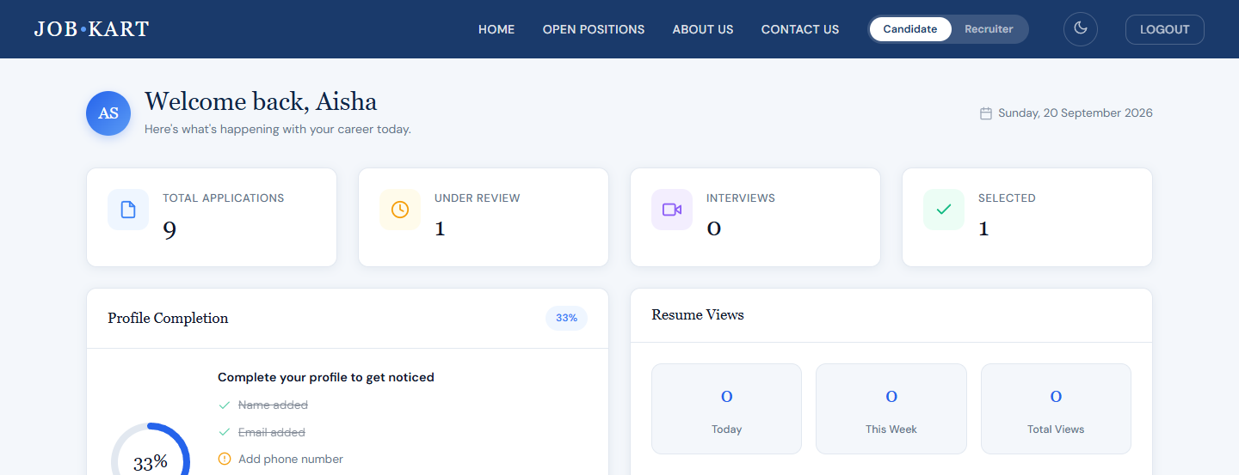
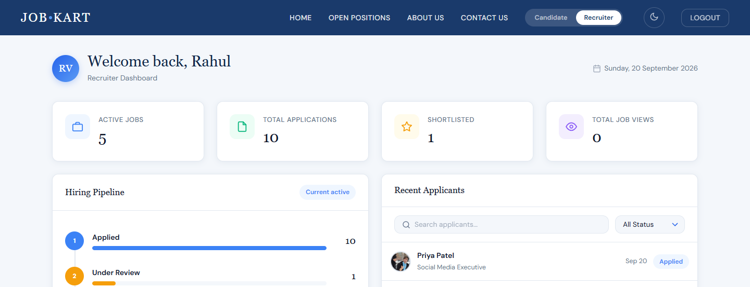
03 — PROJECT FUNCTIONALITIES
Key functionalities — one platform, two journeys
FOR CANDIDATES
FOR RECRUITERS
● Smart discovery — filter by role, salary, location & experience
● One-click apply — auto-filled profile + resume upload
● Live tracker — Applied → Under Review → Selected
● Saved jobs & compare — weigh two offers side-by-side
● Profile meter — guided setup that boosts hiring odds
● Post & manage jobs — skills, benefits, deadlines & status
● Visual pipeline — hiring stages with live counts
● Candidate screening — search & filter applicants instantly
● Company branding — mission, gallery, benefits & reviews
● Live analytics — per-job and status charts
job-kart.org
job-kart.org
Candidate dashboard — live stats, timeline & interview schedule
04 / 07
Recruiter dashboard — pipeline & application analytics

Slide 5
04 — METHODOLOGY / ARCHITECTURE
Three-tier architecture, secured by design
REQUEST FLOW
Browser
FRONTEND
HTML · CSS · JS · fetch API
HTML5 · CSS3 · Vanilla JavaScript · Chart.js · Font Awesome 6 · DM Sans · Dark Mode
BACKEND
Express.js API
Node.js · Express.js 5 · JWT · bcryptjs · express-rate-limit · dotenv · Nodemon
27 REST endpoints · middleware chain
DATABASE
MongoDB Atlas
MongoDB Atlas · Mongoose ODM · 6 collections · aggregation pipelines
Mongoose models · aggregation
METHODOLOGY
Requirement Analysis
UI/UX Design
API Development
Integration & Testing
Deployment
Auth flow: register / login → bcrypt verify → signed JWT → protected routes with role-gated access for candidates & recruiters.
SECURITY LAYER
bcrypt hashing
JWT tokens
role-based access
XSS sanitizer
rate limiting
05 / 07

Slide 6
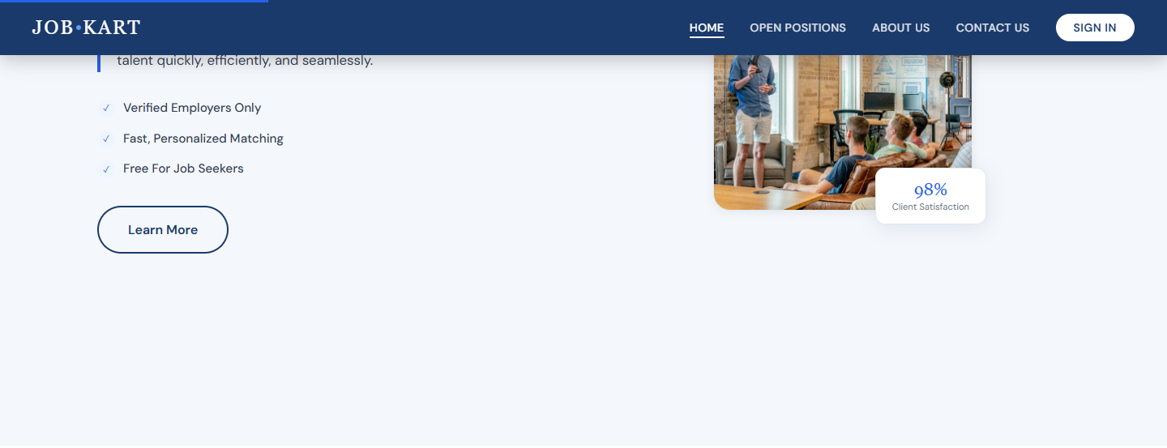
05 — RESULTS
Outputs achieved — a working platform
27
6
13.8k+
10+
REST endpoints
data collections
lines of code
responsive pages
DEMONSTRATED OUTPUTS
job-kart.org
● End-to-end hiring loop — post, apply, track, shortlist, hire in one platform
● Rich company pages — 7 seeded companies, culture pages & 12 verified reviews
● Analytics dashboards — Chart.js visuals for both roles via aggregation pipelines
● Secure demo environment — JWT sessions, demo users & full hiring-pipeline data
Homepage — animated stats, featured roles & company strip
ALSO VERIFIED
Candidate & recruiter roles
Mobile-first layout
Zero framework overhead
06 / 07

Slide 7
06 — CONCLUSION & FUTURE WORK
Where the project stands — and where it goes next
CONCLUSION
FUTURE ENHANCEMENTS
● Fully functional platform — every core flow works end-to-end on live data
● Both journeys served — candidates track applications; recruiters manage a visual pipeline
● Security-first stack — JWT auth, bcrypt hashing, XSS sanitization & rate limiting
● Lean by design — framework-free frontend: zero build step, instant deploys
● Deploy-ready — cloud database + static frontend, live on Vercel
Email & push alerts
application status updates and new-job notifications
AI job matching
resume-based recommendation of best-fit roles
Resume parsing
auto-fill profiles from uploaded CVs
Admin verification
company and posting approval workflow
PWA mobile app
installable experience with offline support
Thank you · Questions welcome
JOB·KART | Empowering Careers, Simplifying Hiring
07 / 07

