Slide 1
Project Presentation of CO-OP Project at Industry (Module-2) (22CS421)
On
Influence of Student Club Participation on Academic Performance and Student Development
Ishika , Daksh
2210990421, 2210991470
Supervised By
Dr. Manav Bansal
Department of Computer Science and Engineering,
Chitkara University, Punjab

Slide 2
Index
Introduction
Glimpses
Problem Statement
Objectives of the Study
Research Methodology
Participation Overview
Academic Performance Analysis
Confidence and Communication Skills
Teamwork and Time Management
Average Skill Development
Major Findings
Conclusion
Future Scope
References
2

Slide 3
Introduction
Higher education institutions are increasingly focusing on the holistic development of students rather than limiting learning only to academics. Universities now encourage experiential learning, leadership development, and interpersonal skill enhancement through extracurricular activities.
Student clubs have emerged as an important platform for promoting student engagement beyond classrooms. These clubs provide opportunities for students to participate in technical, cultural, social, and leadership-based activities, helping them improve communication, teamwork, confidence, and time management skills.
At Chitkara University, the Office of Student Life plays a major role in organizing and supporting student engagement initiatives through various student clubs and activities.
3

Slide 4
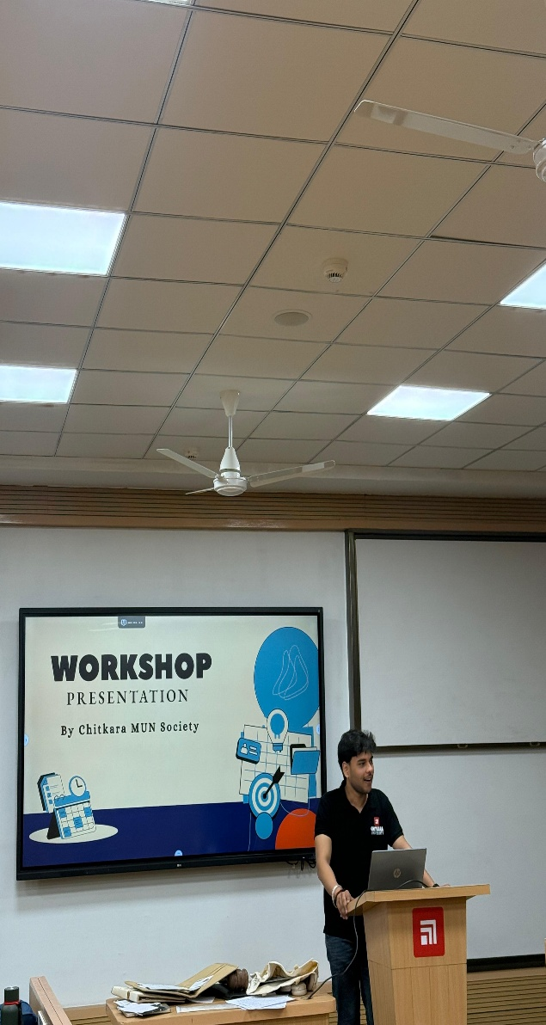
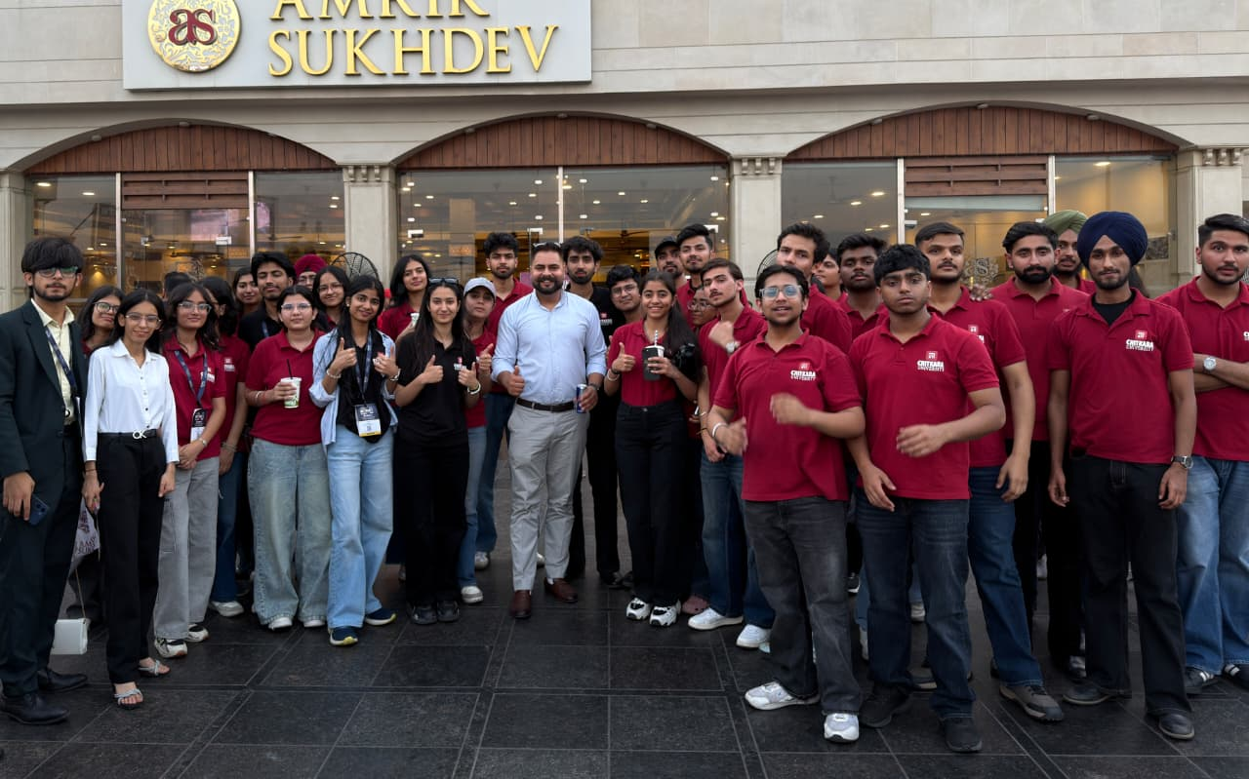
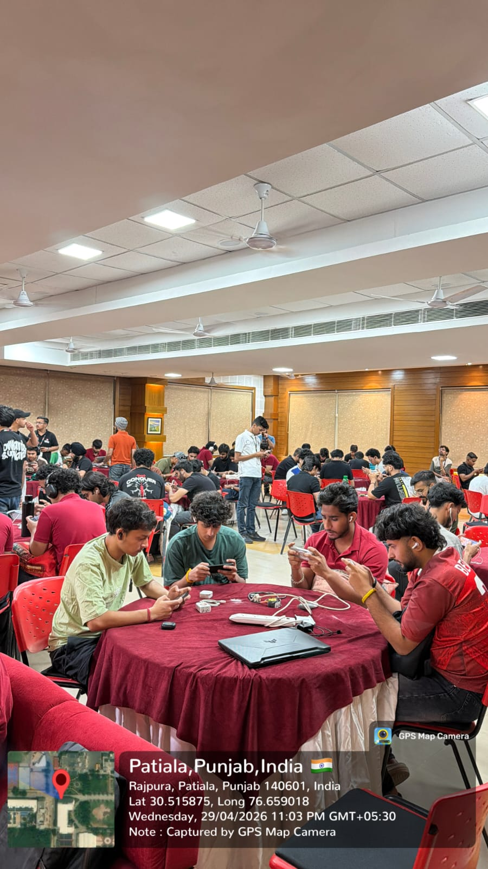
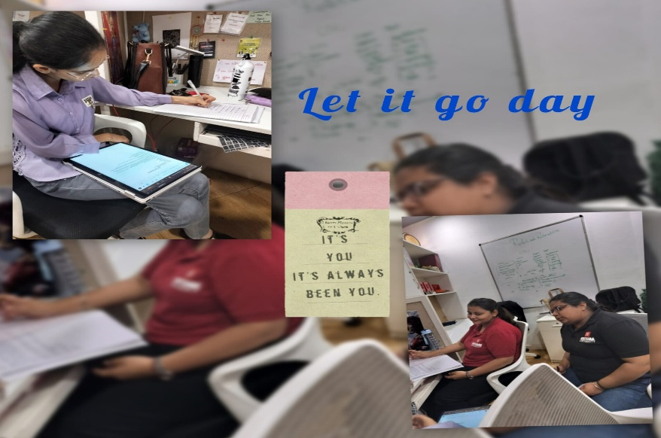
Glimses
4

Slide 5
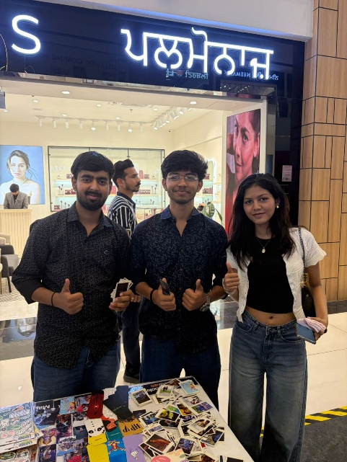
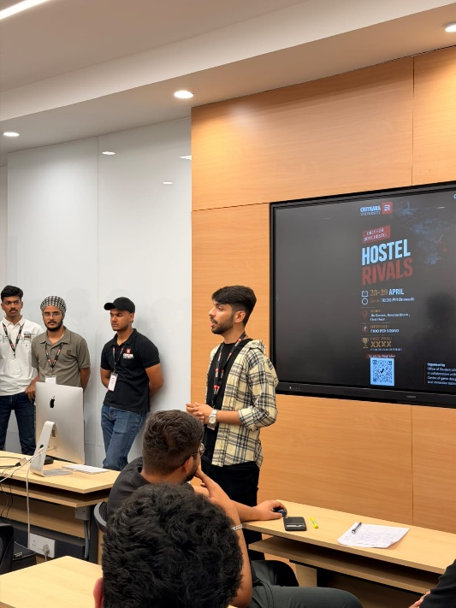

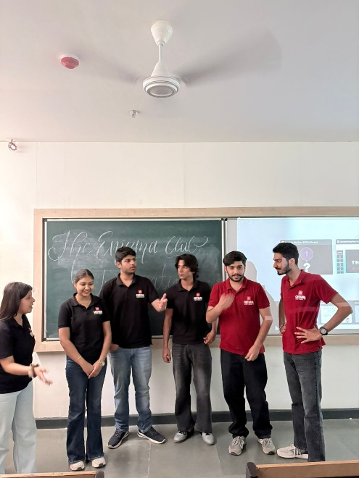
Glimses
5

Slide 6
Problem Statement
Despite the increasing popularity of extracurricular activities, there remains a continuous debate regarding their impact on academic performance.
Some educators and students believe that participation in student clubs enhances productivity, leadership, and personal growth. However, others argue that excessive involvement in extracurricular activities may negatively affect academics and time management.
This study aims to examine the actual influence of student club participation on academic performance and overall student development using real data collected from undergraduate students.
6

Slide 7
Objectives of the Study
The primary objective of this research is to analyze the influence of student club participation on academic performance and overall student development.
The study specifically focuses on:
1. Comparing academic performance of club participants and non-participants 2. Examining confidence and communication skill development 3. Assessing teamwork and time management abilities 4. Understanding the role of student engagement in holistic development
7

Slide 8
Research Methodology
The study adopts a quantitative survey-based research design to analyze the relationship between student club participation and student development.
Data Collection - Structured Google Form Questionnaire
Sample Size - 111 Undergraduate Students
Sampling Technique - Convenience Sampling
Tools Used:
Google Forms
Microsoft Excel
Statistical Analysis
Graphical Visualization
The collected data were analyzed using percentage analysis and comparative analysis methods.
8

Slide 9
Participation Overview
The survey results indicate a strong culture of student engagement within the university. A majority of students reported active involvement in student clubs and extracurricular activities.
Key Findings:
87.4% students actively participate in clubs
12.6% students are non-participants
The findings demonstrate that student clubs play a significant role in promoting engagement and participation beyond classrooms.
9

Slide 10
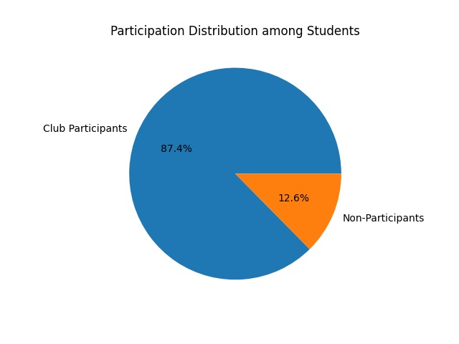
Participation Overview
10

Slide 11
Academic Performance Analysis
One of the major objectives of the study was to examine whether student club participation affects academic performance.
The findings reveal that extracurricular involvement does not negatively impact academics. A large proportion of students maintained high academic achievement while actively participating in clubs.
Key Statistics:
45.9% students reported CGPA above 9.0
29.7% students reported CGPA between 8.0–8.99
The results indicate that students are capable of balancing academic and extracurricular responsibilities effectively.
11

Slide 12
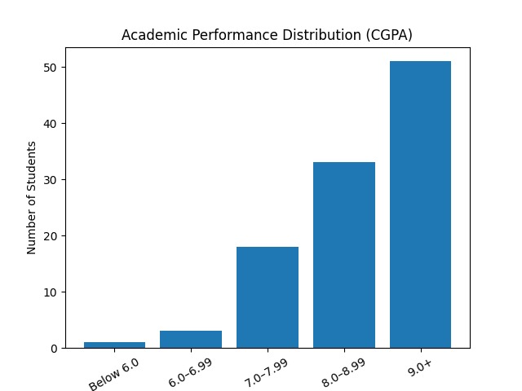
Academic Performance Analysis
12

Slide 13
Confidence and Communication Skills
The study demonstrates that participation in student clubs positively contributes to confidence building and communication skill enhancement.
Students reported improved confidence due to participation in:
Leadership activities
Event management
Public speaking
Team interactions
Communication skills improved through presentations, networking, and collaborative activities.
Average Scores
Confidence Level → 4.2 / 5
Communication Skills → 4.3 / 5
13

Slide 14
Teamwork and Team Management
Student clubs encourage students to work collaboratively on projects, events, and organizational activities. As a result, participants develop stronger teamwork and coordination abilities.
The findings also indicate that club participation improves time management skills and productivity.
Average Scores:
Teamwork → 4.4 / 5
Time Management → 4.1 / 5
The study suggests that extracurricular involvement helps students effectively balance academics and non-academic responsibilities.
14

Slide 15
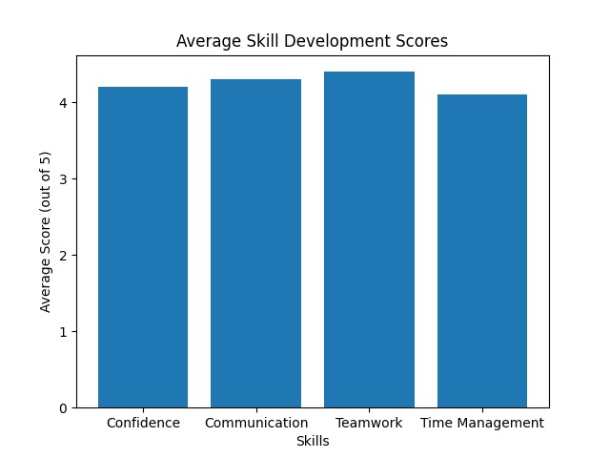
Average Skill Development
15

Slide 16
Major Findings
The research findings clearly indicate that student club participation contributes positively to both academic and personal development.
Key Outcomes
1. Improved communication skills 2. Higher confidence levels 3. Better teamwork abilities 4. Enhanced time management 5. Strong academic performance despite extracurricular involvement
Overall, the findings demonstrate that student clubs are important platforms for holistic student development.
16

Slide 17
Conclusion
The study concludes that student club participation positively influences overall student development without adversely affecting academic performance.
Students actively participating in clubs demonstrated:
Better communication skills
Stronger teamwork abilities
Improved confidence levels
Effective time management practices
The findings highlight the importance of structured student engagement initiatives in preparing students for future academic and professional challenges.
17

Slide 18
Future Scope
Although the present study provides valuable insights, future research can further expand the scope by including:
1. Multiple universities 2. Larger sample sizes 3. Advanced statistical analysis techniques 4. Long-term impact analysis on career growth and employability
Further studies can provide deeper understanding of the relationship between extracurricular engagement and professional development.
18

Slide 19
References
[1] A. W. Astin, “Student Involvement: A Developmental Theory for Higher Education,” 1984.
[2] G. D. Kuh, “High-Impact Educational Practices,” 2008.
[3] F. J. Baker, “The Impact of Extracurricular Activities on Student Development,” 2015.
[4] R. W. Larson, “Toward a Psychology of Positive Youth Development,” 2000.
19

Slide 20
Thank You
20

