Slide 1


Name – Ishwa
Roll no – S19CSE022
Branch – CSE
Semester – 8th
Submitted to – Ms. Bhawna
(Assistant Professor)

Slide 2

Job Portal

Slide 3
INDEX
Introduction
Requirement specification
Content in project
Objective
Purpose
Scope
Procedure
Advantage
Limitations
Output with code
Conclusion
Reference

Slide 4
Introduction
Job Portal is a web application, which serves jobseekers to find available job vacancies and Employers to identify eligible job seekers with the prospect of selecting the most qualified candidates. The only way to select best-qualified candidate is to have a pool of eligible applicants, which is possible by drawing the interest of individuals in the market. Job search portals best serve this purpose. E-recruitment has become the standard means for employers and job seekers to meet their respective objectives. The traditional methods for recruitment includes Job fairs, University career employment services, Employee referrals, advertising in the newspapers, televisions etc. With the advancement in technology and growth of internet usage, the e-recruitment has revolutionized the way organizations hire and candidates search for jobs. With the Online Job search portals, the recruitment process is speeded up at every stage from job postings, to receiving applications from candidates, interviewing process. The cost of searching/posting jobs will be much less compared to the traditional way of advertising. Job search portal stands as an effective means for Employers to outline the job vacancies, responsibilities and qualifications to attract jobseekers. Using the portal jobseekers can extensively search for jobs in companies, organizations and regions they may otherwise have not learnt.

Slide 5
Requirement specification
Hardware Requirement:
Processor Brand : Intel(R)
Processor Type: Core(TM) i3-6100
Processor Speed: 3.70GHz
Ram Size: 8.00 GB

Slide 6
Software Requirement:
Operating system: Windows 10 Pro
Application System: Eclipse
Database Requirement: MySQL Serve
Language Used: Java, HTML, CSS, JavaScript

Slide 7
Content in project
Home page
Login page
Registration Page
Admin Home Page
Admin View Job Page
Post Job Page
Update Job Page
User Login Page
User View Job Page
User Apply Job page
User Edit Profile Page
Logout Page

Slide 8
Objective
The objective of the web as well as android application is to provide flexibility to the jobseekers by providing the functionalities of both job search and job application in a single application. In addition, this application provides an effective means for the employers to post job vacancies and view the job applications by the interested applicants in a single application.

Slide 9
Purpose
The purpose of the study is to solve and develop an online job portal where applications easily find jobs and employer can find candidate for the jobs. This system is designed such that ultimately all vacancies will be posted online and would offer user the facilities to apply their jobs online.
The main objective of Job Portal is saving both time and cost by hiring the right candidate at the right time at the right place has been its Success Mantra. They do it by shortening the entire process of selection and on-boarding with its expertise. The team of experienced professionals works closely with clients to assess their requirement and ensure that the best quality resources are provided in the minimum possible time frame. Its recruitment experts enable quickest turnaround by selecting relevant and industry-specific profiles, interfacing with the candidates from start till the end.

Slide 10
Scope
The scope for the system can be as follows:-
Maintain Job Seeker and Employer records.
We can add payment functionality in future.
We can print receipt and printer in future.
Provide Customized Job Posting.
Live chat messages, where the user can communicate with the admin team.
We will host the server on online server to make it accessible worldwide
Integrate multiple load balancers to distribute the load of the system
Implement the backup mechanism for taking backup of codebase and database on regular basis on different servers

Slide 11
Procedure
User has to register himself by entering the personal details.
Enter Academic Details
Academic Professional Details
Enter Professional Work Experience
Declaration
The information is sent to HR
Team of experienced professional’s select relevant and industry-specific profiles and ensure that the best quality resource is provided, interfacing with the candidates from start till the end.

Slide 12
Advantage
Safe and secure system
User friendly
Only relevant job openings.
No geographical limitations
Economical
Time-saving
Improved efficiency of the recruitment process
Lower cost to the organization
The greatest benefits of a Job website is that there is no fee for the job finder

Slide 13
Limitations
Although I have put my best efforts to make the software flexible, easy to operate but limitations cannot be ruled even by me. Though the software presents a broad range of options to its users some intricate options could not be covered into I; partly because paucity of time. Thus it was not possible to make the software foolproof and dynamic. Lack of time also compelled me to ignore some parts.
List of Limitations which is available in the Job Portal: -
Excel export has not been developed for Job, vacancy due to some criticality.
The transactions are executed in off-line mode, hence online data for resume, jobseeker capture an modification is not possible.

Slide 14
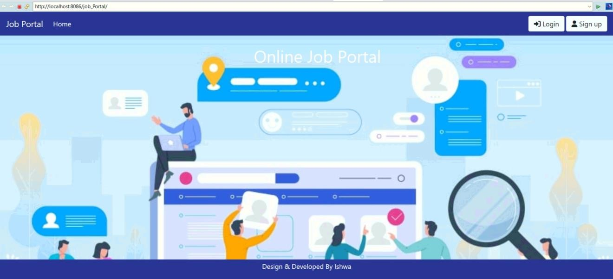
Output with code
Main page

Slide 15

Admin page

Slide 16
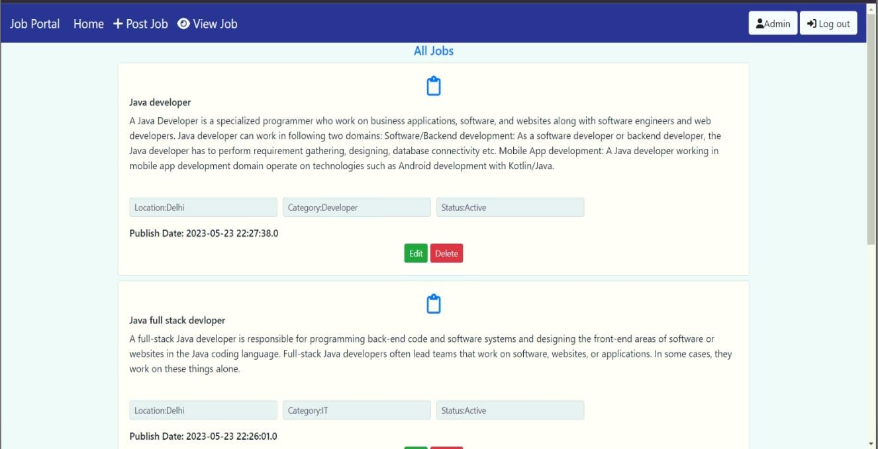
View Jobs page

Slide 17
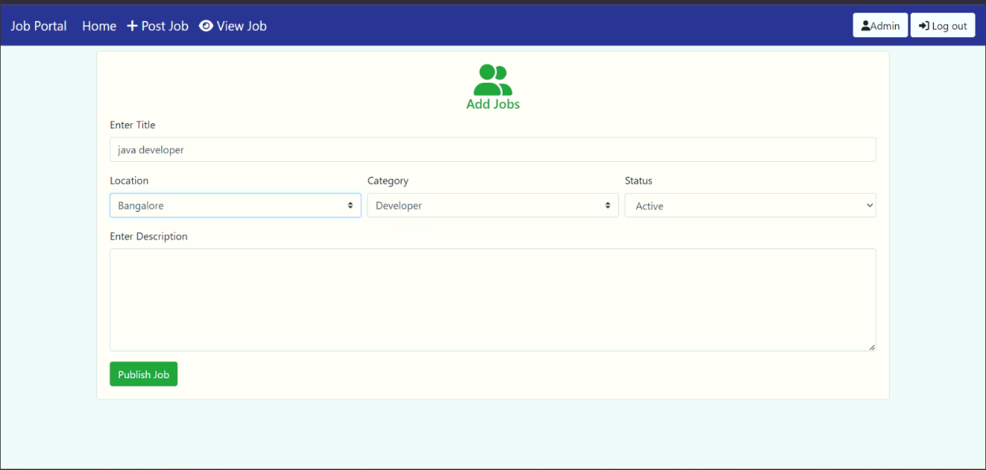
Publish Job page

Slide 18
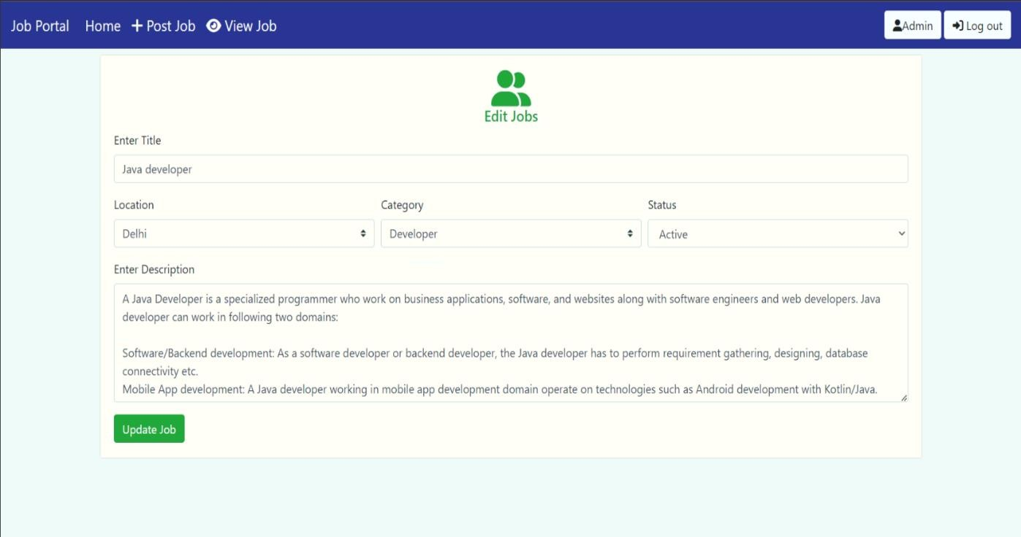
Update Job page

Slide 19
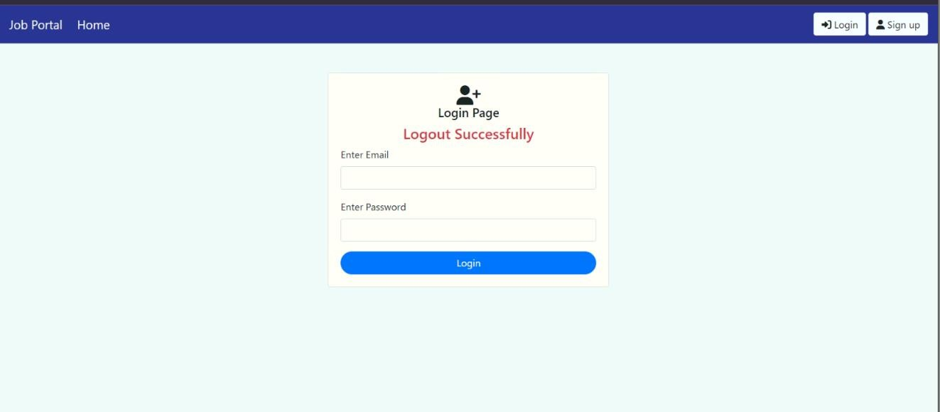
Admin Logout Page

Slide 20
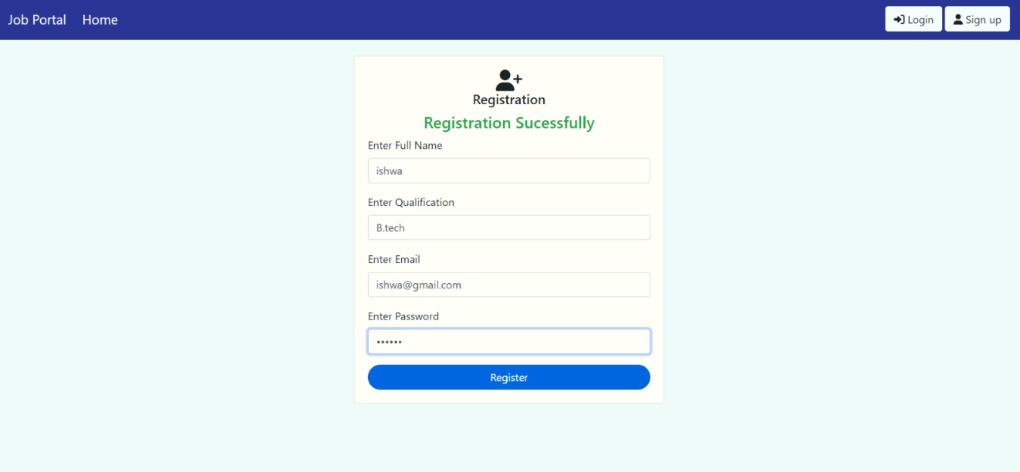
New Registration page

Slide 21
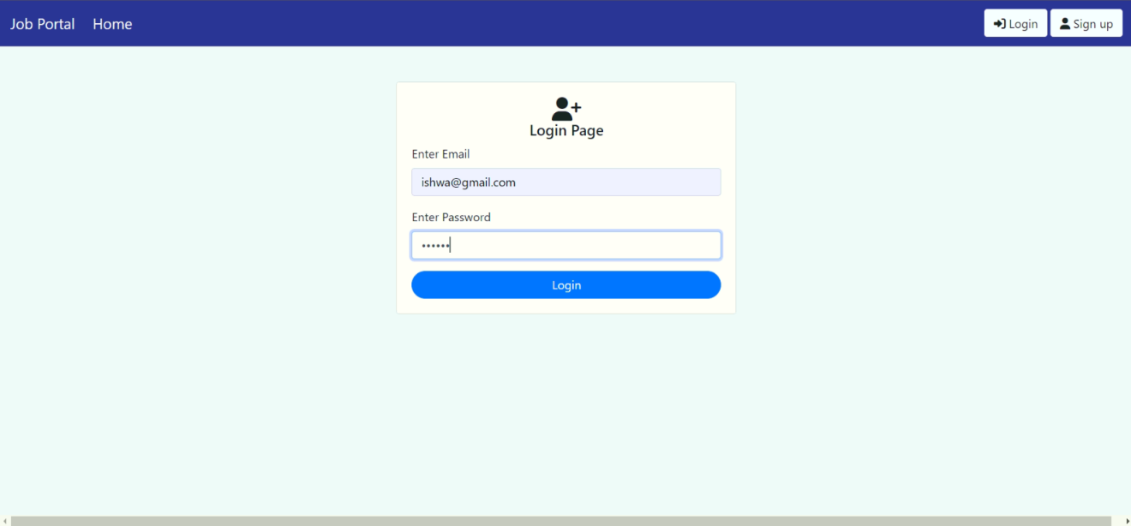
Login Page

Slide 22
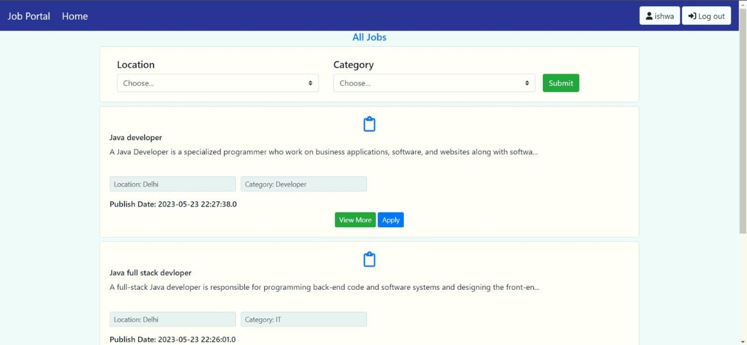
All Jobs Details Page

Slide 23
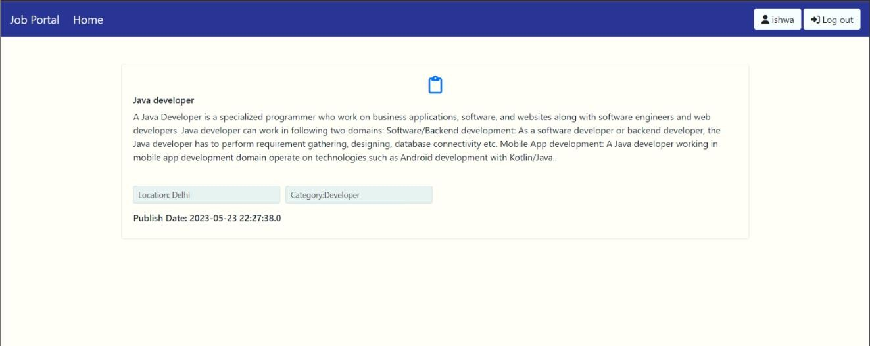
View Jobs Details Page

Slide 24
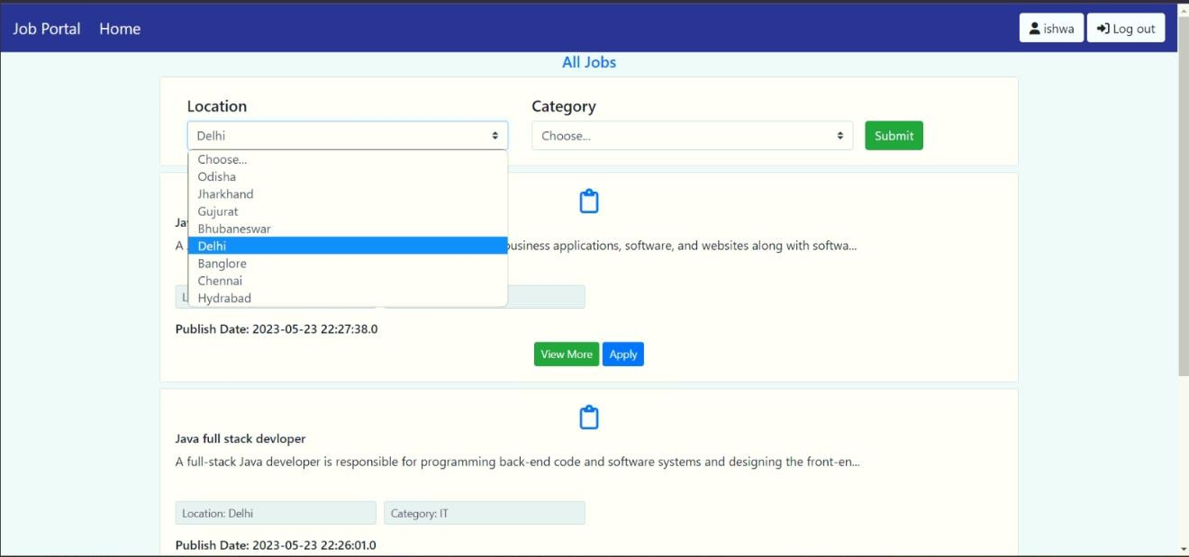
Filter Jobs Page

Slide 25
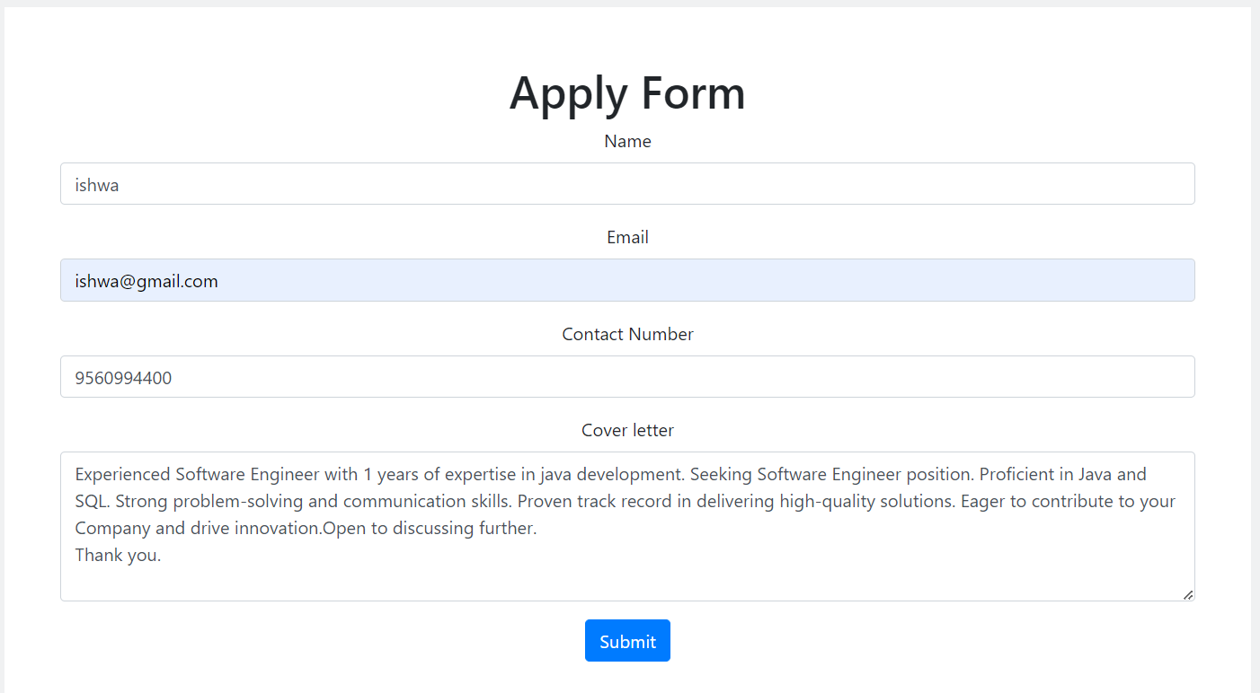
Apply Form Details Page

Slide 26
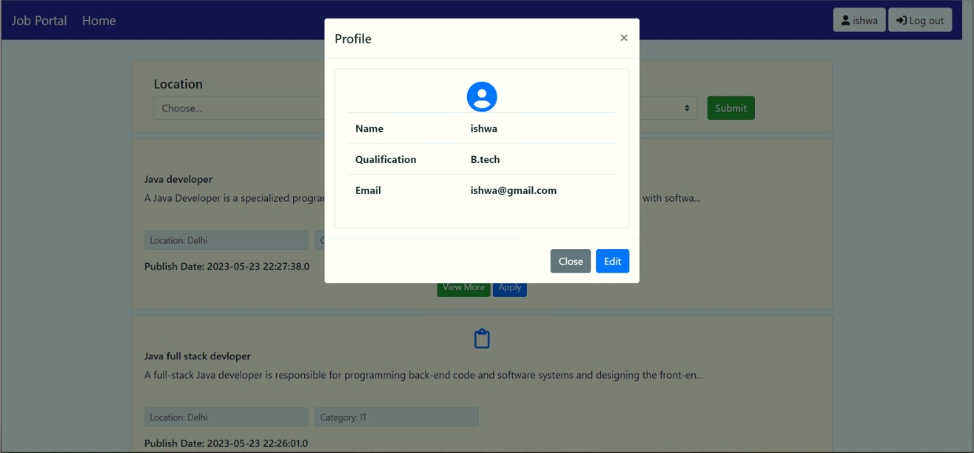
Edit User Profile Page

Slide 27
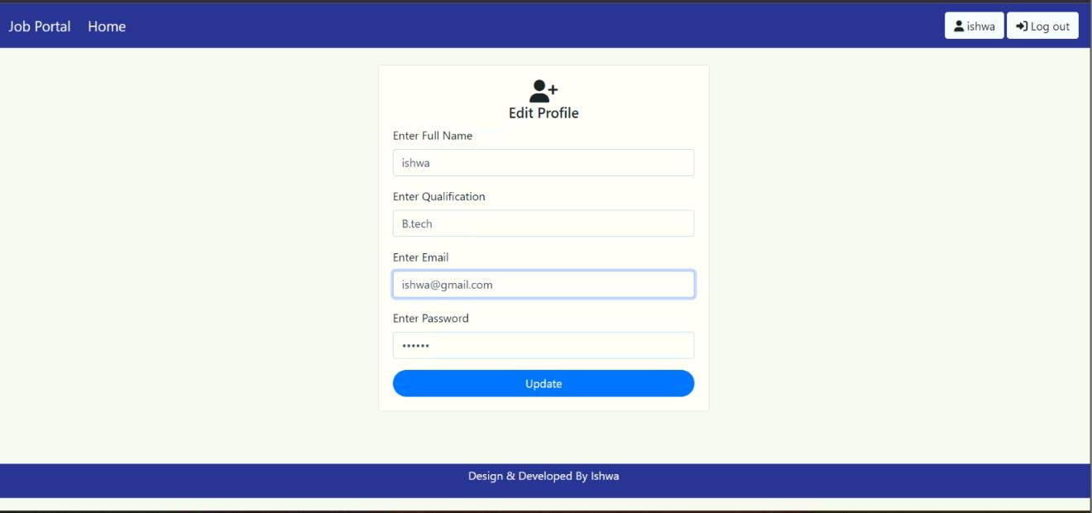
Update User Profile Details Page

Slide 28
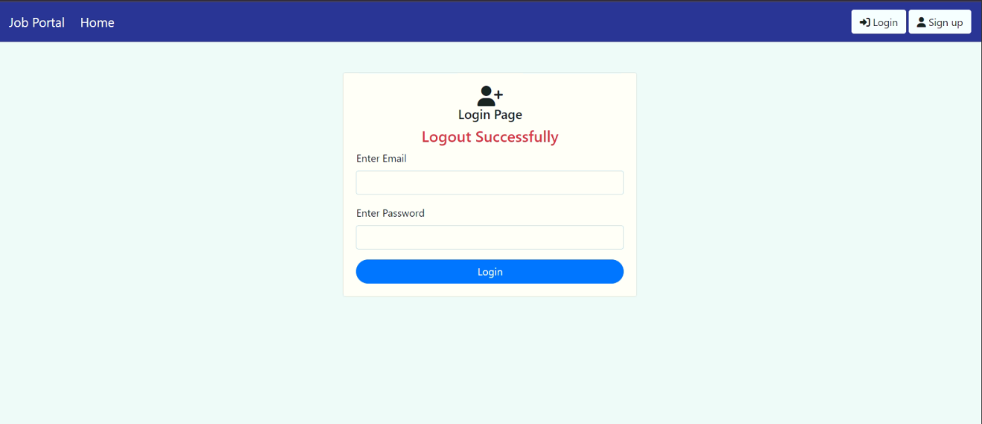
Logout User Page

Slide 29
Conclusion
It can be concluded that this project of Online Job Portal was a real learning experience. The principles of software production were well implemented throughout the system. The project has been made as per as the given specifications. A Job Portal provides an efficient search for online information on job vacancies for Job Seekers. The main goal of this portal is to attempt to produce the right graduates based on the industry needs. However, it is important that be aware the Job Portals can never fulfill all the problems of jobless graduates. Its business operations are performed on the key values driven by passion and purpose with an aim to revolutionize the job search process. Through its efficient end-to-end recruitment processes across various industries, it enhances client experience and attains customer satisfaction.

Slide 30
Reference
Google for problem solving
https://www.infoworld.com/category/java/
Database programming with JDBC and java by O’Relly
Head First Java 2nd edition
https://www.jdbc-tutorial.com/
https://www.javatpoint.com/java-tutorial
https://www.tutorialspoint.com/java/index.htm

Slide 31
Thank You

