Slide 1
TEXT SUMMARIZATION OF INDEXED DOCUMENTS ISHWAR GUPTA CHANDAN SHARMA

Slide 2
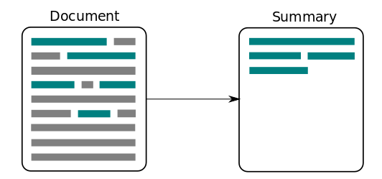
WHAT IS TEXT SUMMARIZATION?
It is the process of producing summaries from the huge sets of information while maintaining the actual context of information. The summary should be fluent and concise throughout.

Slide 3
WHY WE NEED TEXT SUMMARIZATION?
Summaries reduce reading time.
When researching documents, summaries make the selection process easier.
Automatic summarization algorithms are less biased than human summarizers.
Summarization improves the effectiveness of indexing.

Slide 4
TECHNOLOGIES USED
LANGUAGES | PYTHON, C#
FRAMEWORKS | FLASK, .NETCORE
MODEL | FACEBOOK/BART-LARGE-CNN OF HUGGINGFACE

Slide 5
INTEGRATING WITH HSP

Slide 6
MODEL CREATION, CREATING FLASK API & INTEGRATING WITH INDEXER SERVICE
server.py : We have created our huggingface model in this file such that whenever string is passed, it’s summary is returned. The extracted text of the uploaded file will be passed as string and summary response will be returned in JSON format.
PythonTextSummarizedModel.cs : A model is created with two properties- SummarizedText and Code.
DocumentIndexer.cs : In the Indexer Service we call server.py and pass the uploaded document’s extracted data. The response returned is then set to the model we have created and summarized text is indexed.

Slide 7
THE FLOW
Document sent to Indexer
via Postman
Extracted TextData sent as string
Document
Document Indexer
server.py
Summarized Text with response code is sent
Summarized Text indexed
ElasticSearch

Slide 8
LET’S MOVE TO THE DEMO

