Slide 1
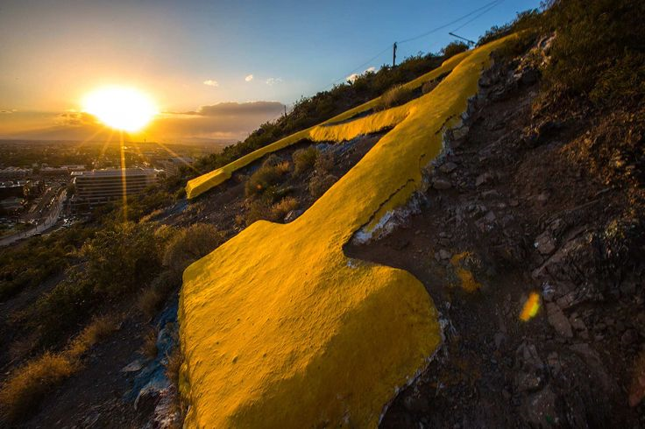
-Mountain Restoration
Earth Day 2017
An Initiative by:
Active Minds at Arizona State University

