Slide 1
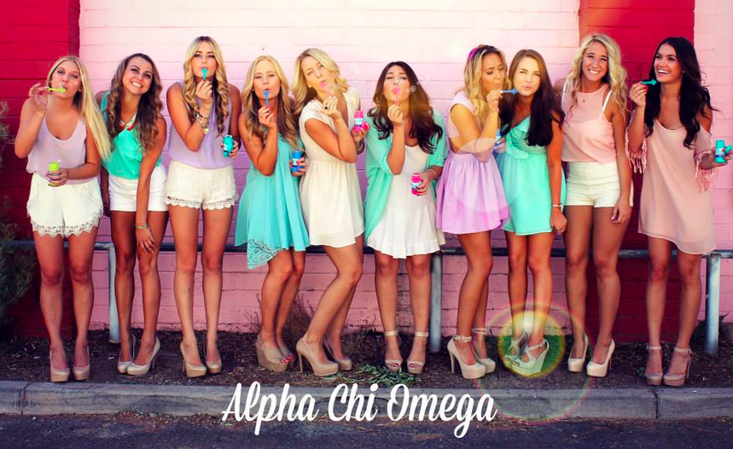
Sisterhood Event Come Join us for a color run
Mill avenue

