Slide 1

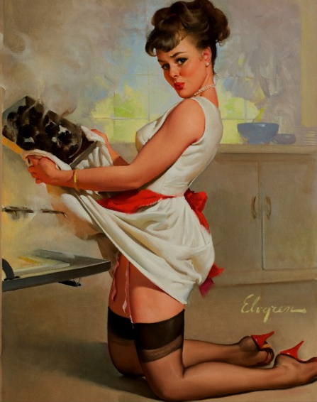
The Baker’s cultural festival is back!
Are you ready to
try our HOT buns? ;)

