Slide 1
BIG DATA Analysis
Anirban Bhattacharya
Ishwar bhat kattur
Priyanka pakhale
Rasika chafekar

Slide 2
SYSTEM OVERVIEW
S3
Twitter
T2.micro instance
Slave 1
Json file
Master (Driver)
Slave 2
Cluster management instance m4.large
Spark Cluster

Slide 3
Getting the data
Python script to pull data from twitter api
This script was run on a t2.micro instance(40 GB SSD and 1 GB RAM)
This file is then pushed to the S3 storage.

Slide 4
Creating the cluster
Apache Spark used for implementation of distributed system.
Based on the concept of master-slave.
EC2 m4.large instance created separately for running the scripts which are used to create the cluster.
Master – Spark context(driver program)
Master and 2 slaves – m4.large instances
8GB RAM & 8GB Hard Disk

Slide 5
The master
The master contains driver program which is written in Jupyter for analysis.
It accesses the S3 storage which contains the dataset.
Analyses the data and displays the results.

Slide 6
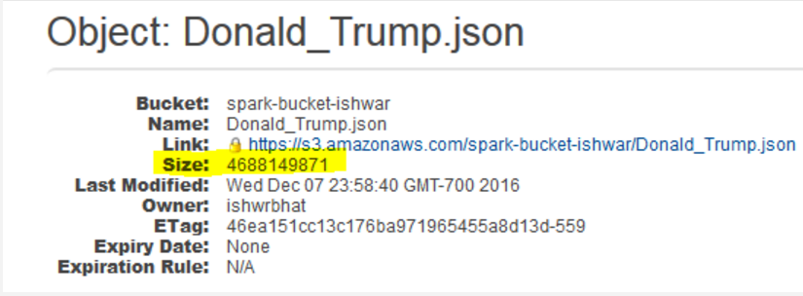
Hashtag analysis for trending twitter topics
Driver uses the spark context object which acts as the entry point to Spark core.
S3 storage is accessed for a the json file in a particular bucket.
4.4 GB of data (~1,000,000 tweets)

Slide 7
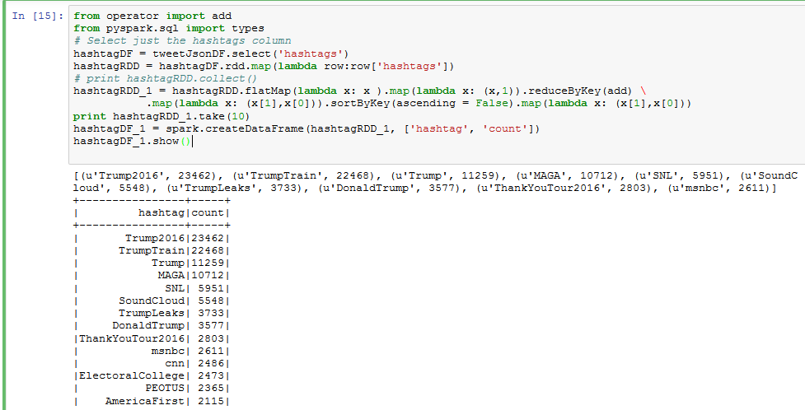
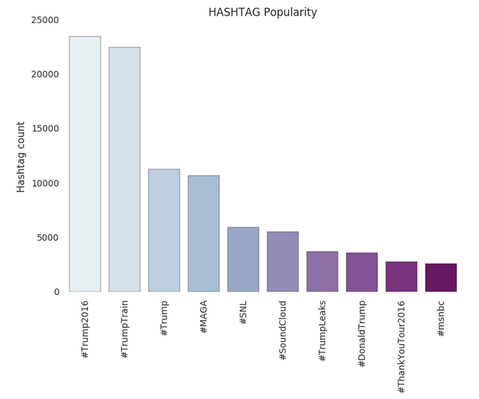
Hashtag analysis for trending twitter topics(cont…)
Get the top ten hashtags from the dataset and plot a graph

Slide 8


