Slide 1
VALUATI
HACKED THE GROCERS GAP !

Slide 2
TABLE OF CONTENTS
01
04
PROBLEM STATEMENT
SNEAK PEEKS
02
05
ABOUT THE PROJECT
PROJECT STAGES AND FUTURE SCOPE
03
06
TECH STACK USED
OUR TEAM
The problem that we aim to solve through this project
Glimpse of UI/UX
Landing Page
Predictor
Description of our idea and our approach towards solving the given problem
The milestones reached during the mvp development and the future milestones we hope to achieve
The different languages, frameworks and tools for the development of this project
Meet the creators of Valuati

Slide 3
PROBLEM STATEMENT
Although supermarkets house a lot of products coming from different product markets, the sales of all categories are not the same.
How to know these categories?
Do these categories need to be replaced?
Is there any solution to improving sales and maximising profit?
This is where we will come in!

Slide 4
WHAT WE ARE WORKING ON
SECURE
ACCESSIBLE
FAST AND RELIABLE
A platform that is secure. No private data of the business will be breached
It should be easily accessible for small businesses without needing any prior knowledge of the platform
The predictions generated should be fast as well as reliable enough to be used by real world businesses

Slide 5
ABOUT THE PROJECT
Valuati is a web application built using React.js.
This app provides some key insights of the supermarket identifying those product segments with less sales.
The analysis and prediction of sale of products is carried out with the help of a machine learning model. On the basis of previous records, we analyse and recommend the items to be retained or replaced in the supermarket to get the maximum profit considering quantity and margins.

Slide 6
NOW
PREMATURE DESIGN
UNCLEAN CODE
LACK OF ADAPTABILITY

Slide 7
FUTURE
BRANDING
POSITIONING
ADAPTABILITY

Slide 8
WHAT DOES OUR APP CONTAIN
HOME
PREDICTOR
RESULTS
Introduces the user to the platform, making them familiar with its functionalities and the goals that it hopes to achieve
Provides an easy to use user interface where one can simply enter the information regarding a product and obtain prediction regarding its sales and income obtained, The predictor uses a machine learning model for carrying out the predictions in real time
Provides complete analysis of the data of various products, the sales of different categories of products, their rating, gross incomes, comparison between different genders and payment methods as well as the sales in 3 different cities

Slide 9









TECH STACK USED

Slide 10
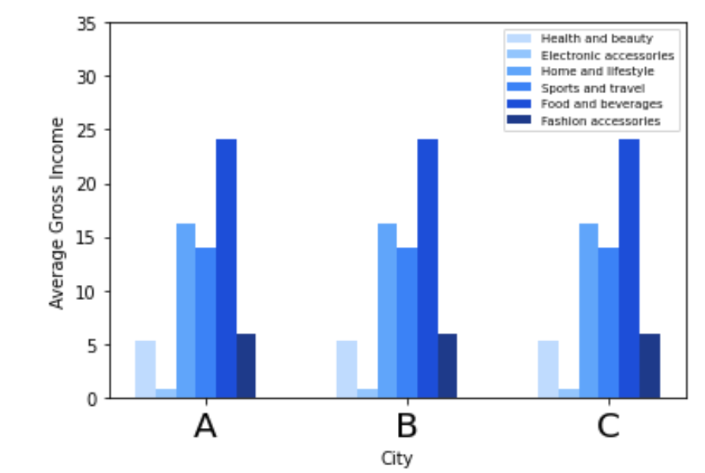
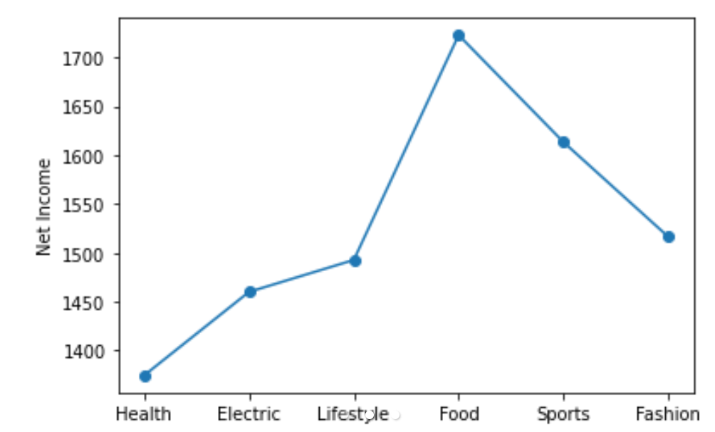
DATA ANALYSIS

Slide 11
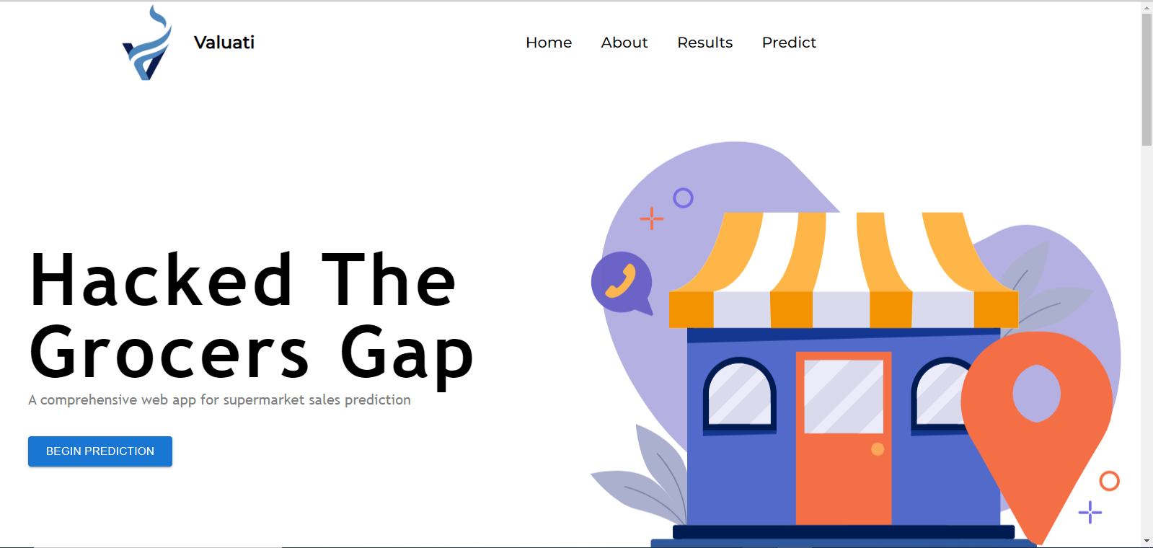
SNEAK PEEKS

Slide 12
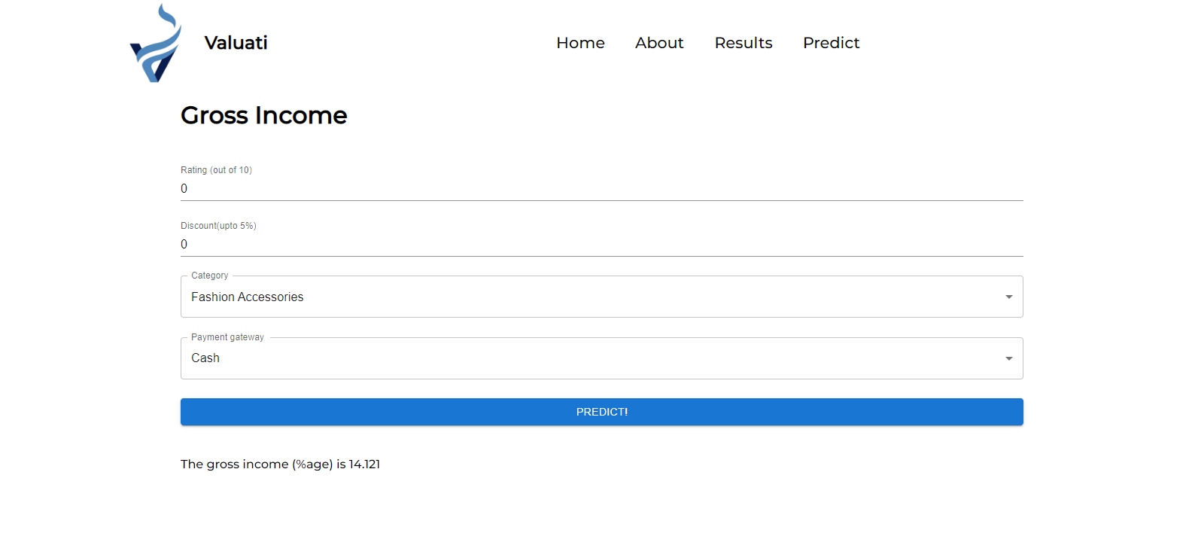
SNEAK PEEKS

Slide 13
PROJECT STAGES
STEP 2
STEP 1
STEP 3
Finding dataset for the products, analysing the data, generating comparisons and then finally training the machine learning model
Creating an easy to use web application containing all the necessary interfaces that will be required
Displaying our results on the website and deploying the ML model on the website to generate predictions for the end users

Slide 14
FUTURE SCOPE
STAGE 1
STAGE 3
BETA
RELEASE
FINAL
VERSIÓN
STAGE 2
STAGE 4
Creating dynamic graphs that provide instantaneous analytical results
Extend the machine learning model to provide recommended products and profit recommendations and that too specifically for each registered business, providing privacy
Making the app available to businesses for registering their sales information and generating privatised predictions for them
Provide opportunities for discussion and collaboration among different businesses and promote competition with the help of combined sale predictions

Slide 15

THE TEAM
SUVIDHI
HARSHPREET SINGH JOHAR
MANJOT SINGH OBEROI
ISHWARENDRA JHA
UTTAM MITTAL
Hey! I Am Suvi. Alongside Web Development, I Love To Sketch And I'm a Sports And Fitness Freak!
Hi, I Am A Web Developer With A Strong Will To Learn New Techs, Looking Forward To Work For Something Big
I am an Open Source Contributor Who Is Hunting Enthusiasts And I Love Coding And Gaming OwO
Full Time Competitive Programmer, Part Time Web Developer (✿◡‿◡)
Data Science, ML Enthusiast And Extremely Passionate About Every Field Of Mathematics

Slide 16
THANKS!

