Slide 1
Hospital Management Analysis
Presentated by:Group-5
Vasa Naga Lakshmi Durgambika
Kunal Kakasaheb Korade
Satish Bhagwat jagtap
Vangala Santhosh
Aishwarya K

Slide 2
Tools Used:
Microsoft Excel – Data cleaning, pivot tables, and dashboard creation
Tableau – Interactive data visualization and dashboards
Microsoft Power BI – Business intelligence dashboards and KPI visualization
MySQL – Database querying and data extraction
Datasets Used:
Hospital Management Dataset containing information such as:
Patient ID
Patient Age & Gender
Department
Admission Date
Discharge Date
Treatment Type
Billing Amount
Doctor Assigned

Slide 3
Concepts Used:
Data Cleaning
Data Transformation
Pivot Tables
Data Visualization
KPI Analysis
Dashboard Creation
SQL Queries
Trend Analysis

Slide 4

Project Overview
This project focuses on analyzing hospital data to understand patient trends, department performance, and overall hospital efficiency. Hospitals use Electronic Medical Record (EMR) systems to digitally store patient information such as medical history, diagnosis, treatments, and billing records. By analyzing this data, the project aims to identify patterns and generate insights that help improve hospital operations and support better healthcare decision-making.

Slide 5
1.Total Patients : 651 2.Total Doctors : 1,000 3.Total Visits : 651 4.Avg Age of Patients : 47 5.Top 5 Diagnosis Count : 651 6.Follow-Up Rate : 46.70% 7.Treatment Cost Per Visit(Avg) : 523.68 8.Total Lab Tests Conducted : 651 9.Percentage of Abnormal Lab Results : 30.41% 10.Doctor Workload(Avg Patients Per Doctor) : 1
KPI List

Slide 6
Key Insights
Visit Type Distribution :
Specialist Consultations: 2,559 visits (highest share of hospital visits).
Follow-up Visits: 2,521 visits indicating ongoing patient treatment.
Routine Checkups: 2,482 visits showing preventive healthcare demand.
Emergency Visits: 2,438 visits highlighting urgent care requirements.

Slide 7
Visit Status Analysis :
Scheduled Visits: 3,390 appointments planned by patients.
Cancelled Visits: 3,344 appointments were cancelled.
Completed Visits: 3,266 visits successfully attended by patients.
The close numbers suggest hospitals must improve appointment management systems.

Slide 8

Diagnosis Pattern Analysis
Migraine: 2,039 patient cases.
Hypertension: 2,011 cases showing chronic disease prevalence.
Asthma: 2,009 diagnosed patients.
Diabetes: 1,960 patients requiring long-term treatment.

Slide 9
Follow-Up Requirement Insights:
Follow-up Required: 4,984 patient visits.
No Follow-up Needed: 5,016 visits.
Almost 50% of patients require follow-up consultations.
This indicates the importance of continuous patient monitoring and treatment management.
Patient Visit Reason Analysis:
Flu Symptoms: around 2,020 patient visits, making it one of the most common reasons for hospital consultation.
Routine Health Checkups: approximately 2,010 visits, indicating growing awareness of preventive healthcare.
Chronic Disease Monitoring: many visits are related to conditions like diabetes and hypertension.
The analysis shows hospitals handle both acute illnesses and long-term disease management.

Slide 10
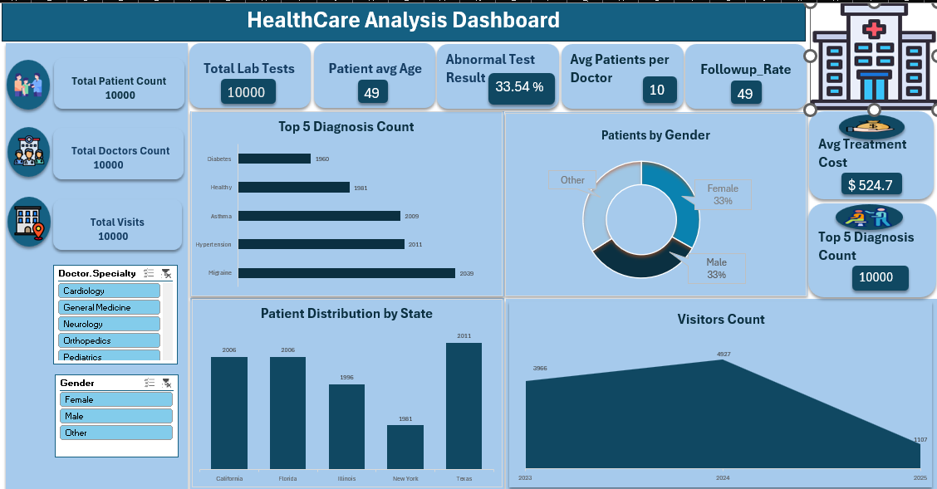
Excel Dashboard :

Slide 11
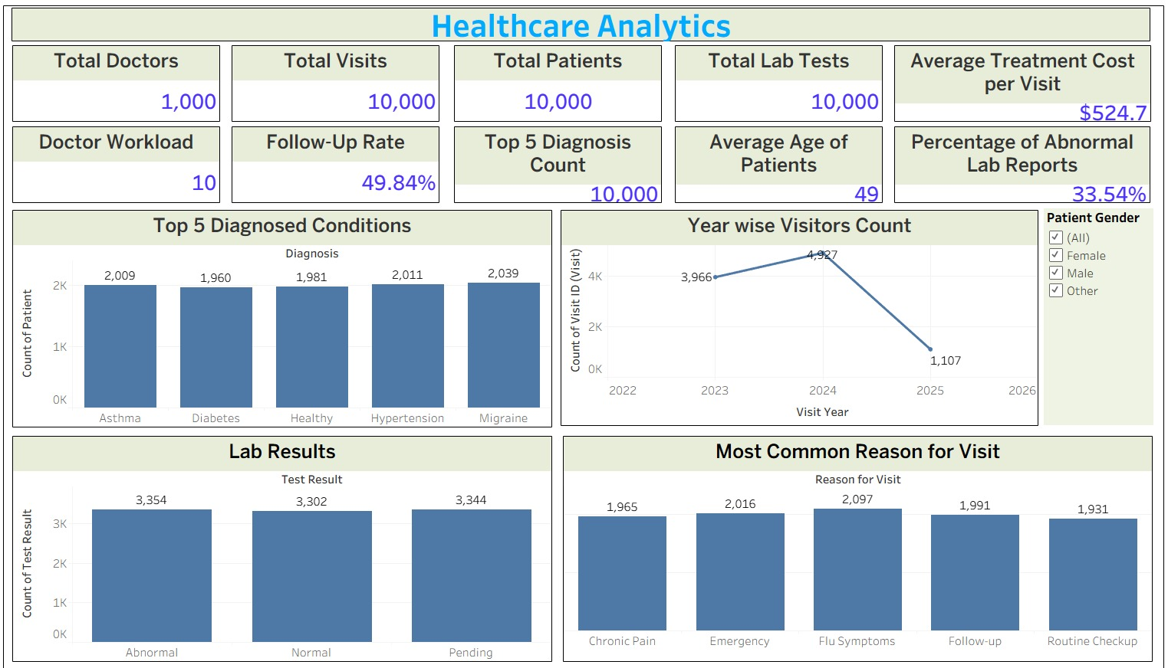
Tableau Dashboard

Slide 12
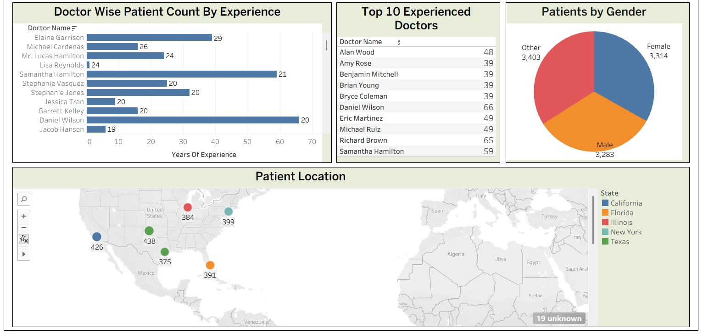

Slide 13
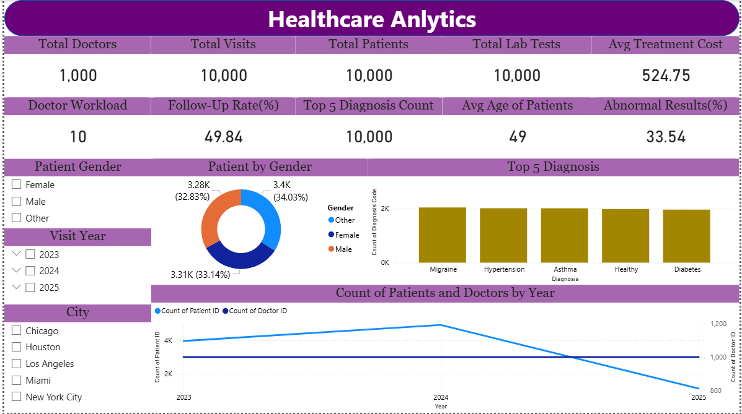
Power BI Dashboard :

Slide 14
SQL Queries
Total Patients, Doctors, and Visits
SELECT COUNT(DISTINCT Patient_ID) AS Total_Patients FROM patient;
SELECT COUNT(DISTINCT Doctor_ID) AS Total_Doctors FROM doctor;
SELECT COUNT(DISTINCT Visit_ID) AS Total_Visits FROM visit;
Top Diagnosed Conditions
SELECT Diagnosis, COUNT(*) AS Total_Cases
FROM visit
GROUP BY Diagnosis
ORDER BY Total_Cases DESC
LIMIT 5;
Follow-Up Rate
SELECT ROUND(SUM(CASE WHEN Follow_Up_Required = 'Yes' THEN 1 ELSE 0 END) * 100.0 / COUNT(*), 2)
AS Follow_Up_Rate
FROM visit;
Doctor Workload (Average Patients per Doctor)
SELECT ROUND(
(SELECT COUNT(*) FROM visit) * 1.0 /
(SELECT COUNT(*) FROM doctor),2) AS Avg_Patients_Per_Doctor;

Slide 15
Challenges Identified : A significant number of appointment cancellations affects hospital scheduling efficiency. Uneven patient distribution across departments may lead to resource imbalance. Managing follow-up visits efficiently can be challenging without proper scheduling systems. Handling large volumes of healthcare data requires effective data management systems.

Slide 16
Future Recommendations : Implement advanced scheduling systems to reduce appointment cancellations. Use hospital data analytics to optimize resource allocation across departments. Improve patient follow-up tracking for better treatment outcomes. Expand data-driven decision-making using digital systems like Electronic Medical Record.

Slide 17
Conclusion
The Hospital Management Analysis project demonstrates how healthcare data can be used to understand patient trends, hospital operations, and service demand. The analysis highlights patterns in patient visits, common diagnoses, follow-up requirements, and department workload.
The insights generated from the dataset help identify areas where hospitals can improve operational efficiency, manage patient flow more effectively, and enhance overall healthcare service delivery.
By leveraging data-driven insights and digital systems like Electronic Medical Record, hospitals can make better strategic decisions and provide improved patient care.

Slide 18
THANK YOU

