Slide 1
Employee Data Analysis using Excel
STUDENT NAME: M.ishwarya
REGISTER NO:312211167asunm1423312211167
DEPARTMENT: B.Com Bank Management
COLLEGE: Dr.MGR Janaki College Of Arts And Science For Women

Slide 2
PROJECT TITLE
Employee Performance Analysis using Excel

Slide 3


AGENDA
Problem Statement
Project Overview
End Users
Our Solution and Proposition
Dataset Description
Modelling Approach
Results and Discussion
Conclusion
3/21/2024 Annual Review

Slide 4

PROBLEM STATEMENT The employee data analysis is done in order track the employee's performance for the betterment of the company

Slide 5

PROJECT OVERVIEW
Objective: Evaluate employee performance to align individual contributions with organizational goals.
Key Focus Areas: Productivity, efficiency, skill gaps, and alignment with KPIs.
Methodology: Use performance metrics, feedback systems, and data analytics to assess and track progress.
Outcome: Identify strengths and areas for improvement while enhancing employee engagement and productivity.
Implementation: Develop targeted training, recognition programs, and performance improvement plans.

Slide 6


WHO ARE THE END USERS? Manager Human Resources Department Team Leader IT and System Administrator Payroll and Finance Teams Legal and Compline Teams Internal Communication Teams External Vendors or Parners Empolyess themselves Auditors or Regulators

Slide 7

OUR SOLUTION AND ITS VALUE PROPOSITION Conditional formatting – missing Filter - remove Formula - performance Pivot – summary Graph - data visualization

Slide 8
Dataset Description Employee-kaggle 26-features 9- features Emp id-num Name-text Emp type Performance level Gender- male female Employee rating-num

Slide 9

THE "WOW" IN OUR SOLUTION
Performance level =IFS(Z8>=5,"VERY HIGH",Z8>=4,"HIGH",Z8>=3,"MED", TRUE, "LOW")
3/21/2024 Annual Review
9

Slide 10
MODELLING
Data collection
From kaggle
2) From edunetdashboard
Feature collection
Data cleaning
Identified missing values
Filtered out the missing values
Performance level calculation
Through attendance
2) Ratings
Pivot table
Graph
1) Visualization
10

Slide 11
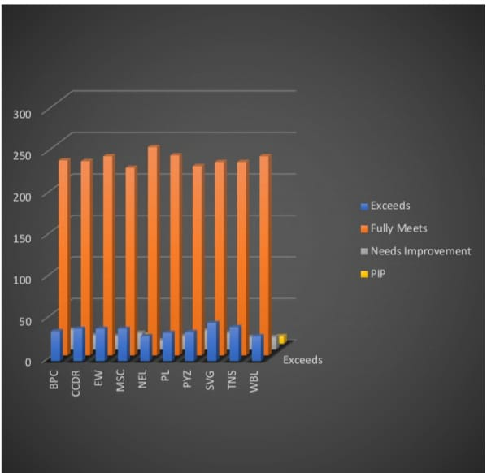
RESULTS
11

Slide 12
Conclusion By comparing the performance of the employee's Number of employees performaning average are higher in number and so we should motivate them to do better. As the graph shows employees who perform well are very low in number here. we should motivate the employee's by giving out tasked based on there performance to get better output

