Slide 1
Evaluation of WebAssembly IoT Runtimes on a ESP32 Microcontroller
Evaluation von WebAssembly IoT Runtimes auf einem ESP32 Microcontroller
Notes:
Welcome to presentation
Glad to find a way to make it work

Slide 2
Abstract
Run WebAssembly on the ESP32
Found runtime
WASM code runs on the ESP32 with decreased performance
Notes:
Run WebAssembly on the ESP32
Find runtime
Design tests
Performance and system interfaces

Slide 3
Outline
Background: ESP32 and WebAssembly
Methodology: Runtime and tests
Evaluation: Rest results and learnings

Slide 4
Background

Slide 5
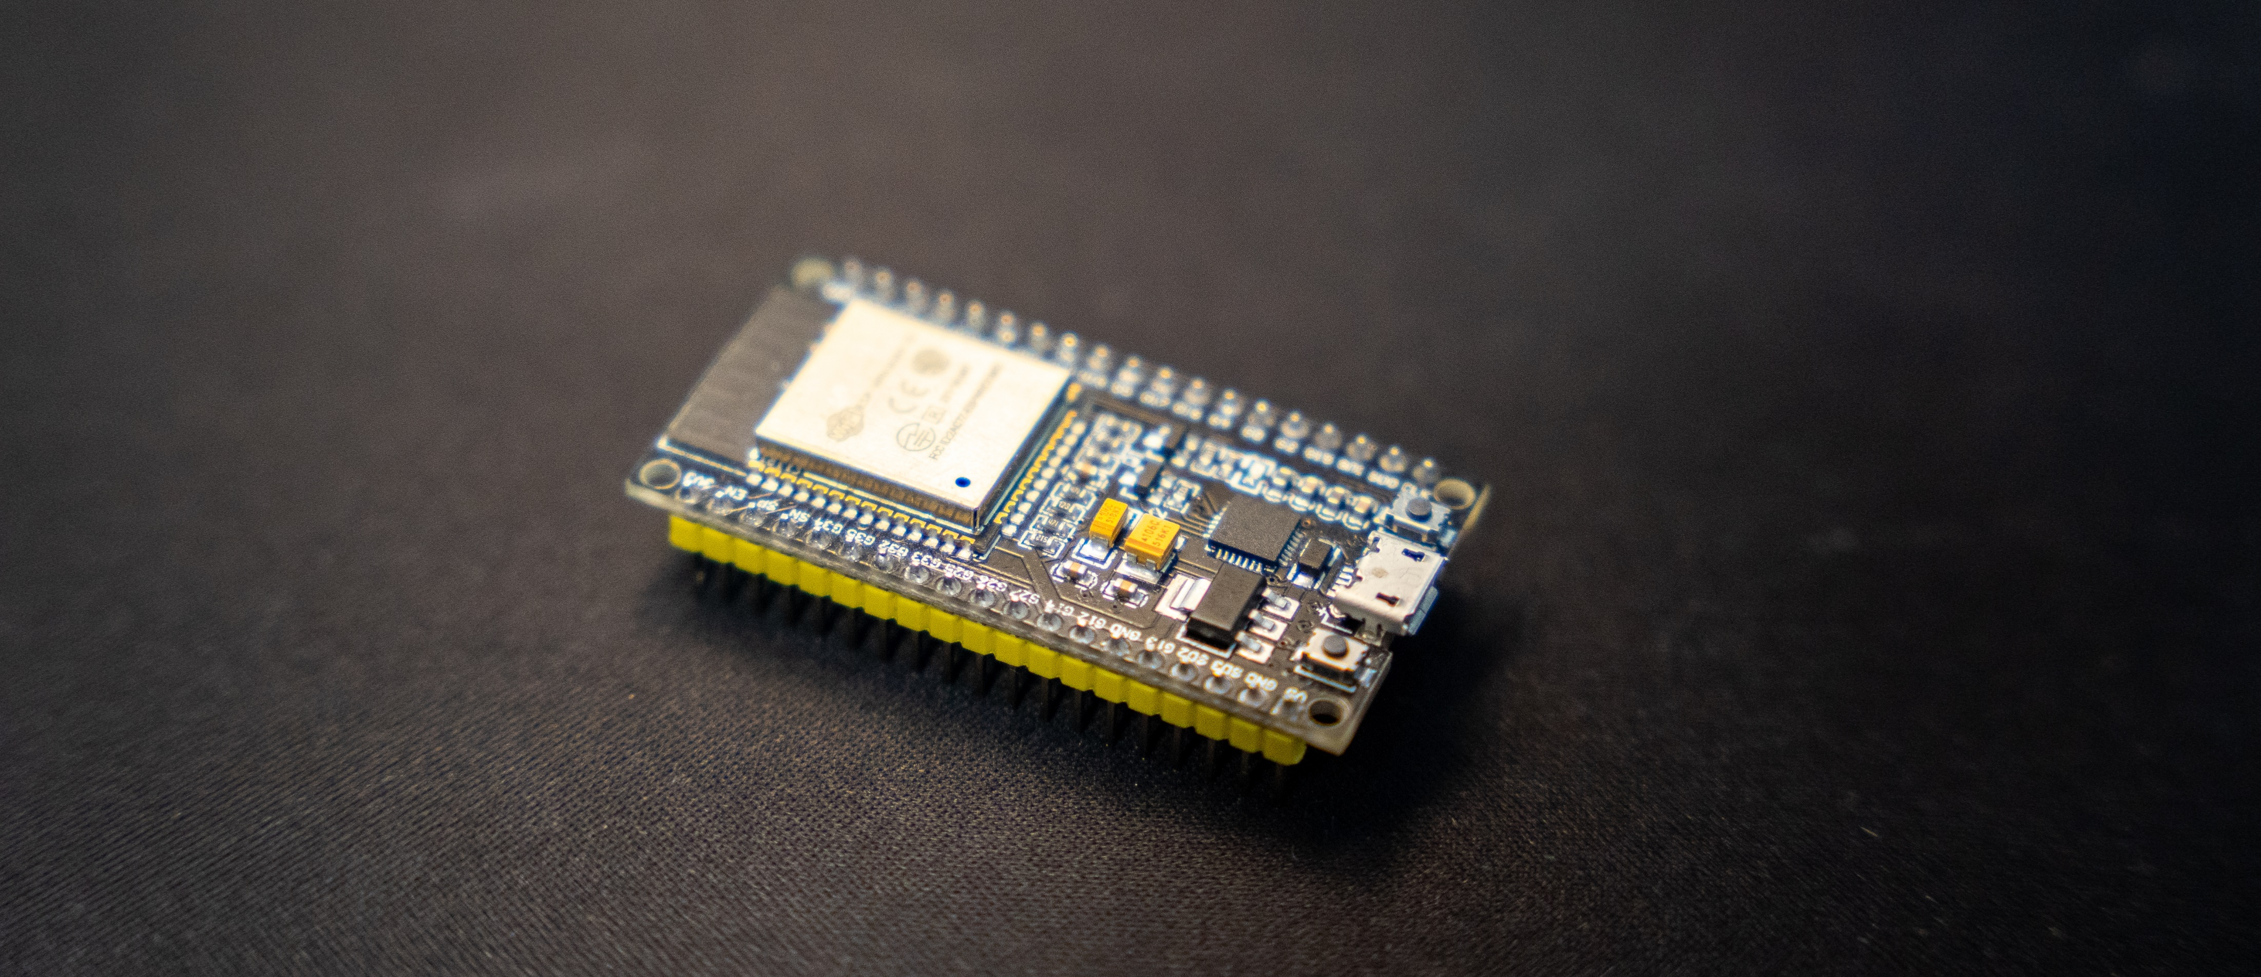
The ESP32
Notes:
Release in sept 2016
With bluetooth and wifi
More power than predecessor ESP8266 => encryption
Light bracelet alibaba annual meeting 2017
4MB flash and 520KB RAM
FreeRTOS

Slide 6
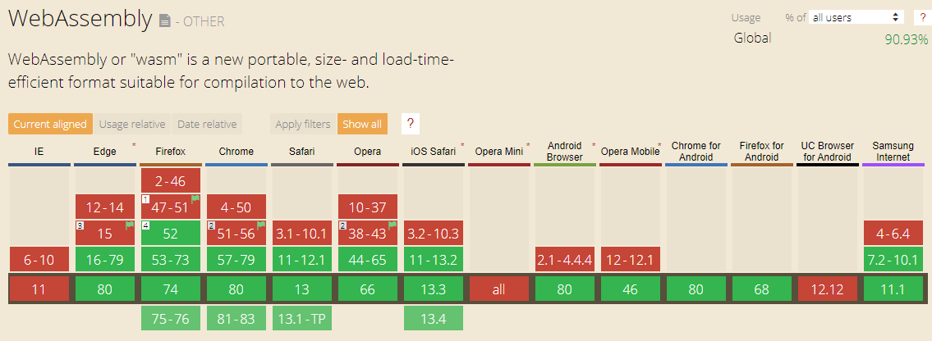
WebAssembly adoption
Notes:
For the web
Announced in 2015 cross browser consensus in 2017
Fix javascript performance inconsistency

Slide 7
WebAssembly
Portable target for languages like C/C++ and Rust
Shipped in self-contained modules
Runs on stack machine
No web dependencies
Advantageous attributes for IoT
Structured control flow
Notes:
Portable target
Module with functions, globals, imports, exports amongst others => encapsulation and sandboxing
Stack instead of registers => compact code since not paramters but stack
Best support on browsers, but new runtimes coming
Web => no trust, fast, universal, trasnittable
No Arbitrary jumps

Slide 8
Structured control flow
instr ::= . . .
| nop
| unreachable
| block resulttype instr∗ end
| loop resulttype instr∗ end
| if resulttype instr∗ else instr∗ end
| br labelidx
| br_if labelidx
| br_table vec(labelidx) labelidx
| return
| call funcidx
| call_indirect typeidx
Notes:
WebAssmebly grammar
Interesting => Block, groups nested sequence, has implicit label
Br_if => conditional branch
Return => unconditional branch
Calling functions => taking from stack result to stack

Slide 9
Methodology

Slide 10
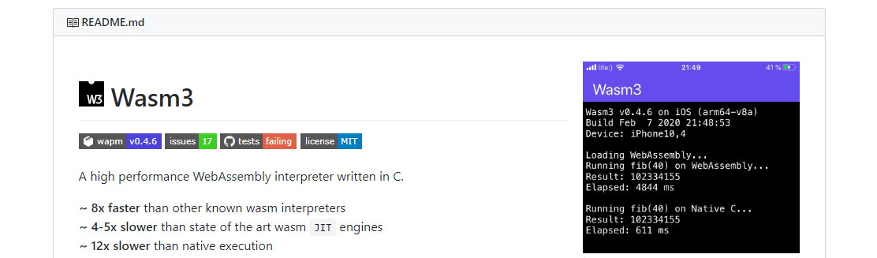
Running WebAssmbly
Notes:
As metioned before, not feasible to use browser
Bytcode alliance nov 2019 => foundations to run WASM on multiple platforms in a secure way
WAMR doesn’t support FreeRTOS
Late 2019, 12x slower than native on refernce machines

Slide 11
Testing setup
Main Program
WebAssembly
C-Code
Notes:
WASM vs native

Slide 12
Recursive: C++
uint32_t run(uint32_t n) { if (n < 2) { return n; } return run(n - 1) + run(n - 2); }
Notes:
Fibonacci

Slide 13
Recursive: WAT
(func $run (export "run") (type $t1) (param $p0 i32) (result i32) (block $B0 (br_if $B0 (i32.lt_u (local.get $p0) (i32.const 2))) (return (i32.add (call $run (i32.add (local.get $p0) (i32.const -1))) (call $run (i32.add (local.get $p0) (i32.const -2)))))) (local.get $p0))
Notes:
WeAssembly text format
P0 argument

Slide 14
Recursive: Comparison
(block $B0 (br_if $B0 (i32.lt_u (local.get $p0) (i32.const 2))) (return (i32.add (call $run (i32.add (local.get $p0) (i32.const -1))) (call $run (i32.add (local.get $p0) (i32.const -2)))))) (local.get $p0)
uint32_t run(uint32_t n) { if (n < 2) { return n; } return run(n - 1) + run(n - 2); }
Notes:
Conditional branch

Slide 15
Recursive: Comparison
(block $B0 (br_if $B0 (i32.lt_u (local.get $p0) (i32.const 2))) (return (i32.add (call $run (i32.add (local.get $p0) (i32.const -1))) (call $run (i32.add (local.get $p0) (i32.const -2)))))) (local.get $p0)
uint32_t run(uint32_t n) { if (n < 2) { return n; } return run(n - 1) + run(n - 2); }
Notes:
Push to top of stack

Slide 16
Recursive: Comparison
(block $B0 (br_if $B0 (i32.lt_u (local.get $p0) (i32.const 2))) (return (i32.add (call $run (i32.add (local.get $p0) (i32.const -1))) (call $run (i32.add (local.get $p0) (i32.const -2)))))) (local.get $p0)
uint32_t run(uint32_t n) { if (n < 2) { return n; } return run(n - 1) + run(n - 2); }

Slide 17
Testcases
Recursive
Switch
Memory
Matrix Multiply
Native Calls
TypeScript
Notes:
Recursive: function calls
Switch: branching in every application
Memory: no linked
Matrtix: basis for other algortihms, tight inner lop optimization
Native calls: interaction, two funcions, one with return, linked into the runtime
TypeScript: AssemblyScript subset of Typescript

Slide 18
Evaluation
Notes:
After test design compilation
Emscripten borwser => wasienv toolchain for others
Wasmc++ wraps clang++
No tail call elimination on the ESP32, but wasm3 depends on that, call frames and massive stack use => fix in sight

Slide 19
Measurements
Test case | WASM Execution | Native Exectuion | Slowdown factor
Recursive Calls | 41,766 µs (σ=0.79) | 1,000 µs (σ=0.28) | 42
Switch statement | 1,021 µs (σ=0.71) | 0 µs (σ=0.00)
Memory Access | 1,802 µs (σ=0.74) | 55 µs (σ=0.26) | 33
Matrix Multiplication | 26,277 µs (σ=0.60) | 281 µs (σ=0.58) | 93
Native calls* | 33 µs (σ=5.15) | 8 µs (σ=0.64) | 4
TypeScript execution | 41,493 µs (σ=0.85) | 1,000 µs (σ=0.24) | 41
Notes:
Run 100 times => average over 10
Low variance <= deterministic scheduler
* Length of ten calls
Matrix => more complex alorightms take bigher hit, contributors no expensive actions => no complex algorithms in WebAssembly
Native: little slowdown

Slide 20
Learnings
Drawbacks
Potential
Performance loss
Significant limitations
Dynamic code
Browser execution
New languages
Notes:
30-90x slower
Unusual for webassembly
Suspect more energy => more reasearch
No malloc() only defined functions
Since common usecase => WASI for non browser platforms
Runtime => dynamic loading => meant for network
Code for embedded ion the borwser

Slide 21
Conclusion
Notes:
In summery
Runing wasm works using WASM3
40-90x slower and no interface
Performance loss but feature gain

