Slide 1
Milestone 4
Cryptocurrency pricing patterns in response to international financial instability
Jason orender

Slide 2
Motivation
Patterns in cryptocurrency pricing are actively evolving and some understanding is crucial to investing in the space.
Identifying patterns in cryptocurrency valuation may provide clues with respect to monetary strife within a country before the international community can perceive strife or disfunction on a larger scale. It may be a leading indicator (the empty street analogy).

Slide 3
Dataset Description
This report will focus on Bitcoin since it has the longest history and is the most well known.
Accurate pricing data exists starting shortly before January 1st, 2011.
Prior to that point there was no exchange and pricing data could essentially be considered anecdotal.
MtGox was established in August 2010.
Pricing data from January 1st, 2011 to present will be used and is continuously available via blockchain.info.
Other data sets, including localbitcoins (country specific) data and Google Trends data will also be used.

Slide 4
Abstract Tasks
Overall: Analyze. Consume. Present.
Search. Locate. Query. Identify.
Use fiat currency exchange rates to identify instability
Present any correlations that might exist.
Search. Explore. Query. Summarize Cross-Correlations
Spikes in USD exchange rates will be cross-correlated with spikes in Bitcoin volume
Search. Locate. Query. Compare Local to Worldwide trading volume.
Local trading rates should outstrip average worldwide trading rates in times of crisis if the hypothesis is correct.

Slide 5
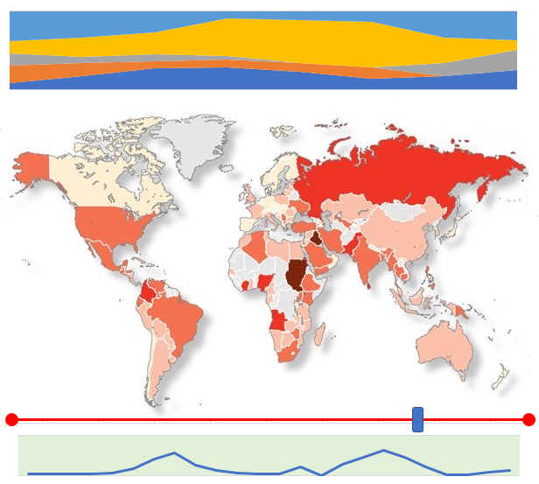
Mock-Up
Sand Plot
Crisis Map with selectable countries
Time Slider
Cryptocurrency Volume

Slide 6
Development Tools
Tableau
D3
Illustrator/Photoshop (iconography)

Slide 7
Task List and Timeline
Oct 13 - test LaTeX template -- done
Oct 18 - sketch final design -- done
Oct 31 - finish data cleaning and synchronization
Nov 11 - implement chart 1 & 2
Nov 18 - implement chart 3
Nov 20 – assemble dashboard
Nov 23 – first draft of paper
Nov 27 - implement user interaction components and linking
Dec 1 – finish testing of system
Dec 8 - sketch demo video, grab screenshots of visualization, project status update
Dec 14 - submit final paper, demo video

