Slide 1
Milestone 5
Cryptocurrency pricing patterns in response to international financial instability
Jason orender (group of one)

Slide 2
Motivation
Patterns in cryptocurrency pricing are actively evolving and some understanding is crucial to investing in the space.
Identifying patterns in cryptocurrency valuation may provide clues with respect to monetary strife within a country before the international community can perceive strife or disfunction on a larger scale. It may be a leading indicator (the empty street analogy).

Slide 3
Dataset
This report will focus on Bitcoin since it has the longest history and is the most well known.
The most comprehensive multi-country data starts August 17, 2013, so dataset was trimmed from the original January 1st, 2011 as the start date.
Localbitcoins, a peer-to-peer trading facilitation site turned out to be the best source for data (via the “coindance.com” website) since it can operate without the blessing of local governments and is generally just a matchmaking service.

Slide 4
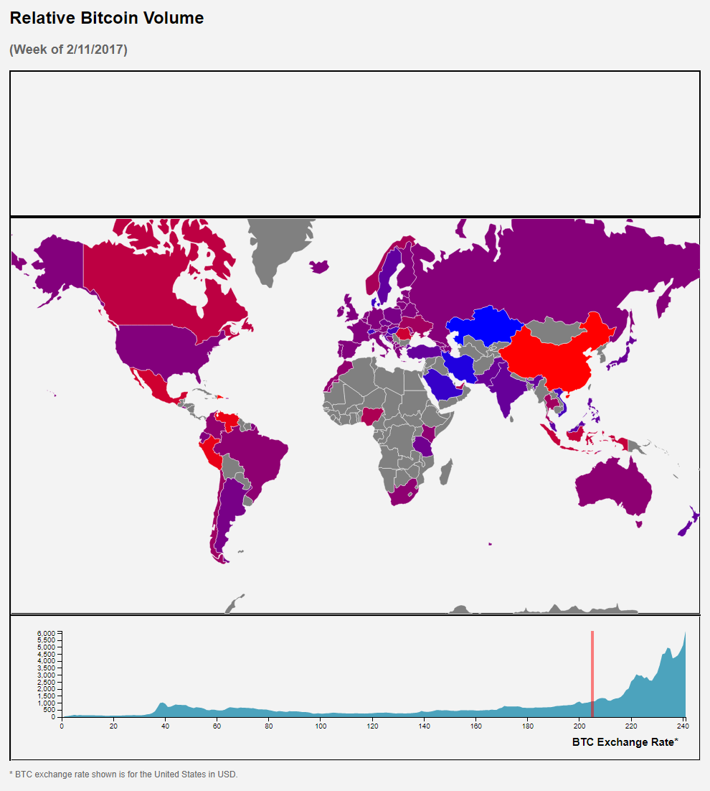
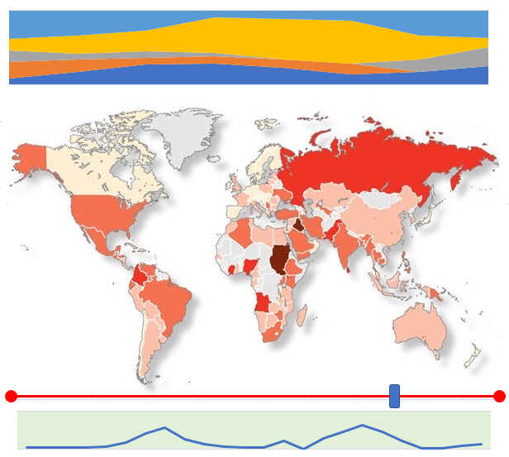
Screen Shot
Stacked area (not completed - mock-up shown)
Crisis Map with selectable countries
Time Slider replaced with context sensitive linked area graph
Cryptocurrency Exchange Rate

Slide 5
Task List and Timeline
Oct 13 - test LaTeX template -- done
Oct 18 - sketch final design -- done
Oct 31 - finish data cleaning and synchronization -- done
Nov 11 - implement chart 1 & 2 -- done
Nov 18 - implement chart 3 – in progress (→ Dec 3)
Nov 20 – assemble dashboard – layout done, need to insert chart three in placeholder
Nov 23 – first draft of paper – in progress (→ Dec 3)
Nov 27 - implement user interaction components and linking - done
Dec 1 – finish testing of system – interactive components testing complete
Dec 8 - sketch demo video, grab screenshots of visualization, project status update
Dec 14 - submit final paper, demo video

Slide 6
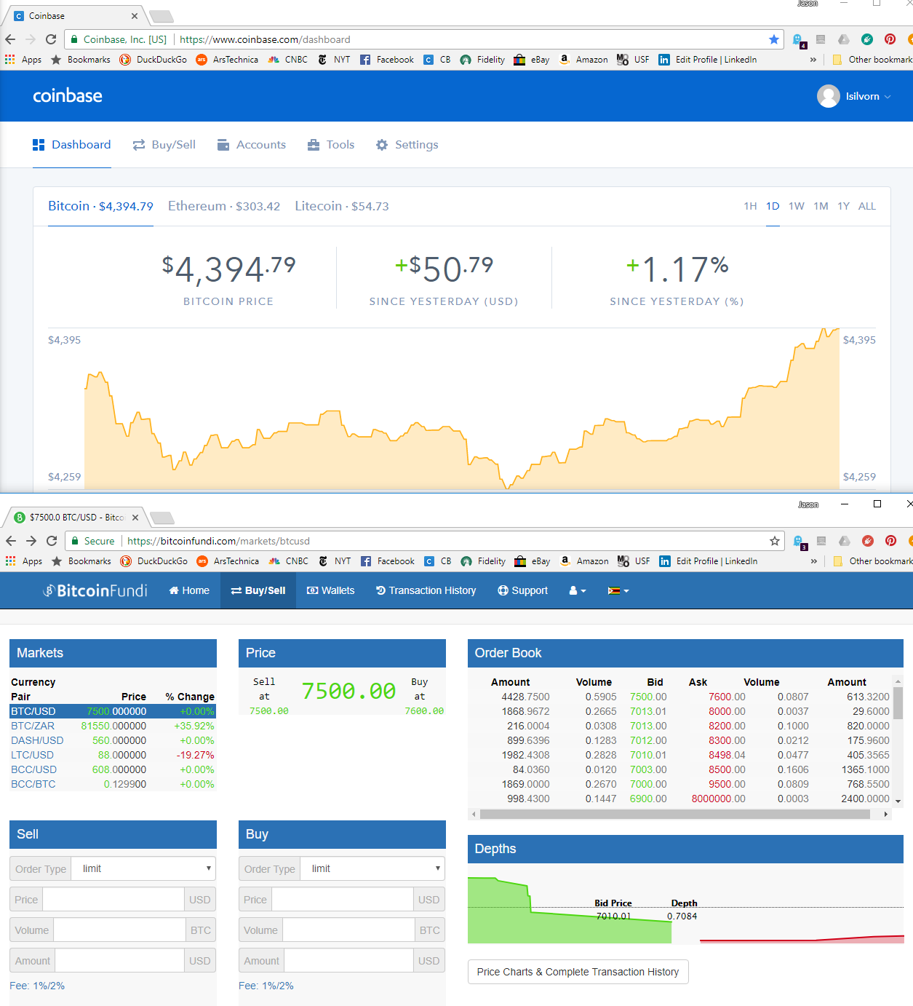
October 1st
Capital Controls ramped up in Zimbabwe 15 September
Foreign exchange extremely limited, but high demand
Defacto currency switched to US Dollars after skyrocketing hyperinflation caused the local currency to be scrapped in 2009.

Slide 7
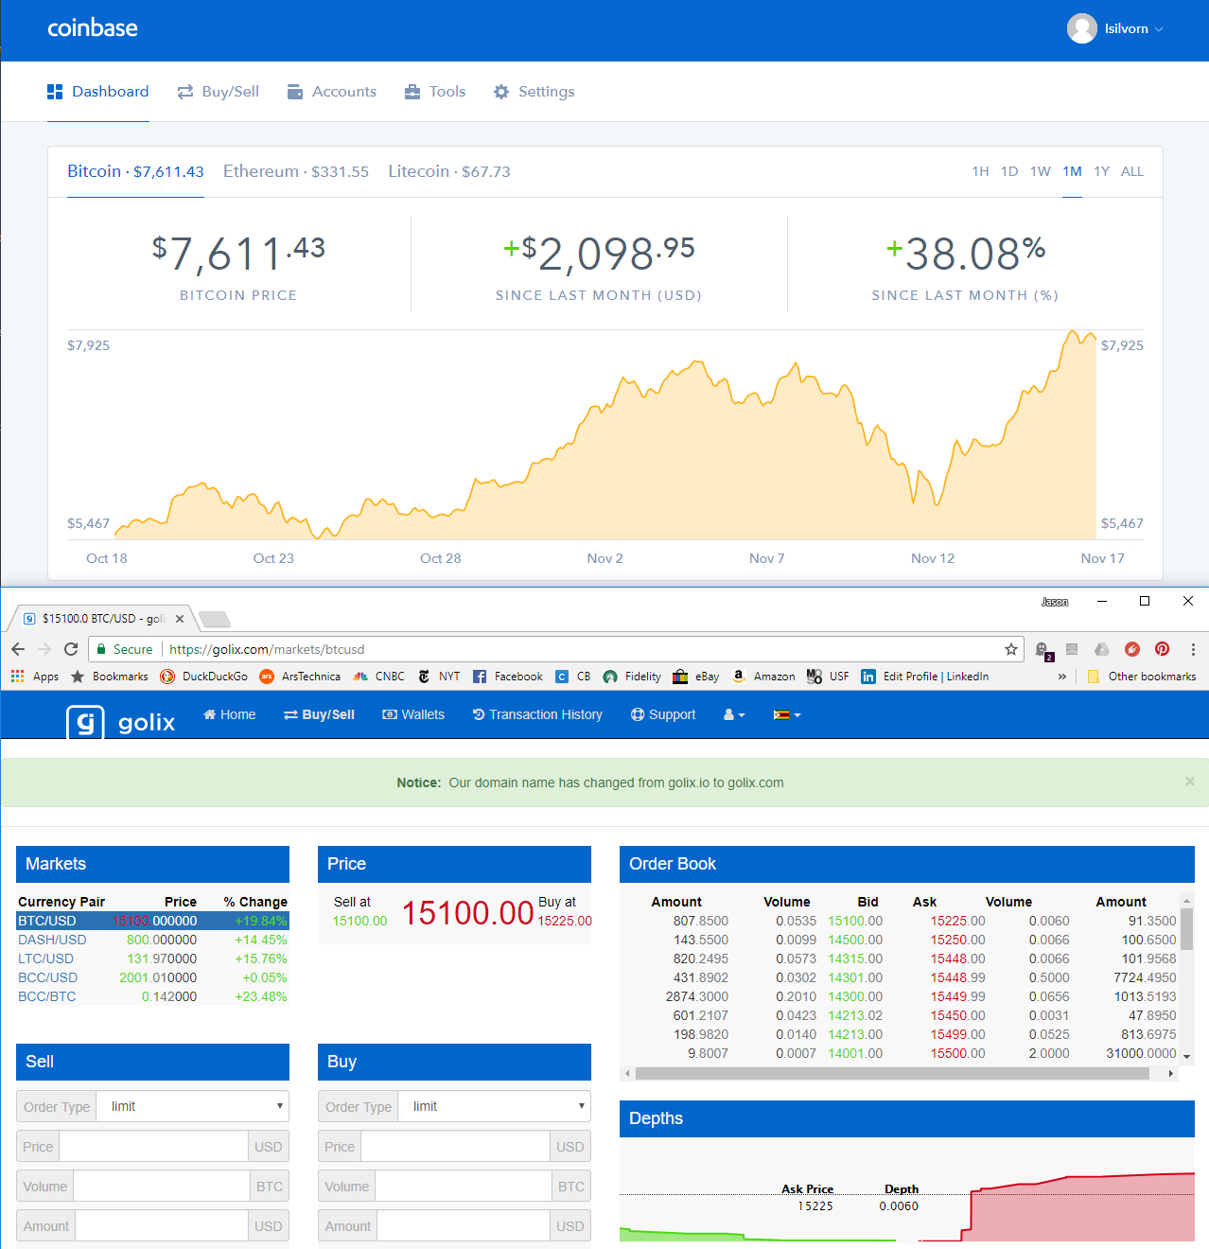
November 17th
Tanks roll through the capital as the military takes over on 14 November

