Slide 1

Secure IIoT Virtual Lab
A virtual environment for simulating industrial communication and cybersecurity testing
Team Members:
Sukhpinder — Infrastructure & Protocol
Inderpal — Security (Attack Simulation)
Jesse — Defense (IDS

Slide 2

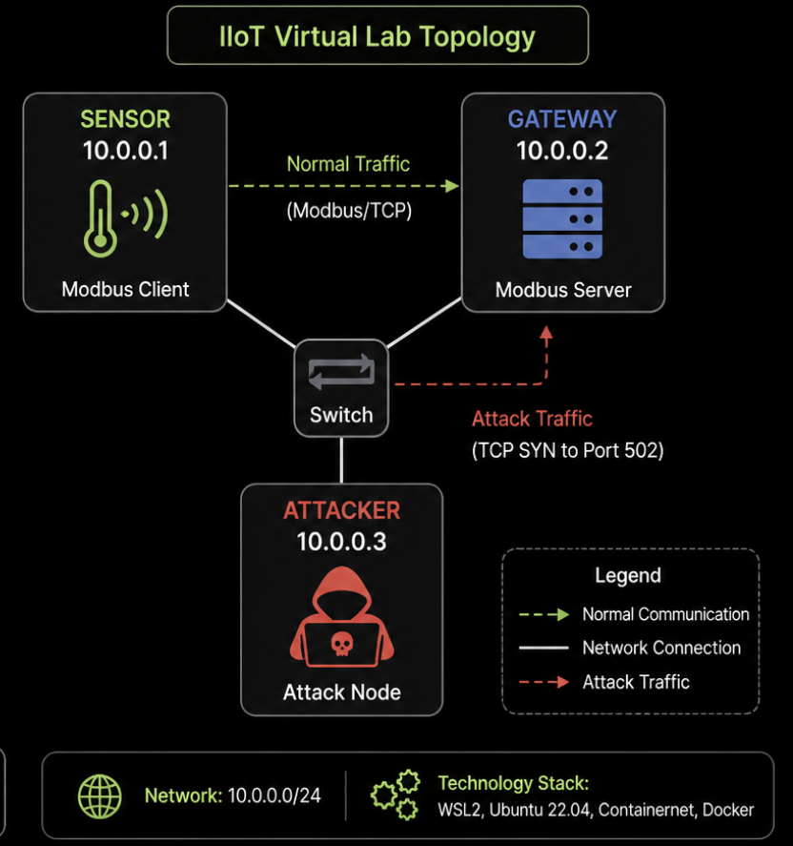
Infrastructure & Protocol (Normal Operation)
Ran environment on Ubuntu (WSL2)
Built IIoT network using Containernet (Mininet + Docker)
Created network topology with:
Sensor → 10.0.0.1
Gateway → 10.0.0.2
Attacker → 10.0.0.3
Sensor acts as Modbus Client
Gateway acts as Modbus Server
Normal traffic: Sensor → Gateway (Modbus/TCP)

Slide 3
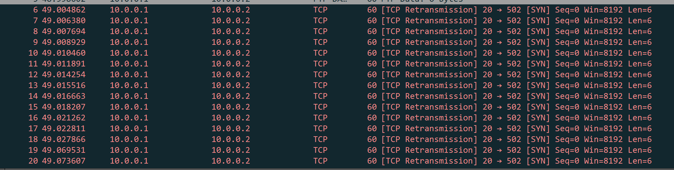
Security — Attack Simulation & Analysis
Used attacker node (10.0.0.3)
Generated traffic using Scapy (Python)
Sent repeated TCP SYN packets to port 502 (Modbus)
Captured traffic using tcpdump (.pcap)
Analyzed traffic in Wireshark
Normal: request → response
Attack: repeated SYN, no response
Result: TCP retransmissions indicate abnormal behavior

Slide 4
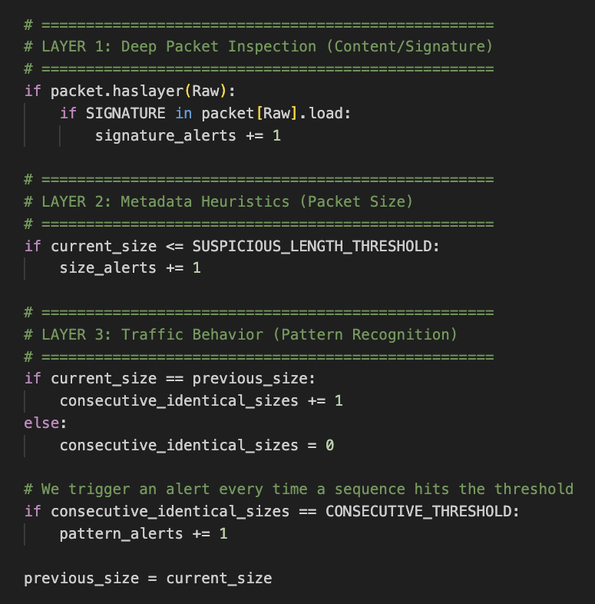
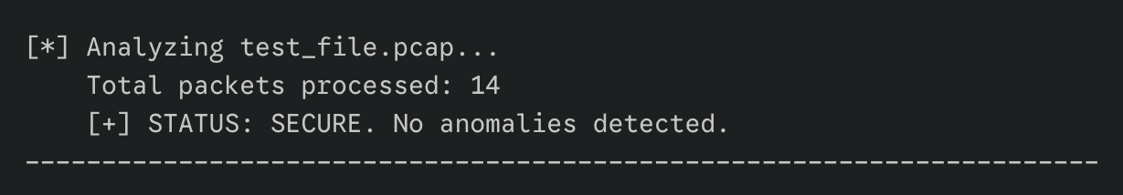
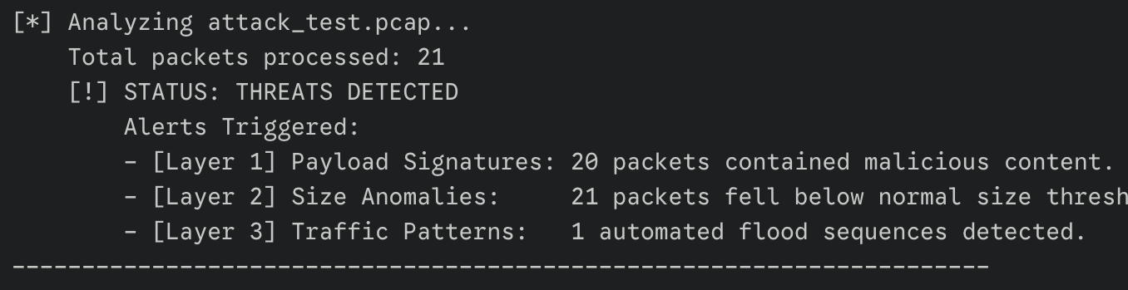
Defense — Intrusion Detection (IDS)
Developed IDS to detect abnormal traffic patterns
Analyzed PCAP data from attack simulation
Defense-in-Depth approach. Real-world Intrusion Detection Systems (like Suricata or Snort) rarely rely on just one metric.
Deep Packet Inspection (payload signatures)
Metadata Analysis (packet sizes)
Stateful Heuristics (traffic patterns)
Encryption resistant
SECURE
No attack detected
System traffic appears normal
ALERT!
Attack detected
Payload signatures match known attacks
Packet sizes are anomalous - below threshold
Traffic patterns are anomalous - repeated packets of the same length.

