Slide 1
MecaArm
An STM32-based omnidirectional mobile manipulator
Omnidirectional Mecanum drive • 5-DOF arm • Custom 4-layer PCB • STM32 + Bluetooth control
Sukhpinder Singh • Inderpal Singh • Feranmi Falodun • Pierreline Jacob
CMPE 493 — Senior Design Capstone • Spring 2026
California State University, East Bay • Department of Engineering

Slide 2
THE OPPORTUNITY
Why build a custom robotics control platform?
Low-level hardware access
Custom embedded control
Full-system integration
Vendor robotics controllers often hide low-level access to PWM timers, encoder interfaces, and real-time control loops behind proprietary firmware.
A custom STM32-based PCB enables direct integration of motors, servos, sensors, power management, and communication interfaces.
The project combines embedded firmware, PCB layout, power integrity, motor control, and robotic actuation into a single platform.
MecaArm replaces vendor electronics with a custom STM32-based control board that enables direct access to embedded control, hardware interfaces, and full-system integration.
MecaArm • Senior Design Capstone, Spring 2026
The Opportunity • 2 / 17

Slide 3
OUR SOLUTION
MecaArm — a custom STM32-based mobile manipulator platform
1
Omnidirectional locomotion
MecaArm at a glance
Four Mecanum wheels driven by TB6612FNG dual H-bridge drivers enable X/Y translation and in-place rotation.
Microcontroller
STM32F429VET6
2
5-DOF articulated arm
Power rails
7.4 V / 5 V / 5 V / 3.3 V
High-torque servos powered directly from the 7.4 V rail drive the base, shoulder, and elbow joints, while smaller 5 V servos control the wrist and gripper.
Drive motors
4 × DC + encoders
Arm joints
5 servos (PWM)
3
Custom 4-layer STM32 PCB
A custom STM32F429VET6 control board provides direct access to timers, PWM, I²C, UART, and embedded hardware interfaces.
Comms
Bluetooth SPP (UART)
IMU
LSM6DSR IMU interface
4
Wireless mobile-app control
Approx.
USD 213
Bluetooth SPP communication enables wireless control of locomotion and arm actuation through a MIT App Inventor mobile app.
MecaArm • Senior Design Capstone, Spring 2026
Solution • 3 / 17

Slide 4
MARKET & USE CASES
Potential applications for custom mobile manipulation platforms
Light logistics
Lab automation
Retail / inventory
Potential platform for flexible material transport and mobile manipulation workflows.
Potential mobile manipulation platform for configurable laboratory workflows.
Potential future expansion for inventory transport and assisted restocking tasks in indoor environments.
Education & research
Inspection & light maintenance
Hospitality & elder care
Open hardware/firmware platform for teaching control, embedded systems, and robotics — no vendor lock-in.
Potential platform for mobile reach and programmable arm interaction in constrained environments.
Compact omnidirectional mobility could support assisted transport tasks in indoor environments.
MecaArm • Senior Design Capstone, Spring 2026
Market & Use Cases • 4 / 17

Slide 5
SYSTEM ARCHITECTURE
Centralized STM32-based system architecture
2S LiPo 7.4 V
5 Servos
Primary power source
Base • shoulder • elbow • wrist • gripper
STM32F429VET6
RT7258 ×3
ESP32-WROOM-32
5 V motor rail • 5 V auxiliary rail • 3.3 V logic rail
180 MHz Cortex-M4F
Bluetooth-to-UART bridge
Custom 4-layer PCB
All real-time control
TB6612FNG ×2
LSM6DSR IMU
4 DC motors
I²C sensor interface
MecaArm • Senior Design Capstone, Spring 2026
System Architecture • 5 / 17

Slide 6
CUSTOM 4-LAYER PCB
Designed, fabricated, and debugged in a single PCB revision.
Board specs
Issues found → mitigated without respin
Dimensions
≈ 95 × 110 mm
!
UART TX/RX swap
Manual rework on bridge connection.
Stackup
4 layers — signal / GND / PWR / signal, 1.6 mm FR-4
!
Servo-rail droop
Added bulk + local decoupling capacitors.
Power tree
7.4 V battery → dual 5 V rails → dedicated 3.3 V logic rail
!
Undersized motor traces
Decoupling
100 nF + 10 µF per VDD; 10 kΩ + 100 nF on RESET
Reinforced during hardware bring-up validation.
!
RT7258 thermal pad
Programming
SWD / JTAG via 0.1" header (ST-Link V3)
Documented for v2 layout improvements.
!
Noise into signal lines
High-current zone
Localized along the bottom edge to isolate noise
Re-routed; better separation from switching paths.
MecaArm • Senior Design Capstone, Spring 2026
Custom PCB • 6 / 17

Slide 7
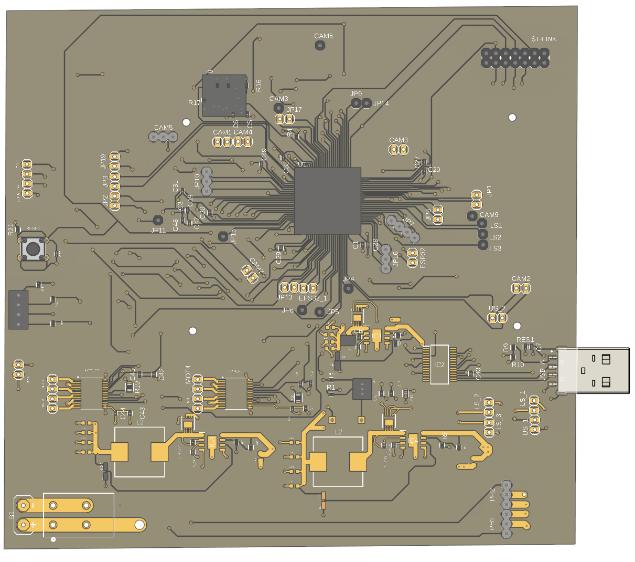
CUSTOM 4-LAYER PCB
Custom PCB layout and hardware implementation
STM32-centered 4-layer PCB architecture
Isolated power and logic routing regions
Integrated motor drivers, wireless bridge, and sensor interfaces
MecaArm • Senior Design Capstone, Spring 2026
Custom PCB • 7 / 17

Slide 8
FIRMWARE & CONTROL
Real-time embedded control on bare-metal STM32.
C + STM32 HAL
Hardware-timer PWM
Mecanum kinematics
Generated with STM32CubeMX. Polling-based main loop, non-blocking UART input.
All servo and motor PWM driven by hardware timers for stable timing independent of main-loop execution.
STM32 computes directional wheel-speed mapping for omnidirectional mecanum drive control.
Velocity normalization
Safe-state machine
ESP32 = bridge only
Motor command scaling used to maintain stable directional movement during combined drive commands.
Communication faults or invalid commands trigger motor disable and visual/audible fault indication.
ESP32 used only as a Bluetooth-to-UART communication bridge.
Hardware timers + non-blocking I/O support stable embedded control behavior.
MecaArm • Senior Design Capstone, Spring 2026
Firmware & Control • 8 / 17

Slide 9
SENSING & WIRELESS
Wireless control and onboard sensing.
Wireless control pipeline
Onboard sensing (LSM6DSR)
MIT App Inventor
Operator UI on Android
6-axis LSM6DSR IMU connected through I²C communication.
Used for orientation and motion sensing through I²C communication.
Encoder feedback support for closed-loop velocity control expansion.
Camera footprint (OV2640) on board for future visual processing.
Status LEDs + buzzer for fault signaling.
Bluetooth SPP
Transparent UART link
ESP32-WROOM-32
BT-to-UART bridge only
STM32F429VET6
Parses, controls, actuates
Motors + servos
Real-time PWM outputs
MecaArm • Senior Design Capstone, Spring 2026
Sensing & Wireless • 9 / 17

Slide 10
EXPERIMENTAL RESULTS
It works — and it's reliable.
Stable
Reliable
≥1 hr
Verified
Power rails remained operational during bring-up and testing.
Stable Bluetooth communication during live demonstrations.
Continuous operation on a 2S LiPo under mixed driving + manipulation.
Forward, lateral, and in-place Mecanum motion demonstrated.
Findings from system bring-up and demo runs
All four power rails (7.4 V, 2× 5 V, 3.3 V) stable under dynamic load — no voltage droop after capacitor mitigation.
Arm responds correctly to joint-level commands; small steady-state error consistent with open-loop servo control.
Drive system reliably executes forward/reverse, lateral translation, and in-place rotation under operator control.
Encoder feedback evaluated for velocity stabilization; chassis heading remains open-loop.
MecaArm • Senior Design Capstone, Spring 2026
Results • 10 / 17

Slide 11
COST STRUCTURE
Bill of Materials at single-unit volume.
Item | Qty | Unit (USD) | Total (USD)
STM32F429VET6 MCU | 1 | 14.28 | 14.28
RT7258 Buck Converter | 3 | 2.32 | 6.96
TB6612FNG Motor Driver | 2 | 2.12 | 4.24
ESP32-WROOM-32 (BT bridge) | 1 | 19.99 | 19.99
OV2640 Camera Module | 1 | 9.99 | 9.99
LSM6DSR IMU | 1 | 4.58 | 4.58
TT DC Motors | 4 | 3.99 | 15.96
LD-1501MG Servo (base) | 1 | 20.47 | 20.47
LFD-218 Servo | 1 | 14.99 | 14.99
LFD-01M Servos | 3 | 6.99 | 20.97
Buzzer + LEDs | — | — | 14.15
2S LiPo Battery | 1 | 27.89 | 27.89
Connectors & Passives | — | — | 18.00
PCB Fabrication (4-layer) | 1 | — | 25.00
Estimated Single-Unit Total |  |  | USD 213.46
Cost narrative
Target was < $100 board-level — actual is $213 system-level (board + actuators + battery).
Custom PCB electronics alone are cost-effective — passives, MCU, drivers ≈ $30.
Dominant costs: actuators (servos), Bluetooth module, battery.
Future revisions could reduce cost through integrated regulators and alternative actuator selection.
MecaArm • Senior Design Capstone, Spring 2026
Cost • 11 / 17

Slide 12
MILESTONES ACHIEVED
What's working, end-to-end.
✓
Mechanical chassis integrated with the custom 4-layer PCB.
✓
Successful bring-up of the 7.4 V, dual 5 V, and 3.3 V power rails.
✓
Mecanum drive controlled through Bluetooth command input.
✓
Joint-level robotic-arm actuation across all 5 servos.
✓
Bluetooth communication between MIT App Inventor app and STM32 via ESP32 UART bridge.
✓
Integrated system demonstration: drive + manipulate + onboard sensing.
MecaArm • Senior Design Capstone, Spring 2026
Milestones • 12 / 17

Slide 13
REACH GOALS & LESSONS
Where we pushed, what we learned.
Reach goals
Lessons learned
Wireless command path (mobile → STM32)
Achieved
Align the sensor suite with autonomy goals early — limited sensing reduced autonomous control capability.
Size bulk capacitance for worst-case servo transients, not nominal load.
Partition responsibilities cleanly between MCUs — ESP32 strictly bridge, STM32 owns real-time.
Schematic capture: verify every TX/RX, every power pin, every silkscreen label before fab.
Mitigations beat respins on a fixed timeline — but document everything for v2.
App Inventor commands received and executed correctly via ESP32 UART bridge.
Closed-loop Mecanum drive
Partial
Per-wheel PI velocity loop on encoders — long-trajectory heading still open-loop.
Closed-loop arm control
Partial
PWM positioning works; no joint-level feedback — full kinematic loop not implemented.
MecaArm • Senior Design Capstone, Spring 2026
Reach Goals & Lessons • 13 / 17

Slide 14
ROADMAP
From classroom prototype to expanded real-world platform.
Now
+3 mo
+6 mo
+12 mo
+18 mo
v1 demo platform
v2 board respin
Closed-loop arm
Prototype field testing
Production-ready platform
Custom PCB, Bluetooth-driven Mecanum + 5-DOF arm, full system demo on-bench.
Trace widening, RT7258 thermal pads, consolidated power, documented errata fixed.
Joint-level feedback, inverse kinematics integrated into firmware, Cartesian motion.
Future ROS 2 integration, SLAM experimentation, and higher-level motion planning support.
Cost-down BoM (<$150), enclosure design, regulatory + safety review.
MecaArm • Senior Design Capstone, Spring 2026
Roadmap • 14 / 17

Slide 15
WHY MECAARM
Key strengths of the MecaArm platform.
01
02
03
Validated hardware platform
Open & extensible
Disciplined engineering
Working system demoed end-to-end — drive, arm, comms, sensing — on a custom 4-layer PCB we designed.
No vendor lock-in. Direct STM32 control of PWM outputs and encoder feedback support— a flexible platform for future development.
Issues found during bring-up, mitigated without a respin, fully documented for v2.
04
Future cost optimization
$213 today; <$150 BoM target with v2 board, consolidated regulators, and volume sourcing.
MecaArm • Senior Design Capstone, Spring 2026
Project Strengths • 15 / 17

Slide 16
THE TEAM
Collaborative senior design team
IS
FF
SS
PJ
Inderpal Singh
Feranmi Falodun
Sukhpinder Singh
Pierreline Jacob
PCB design & power integrity
Mobile UI & software integration
Embedded control & system integration
Servo integration & mechanical assembly
Schematic capture, PCB layout, RT7258 power tree,
decoupling strategy, and hardware bring-up support.
MIT App Inventor application,
command protocol integration,
demo orchestration, and software coordination.
STM32 integration, DC motor control,
UART communication, IMU integration,
system testing, and mecanum-drive integration.
Servo mounting, arm assembly support,
joint-level motion testing, and mechanical integration.
Advised by the CSU East Bay Department of Engineering — CMPE 493 Senior Design Capstone, Spring 2026.
MecaArm • Senior Design Capstone, Spring 2026
Team • 16 / 17

Slide 17
Thank you.
Questions, demos, and next steps.
Get in touch
Sukhpinder Singh • Inderpal Singh • Feranmi Falodun • Pierreline Jacob
California State University, East Bay • Department of Engineering
CMPE 493 Senior Design Capstone — Spring 2026
Senior Design Final Presentation, May 8

