Slide 1

Real-Time EV Charging Monitoring System (Local Cloud Simulation)
Presented by: Sukhpinder Singh & Inderpal Singh
CS 623 Final Project Presentation

Slide 2
Problem Statement
No real-time station visibility
Users choose inefficient stations
No coordination between stations

Slide 3




System Architecture (Local Cloud Simulation)
Edge Infrastructure
Data Orchestration
Docker containers simulate EV charging stations
Containernet creates a virtual network
Python generates real-time telemetry (battery, voltage)
Bash script extracts data from containers
Merges station data into one JSON file
Updates every 2 seconds for real-time flow
Application Layer
API Layer
React displays live station data
Shows battery %, voltage, and status
Updates every 2 seconds
Recommends best station
json-server converts JSON file into REST API
Runs on localhost:5000
Provides real-time data to frontend

Slide 4
System Components
Containernet → network simulation
Docker → EV stations
Python → telemetry generation
Bash → data pipeline
JSON → data storage
json-server → API layer
React → frontend dashboard

Slide 5
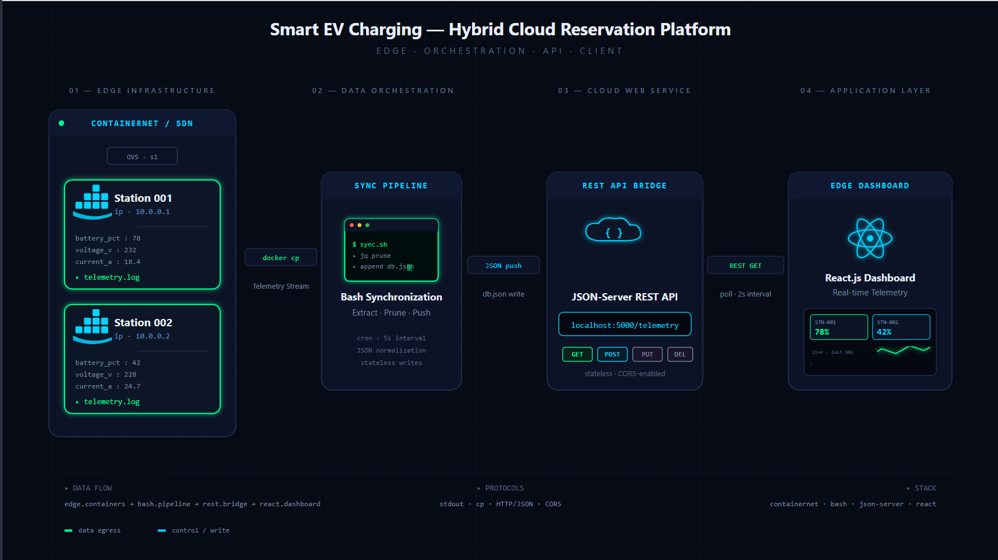
Real-Time Data Flow
Step 1: Data Generation
EV stations (Docker containers) generate telemetry
Includes battery %, voltage, status
Step 2: Data Processing
Bash pipeline extracts data from containers
Merges into a single JSON file
Step 3: Data Exposure
json-server converts JSON into REST API
Runs on localhost:5000
Step 4: Data Visualization
React dashboard fetches API data
Updates every 2 seconds

Slide 6


Edge Infrastructure Layer
Docker Station Nodes
We utilized Containernet to virtualize the physical environment. Each station is an isolated container, not just a script variable.
•
Real-time Python telemetry generation
•
Isolated process management
•
Simulated network using Containernet

Slide 7
Backend & Cloud API
Hosting and managing the data lifecycle.

Slide 8






API Gateway & Scalability
Cloud Service
Scalable Design
Data Persistence
json-server exposes JSON as REST API
Runs on localhost:5000
Standard HTTP protocols allow this backend to transition to AWS or GCP with zero changes to frontend logic.
JSON file stores real-time telemetry
Updated every 2 seconds

Slide 9

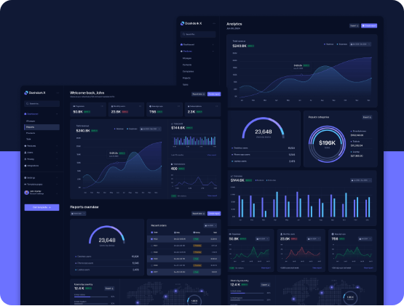
Application Layer Details
React & Recharts UI
The frontend provides a real-time window into the charging network's health and grid stability.
•
Live 2-second polling interval
•
Time-series Voltage Trend graphs
•
Dynamic visual status encoding

Slide 10
Intelligence & Scoring
Recommendation Logic
20%
The "Best Station" algorithm evaluates health metrics to guide users efficiently:
Green: High Battery % + Stable Voltage
Busy: Low Voltage Grid Fluctuations
Critical Threshold
Unavailable: Battery dropped below 20%

Slide 11
Ubuntu Live Demo Flow
Terminal 1
Terminal 2
Terminal 3
Dashboard
Launching the SDN Topology & Python Edge Simulation
Starting the API Gateway (Cloud Web Service)
Executing the Data Sync Loop (Bash Pipeline)
Live Monitoring in the React Web Interface

Slide 12


Challenges & Conclusion
The Synchronization Challenge
Project Conclusion
Managing file-locking between Docker's local logs and the API ingestor. We resolved this by implementing a temporary buffer system to prevent simulation crashes.
We built a real-time EV monitoring system that simulates cloud architecture locally, integrating data pipeline, API, and frontend dashboard
Visualization Challenge
Initial graph appears unstable (wobbly data)
Improved by smoothing and using linear interpolation

