Slide 1
CMPE 480 VLSI PROJECT
4B/5B Line Encoder with Dual 16-bit LFSR Scrambling
Encoder · 5×1 Multiplexer · Mod-5 Counter · Dual LFSR · XOR Logic · Shift Register · Decoder
Schematic Design • Magic Layout • Simulation
Sukhpinder Singh
Wasi Mohammed
Inderpal Singh
CMPE 480 • VLSI Design • Spring 2026

Slide 2
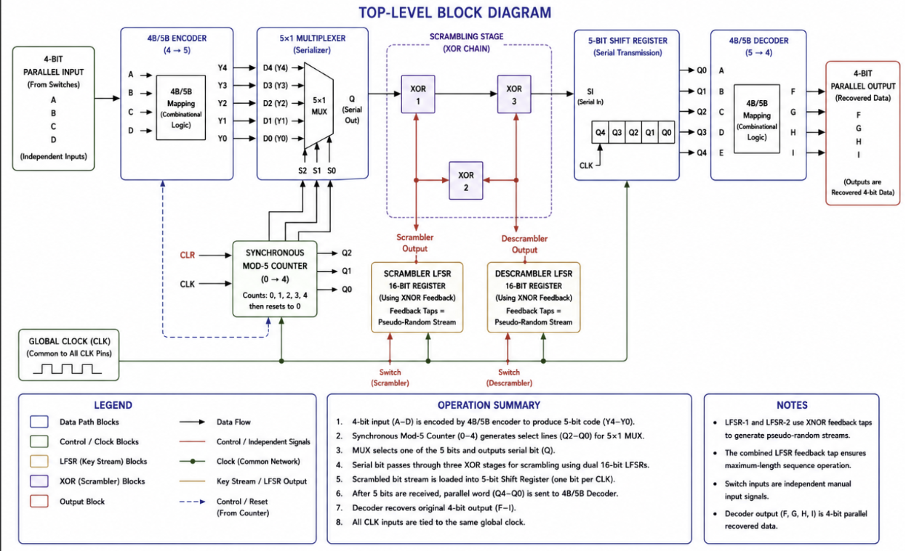
INTRODUCTION
Project Overview & Block Diagram
System Overview
The system converts 4-bit parallel input data into a serialized and scrambled bitstream before reconstructing the original data at the receiver.
4B/5B encoder converts 4-bit input into a transition-rich 5-bit code.
Mod-5 counter drives the 5×1 multiplexer for serialization.
Dual 16-bit LFSRs generate pseudo-random scrambling streams.
XOR stages scramble and descramble the serial data path.
Shift register reconstructs the received 5-bit symbol.
4B/5B decoder recovers the original 4-bit output.
All blocks operate using a shared global clock.
VLSI Project — Pseudo-Random Stream Scrambler
2 / 28

Slide 3
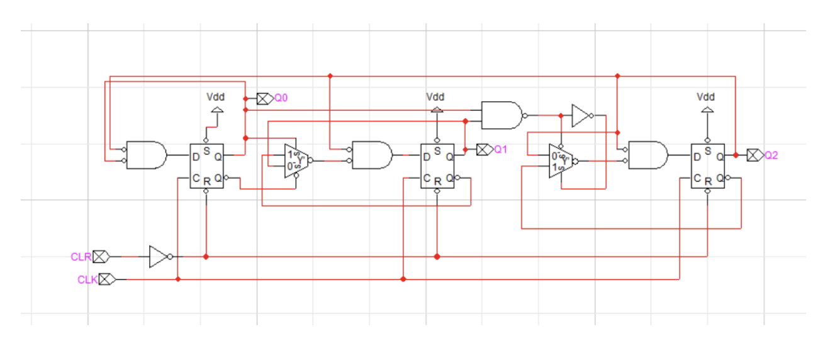
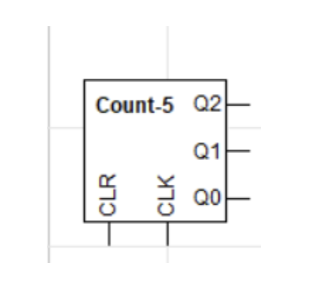
CONTROL · select-line generator
Synchronous Mod-5 Counter — Schematic
Function & Notes
Generates MUX select signals (S2, S1, S0).
Uses synchronous CLK and CLR control logic.
Cycles through states 0–4 before resetting to 0.
Controls the serialization sequence of the encoded 5-bit data.
VLSI Project — Pseudo-Random Stream Scrambler
3 / 28

Slide 4
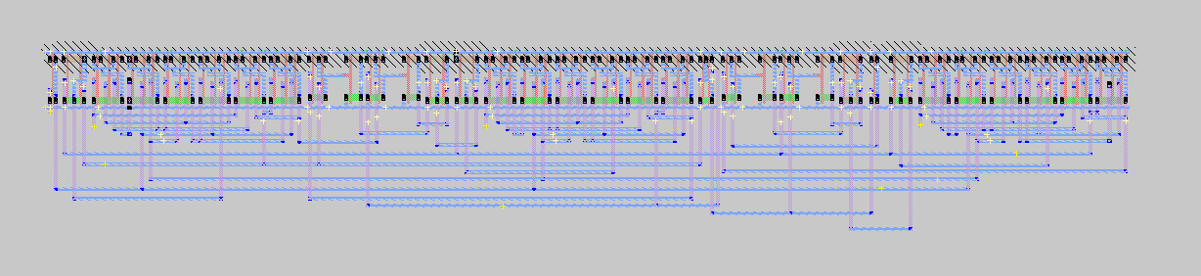
CONTROL · select-line generator
Synchronous Mod-5 Counter — Magic Layout
LAYOUT
Layout Notes
Three D flip-flops store counter states Q0, Q1, and Q2.
Shared CLK and CLR signals synchronize and reset the counter.
2×1 multiplexers control next-state selection logic.
Layout verified through hierarchical Magic VLSI implementation.
VLSI Project — Pseudo-Random Stream Scrambler
4 / 28

Slide 5
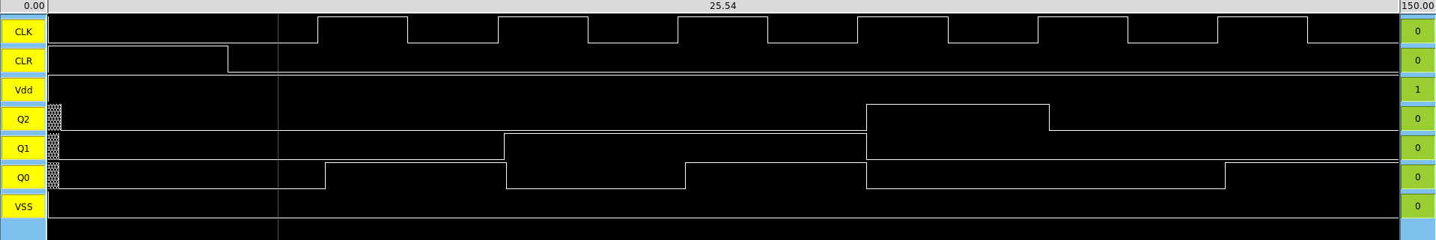
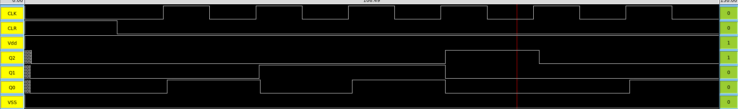
CONTROL · select-line generator
Synchronous Mod-5 Counter — Simulation
SIMULATION
Simulation Notes
Waveforms verify synchronous Mod-5 counting behavior.
Counter cycles through states:
000 → 001 → 010 → 011 → 100 → 000
CLK synchronizes all state transitions.
Reset logic correctly returns the counter to 000.
VLSI Project — MOD 5 COUNTER
5 / 28

Slide 6
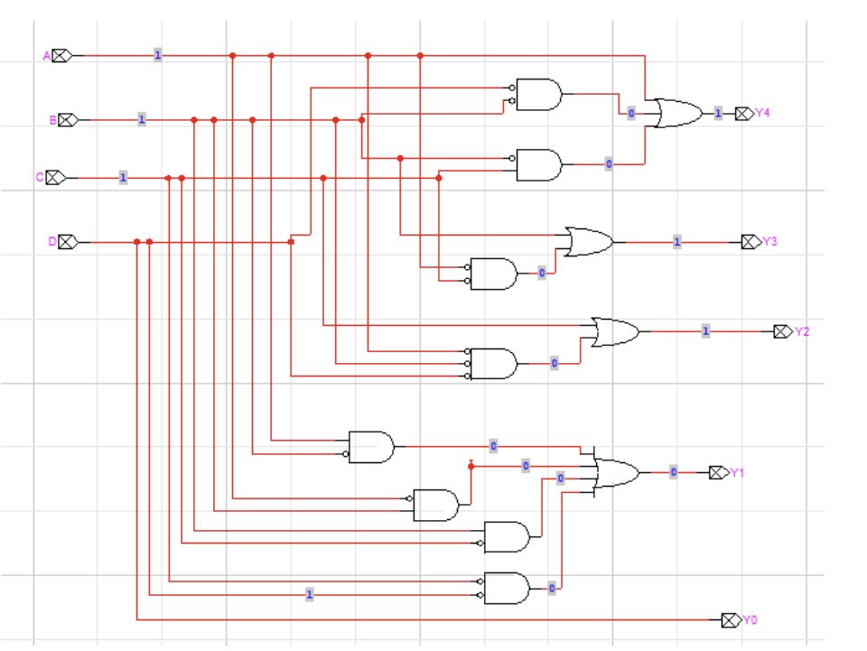
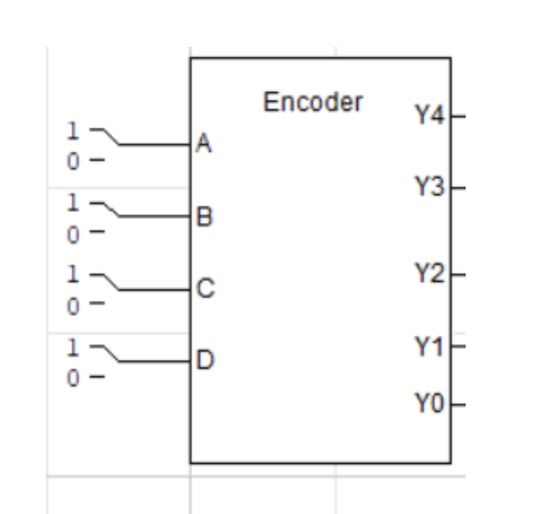
DATAPATH · input-side encoder
Encoder (4 → 5) — Schematic
SCHEMATIC
Function & Notes
Accepts 4-bit parallel input data (A, B, C, D).
Generates 5-bit encoded outputs (Y4–Y0) using 4B/5B logic.
Improves transition density and reduces DC imbalance.
Encoded outputs are forwarded to the 5×1 MUX for serialization.
VLSI Project — Pseudo-Random Stream Scrambler
6 / 28

Slide 7
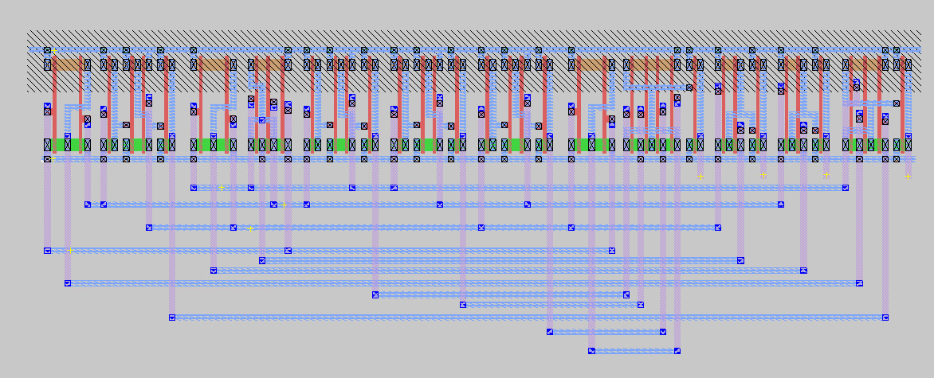
DATAPATH · input-side encoder
Encoder (4 → 5) — Magic Layout
LAYOUT
Layout Notes
Magic layout implements the 4B/5B combinational encoder logic.
PMOS and NMOS transistor networks generate outputs Y4–Y0.
Metal routing connects parallel inputs to encoding logic paths.
Hierarchical layout structure improves modular design organization.
Layout verified through Magic VLSI implementation and simulation.
VLSI Project — Pseudo-Random Stream Scrambler
7 / 28

Slide 8
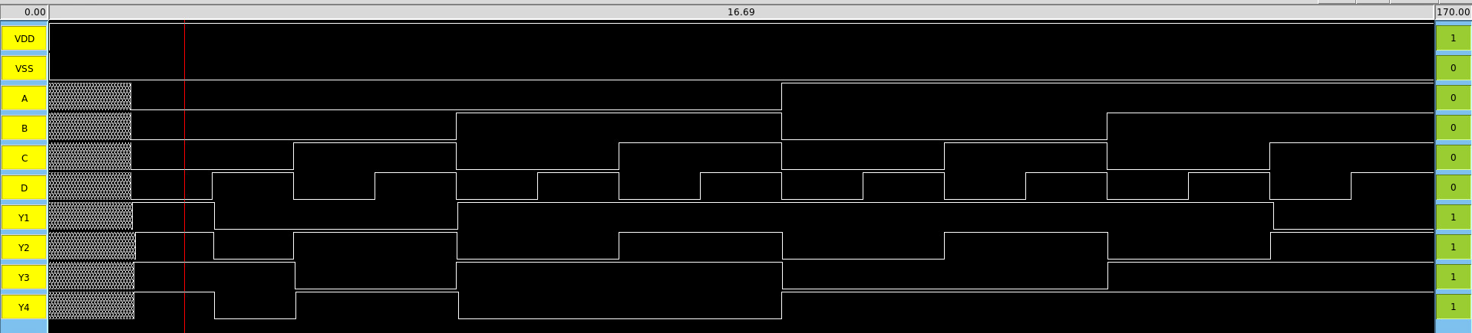
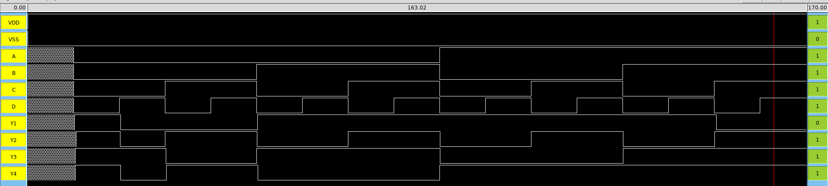
DATAPATH · input-side encoder
Encoder (4 → 5) — Simulation
SIMULATION
Simulation Notes
Encoder supports 16 possible 4-bit input combinations.
All input cases were tested using simulation command files.
Waveforms verified correct 4B/5B encoded outputs for each case.
Simulation confirmed proper encoder functionality across all inputs.
VLSI Project — Pseudo-Random Stream Scrambler
8 / 28

Slide 9
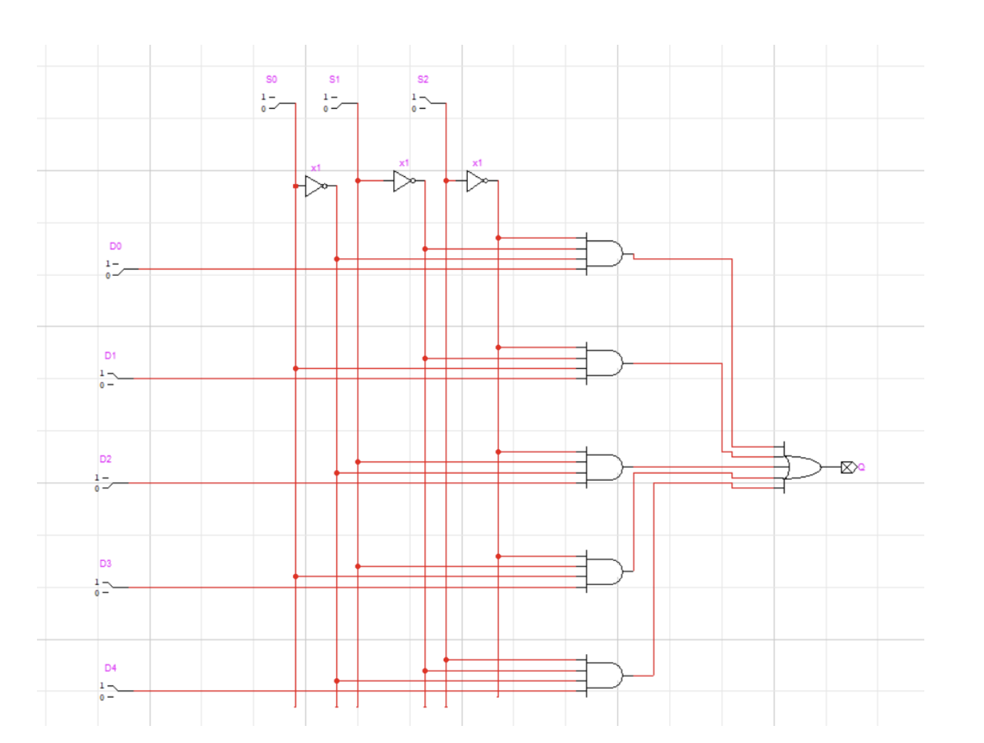
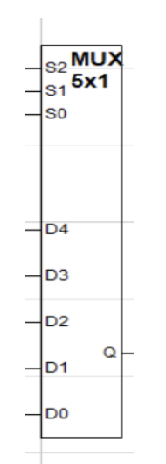
DATAPATH · serializer
5×1 MUX — Schematic
SCHEMATIC
Function & Notes
Receives encoded inputs D4–D0 from the 4B/5B encoder.
Select lines S2, S1, and S0 are driven by the synchronous Mod-5 counter.
Serial output Q transmits one encoded bit per clock cycle.
Converts the 5-bit parallel word into serialized data for the XOR scrambling stage.
VLSI Project — Pseudo-Random Stream Scrambler
9 / 28

Slide 10
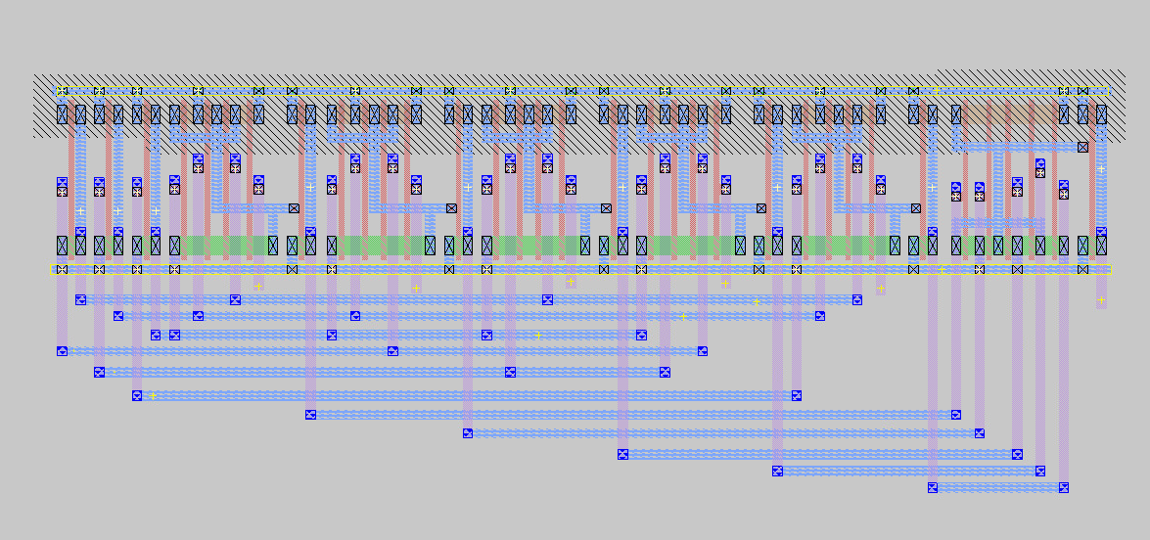
DATAPATH · serializer
5×1 MUX — Magic Layout
LAYOUT
Layout Notes
Inverters generate complementary select-line signals for S0, S1, and S2.
Five AND gates implement selection logic for inputs D0–D4.
Only one data path is enabled during each counter state.
OR logic combines the selected path into the final serial output Q.
Layout routes serialized encoder data toward the scrambling stage.
VLSI Project — Pseudo-Random Stream Scrambler
10 / 28

Slide 11
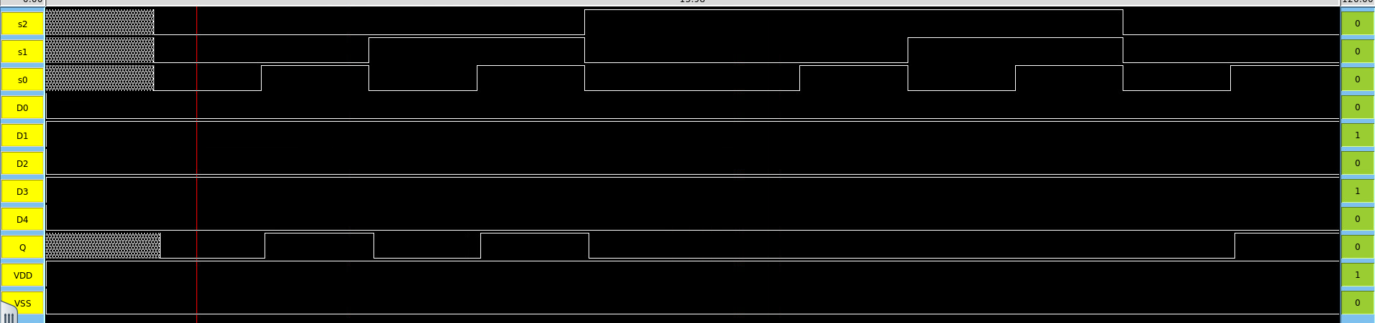
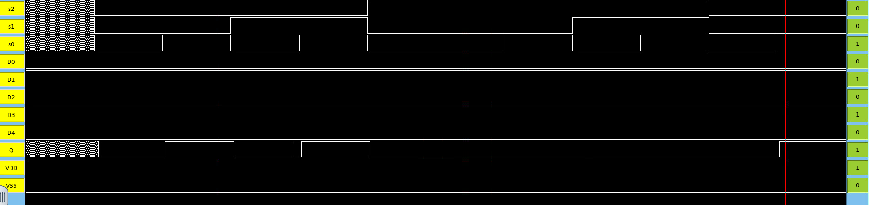
DATAPATH · serializer
MUX 5 × 1 — Simulation
SIMULATION
Simulation Notes
Functional verification against the expected truth table.
Stimulus applied to all MUX input and select pins.
Outputs match the schematic specification.
Waveforms captured using IRSIM simulation.
VLSI Project — Pseudo-Random Stream Scrambler
11 / 28

Slide 12
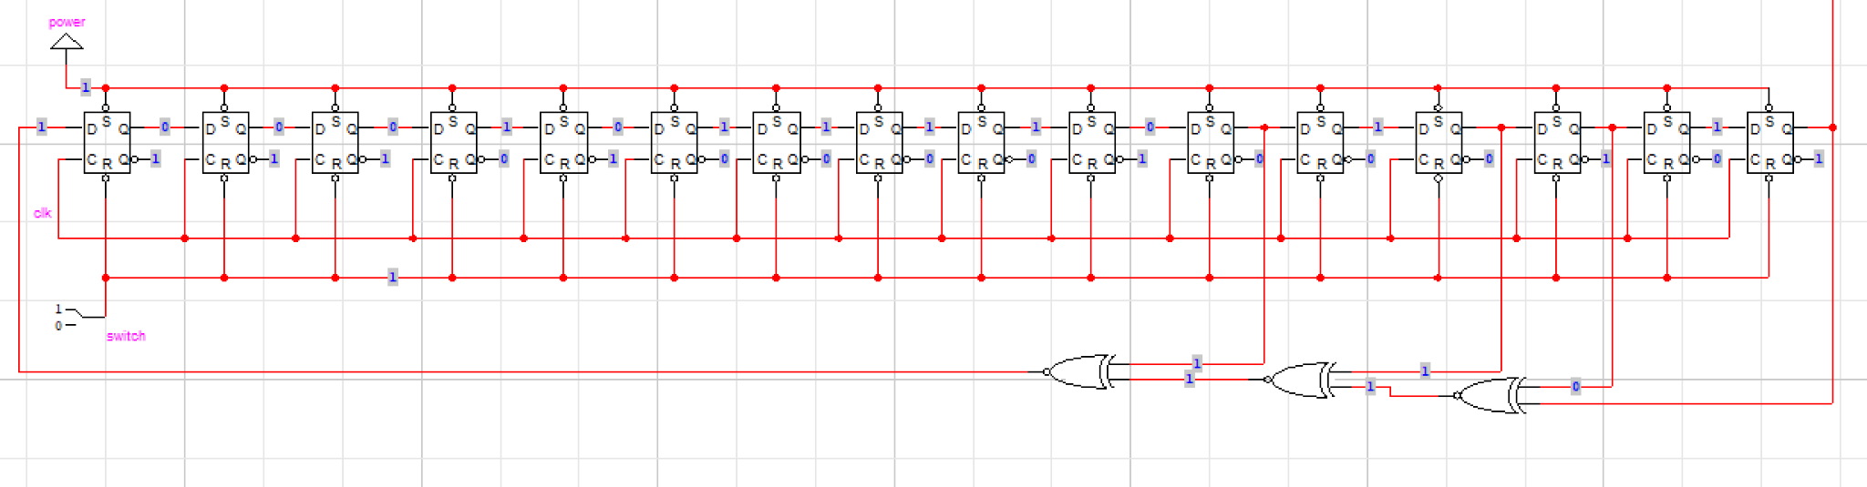
KEYSTREAM · pseudo-random generator
LFSR-1 (16-bit) — Schematic
SCHEMATIC
Function & Notes
16-stage shift register chain built using D flip-flops.
XNOR feedback taps generate the pseudo-random keystream.
Used as the first scrambling source for the XOR stage.
Operates synchronously with the shared global clock.
VLSI Project — Pseudo-Random Stream Scrambler
12 / 28

Slide 13
KEYSTREAM · pseudo-random generator
LFSR-1 (16-bit) — Magic Layout
LAYOUT
Layout Notes
Magic layout implements the physical 16-stage LFSR structure.
Repeated transistor cells form the cascaded flip-flop chain.
Metal routing distributes feedback connections across the register stages.
Compact layout organization improves routing efficiency and modularity.
Layout verified using Magic VLSI design-rule validation.
VLSI Project — Pseudo-Random Stream Scrambler
13 / 28

Slide 14
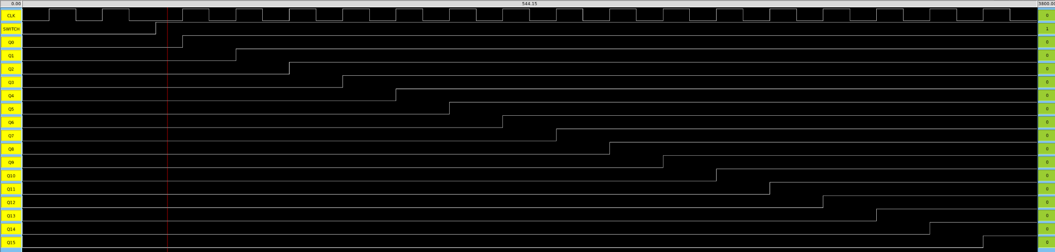
KEYSTREAM · pseudo-random generator
LFSR-1 (16-bit) — Simulation
SIMULATION
Simulation Notes
Waveforms verify sequential shifting across the 16-bit LFSR stages.
Each clock pulse propagates the register state through the flip-flop chain.
XNOR feedback logic generates the pseudo-random keystream sequence.
Output transitions demonstrate synchronized operation under the shared CLK signal.
IRSIM waveforms confirm proper LFSR feedback and stage propagation behavior.
Waveform / Functional Simulation
Insert image here (right-click → Change Picture)
VLSI Project — Pseudo-Random Stream Scrambler
14 / 28

Slide 15
KEYSTREAM · pseudo-random generator
LFSR-2 (16-bit) — Schematic
SCHEMATIC
Function & Notes
Independent 16-bit LFSR using a separate feedback network.
Different seed and feedback taps produce a de-correlated keystream.
Dual-LFSR structure improves scrambling diversity across the serial data stream.
Provides the second pseudo-random input for the XOR scrambling stage.
Operates synchronously with the shared system clock.
VLSI Project — Pseudo-Random Stream Scrambler
15 / 28

Slide 16
KEYSTREAM · pseudo-random generator
LFSR-2 (16-bit) — Magic Layout
LAYOUT
Layout Notes
Layout implements the second 16-stage LFSR feedback structure.
Repeated flip-flop cells create the secondary keystream generator chain.
Independent feedback routing supports a de-correlated scrambling sequence.
Compact transistor organization maintains modular routing across all stages.
Magic VLSI verification confirmed proper physical layout implementation.
VLSI Project — Pseudo-Random Stream Scrambler
16 / 28

Slide 17
KEYSTREAM · pseudo-random generator
LFSR-2 (16-bit) — Simulation
SIMULATION
Simulation Notes
Waveforms verify synchronized shifting across the second 16-bit LFSR chain.
Independent feedback taps generate a separate pseudo-random keystream sequence.
Clock transitions propagate data sequentially through all register stages.
Simulation confirms de-correlated output behavior relative to LFSR-1.
IRSIM waveforms validate proper feedback propagation and keystream generation.
VLSI Project — Pseudo-Random Stream Scrambler
17 / 28

Slide 18
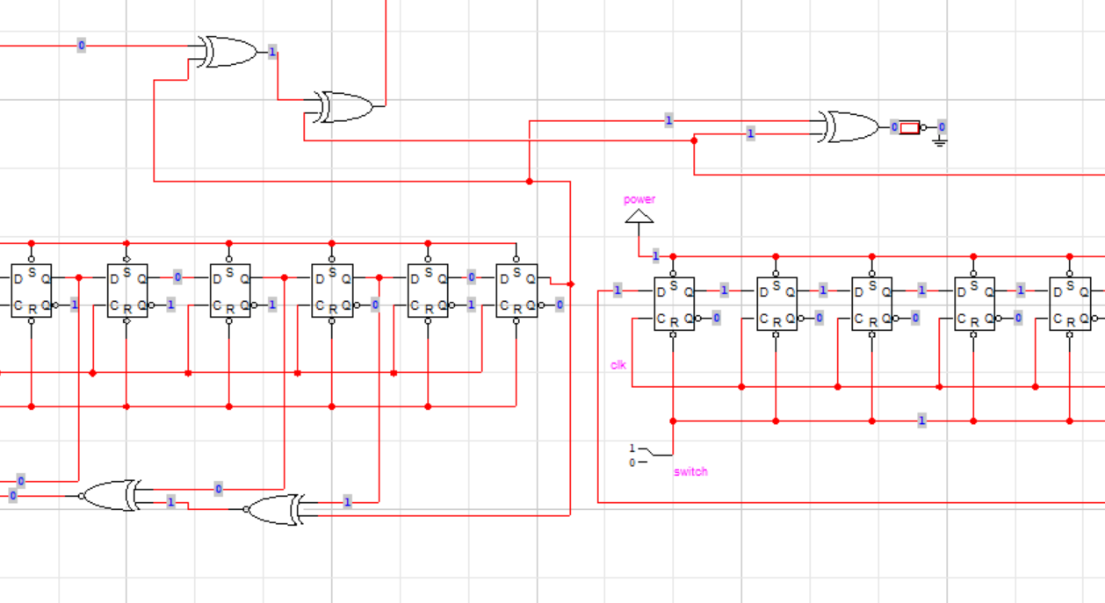
DATAPATH · stream-cipher core
XOR Scrambler (3 gates) — Schematic
SCHEMATIC
Function & Notes
• Three cascaded 2-input XOR gates. • XOR-1: MUX output ⊕ LFSR-1 output. • XOR-2: result ⊕ LFSR-2 output. • XOR-3: combines previous XOR result with feedback data to generate the encrypted serial output bit.
VLSI Project — Pseudo-Random Stream Scrambler
18 / 28

Slide 19
DATAPATH · stream-cipher core
XOR Scrambler (3 gates) — Magic Layout
LAYOUT
Layout Notes
Layout implements three cascaded XOR stages for stream scrambling.
Metal routing connects MUX output and both LFSR outputs into the XOR network.
Compact transistor placement minimizes delay between XOR stages.
Shared routing paths synchronize encrypted bit generation.
Final layout produces serialized scrambled output for transmission.
VLSI Project — Pseudo-Random Stream Scrambler
19 / 28

Slide 20
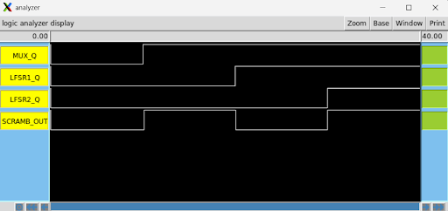
DATAPATH · stream-cipher core
XOR Scrambler (3 gates) — Simulation
SIMULATION
Simulation Notes
Waveforms show interaction between MUX output and both LFSR keystreams.
SCRAMB_OUT changes whenever XOR input combinations change.
XOR stages combine serial data with pseudo-random keystream bits.
Simulation confirms synchronized encrypted output generation.
Output waveform demonstrates successful stream scrambling operation.
VLSI Project — Pseudo-Random Stream Scrambler
20 / 28

Slide 21
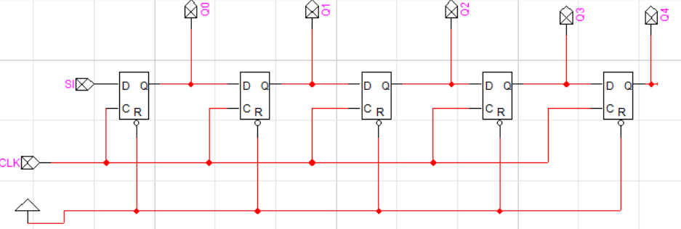
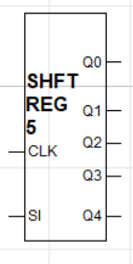
DATAPATH · serial-to-parallel
Shift Register (5-bit) — Schematic
SCHEMATIC
Function & Notes
Serial input SI receives the scrambled serial bit stream.
Five cascaded D flip-flop stages generate parallel outputs Q0–Q4.
Captures one complete 5-bit encoded symbol after five clock cycles.
Parallel outputs are forwarded to the decoder input lines.
VLSI Project — Pseudo-Random Stream Scrambler
21 / 28

Slide 22
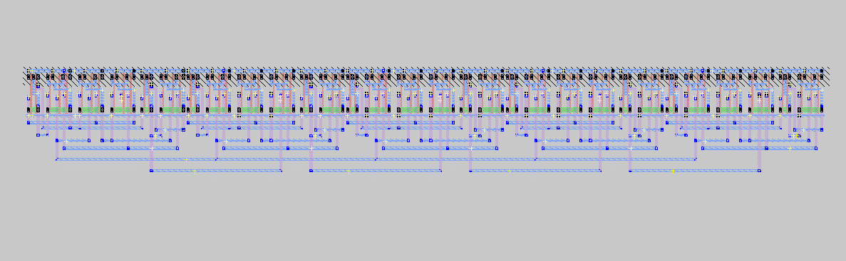
DATAPATH · serial-to-parallel
Shift Register (5-bit) — Magic Layout
LAYOUT
Layout Notes
Layout implements five cascaded D flip-flop stages for serial-to-parallel conversion.
Shared CLK routing synchronizes data shifting across all register stages.
Metal interconnect propagates serial data sequentially through each flip-flop.
Parallel output taps expose reconstructed 5-bit encoded data.
Compact layout organization minimizes routing complexity and propagation delay.
VLSI Project — Pseudo-Random Stream Scrambler
22 / 28

Slide 23
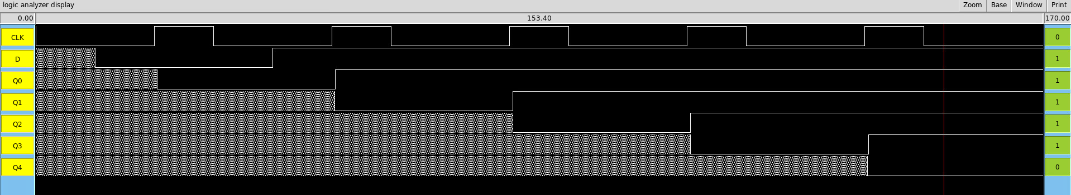
DATAPATH · serial-to-parallel
Shift Register (5-bit) — Simulation
SIMULATION
Simulation Notes
Pulse 1: Serial input SI = 0 enters Q0.
Pulse 2: SI changes to 1. Previous data shifts from Q0 to Q1.
Pulse 3: Data continues shifting through Q2 while new input enters Q0.
Pulse 4: Stored bits propagate through the register stages.
Pulse 5: Final shifted data reaches output stage Q4.
VLSI Project — Shift Register
23 / 28

Slide 24
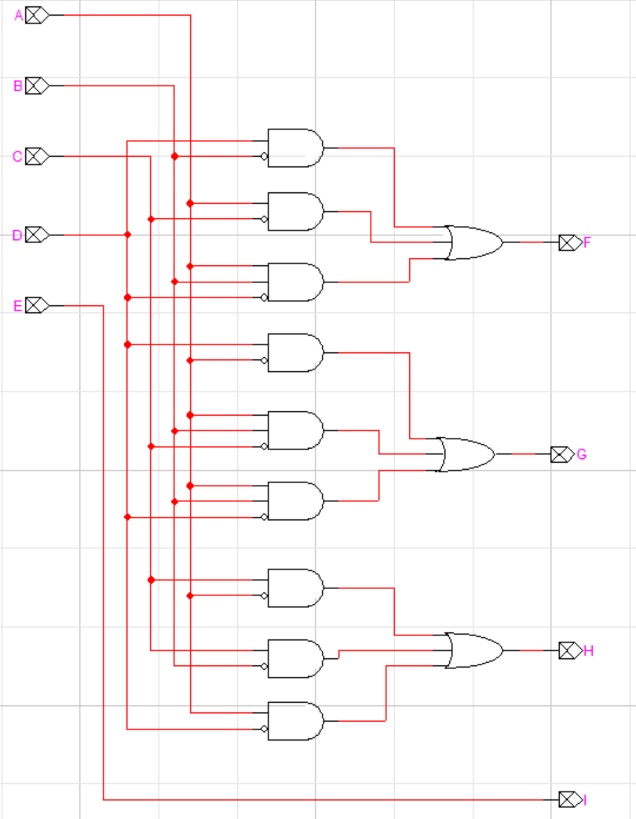
DATAPATH · output-side decoder
Decoder (5 → 4) — Schematic
SCHEMATIC
Function & Notes
Converts the 5-bit shift register output into 4-bit decoded data.
Outputs F, G, H, and I drive the indicator LEDs.
Reconstructs the original 4-bit data from the encoded stream.
Implemented using combinational logic gates.
VLSI Project — Pseudo-Random Stream Scrambler
24 / 28

Slide 25
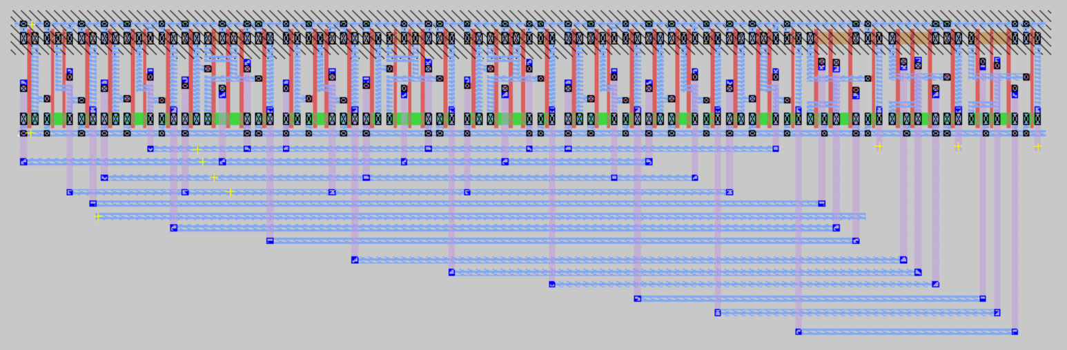
DATAPATH · output-side decoder
Decoder (5 → 4) — Magic Layout
LAYOUT
Layout Notes
Decoder layout implements the 5B/4B combinational decoding network.
PMOS and NMOS transistor paths generate outputs F, G, H, and I.
Metal routing distributes shift register outputs to decoding logic gates.
Hierarchical layout organization simplifies decoder signal routing.
Layout verified through Magic VLSI implementation and simulation.
VLSI Project — Decoder
25 / 28

Slide 26
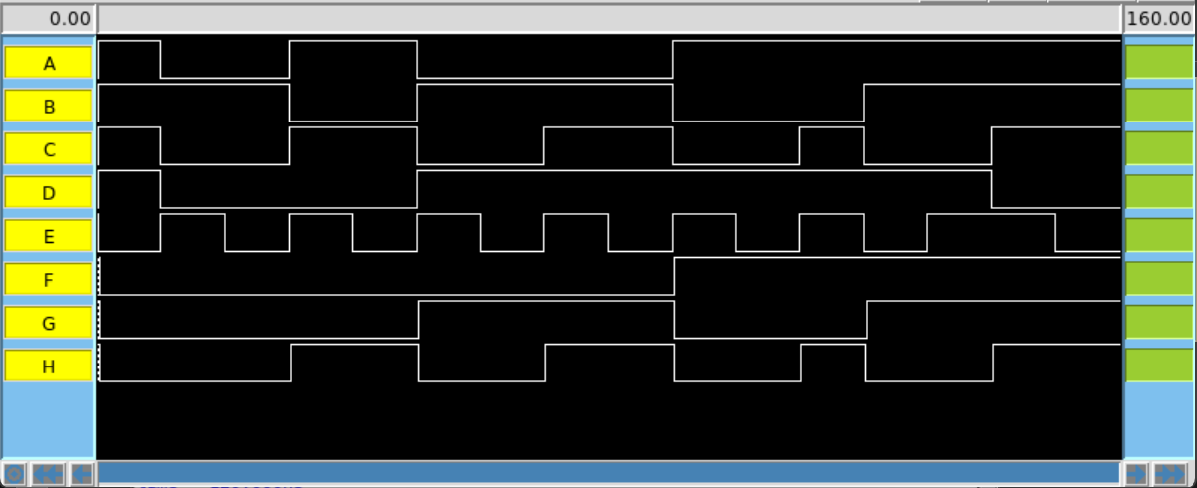
DATAPATH · output-side decoder
Decoder (5 → 4) — Simulation
SIMULATION
Simulation Notes
Simulation verifies correct 5B/4B decoding behavior.
Inputs A–E apply encoded 5-bit patterns from the shift register.
Outputs F, G, H, and E_I reconstruct the original 4-bit data.
Waveforms confirm correct decoder output transitions for each test case.
Decoder functionality verified using IRSIM waveform analysis.
VLSI Project — Pseudo-Random Stream Scrambler
26 / 28

Slide 27
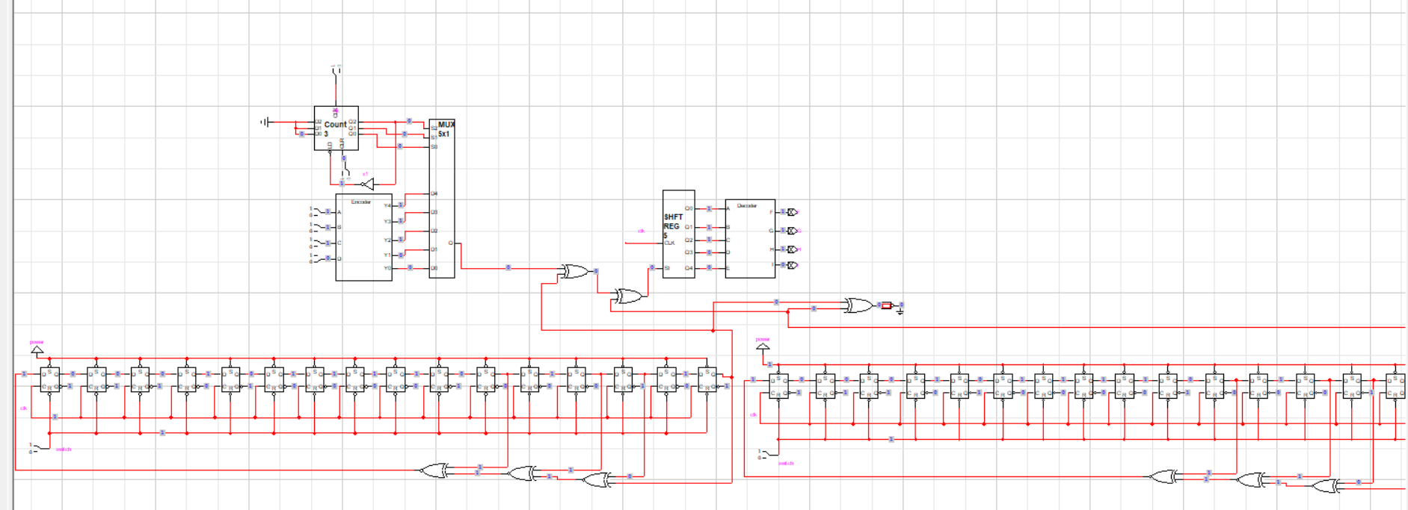
FULL CIRCUIT
Top-Level Integration
INTEGRATED
Integration Notes
All functional blocks operate under a shared clock domain.
Encoder, Counter, and MUX form the transmit-side datapath.
Dual LFSRs and XOR gates implement the scrambling stage.
Shift Register and Decoder reconstruct the received data stream.
Full-system integration verified through schematic simulation and testing.
VLSI Project — Final Schematic
27 / 28

Slide 28
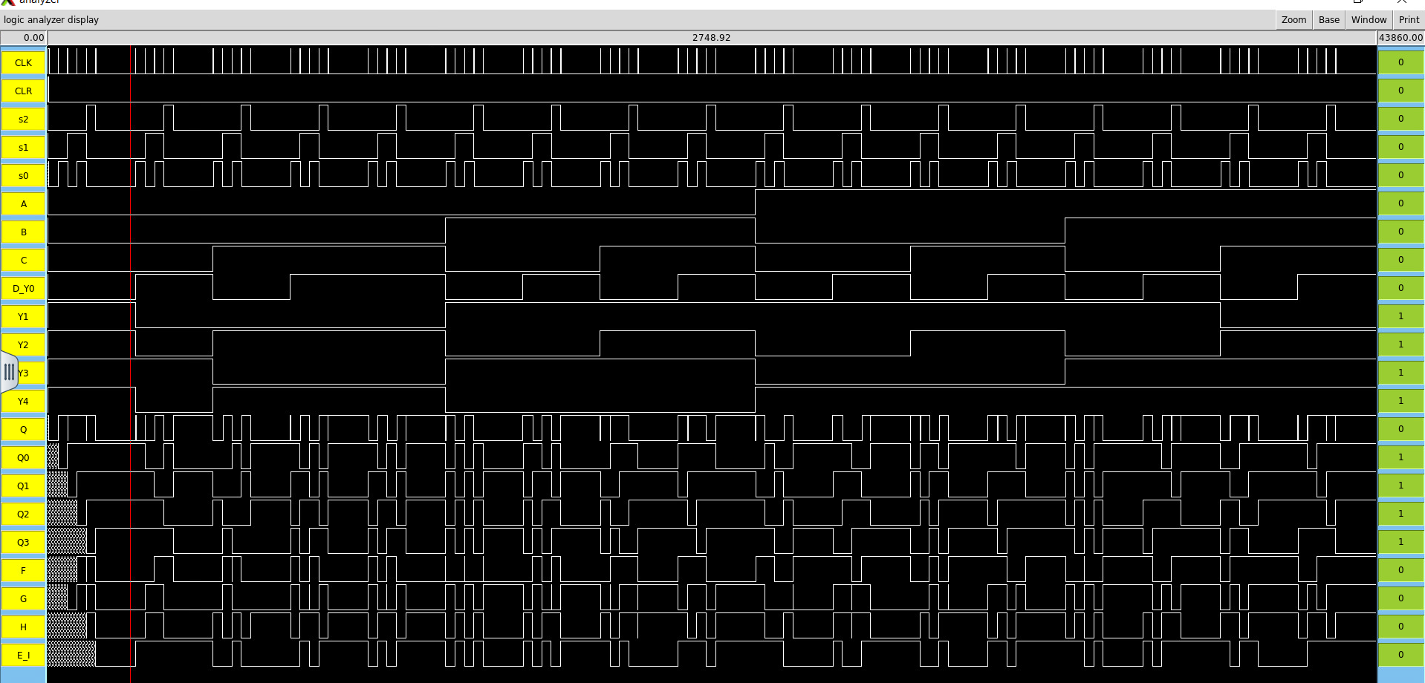
RESULTS
Top-Level Simulation & Conclusion
SIMULATION
Conclusion
Encoder, Counter, and MUX successfully serialize the input data stream.
Dual LFSRs generate pseudo-random scrambling sequences.
Cascaded XOR stages scramble the transmitted bit stream.
Shift Register and Decoder recover the original 4-bit output data.
Full-system simulation verified correct functional operation.
Future improvements include wider datapaths, enhanced LFSR structures, and ASIC implementation.
VLSI Project — Final simulation
28 / 28

