Slide 1




P. R. Pote (Patil) College of Engineering & Management, Amravati
(An Autonomous Institute)
Department of Artificial Intelligence and Data Science
Presentation on
Image Classification Using transfer learning
Presented By
Ishwari Kshirsagar
Monika Yawale
Janhavi Baraskar
Vaishnavi Baraskar
Guided By
Prof. P. D. Bharsakle
Year 2024-25
Notes:
qqqq

Slide 2
Abstract
This project focuses on image classification using transfer learning, a cutting-edge machine learning approach. Transfer learning leverages pre-trained deep learning models, such as VGG16, ResNet, or Inception, to classify images into distinct categories. By fine-tuning these models on a custom dataset, the project efficiently achieves high accuracy with reduced computational effort. The methodology involves feature extraction and model adaptation to specific datasets, demonstrating its utility in domains like medical imaging, facial recognition, and object detection. This project highlights the potential of transfer learning in enhancing classification tasks by reducing training time and optimizing performance.
Keywords: Image Classification, Transfer Learning, Deep Learning, Pre-trained Models, VGG16, ResNet, Feature Extraction, Object Detection.
AI&DS Department, PRPCEM

Slide 3

Introduction
The project focuses on solving classification problems using transfer learning, a powerful technique in deep learning.
Transfer learning allows us to reuse pre-trained models on new but related tasks, reducing training time and improving accuracy.
This approach is especially useful when we have limited labeled data for our classification problem.
The project demonstrates how transfer learning can be applied effectively to image/text classification tasks.
It leverages popular deep learning architectures such as ResNet, VGG, or BERT (based on your use case).
The goal is to achieve high performance with minimal training from scratch by utilizing learned features from large datasets.
AI & DS Department , PRPCEM
2

Slide 4
AIM & Objectives
Aim:
To develop an efficient classification model using transfer learning techniques to improve performance on limited data.
Objectives:
To understand and implement the concept of transfer learning in deep learning.
To select and utilize a suitable pre-trained model (e.g., VGG16) based on the classification task.
To preprocess and prepare the dataset for training and evaluation.
To compare the performance of the transfer learning model with a baseline (from-scratch) model.
To evaluate the model using appropriate metrics like accuracy, precision, recall, and F1-score.
AI & DS Department , PRPCEM
3

Slide 5
Problem Statement
Training deep learning models from scratch requires large amounts of labeled data and high computational power.
In many real-world scenarios, collecting and labeling data is costly and time-consuming.
Traditional models often struggle to generalize well on small or domain-specific datasets.
There is a need for a method that can leverage existing knowledge to perform well even with limited data.
AI & DS Department , PRPCEM
4

Slide 6
Literature Survey
Simonyan & Zisserman (2015): Introduced VGGNet, a deep CNN model widely used in image classification and transfer learning due to its simple architecture.
Deep Transfer Learning for Image Classification: A Survey (2022): A detailed review of how transfer learning is applied in image classification, discussing various strategies and performance comparisons.
Transfer Learning via Model Risk Analysis (2024): Focused on text classification with limited data, introducing a model risk approach to adapt pre-trained models to new tasks.
AI & DS Department , PRPCEM
5

Slide 7
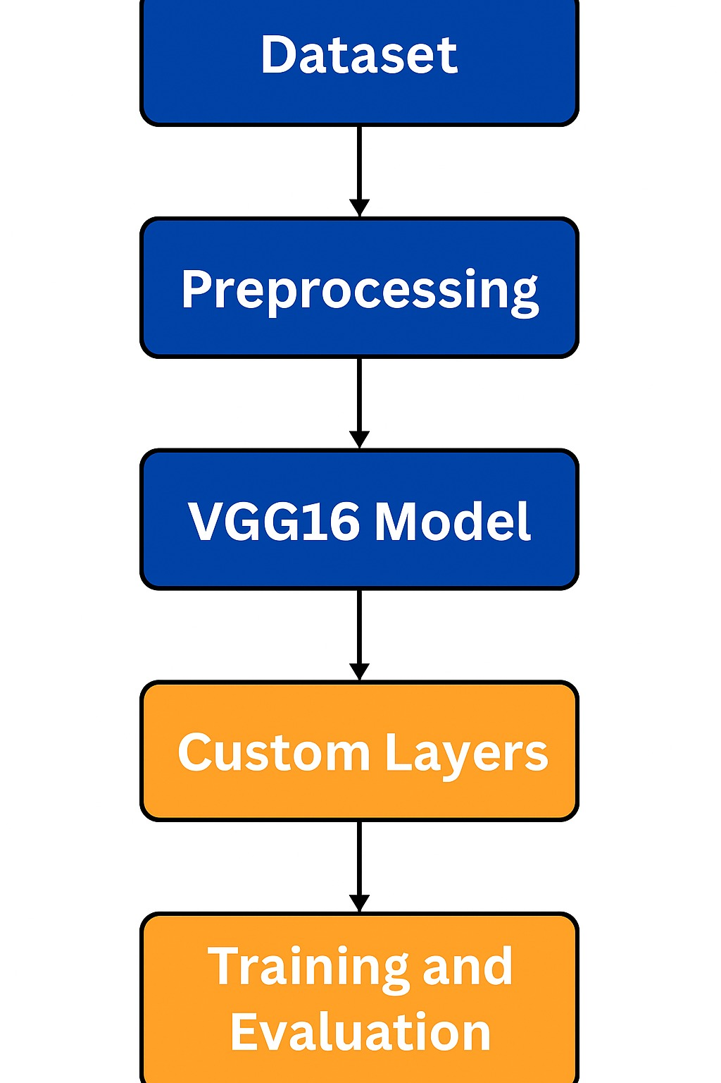
Idea / Methodology
Dataset Preparation: Images of cats and dogs organized into training and testing folders.
Preprocessing: Images resized, normalized, and augmented for better learning.
Transfer Learning: Used a pre-trained model (VGG16) as the base.
Model Training: Fine-tuned the model on our dataset using dense layers.
Evaluation: Measured accuracy and loss on training and validation sets.
AI & DS Department , PRPCEM
6

Slide 8
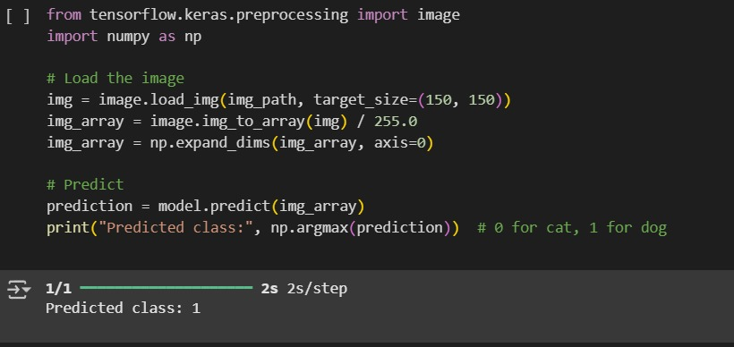
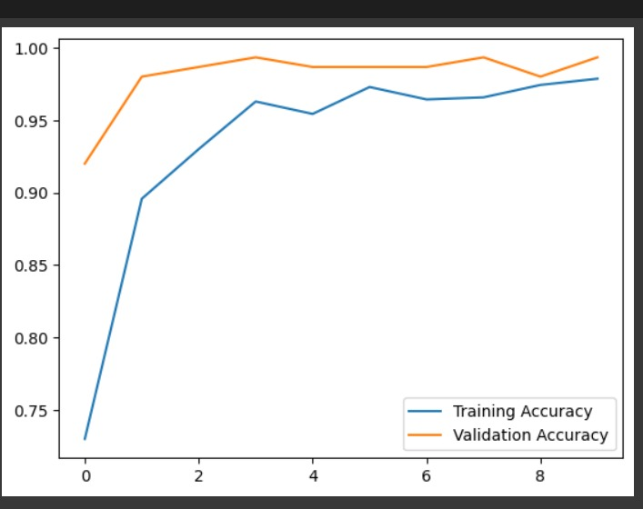
Screen shots/ Results
AI & DS Department , PRPCEM
8

Slide 9
Result Analysis
The transfer learning model achieved high accuracy with significantly less training time compared to training from scratch.
Evaluation metrics used:
Accuracy
F1-Score
The model showed strong performance even with limited labeled data.
Comparison with a baseline model showed that transfer learning yielded better generalization and faster convergence.
Performance was tested on a validation/test set to avoid overfitting.
AI & DS Department , PRPCEM
9

Slide 10
Opportunities and Challenges
Opportunities:
Enables high performance even with limited labeled data.
Reduces training time and computational cost using pre-trained models.
Can be applied to various domains: medical imaging, NLP, agriculture, remote sensing, etc.
Opens up research possibilities in model optimization, domain adaptation, and low-resource learning.
Challenges:
We realized that if the dataset is too small or unbalanced, the model can overfit, meaning it performs well on training data but poorly on new data.
The quality of images matters a lot. If an image is blurry or unclear, the model can get confused and give wrong predictions.
Lastly, since VGG16 is a deep model, training can be slow without GPU support, especially with large image datasets.
AI & DS Department , PRPCEM
10

Slide 11
Conclusion
Transfer learning proved to be an effective approach for classification tasks, especially when working with limited labeled data.
The use of pre-trained models significantly reduced training time and improved performance.
Fine-tuning helped the model adapt to the target dataset while preserving learned features from the source dataset.
The model achieved high accuracy and efficiency compared to a baseline model trained from scratch.
This project highlights how transfer learning bridges the gap between deep learning and real-world applications with fewer resources.
AI & DS Department , PRPCEM
12

Slide 12
References
https://www.kaggle.com – for dataset
https://keras.io – for deep learning libraries
https://www.tensorflow.org – for model trainingResearch papers and blogs on Transfer Learning and CNNs
AI & DS Department , PRPCEM
13

