Slide 1
DOCUMENTATION
Diffie-Hellman Key Exchange Algorithm combined with AES Symmetric Encryption between two communicating parties
Table of Contents
Introduction
Background
Implementation Details
Environment Setup
Diffie-Hellman Key Exchange
AES Encryption and Decryption
Communication Simulation
Running the Program
Source Code Explanation
Running Program
Conclusion
Degenbaev Iskender

Slide 2
Introduction
In today's digital world, ensuring secure communication over insecure channels is of paramount importance. Cryptographic protocols play a crucial role in achieving this goal.
Background
The Diffie-Hellman key exchange algorithm is a cornerstone of modern cryptography. It allows two parties to securely establish a shared secret key over an insecure communication channel. AES (Advanced Encryption Standard) is a symmetric encryption algorithm widely used for encrypting and decrypting data securely.
Implementation Details
This project is a simple implementation created by a student for educational purposes. It involves generating Diffie-Hellman keys for two parties, exchanging public keys, computing a shared secret key, and using AES encryption and decryption for secure communication.
Environment Setup
Before running the program, ensure you have Python installed on your system. Additionally, you need to install Cryptography library using the following command: pip install cryptography

Slide 3
Diffie-Hellman Key Exchange
The Diffie-Hellman key exchange algorithm involves several steps:
Generating Diffie-Hellman keys for both parties.
Exchanging public keys securely.
Computing a shared secret key using each party's private key and the received public key.
AES Encryption and Decryption
AES encryption and decryption are performed using the shared secret key obtained from the Diffie-Hellman key exchange. This ensures the confidentiality of the communication between the parties.
Communication Simulation
The simulation involves two parties, Alice and Bob, exchanging messages securely:
They generate Diffie-Hellman keys and exchange public keys.
They compute a shared secret key.
They use the shared secret key for AES encryption and decryption of messages.

Slide 4


Running the Program
To run the program, execute the Python script “secure_communication.py”. The program will simulate secure communication between Alice and Bob.
Source Code Explanation
Alice and Bob generate their Diffie-Hellman key pairs
Exchange public keys
Load public keys
Generate shared keys
Encrypt and decrypt a message using the shared key

Slide 5
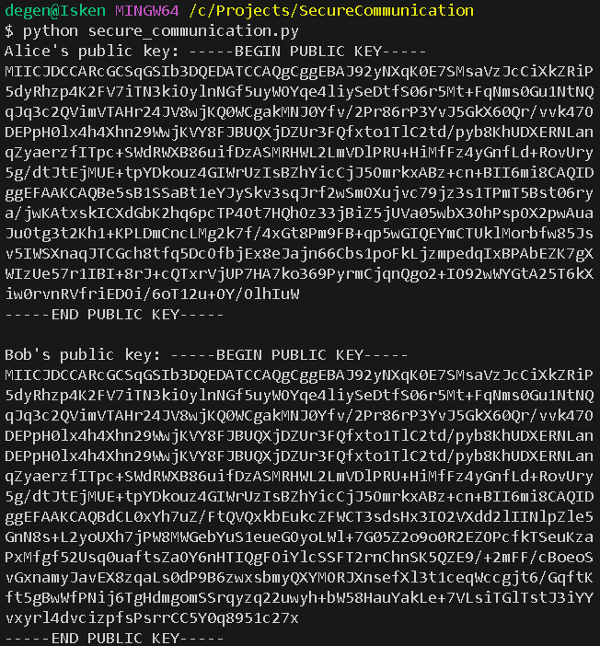
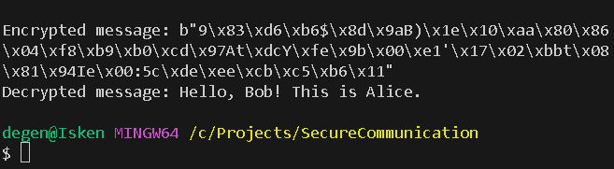
Running Program

Slide 6
Conclusion
This project demonstrates the basic implementation of secure communication using the Diffie-Hellman key exchange algorithm and AES encryption. While simple, it highlights the fundamental concepts of cryptographic protocols and their role in ensuring secure communication.
I've added everything I could to the documentation. I might have missed something, probably because I haven't slept in three days. LOL

