Slide 1
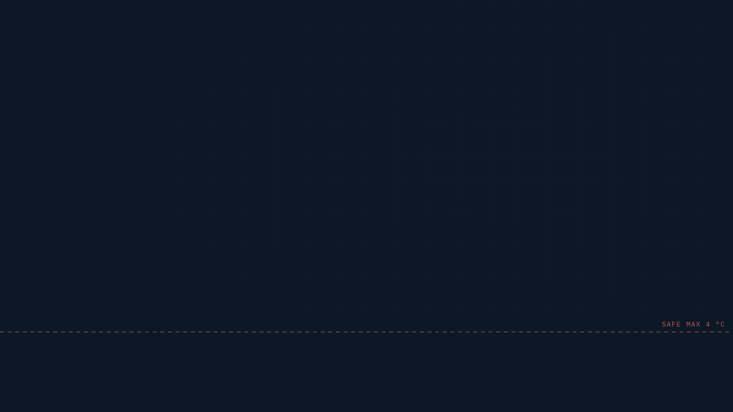








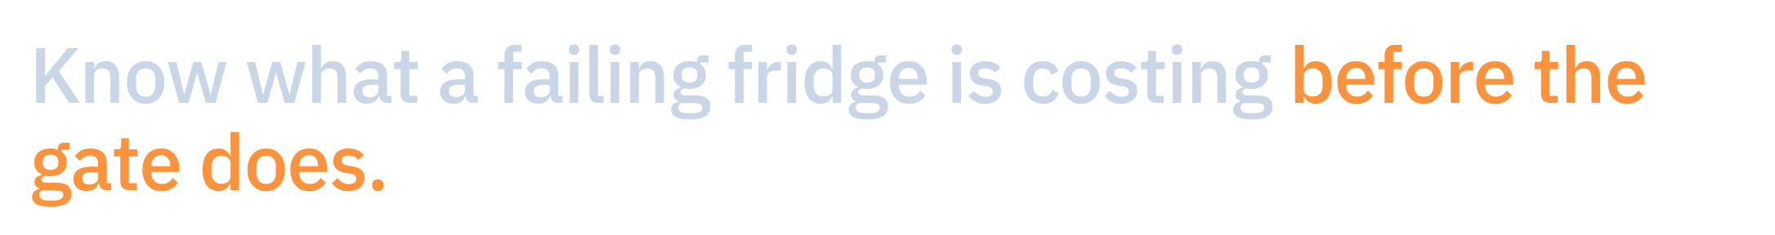


Notes:
Open with who we are, then the product in one sentence, then the ask up front. Pause after the headline. We are Generative Gains, and this is Thermal Trace. It turns a cargo's temperature history into two numbers: how much safe life it has left, and how much value can still be recovered from it. We are raising QAR 1.85 million, pre-seed, to prove it in the field: Qatar first, then the GCC.

Slide 2


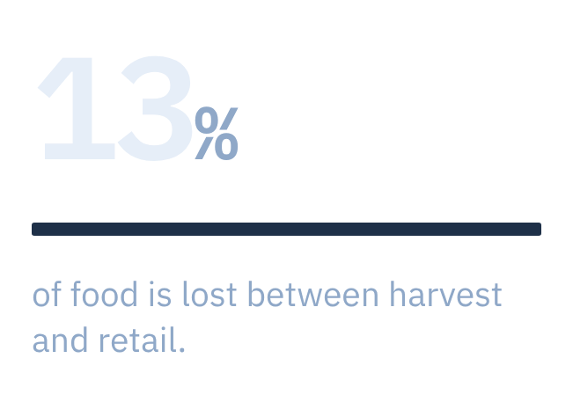
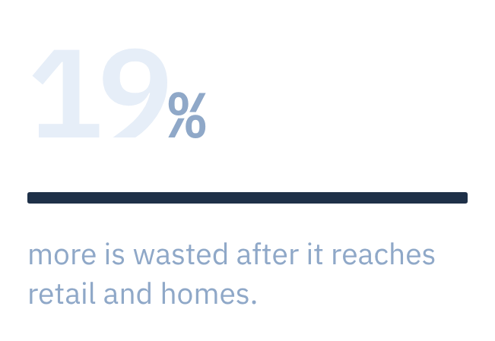
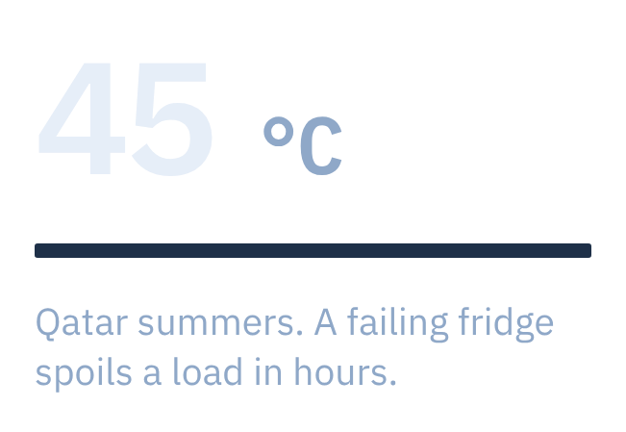
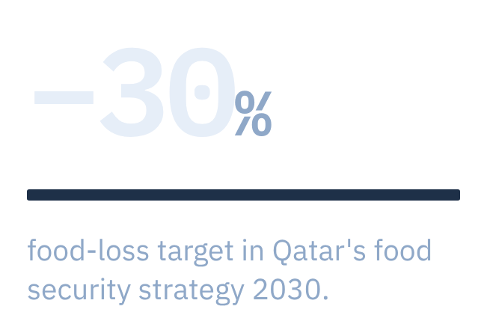




Notes:
One slide, then straight to the product. 13% of food is lost between harvest and retail; another 19% is wasted after (FAO / UNEP 2024). This is UN SDG target 12.3, and it serves SDG 2 and SDG 13.
Make it local in one breath: Qatar imports most of its fresh food across summers above 45 °C, and the National Food Security Strategy 2030 targets −30% food loss. Today's systems raise an alarm; none of them says how much value is left.

Slide 3


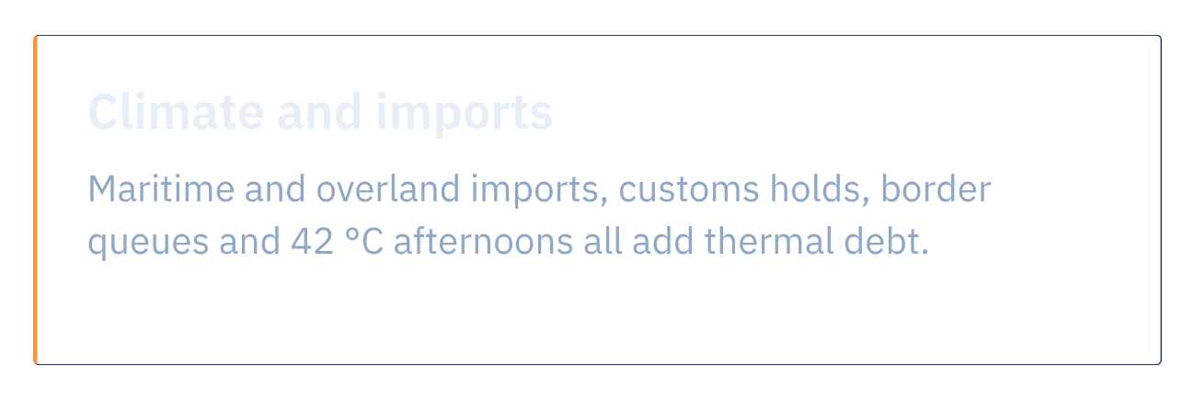
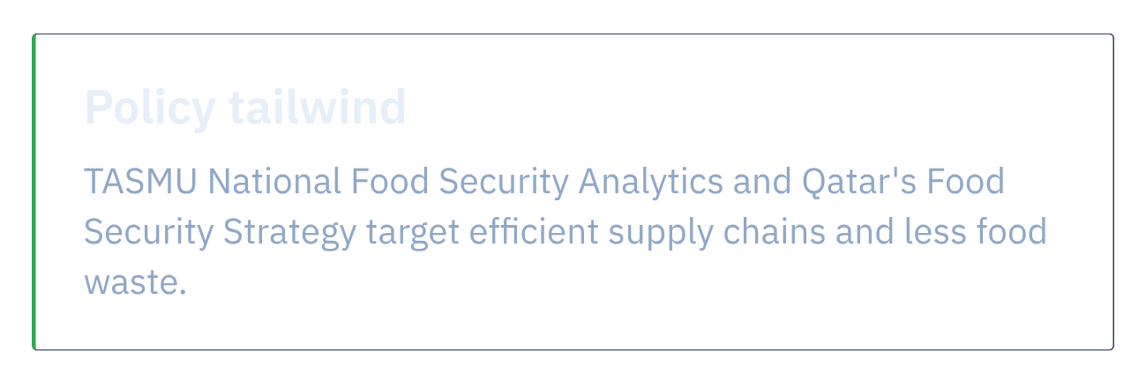
Notes:
Why we start in Qatar. It is an import-dependent region with a brutal summer. Food arrives by sea and over land, waits in customs holds and border queues, and crosses 42 °C afternoons. Every one of those stops adds thermal debt: shelf life spent before the food reaches a shelf.
And the policy is already pointing the same way: TASMU's National Food Security Analytics and Qatar's National Food Security Strategy target efficient supply chains and less food waste. They work at national level. Thermal Trace is the operator-level layer that complements them: one truck, one cold room, one pallet at a time.

Slide 4

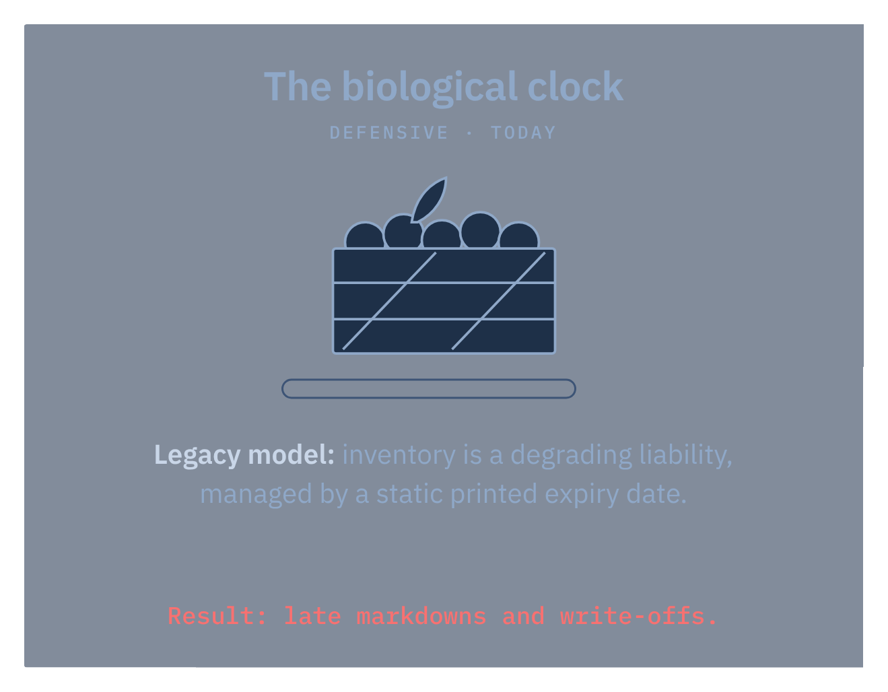
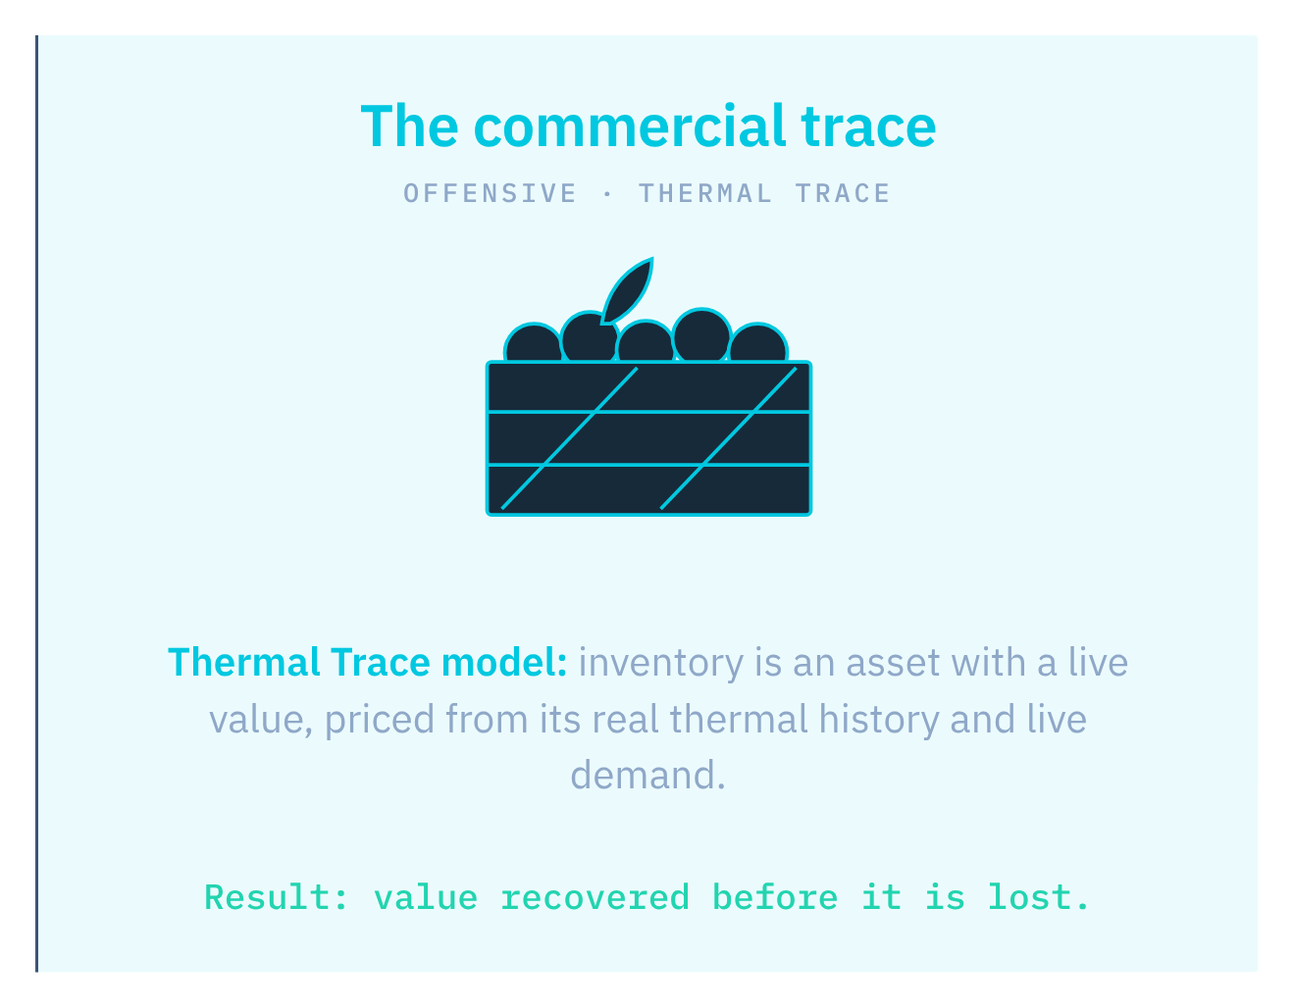




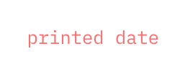


Notes:
This is the whole idea in two pictures. Today a crate of food is treated as a liability that decays toward a printed date. Nobody knows what it is worth until it is marked down or thrown away.
We treat the same crate as an asset with a live value: its real thermal history tells us how long it has, live demand tells us where it sells, and we act while there is still value to recover.

Slide 5

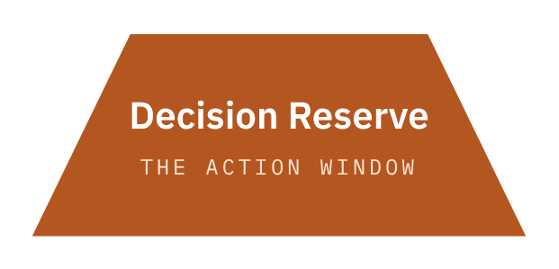
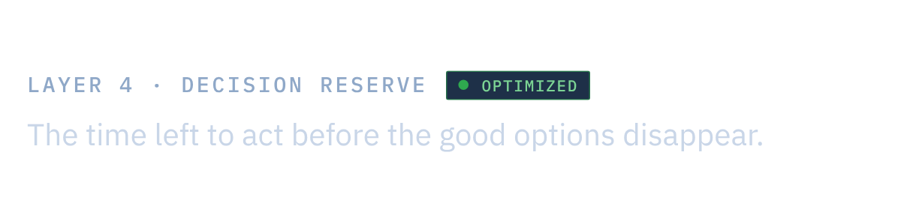


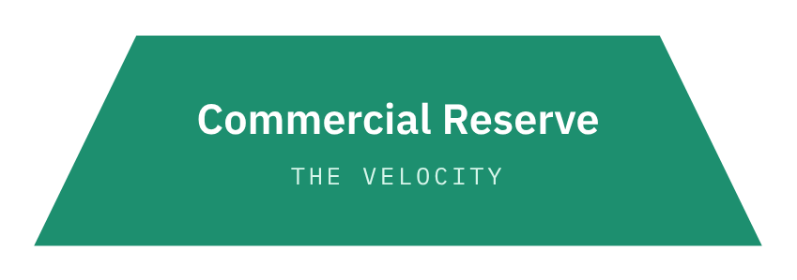
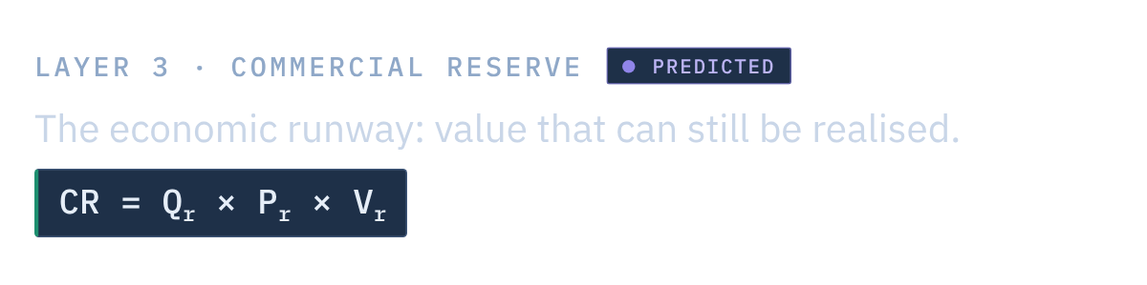

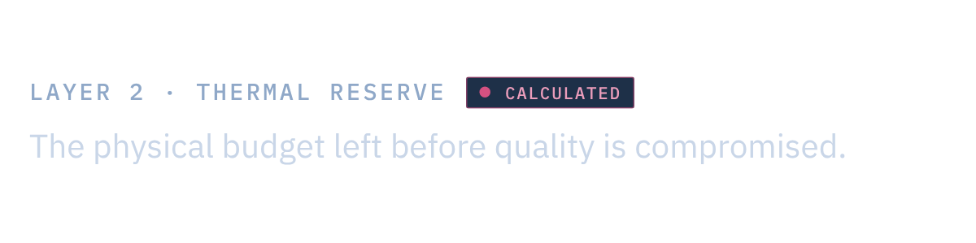

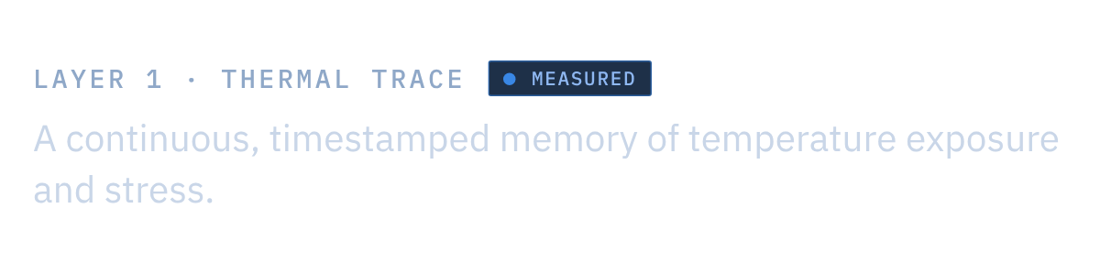
Notes:
This is the spine of the product: four layers, each built on the one below. Layer 1, the Thermal Trace, is ground truth: a continuous, timestamped memory of temperature and stress. Layer 2, the Thermal Reserve, is the physical budget left before quality is compromised. Layer 3, the Commercial Reserve, is the economic runway: how much of that remaining life can still be turned into money, CR = Qr × Pr × Vr. Layer 4, the Decision Reserve, is the window left to act before the good options disappear.
Safety rules stay deterministic at layers 1 and 2. Commercial optimisation runs inside them, never around them.

Slide 6


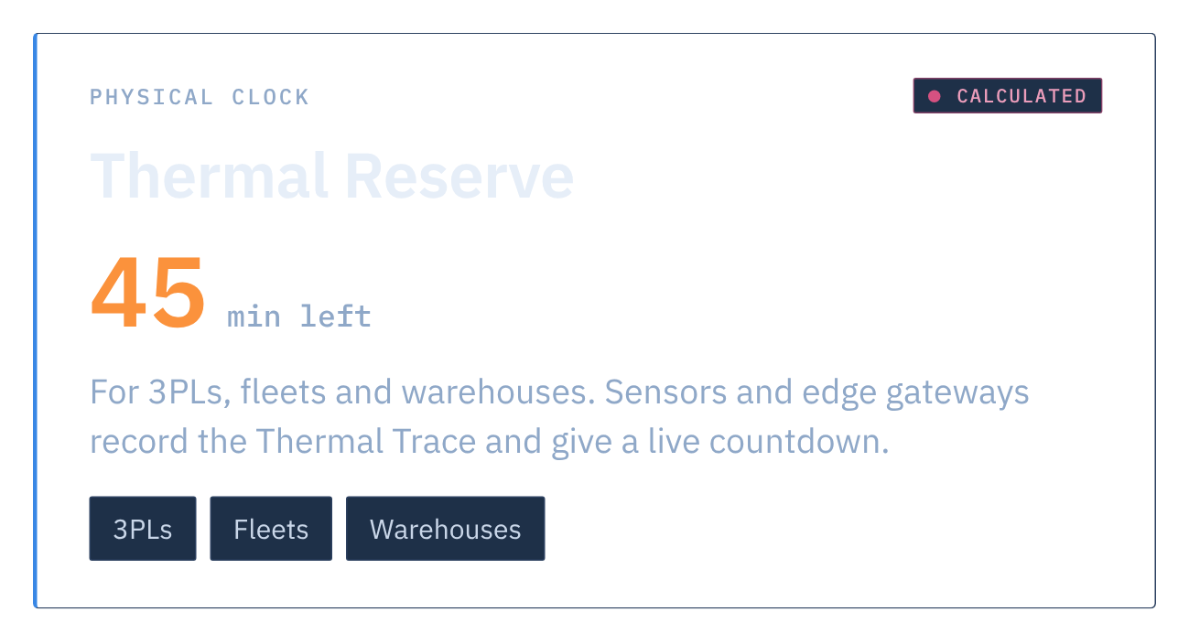
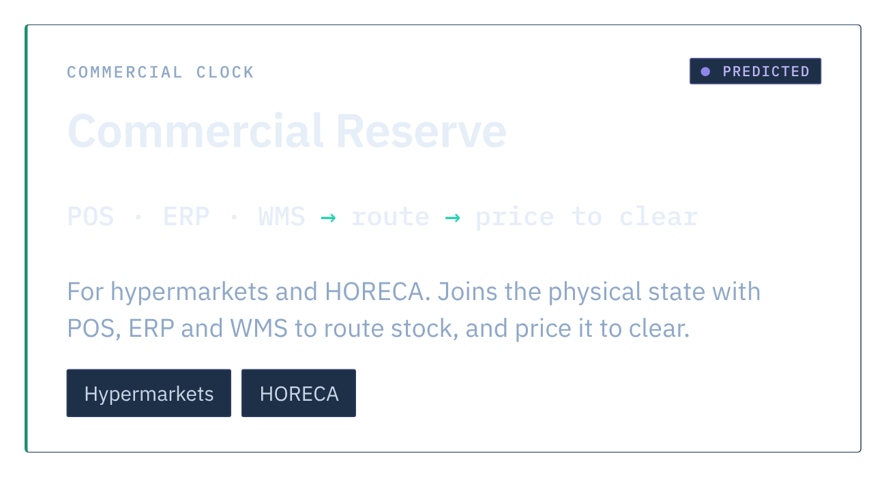
Notes:
One platform, sold as two divisions, each on its own clock. The physical clock is the Thermal Reserve, for 3PLs, fleets and warehouses. Sensors and edge gateways record the Thermal Trace and give a live countdown: this load has, say, 45 minutes left.
The commercial clock is the Commercial Reserve, for hypermarkets and hotels, restaurants and caterers. It joins that physical state with point-of-sale, ERP and warehouse data to route stock to where it sells, and price it to clear.
Thermal Reserve is the entry point. Commercial Reserve follows as a controlled extension, once the physical layer is trusted. The 45 minutes is an example.

Slide 7

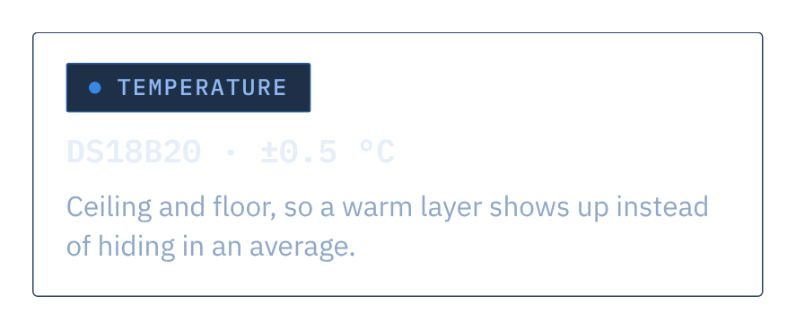
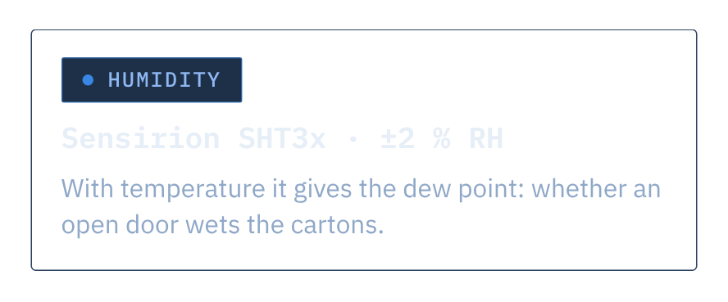
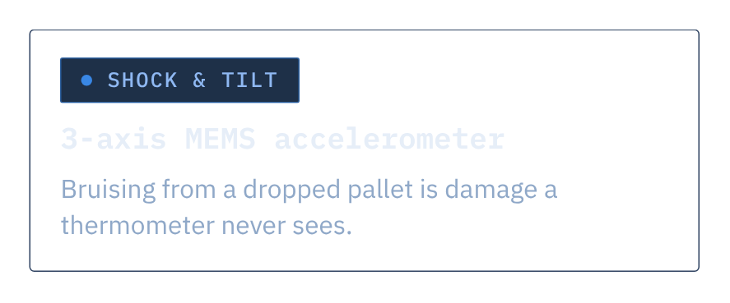
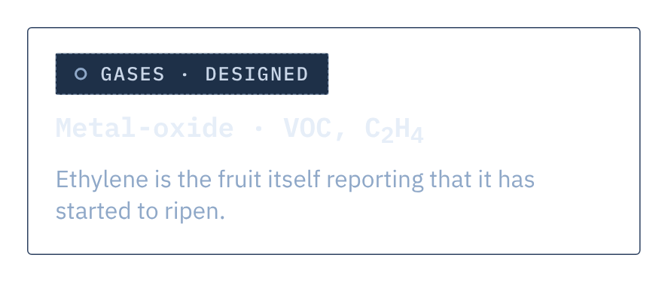
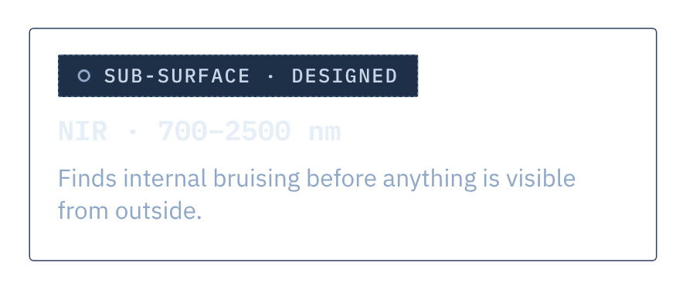
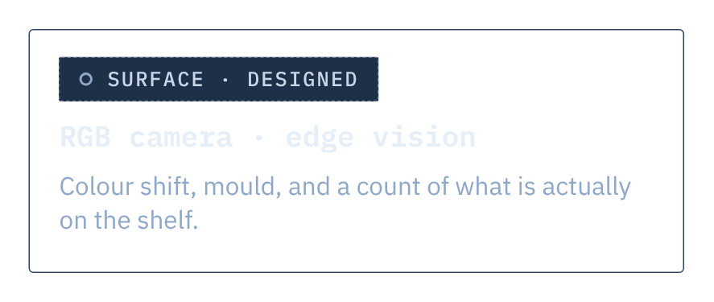
Notes:
One line per sensor if you have time; otherwise read the three outputs at the bottom and move on. Temperature and humidity are the cold chain's vital signs. Shock explains bruising that temperature cannot. Ethylene is the food itself reporting that it has started to ripen. NIR sees inside the box before anything shows outside it, and a camera sees the surface.
Be straight about the tiers: temperature, humidity and shock flow through the pipeline today; gas, NIR and vision are the designed next layer, not built. Every sensor publishes the same MQTT message, so adding one changes nothing downstream.
Then land the point: these six signals exist to produce three numbers - is it deteriorating, how long is it still good for, and how much damage has already been done.

Slide 8


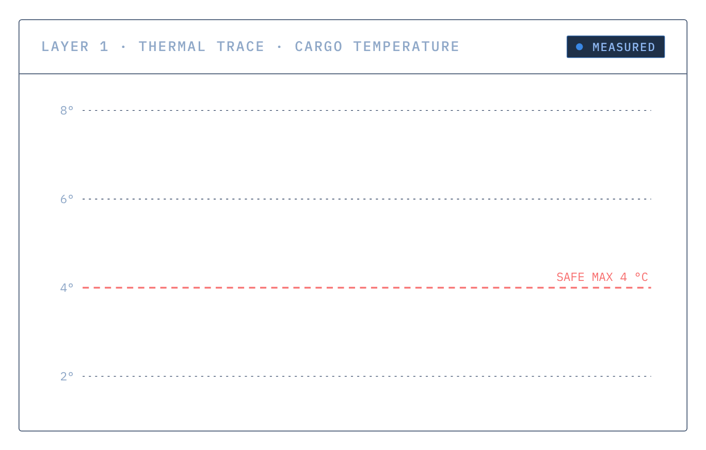
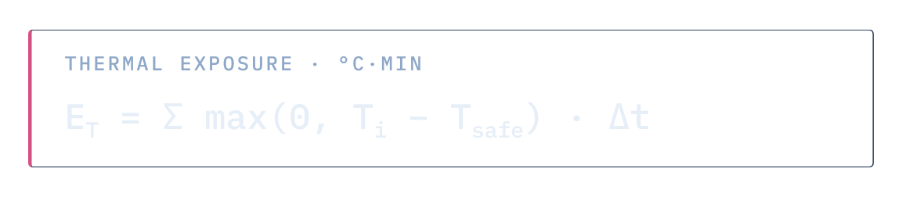
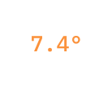
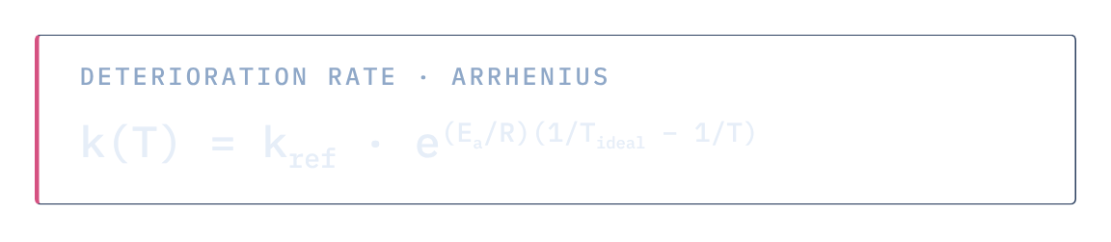


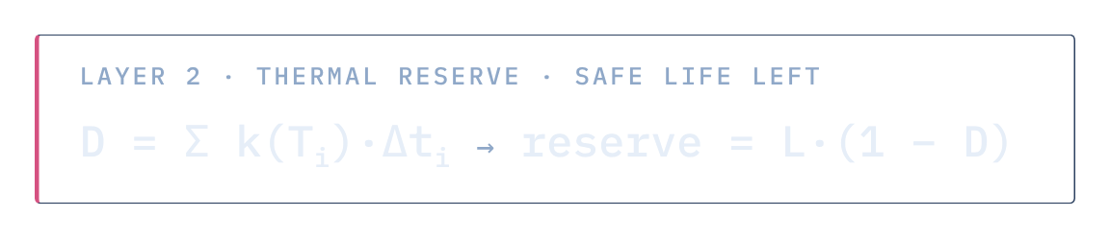
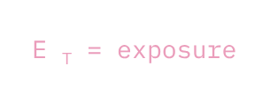

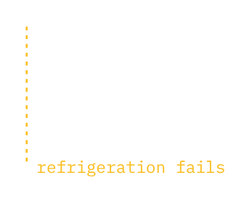
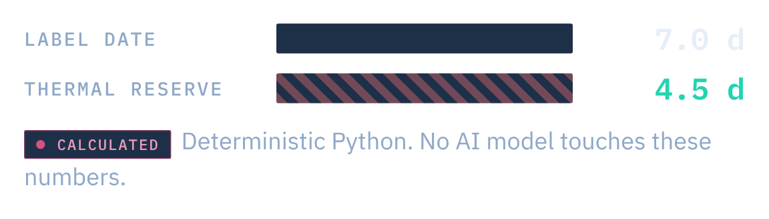


Notes:
The physical foundation, and it is pure physics. Thermal exposure is the sum of the degrees above the safe limit over time: the shaded area. Deterioration runs at an Arrhenius rate relative to the product's ideal temperature. Add it up and you get the share of shelf life already spent, and the Thermal Reserve that is left: L times one minus D.
So a load whose label says seven days can arrive with four and a half. The label assumes it was kept cold the whole way; the trace knows it was not. Every one of these numbers is deterministic Python; no AI model touches them. They are prototype models with literature constants, calibrated per product in the pilot. The 7.0 vs 4.5 days is an example.

Slide 9



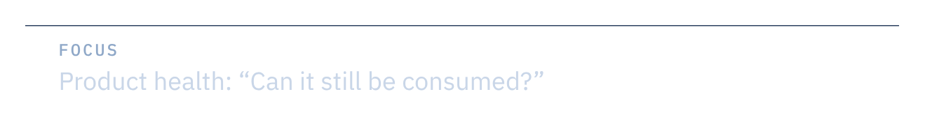
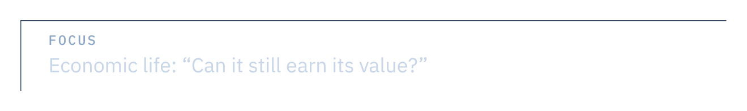
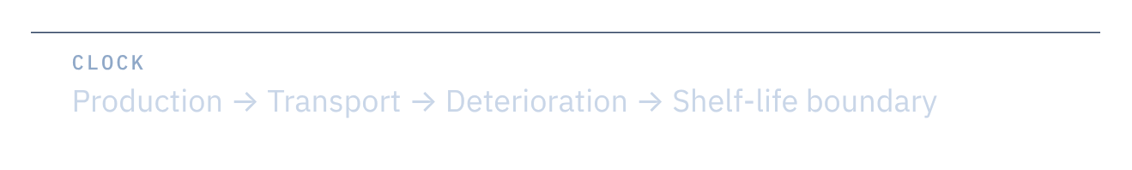
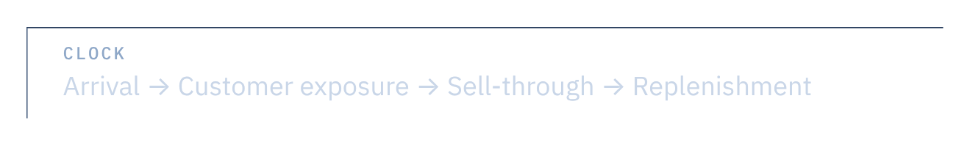
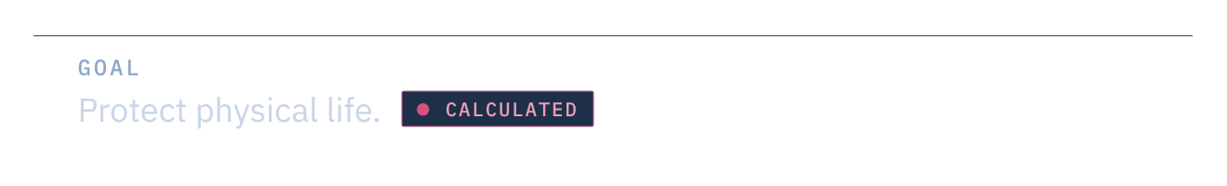
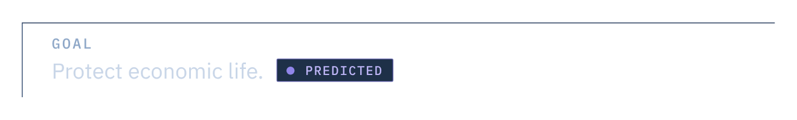
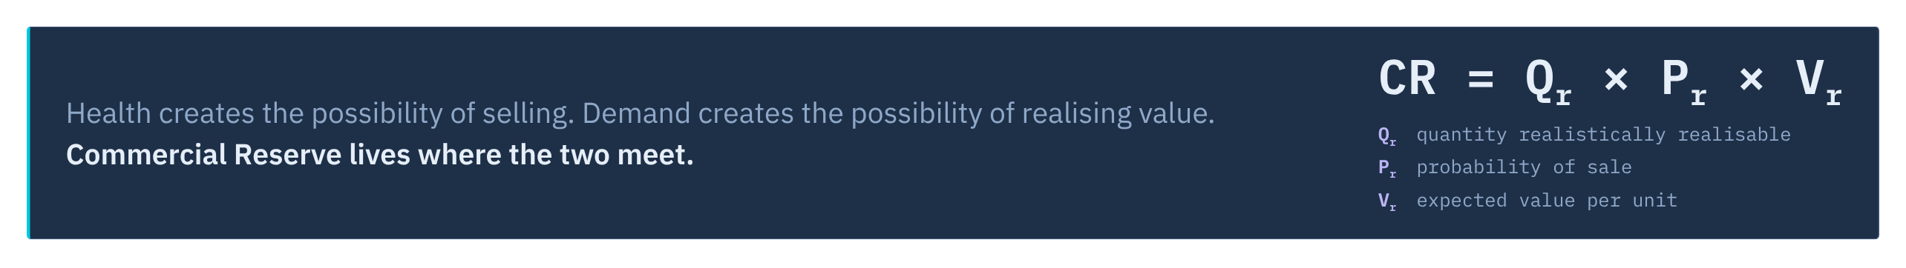
Notes:
Safe is not the same as sellable, and this is where most systems stop thinking. The Thermal Reserve is the physical clock. It asks whether the food can still be eaten, it runs from production through transport to the shelf-life boundary, and its job is to protect physical life.
The Commercial Reserve is the commercial clock. It asks whether the food can still earn its value. It runs from arrival through customer exposure to sell-through and replenishment, and its job is to protect economic life.
Health creates the possibility of selling; demand creates the possibility of realising value. Commercial Reserve lives where the two meet: the quantity that can realistically be sold, times the probability it sells in time, times the expected value per unit. These are estimates with uncertainty; food-safety release always stays with authorised people.

Slide 10


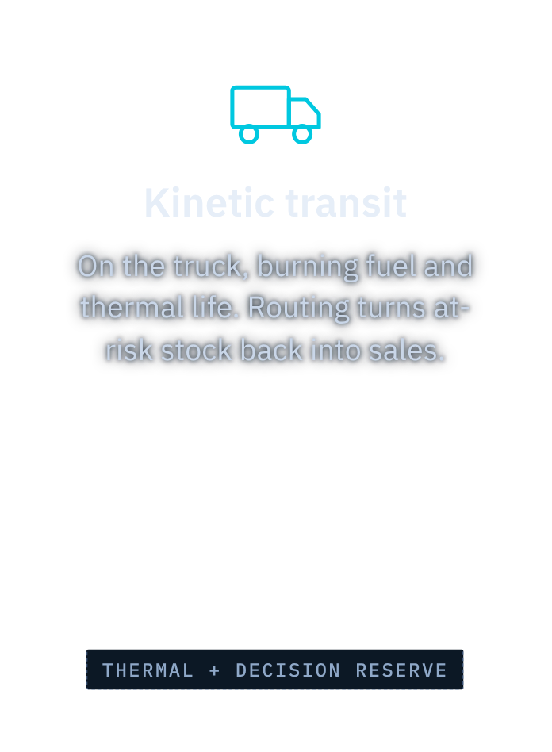
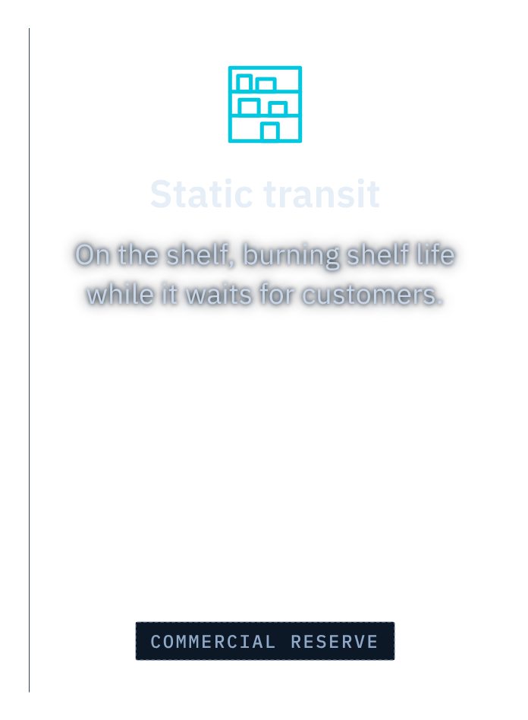
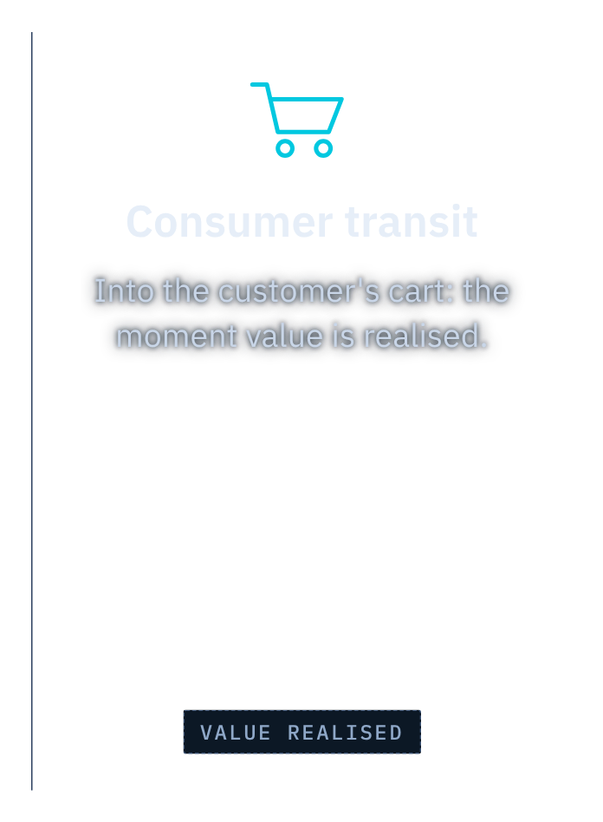
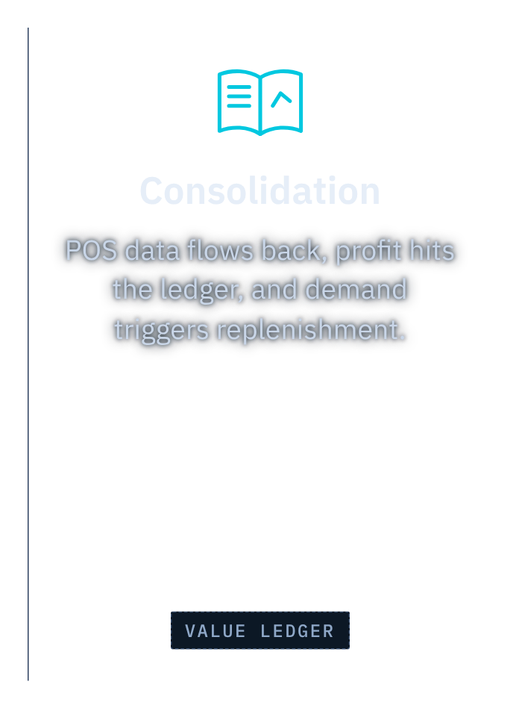

Notes:
We redefine what “in transit” means. A load is in transit until the profit is booked, not until it reaches the dock. Kinetic transit: on the truck, burning fuel and thermal life. This is where routing turns at-risk stock back into sales. Static transit: on the shelf, burning shelf life while it waits for customers; this is the Commercial Reserve's territory. Consumer transit: into the customer's cart, the moment value is actually realised. Consolidation: point-of-sale data flows back, the profit reaches the ledger, and the demand signal triggers replenishment.
The line is the value bleeding away at every stage. The trace follows it from farm to ledger. The curve is illustrative.

Slide 11

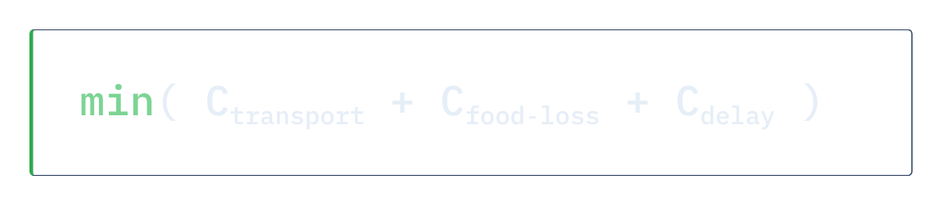
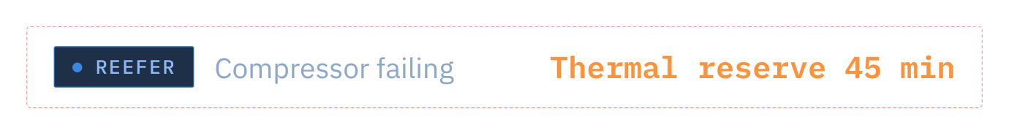
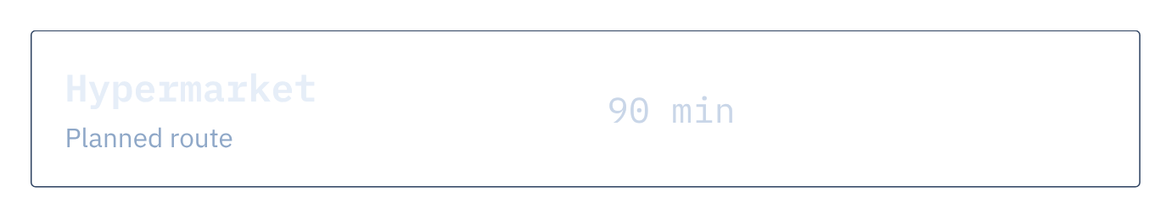
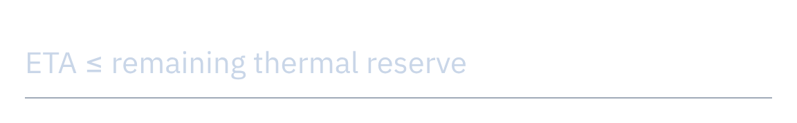


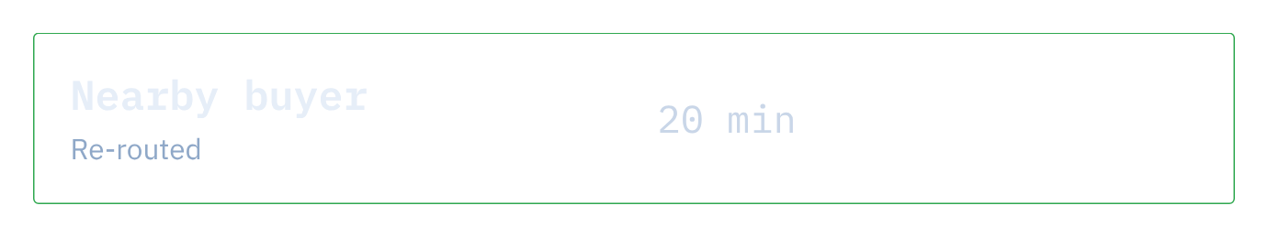



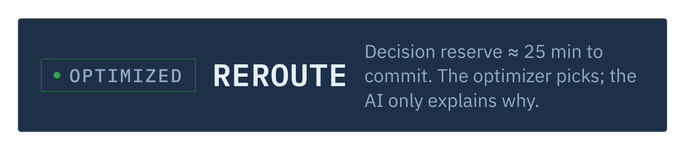
Notes:
The top layer turns reserves into an action, before the window closes. A reefer truck's compressor is failing. The Thermal Reserve says 45 minutes; the planned hypermarket is 90 minutes away, so the load would arrive spoiled. A buyer 20 minutes away fits the reserve. That leaves about 25 minutes to commit: that is the Decision Reserve.
The choice is an optimization, not an opinion: minimise transport, food-loss and delay cost, under hard constraints. The AI layers never pick it: a local model corroborates, a language model explains in plain words, and neither may invent a number. Times are the example scenario.

Slide 12



Notes:
Two AI layers, both on a leash. Laya is System 1: a local, offline, Apache-2.0 decision model. It answers typed questions in a single forward pass (condition, action, urgency, needs human review) and cannot write text, so it cannot invent a number. It corroborates the deterministic decision and never overrides it.
System 2 is DeepSeek V4.1 Flash, a cloud language model reached through OpenRouter, the explainer: it turns code-computed facts into plain language. It may only move the spoilage estimate within a fixed band and only rank options that are already feasible. With no API key the system still runs; only the prose is plainer.
The chips at the bottom are deterministic code, not AI.

Slide 13


Notes:
The shift in one table. The legacy supply chain plays defence: delay spoilage, treat stock as a degrading object, ship by the printed date, wait for a temperature alarm, and absorb waste as an invisible tax.
Thermal Trace plays offence: maximise the value recovered, treat stock as an asset with a live value, ship the lowest Commercial Reserve first out, act through routing and early markdowns, and turn waste into a quantified, bounded value at risk.

Slide 14





Notes:
How it makes money: we price against value we can prove. A paid pilot of 12 to 16 weeks, QAR 100 to 175 thousand depending on sites and integrations. Then an enterprise subscription, QAR 120 to 240 thousand a year, plus implementation fees for heavy installs.
The test we hold ourselves to: measured avoided loss of at least three times the fee. On a QAR 180,000 fee that is QAR 540,000 of benefit, measured against a baseline we agree with the customer up front.
The target for the end of the first year is QAR 300 to 500 thousand of contracted ARR. Prices are hypotheses to validate with customers; the ARR is a target, not a forecast.

Slide 15







Notes:
This is the slide to land. We are raising QAR 1.85 million, about 508 thousand US dollars, as a pre-seed or strategic round, to run for 12 months. 55% builds the core five-person engineering team. 23.5% goes to sensors, deployment, cloud and integration. 10.8% to food-domain validation, customer development and legal. 10.5% is a contingency reserve, released only with documented approval from founders and investors.
What it buys: one anchor customer live at three to five facilities, avoided loss measured at three times our fee or more, Commercial Reserve tested in controlled trials, and an annual contract with a second customer behind it. Every kilogram saved is logged: evidence toward SDG 12.3.
The next five slides show exactly where it goes: the flow, the team, the equipment, the months, and the risks.

Slide 16






































Notes:
Follow one riyal through the round. Of QAR 1.85 million, 1.02 million, 55%, is the engineering team: that is where the product gets built. 435 thousand is hardware and platform: sensors and edge equipment, deployment and calibration, cloud and security, and integration with the customer's systems. 200 thousand is validation and go-to-market: food-safety experts, customer development, and the legal work behind data access and contracts. And 195 thousand is a contingency reserve that nobody can spend without documented approval from founders and investors.
The next three slides open each of those boxes.

Slide 17



Notes:
More than half the round is people, so here is exactly who. Five engineers, one owner per part of the product. A CTO and systems architect owns architecture, scope, data contracts, security and delivery. A thermal-intelligence and data engineer owns the thermal state, exposure, risk models, shelf-life logic and validation. A backend and data-platform engineer owns ingestion, databases, APIs, identity and integrations. An IoT and edge engineer owns sensors, gateways, connectivity, calibration and diagnostics. And an application and workflow engineer owns the operator interface, alerts, approvals and the ERP and warehouse workflows.
QAR 76,000 a month gross, 912,000 a year, plus about 109,000 of employment costs: about QAR 1.02 million. The CEO leads investors, anchor customers and sales. Food-safety experts are hired fractionally from the validation line. These are lean planning assumptions, not guaranteed market rates.

Slide 18


Notes:
The other QAR 830,000, line by line. Hardware and platform, 435 thousand: sensors and edge gateways for three to five facilities across two or three asset classes (cold rooms, reefer trucks, dispatch areas); installing, calibrating and testing them; twelve months of cloud, storage and security; and a few high-value data flows into the customer's product, shipment, ERP and warehouse records.
Validation and go-to-market, 200 thousand: fractional food-safety experts to review the thresholds and shelf-life models; the anchor-customer pilot itself, from site survey to conversion; and the data-access agreements and contracts.
Contingency, 195 thousand: released only with documented approval from founders and investors.

Slide 19









Notes:
How the money turns into proof over twelve months. Months one and two: secure the pilot, survey the sites, agree with the customer how value will be measured, and build the baseline. Three and four: install devices, build ingestion and the asset history, test outages and alerts. Five and six: run the excursion logic, risk estimates and the approved intervention workflow. Seven to nine: compare against the baseline, quantify the value, and start controlled Commercial Reserve tests. Ten to twelve: convert to an annual contract and pursue a second customer.
The team costs about QAR 85,000 a month the whole way through (1.02 million over twelve months). The other lines follow the work; the phasing shown is indicative. The bar the pilot has to clear: measured avoided loss of at least three times the platform fee, linked from the equipment anomaly to the economic exposure.

Slide 20



Notes:
What could go wrong with the money, and what we do about it. Customer data access: we sign data access and a named sponsor before anything is installed. False precision: validated assumptions, uncertainty shown on screen, and domain review. Integration complexity: a few high-value data flows with clear contracts, not a big-bang integration. A long sales cycle: named decision-makers, agreed success criteria and conversion terms in the pilot contract. And building both divisions too early: Thermal Reserve first, Commercial Reserve staged after it.
Behind all of that sits the 10.5% contingency, which needs documented approval from founders and investors to spend.

Slide 21








Notes:
Close on the future, after everything that exists today. Trace, state, reserve, decision is not a food feature; it is a general primitive. Any industry where an asset deteriorates, cures or loses viability under the stress of time needs the same architecture. Biopharma has stability budgets and needs to intercept a shipment before it fails. Energy grids read inverter telemetry and need a flexibility reserve. Space cargo bleeds propellant and cycles thermally and needs a mission reserve. Defence logistics tracks munition shock and degradation for readiness.
We start where the loss is largest and the data is easiest: the food cold chain in Qatar. These are directions, not products we have built. Then: thank you.

Slide 22









Notes:
Leave this up while taking questions. Restate the ask in one line: Generative Gains is raising QAR 1.85 million, for twelve months, to prove Thermal Trace in the field: that a failing fridge's cost can be measured and recovered. Thank you.

