Slide 1

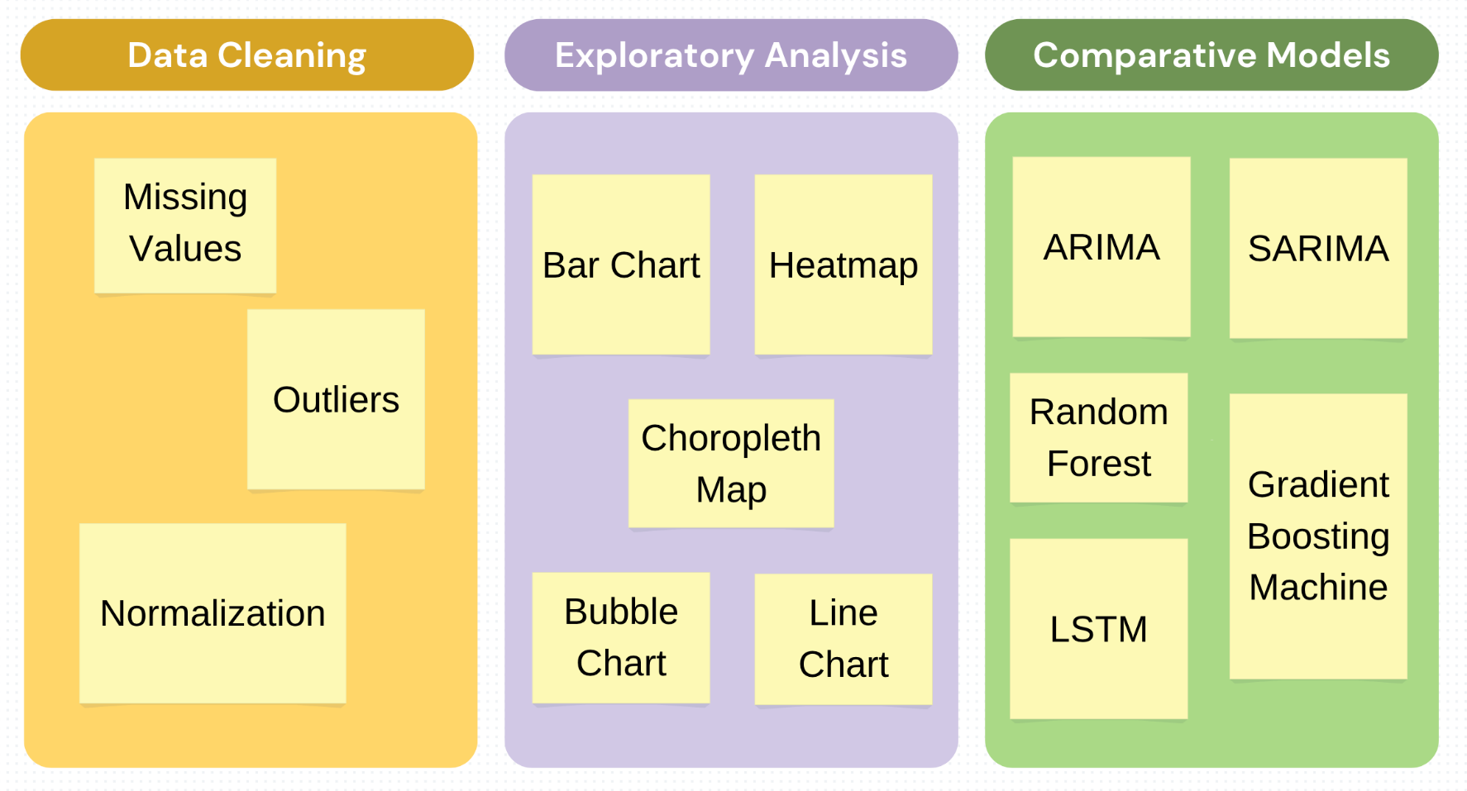
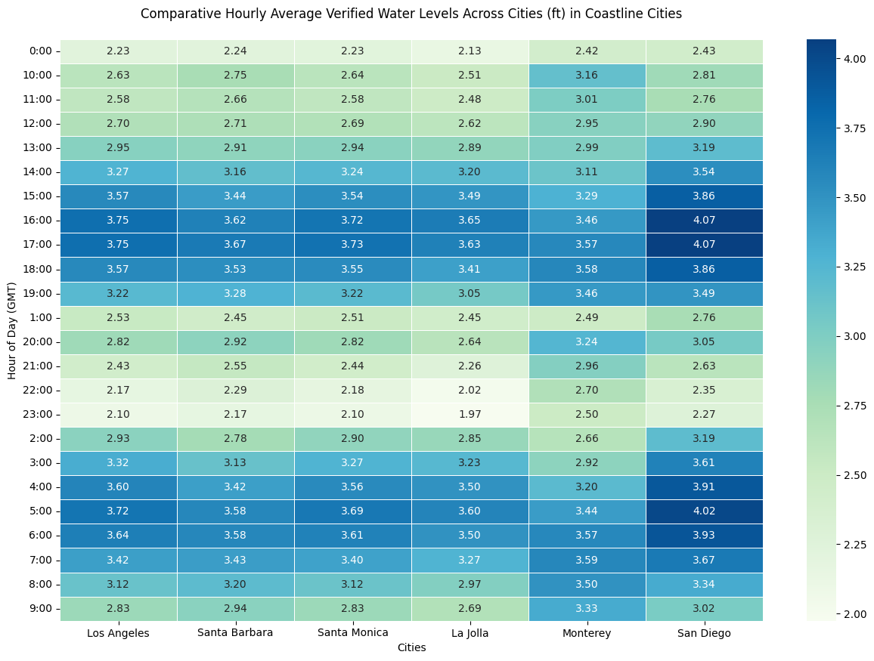
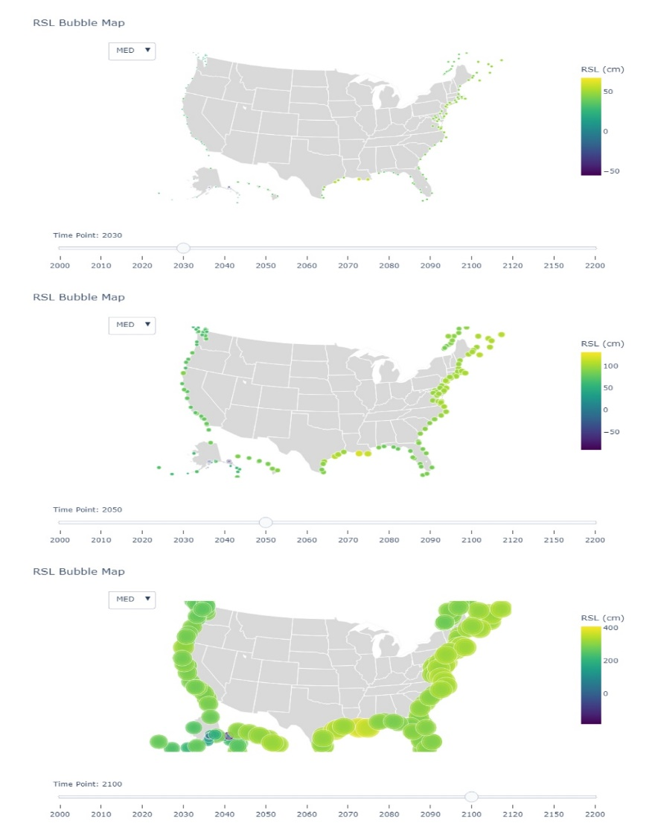
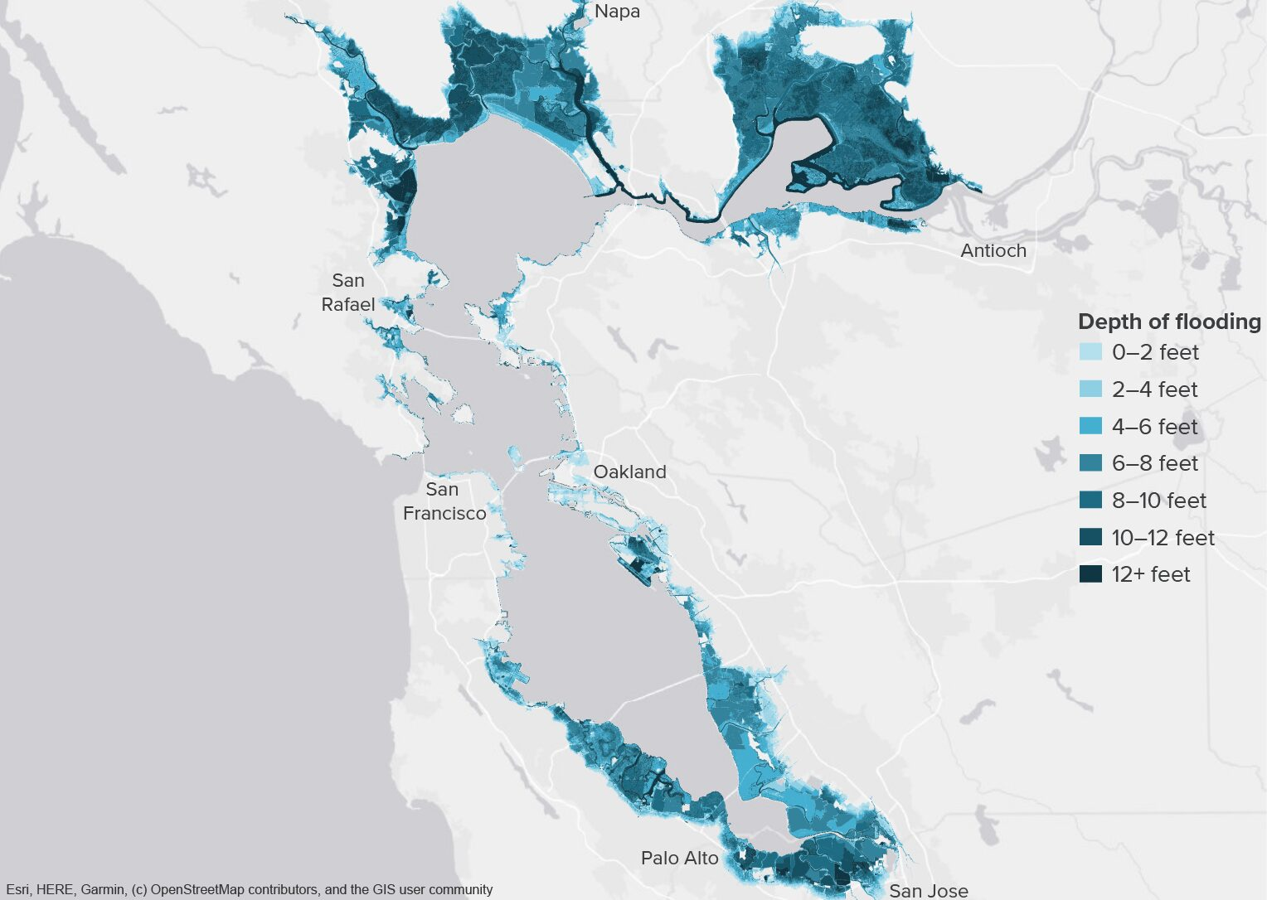
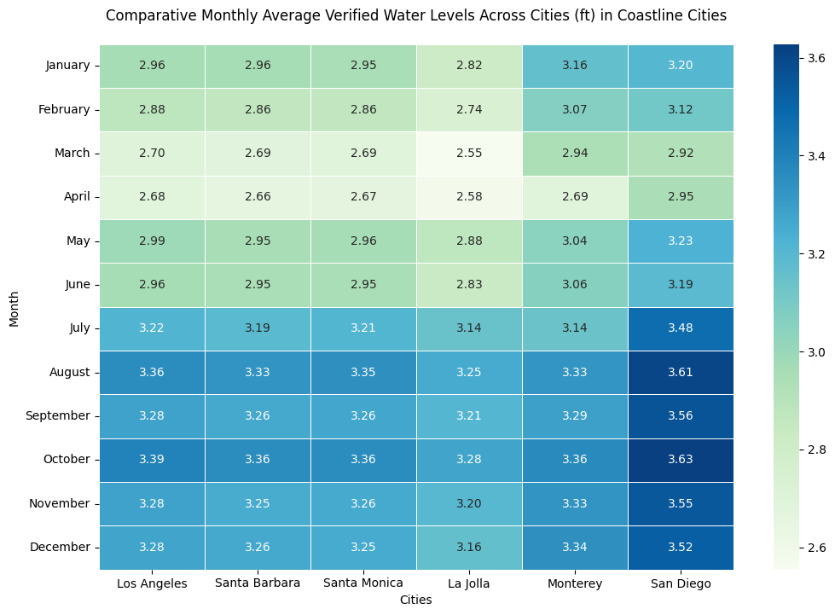
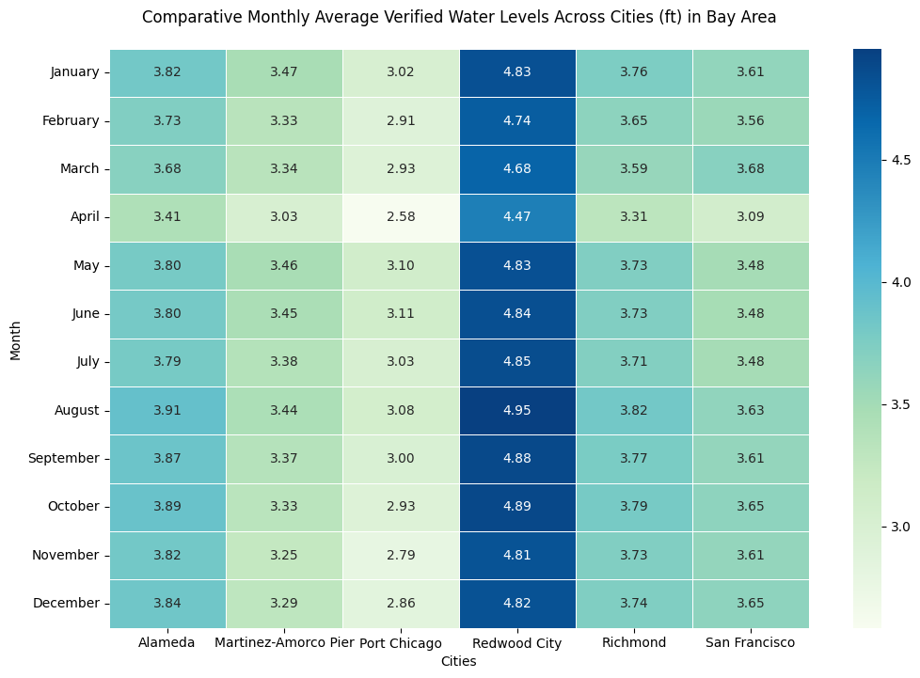
Comparative Analysis of Models for Predicting Coastal Water Levels in California
Hongxin Wu
Georgetown University
Abstract
Materials
Results
This project undertakes the development and comparative analysis of multiple predictive models to forecast coastal water levels along California's coastline with a focus on enhancing accuracy and reliability. Employing time series analysis (ARIMA, SARIMA), machine learning techniques (Random Forest, Gradient Boosting Machines), and deep learning methodologies (LSTM), the study delivers forecasts on two scales: short-term (hourly for the next 24 hours) and long-term (looking ahead to 2050, 2100, and 2200). Data sourced from tide gauges and advanced climate models form the basis of our refined input. Our results underscore the benefits of integrating various modeling approaches, highlighting superior performance in both temporal scales. Additionally, the project champions sustainable scientific practices by rigorously documenting its carbon footprint via CodeCarbon, setting a benchmark for responsible AI usage in environmental research. The findings are expected to significantly influence future coastal resilience strategies, aiding policymakers and community leaders in proactive decision-making.
Data Sources
Tide Gauge Data - Use historical and current sea level records from NOAA’s National Water Level Observation Network. These records provide ground-truth measurements that are essential for validating satellite data and for training and testing the predictive models.
Meteorological Data - Include wind speed, atmospheric pressure, and precipitation data, which are significant drivers of sea level changes and are used to enhance the predictive accuracy of the models.
Add your information, graphs and images to this section.
137088
Data Points
12
Stations
456
Days
Methodology
Add your information, graphs and images to this section.
Introduction
Globally, coastal communities are increasingly vulnerable to the adverse effects of climate change, with rising sea levels threatening both human and ecological systems. In California, where vast populations reside along the coast, the stakes are particularly high, necessitating precise and actionable forecasts of water levels. This project aims to address these urgent needs by synthesizing traditional and contemporary predictive methodologies to create a robust framework for water level forecasting. Our approach combines time series analysis, machine learning, and deep learning to harness the strengths of each, thus optimizing accuracy and reliability across different time frames. By providing detailed hourly forecasts up to 24 hours and strategic long-term projections for the years 2050, 2100, and 2200, the project facilitates immediate emergency responses and aids in the planning and execution of long-term adaptation strategies. This initiative not only advances our understanding of coastal dynamics under changing climatic conditions but also contributes to the broader field of environmental science by implementing ethical AI practices and promoting the sustainable use of technological resources.
Conclusion
Add your information, graphs and images to this section.
References
Add your information, graphs and images to this section.

