Slide 1
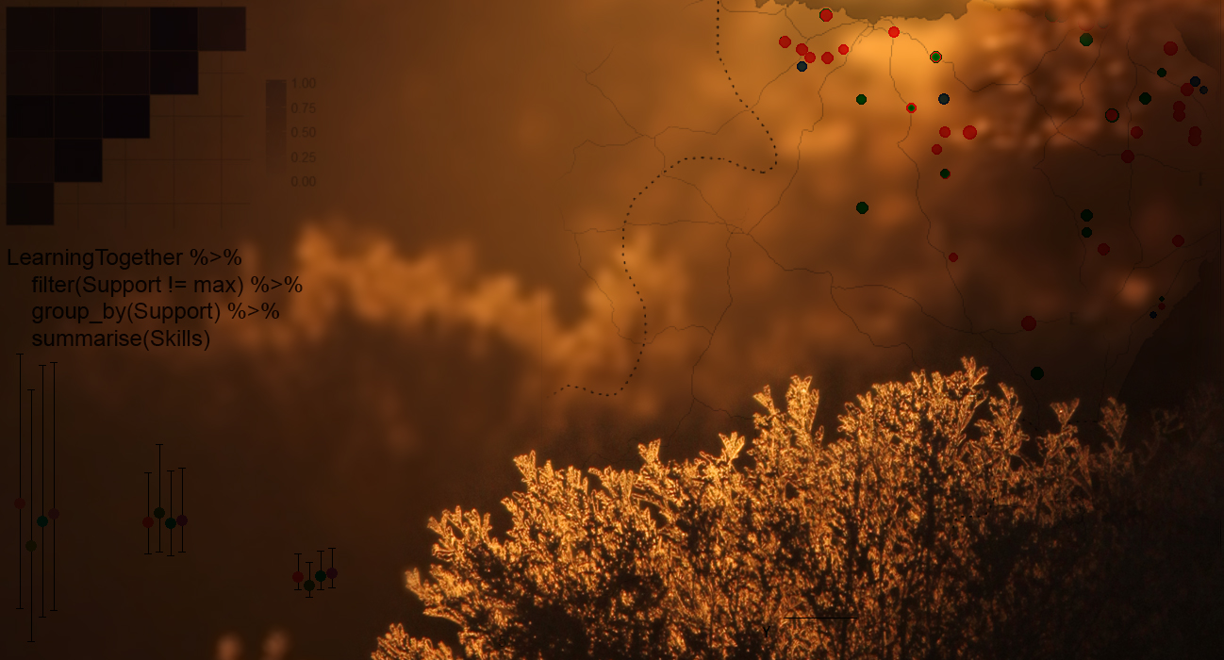

Beautiful and informative data visualisation
Using ggplot2 to communicate your results
Gergana Daskalova
2nd Feb 2017, University of Edinburgh

Slide 2

Workshop outline
1. A graph is worth 1000 words
2. What do all great graphs have in common?
3. ggplot2 galore – let’s make some graphs!
A team graph beautification challenge!
Same data, different teams, what will the graphs be?

Slide 3
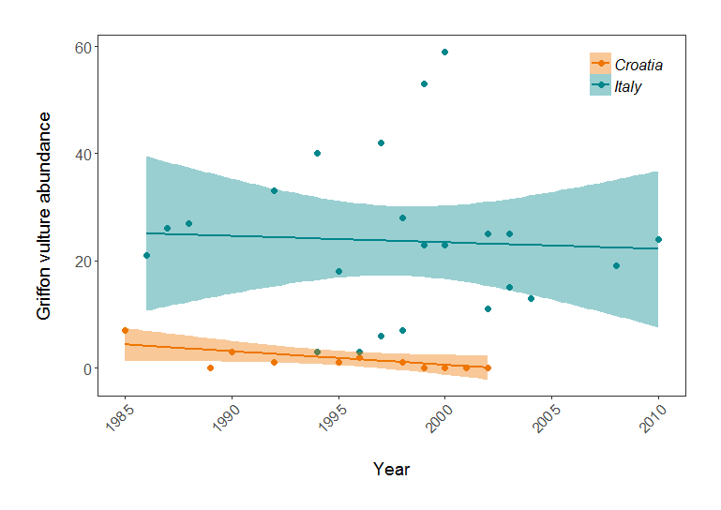
A graph is worth 1000 words
Figure 1. Population trends of Griffon vulture in Croatia and Italy. Points represent raw data with a linear model fit and 95% credible intervals.

Slide 4
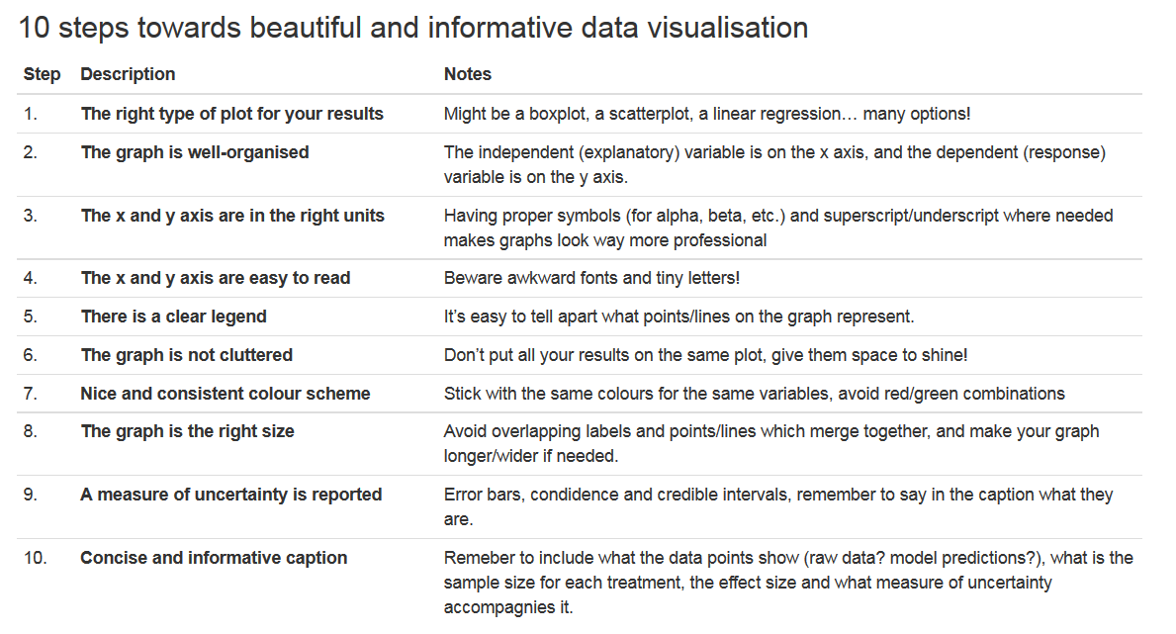
What do all good graphs have in common?

Slide 5
A figure beautification challenge!
Open the Figure_challenge.R script file and follow the instructions to beautify a graph and present more results from the LPI data!
Save your graphs and upload them to this Google Drive folder afterwards:
http://bit.ly/2kKZBAl

