Slide 1
AI TOOLS COURSE · UNIVERSITY PROJECT
AI-Powered Oral Disease Detection System
Using Transfer Learning and Explainable AI
DATASET Oral Diseases · 12,320 images
MODELS 4-architecture TL benchmark
EXPLAIN Grad-CAM heatmaps
Milestones: 1 EDA ✅ · 2 Preprocessing ✅ · 3 Training Benchmark ✅ · 4 Evaluation · 5 Grad-CAM
1/15

Slide 2
MILESTONE 1 · EXPLORATORY DATA ANALYSIS
Understanding the Data
12,320 images · 6 classes · 2.24:1 imbalance · clean quality audit
2/15

Slide 3
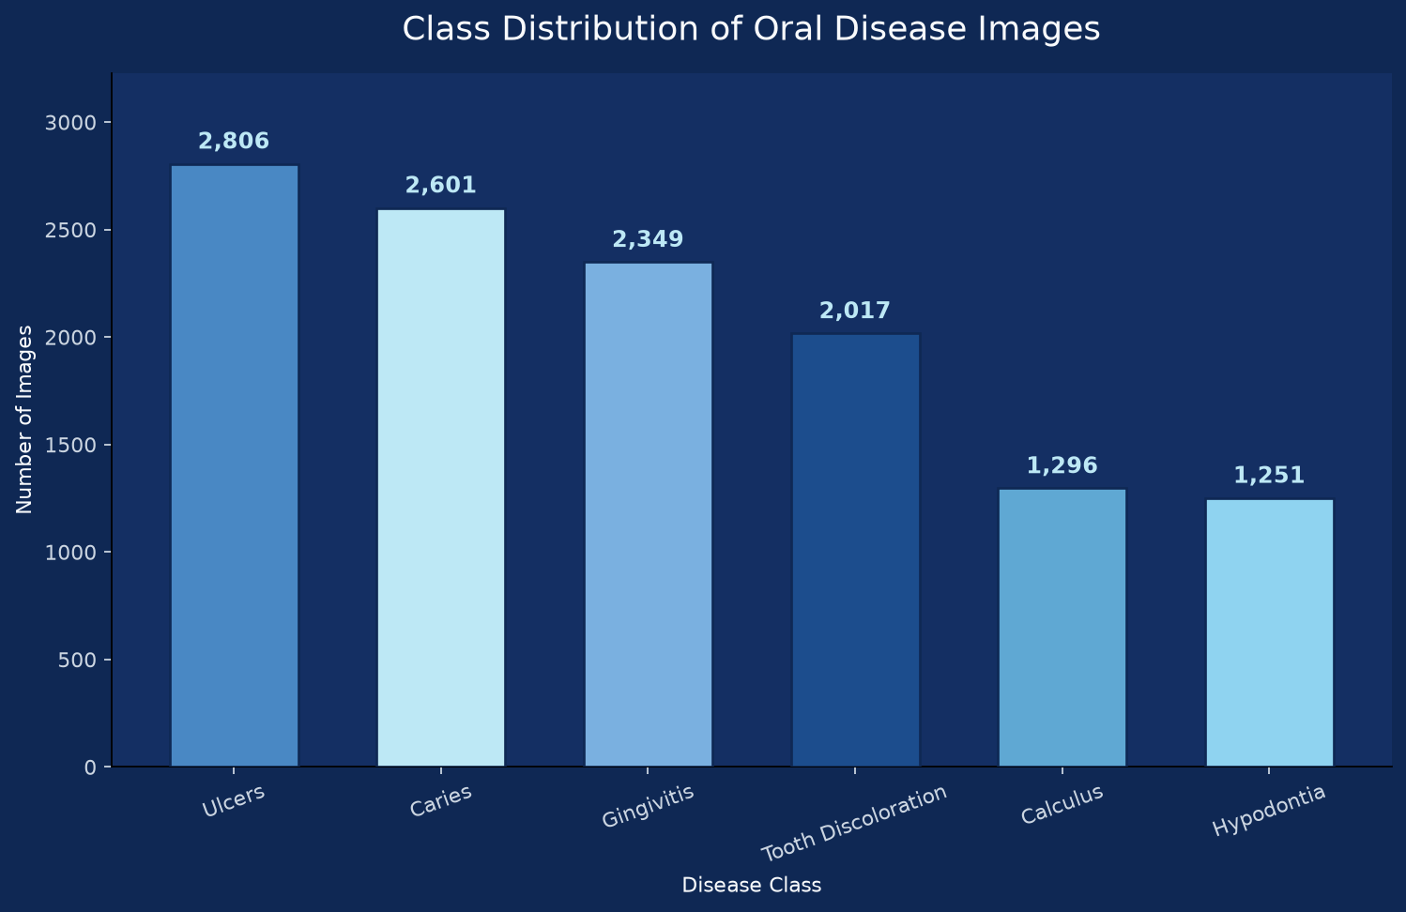
MILESTONE 1 · KEY FINDINGS
What the EDA Revealed
Dataset — 12,320 images across 6 disease classes, clean folder structure
Balance — moderate imbalance 2.24:1 - Hypodontia (10.2%) smallest class
Quality — 0 corrupted images, 0 within-class duplicates, 0 unsupported files
Geometry — variable resolution & aspect ratio → resize to 224×224
Excluded — mixed YOLO-annotated folder removed (noisy labels)
Class distribution from Milestone 1 EDA
3/15
Notes:
Present the EDA outcome: clean, moderately imbalanced data. This defines the preprocessing contract: resize to 224x224, RGB, mild augmentation, class weights (reported in M1/M2).

Slide 4
MILESTONE 2 · TENSORFLOW DATA PIPELINE
Preprocessing Pipeline Workflow
RAW DATA
6 classes 12,320 imgs
CLEANING
validate quarantine
PREPROCESS
RGB → 224×224 float32 [0,255]
tf.data
cache shuffle
AUGMENT
flip · rot · zoom shift · light · contrast
BATCH
batch 32 prefetch
M3 BENCHMARK
4 TL models (attributed)
›
›
›
›
›
›
12,320
0
8,624 / 1,848 / 1,848
2.24:1
files validated
corrupted images
train / val / test
imbalance handled
Next: Milestone 3 trains four transfer-learning architectures on this verified pipeline
4/15
Notes:
Workflow slide. Explain each stage: (1) 12,320 raw images across six classes; (2) exhaustive validation - PIL verify + decode - corrupted files quarantined, zero found; (3) decode RGB, resize 224x224, cast float32, pixels kept in 0-255 because each pretrained backbone normalizes internally; (4) tf.data with cache to avoid re-decoding across epochs and shuffle to remove class ordering; (5) medical-appropriate augmentation - flip, +-15 degree rotation, zoom, translation, brightness and contrast jitter, deliberately mild to preserve clinical features, applied to training only; (6) batch size 32 with prefetch and AUTOTUNE for GPU overlap; (7) Milestone 3 trains the four-architecture benchmark (Custom CNN, MobileNetV2, EfficientNetB3, DenseNet121). Emphasize the stratified 70-15-15 split preserved class proportions exactly, verified in the notebook. Clarify that benchmark model performance is attributed to the reference implementation; our contribution is the analysis, pipeline, and integration.

Slide 5
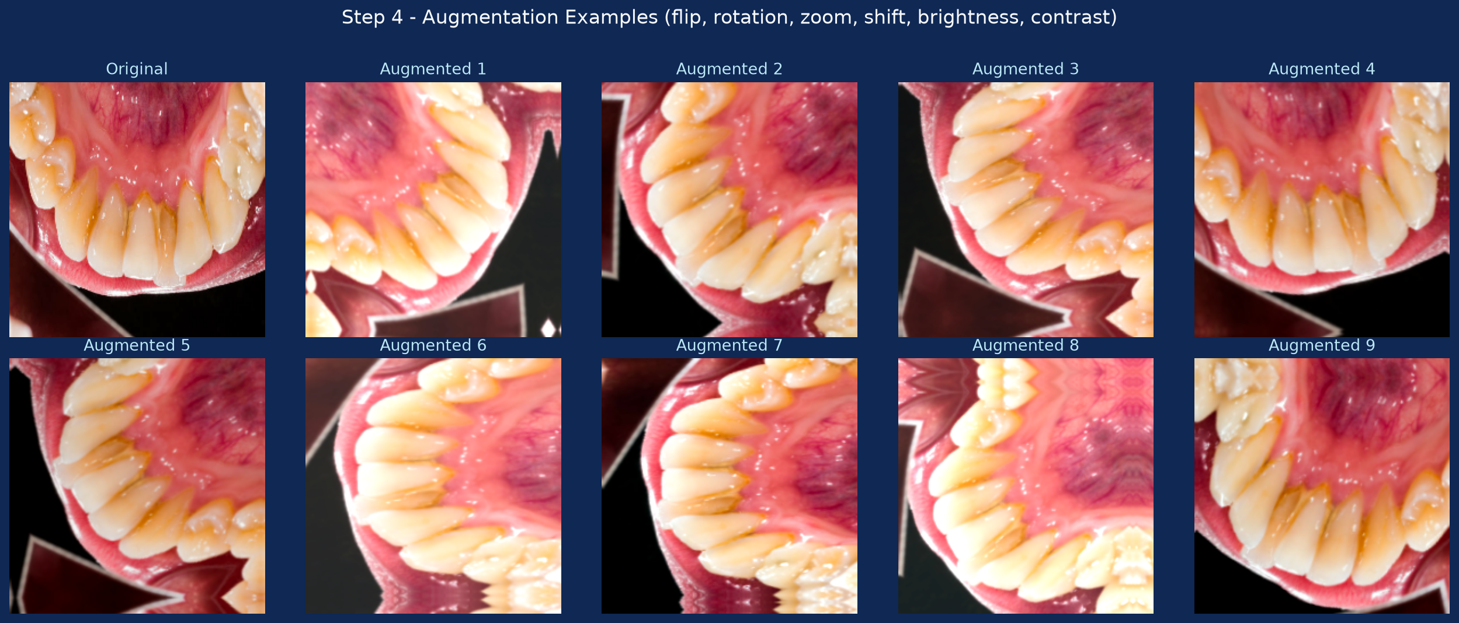
MILESTONE 2 · AUGMENTATION & STRATEGY
Medical-Appropriate Augmentation
Flip — horizontal mirror - mirrored anatomy remains valid anatomy
Rotation — +-15 degrees - camera tilt during screening
Zoom & shift — 0.9-1.1x zoom, translation - distance and alignment variation
Light & contrast — clinic lighting and camera exposure differences
Mild by design — aggressive warps could distort lesions - training split only
Class weights — inverse-frequency w = N / (C · n_c) — 0.73 (Ulcers) to 1.64 (Hypodontia)
One original + augmented examples (flip, rotation, zoom, shift, brightness, contrast)
5/15
Notes:
Explain each augmentation's clinical rationale and why they are mild. Validation/test remain unmodified for honest metrics. Milestone 3 trains the four-architecture benchmark on this augmented tf.data pipeline.

Slide 6
MILESTONE 3 · MODEL TRAINING BENCHMARK
Four Architectures, One Benchmark
Custom CNN · MobileNetV2 · EfficientNetB3 · DenseNet121 — trained on the verified Milestone 2 pipeline
REFERENCE BENCHMARK RESULTS - model performance attributed to the Kaggle reference notebook
OUR CONTRIBUTION - EDA, pipeline, architecture, documentation, integration
6/15
Notes:
Introduce Milestone 3. State clearly: the four models and their training strategy follow the reference implementation (Kaggle); the benchmark model performance is reproduced from the reference notebook and is attributed as such. Our contribution is the EDA, preprocessing pipeline, project architecture, documentation, presentation and system integration. The models train on our verified stratified split (70/15/15, seed 42) built in Milestone 2.

Slide 7
MILESTONE 3 · MOTIVATION
Why Deep Learning for Oral Disease Classification?
Learned features — no manual feature engineering for lesion texture/color cues
Translation invariance — disease can appear anywhere in the oral cavity frame
Hierarchical abstraction — edges → textures → lesion-level patterns
Transfer learning — small medical datasets still reach strong accuracy
Reference evidence — baseline CNN ≈84% → top models >92% validation accuracy
REFERENCE BENCHMARK RESULTS - model performance attributed to the Kaggle reference notebook
OUR CONTRIBUTION - EDA, pipeline, architecture, documentation, integration
7/15
Notes:
Explain why CNNs fit medical imaging: they learn hierarchical features automatically. Rule-based systems fail on varied lighting, scale, and overlapping lesion cues. Reference benchmark: from-scratch baseline reaches about 84%, pretrained transfer learning exceeds 92%.

Slide 8
MILESTONE 3 · TRANSFER LEARNING
Transfer Learning Explained
The problem — medical datasets are small; training from scratch overfits
The idea — reuse ImageNet weights — early layers encode generic edges/colors/textures
Recipe — load backbone (no top) → freeze → attach head → train head
Fine-tune — unfreeze top layers at a 10× lower learning rate
Partial unfreezing — early filters transfer as-is; only task-specific blocks adapt
REFERENCE BENCHMARK RESULTS - model performance attributed to the Kaggle reference notebook
OUR CONTRIBUTION - EDA, pipeline, architecture, documentation, integration
8/15
Notes:
Medical datasets are far smaller than ImageNet (1.2M images). Transfer learning reuses generic visual features. The standard recipe: load pretrained backbone without its 1000-class head, freeze it, train a small classification head, then fine-tune the top blocks at a much lower learning rate. The reference applies this to all three pretrained models with different unfreeze depths (MobileNetV2: all, EfficientNetB3: top 50, DenseNet121: last 40).

Slide 9
MILESTONE 3 · MODEL 1 · BASELINE
Custom CNN — From-Scratch Baseline
4 conv blocks (32→64→128→256) + BatchNorm + MaxPool · Dense(256) · Dropout 0.4
Why — quantifies how much transfer learning actually helps on our data
Design — augmentation + rescaling [0,1] embedded in the model
Strength — small, fast, fully transparent — every weight learned from our data
Limit — Flatten→Dense(256) = 12.8M params — most overfitting-prone part
Role — establishes the performance floor for the benchmark
REFERENCE BENCHMARK: Custom CNN · 83.97% validation accuracy
REFERENCE BENCHMARK RESULTS - model performance attributed to the Kaggle reference notebook
OUR CONTRIBUTION - EDA, pipeline, architecture, documentation, integration
9/15
Notes:
The from-scratch baseline validates the pipeline end-to-end and answers the key question: how much does transfer learning help? ~13.2M params, Adam 1e-4, 20 epochs, EarlyStopping patience 5. Reference result: 83.97%. Attributed - not our run.

Slide 10
MILESTONE 3 · MODEL 2 · LIGHTWEIGHT
MobileNetV2 — Lightweight Transfer Learning
2.26M-param mobile backbone · two-phase training · head Dense(256) · Dropout 0.3
Why — the efficiency probe — how far does a deployable mobile network go?
Phase 1 — backbone frozen, head trained at 5e-4 (15 epochs)
Phase 2 — full fine-tuning at 1e-5 — 10× lower LR (15 epochs)
Preprocessing — pixels rescaled to [-1, 1] — MobileNetV2 input contract
Strength — smallest model — the cheapest to deploy
REFERENCE BENCHMARK: MobileNetV2 (fine-tuned) · 89.57% validation accuracy
REFERENCE BENCHMARK RESULTS - model performance attributed to the Kaggle reference notebook
OUR CONTRIBUTION - EDA, pipeline, architecture, documentation, integration
10/15
Notes:
Mobile-first backbone built from inverted residuals. The two-phase protocol (frozen feature extraction, then whole-backbone fine-tuning at a rescue learning rate of 1e-5) is the safest way to adapt a mobile network. Reference result: 89.57% after fine-tuning - +5.6 points over the baseline, the direct payoff of ImageNet pretraining. Attributed.

Slide 11
MILESTONE 3 · MODEL 3 · DEEP
EfficientNetB3 — Deep Transfer Learning
Compound-scaled backbone (~10.7M) · top-50 unfrozen · head Dense(512) · Dropout 0.4
Why — compound scaling (depth/width/resolution) — SOTA accuracy per parameter
Fine-tune — top 50 layers at 1e-4 — early generic filters stay frozen
Augmentation — more aggressive (rotation/zoom 0.2) to match capacity
Preprocessing — built-in normalization — M2 [0,255] contract works directly
Limit — deepest model — slowest to train and serve
REFERENCE BENCHMARK: EfficientNetB3 · 93.02% validation accuracy (champion)
REFERENCE BENCHMARK RESULTS - model performance attributed to the Kaggle reference notebook
OUR CONTRIBUTION - EDA, pipeline, architecture, documentation, integration
11/15
Notes:
The reference champion. Compound-scaled architecture reaches the best accuracy per parameter; partial fine-tuning of the top 50 layers adapts task-specific features. Reference result: 93.02% - the best of the benchmark. Attributed.

Slide 12
MILESTONE 3 · MODEL 4 · MEDICAL STANDARD
DenseNet121 — Dense-Connected Standard
Dense feature reuse (~7M) · last-40 unfrozen · LR annealing · head Dense(512) · Dropout 0.5
Why — dense connectivity resists vanishing gradients — popular in medical imaging
Fine-tune — last 40 layers at 1e-4 — early blocks keep generic filters
Smart LR — ReduceLROnPlateau (factor 0.3, patience 3) — keeps improving
Augmentation — includes RandomContrast — teeth/gum color cues
Limit — heavy backbone — slower than the lightweight models
REFERENCE BENCHMARK: DenseNet121 · 92.57% validation accuracy (close second)
REFERENCE BENCHMARK RESULTS - model performance attributed to the Kaggle reference notebook
OUR CONTRIBUTION - EDA, pipeline, architecture, documentation, integration
12/15
Notes:
DenseNet connects every layer to all later layers, reusing features densely. With LR annealing (ReduceLROnPlateau) and contrast augmentation it reaches 92.57% - only 0.45 points behind the champion. Attributed.

Slide 13
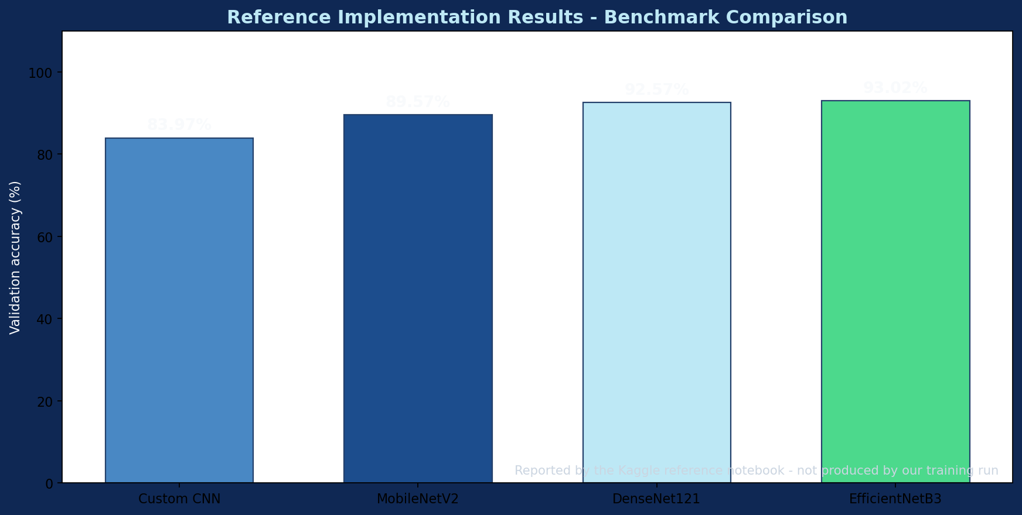
MILESTONE 3 · REFERENCE BENCHMARK RESULTS
Model Comparison — Reference Implementation Results
Validation accuracy reported by the reference notebook (attributed — not our experimental results)
Model | Strategy | Val accuracy
Custom CNN | from scratch | 83.97%
MobileNetV2 | TL + fine-tune | 89.57%
DenseNet121 | TL + partial FT | 92.57%
EfficientNetB3 | TL + partial FT | 93.02%
CHAMPION: EfficientNetB3 · 93.02%
Reference benchmark comparison (chart attributed to the reference notebook)
REFERENCE BENCHMARK RESULTS - model performance attributed to the Kaggle reference notebook
OUR CONTRIBUTION - EDA, pipeline, architecture, documentation, integration
Notes:
This is the reference benchmark slide. All numbers are the Reference Implementation Results reported by the Kaggle reference notebook - never presented as our own experimental results. Champion is EfficientNetB3 at 93.02%; DenseNet121 is a very close second at 92.57%. Reading: +5.6 points from the CNN baseline to MobileNetV2 proves the value of ImageNet pretraining; +3.5 points from MobileNetV2 to EfficientNetB3 shows capacity matters once features are pretrained. Our Milestone 4 will evaluate the deployed model on our own held-out test set (1,848 images).

Slide 14
MILESTONE 3 · CHAMPION ANALYSIS
EfficientNetB3 Champion — and DenseNet121 Close Behind
Why EfficientNetB3 won — deep compound-scaled backbone (~10.7M params) captures subtle lesion textures
Partial fine-tuning — top 50 layers adapted at 1e-4 — generic early filters preserved
DenseNet121 (92.57%) — dense feature reuse + LR annealing keeps it within 0.45 pts of the champion
Both heavy models lead — capacity + pretrained features dominate on fine-grained medical classes
Our contribution — we verify the champion on our own held-out test set in Milestone 4
REFERENCE BENCHMARK RESULTS - model performance attributed to the Kaggle reference notebook
OUR CONTRIBUTION - EDA, pipeline, architecture, documentation, integration
14/15
Notes:
Champion: EfficientNetB3 (93.02%). Its compound-scaled architecture combines depth, width and resolution efficiency; partial fine-tuning of the top 50 layers adapts task-specific features without destroying generic filters. DenseNet121 reaches 92.57% - only 0.45 points behind - thanks to dense feature reuse and ReduceLROnPlateau annealing. Both heavy models outperform the lightweight MobileNetV2. Reiterate: these are reference benchmark results; our experimental contribution starts with Milestone 4 evaluation on our test split.

Slide 15
TRANSITION · MILESTONE 3 → 4
From Benchmark to Evaluation
Reference benchmark integrated and attributed — next: held-out test evaluation, confusion matrix, per-class metrics
REFERENCE BENCHMARK RESULTS - model performance attributed to the Kaggle reference notebook
OUR CONTRIBUTION - EDA, pipeline, architecture, documentation, integration
15/15
Notes:
Milestone 3 delivered the four-architecture benchmark notebook (30 cells), reference benchmark chart, workflow diagram, presentation slides, and report. Next milestone: evaluation on the 1,848-image test set that was isolated in Milestone 2 and never touched by training - accuracy, precision/recall per class, confusion matrix, then Grad-CAM and the Streamlit app in Milestone 5.

