Slide 1

EDA Of Airbnb(NYC) Dataset
What Does Dataset Contain , What Patterns Had Been Extracted Helping Me For Further ML Modelling

Slide 2
Introduction — What is the dataset?
Dataset Is NYC Airbnb Open Data Consisting Of Instances Or Operations Applied On Airbnb Platform.
Dataset
NYC Airbnb Open Data
Location
New York City
Listings
~49K
Features
16 Original Features
Period
2011 To 2019
Target Variable
price

Slide 3
Feature Categories
👤 Host Information
host_id
host_name
calculated_host_listings_count
📍 Location
neighbourhood_group
neighbourhood
latitude
longitude
⭐ Review Information
number_of_reviews
last_review
reviews_per_month
🏠 Listing Information
room_type
minimum_nights
price
availability_365
🎯 Purpose
Understand listing characteristics and prepare the data for ML modelling .
Executing Exploratory Data Analysis On NYC Airbnb dataset By Using Python Libraries Helping In Understanding Data And Cleaning That Data To Be Ready For Modelling And Gaining Best Performance Can Be Expected In User Work Environment.

Slide 4
Feature Descriptions
id → Unique identifier for each Airbnb listing.
name → Name/title of the Airbnb listing.
host_id → Unique identifier of the host who owns/manages the listing.
host_name → Name of the host.
neighbourhood_group → The larger NYC Place(Neighbourhood) where the listing is located: Manhattan, Brooklyn, Queens, Bronx, or Staten Island.
neighbourhood → The specific neighborhood where the listing is located.
latitude → Geographic latitude of the listing.
longitude → Geographic longitude of the listing.
room_type → Type of accommodation offered: Entire home/apt, Private room, or Shared room.
minimum_nights → number of nights that a guest must book.
number_of_reviews → Total number of reviews received by the listing.
last_review → Date of the most recent review for the listing.
reviews_per_month → Average number of reviews received per month.
calculated_host_listings_count → Number of Airbnb listings associated with that host.
availability_365 → Number of days during the year that the listing is available for booking, from 0 to 365
price → Price of the listing per night in USD.

Slide 5

Data Quality
Missing values
Duplicate records
Non-Necessary Features
Data types
name ​
Host_name
last_review
review_per_month
Zero Duplicate Instances
id
host_id
8 Numerical Features
6 categorical Features

Slide 6
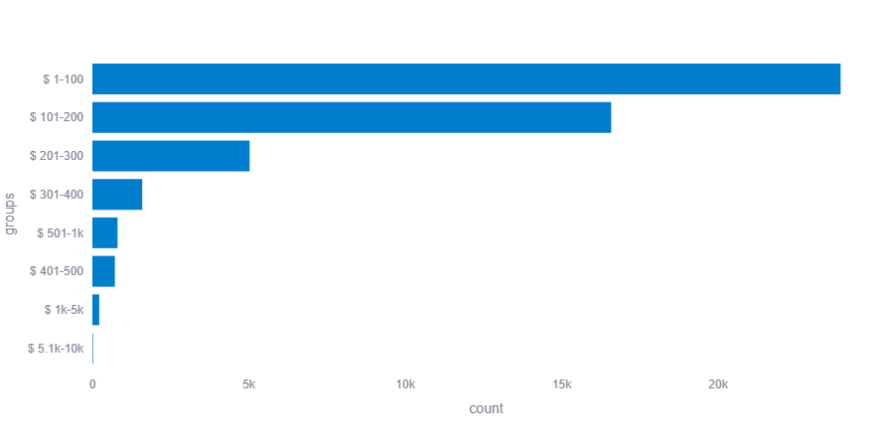
EDA Analysis
◈Data Understanding Of Price Feature
Metric
Eleven Inconsistent Outliers Is Assigned with 0 Renting Price
Metric
Price Distribution Is Right Skewed With Rate 19.12.
🔎Key Insights
Minimum Value In Price is Zero Renting Prices Which It Is Not Logic Value And Considered As Inconsistent Outliers Where Eleven Instances Contain.
The Largest Group 1-100 With ~24k Listings And Lowest Group Is 5.1k-10k With 20 listings.
The Price Is Highly Right-skewed Distributed With most Listings Concentrated At Lower Prices
Metric
Median Price is 106.0
Average Price is 152.72

Slide 7
EDA Analysis
◈Data Understanding Of name Feature
Metric
There Is 16 Missing Values
What's Happened In Data Cleaning Process?
There Is Special Characters In Descriptions Of Listings And All Had Been Deleted To Show Those Descriptions In Clearer View.
Metric
Most Frequent Description Is Hillside Hotel
🔎Key Insights
The Description Of Accommodations Owned Highest Renting Costs In That Dataset Are
  one-BR Lincoln Center.
  Furnished room In Astoria
  Luxury one bedroom
  Stunning Manhattan Views
Extracted Features
desc_len
desc_lang
has_prop_keyword
has_room_keyword
has_rental_keyword
has_amenity_keyword
location_keyword
market_keyword

Slide 8
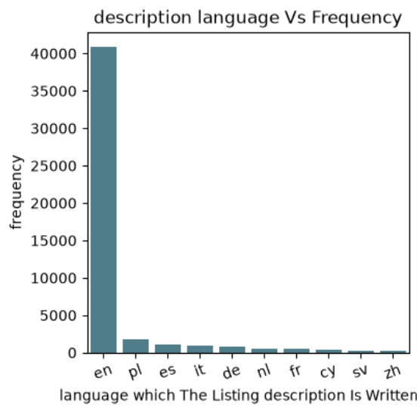
EDA Analysis
◈Data Understanding Of desc_lang Feature
Metric
Description Of Listings Is Written In 71 Variant Languages
🔎Key Insights
~ 41k Listings Description Are Written In English Language and ~2k In polish language

Slide 9
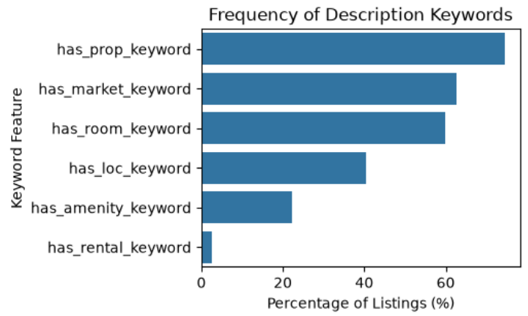
EDA Analysis
◈Data Understanding has keywords Features
Feature | View Percentage
has_prop_keyword | 74.5%
has_market_keyword | 62.6%
has_room_keyword | 60.0%
has_loc_keyword | 40.3%
has_amenity_keyword | 22.4%
has_rental_keyword | 2.5%
Property Keywords
'apartment' ,'apt','flat','home','house', 'room','studio',
'loft','suite','condo', 'condominium','townhouse' , others...
🔎Key Insights
- Property, market, and room-related terminology appears frequently in listing descriptions, while explicit rental terminology is relatively uncommon And Which It Will Help While ML Modelling

Slide 10
EDA Analysis
◈Data Understanding Of host_name Feature
What's Happened In Data Cleaning Process?
There Is Special Characters In Host Names And All Had Been Deleted To Show Those Names In Clearer View.
Replacing All Nan Values With 'Unknown'.
Metric
There Is 21 Missing Values
Metric
Unique Hosts Is 11452 Name
🔎Key Insights
The Most Frequent Ten Hosts In That Dataset Provided Renting Of Their Houses Was Just Individual Persons. (One Host Raised Rentals On Airbnb In US New York City ) Are Presented In Visualized Charts In Jubyter Python Notebook.
Multiple Hosts Provided Rentals Greater Than Single Hosts Where Number Of Rentals Provided By Multiples Are 48587 Listings While Singles 296.
Metric
Most Frequent Host Is Michael with 417 time
Extracted Features
host_count

Slide 11
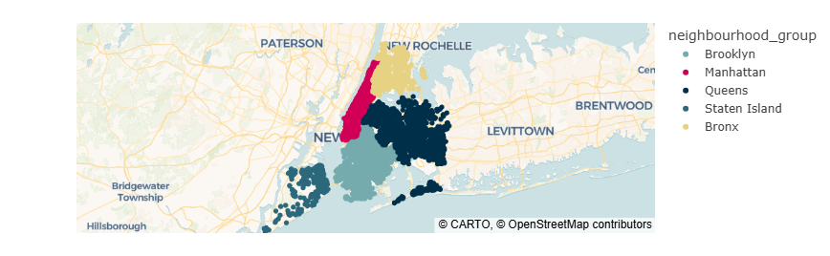
Mapping Listing Locations
🔎Key Insights
The Listing Locations Are Spread In All Five Boroughs At New York City

Slide 12
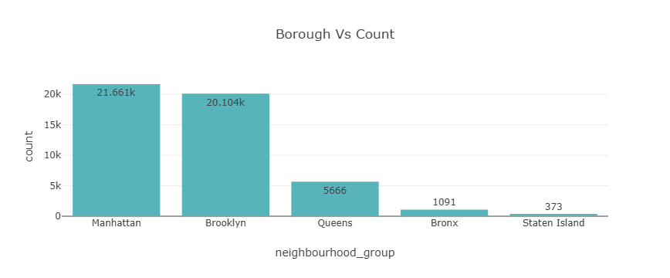
EDA Analysis
◈Data Understanding Of nighbourhood_group Feature
Metric
There Is No Missing Values
Metric
There Are Only Five Unique Boroughs
🔎Key Insights
This Feature Is A Categorical Variable Consisting Of Five Boroughs (Manhattan , Brooklyn , Queens , Bronx And Staten Island )
Most Two Boroughs Where Rentals Number Is Highest Are Manhattan And Brooklyn And Therefore Airbnb Activity Is Concerned With Two Previous Boroughs

Slide 13
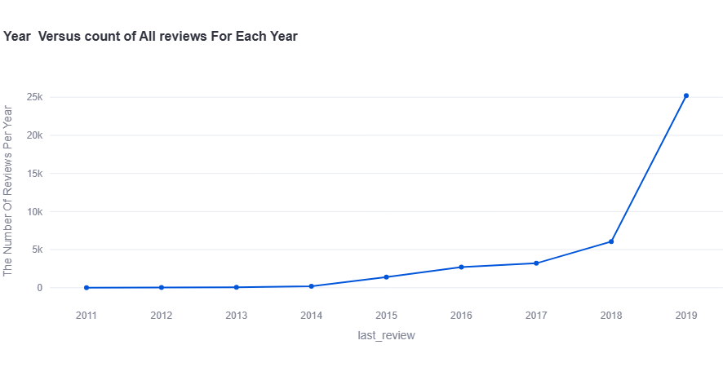
Listings Number Progress Over Years
🔎Key Insights
Number Of Listings Increases Over Years From 2011 To 2019 Where Highest Number Of Listings Was Provided In Year 2019.

Slide 14
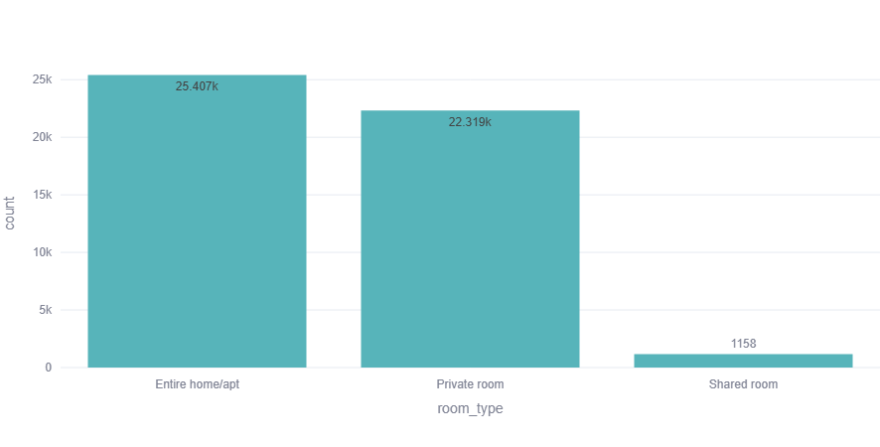
EDA Analysis
◈Data Understanding Of room_type Feature
Metric
There Is No Missing Values
Metric
There Is Three Unique Room Types
🔎Key Insights
The Most Frequent Room Type Is Entire home/apt Where The Average Of Renting Price Is 212.81 USA Dolar And Maximum Price Was In That Room Type Is 10 USA Dolar
Metric
Most Frequent Room Type Is Entire Home

Slide 15
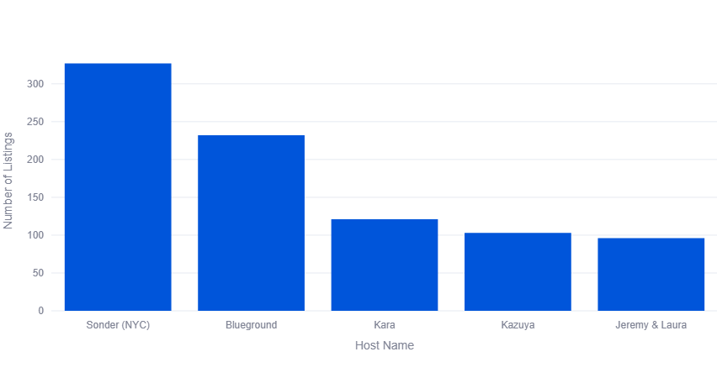
EDA Analysis
◈Data Understanding Of room_type Feature
Metric
There Is No Missing Values
Metric
Less Number of Listings Which Host Provided Is 1 accommodation
Metric
Maximum Number Of Listings Which Hos Provided Is 327 Listings
🔎Key Insights
The Host Providing Highest Number Of Listings Are Sonder(NYC) With 327 Renting Accommodation And Sonder(NYC) Is One Of Most Popular Companies Providing short-term Rentals In New York City.

Slide 16
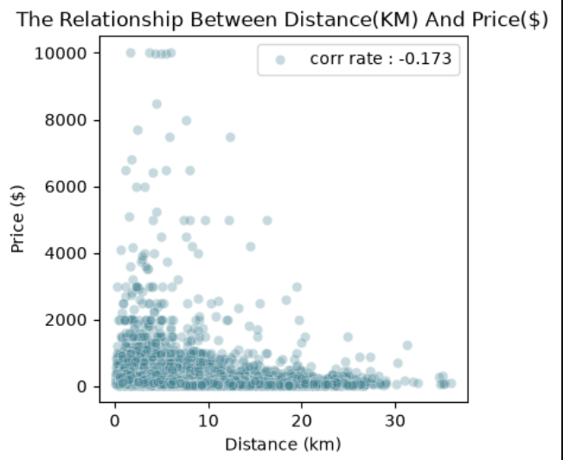
Distribution Of Distance(From City Center ) And Price
🔎Key Insights
There Is A Weak Negative Relationship Between Distance And Price With –0.173 . Therefore , We Can't Say That The Distance_km Feature Alone Determines The Price .
Price Tends To Slowly Decrease As The Distance From The City Center Increases

Slide 17
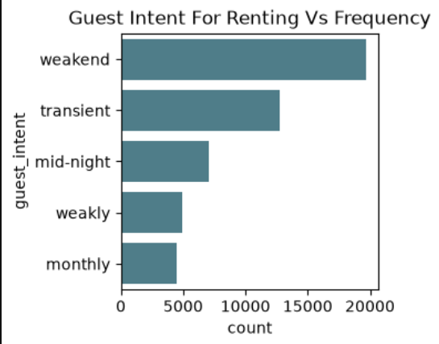
Guest Intent Frequency
🔎Key Insights
The Dominant Intent Of Guest Is Renting For Weakend With 19691 Time
Short-term/stay-pattern categories dominate the dataset , while monthly-oriented listings form a smaller group

Slide 18
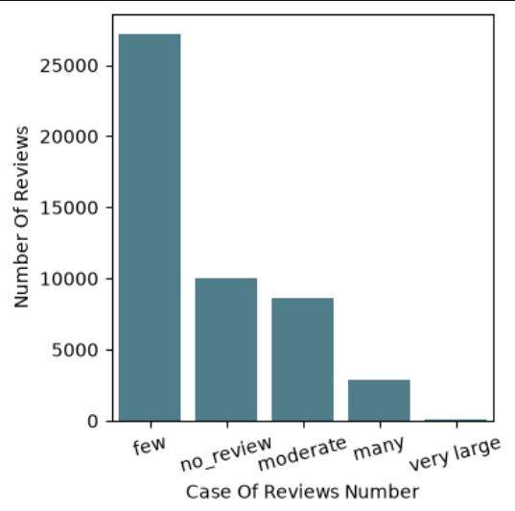
Frequency of review Number case
🔎Key Insights
Huge Number of listings (accommodations) Is Categorized As Few In Review Category Feature At Precent 55.67% Which It Could Represent One Of Those Probabilities :
  Newer listings
  Inactive listings
  Listings with low booking activity
  Listings that simply received small number of reviews

Slide 19

Insights
Set-1
the number of instances In Renting Dataset Is 48895 While The Number Of Features After Droping Non-Necessary Features Is 14
There Is No Duplicated 'Repeated' Instances In That Data .
Features Has Missing Values Are name , host_name , last_review And reviews_per_month ( 4 features has And 10 hasn't ) .
There Is 8 Numeric Feature And 6 Categorical Feature - Price Feature Is Positive Integer Numbers Such That Minimum Value Is Zero Renting Price Which It Is Not Logic And Considered As Inconsistent Outliers Must Be Removed .
There Are Eleven Inconsistent Outliers Are Valued With zeroe , And They'd been Removed From cleaned DataFrame.
The mean Of Renting Prices Is 152.72 And The median Value Is Only 106.0 While The Maximum Value Is 10k Is An Extreme Outlier.
The Distribution Of Price Feature Values has Right-Skewed Spread With Skewness Rate 19.1 And It's not Suitable For Modelling Predictive AI Algorithm Accurately And It Must Be Normalized Before Modelling Process.

Slide 20
Insights
Set-2
The Largest Group Is 1 - 100 With 23.917k Listings And Lowest Group Is 5.1k - 10k With 20 listings.
name Feature is A Categorical Feature Have 47905 Variant Descriptions Of Listing On Airbnb Website In New Work City Had Been Done.
The Most Repeated Characteristics Of Renting Which They Had Been Listed In That Dataset Is Hillside Hotel.
The Description Of Booking Which It Owned Highest cost Is 1-BR Lincoln Center , Furnished room in Astoria And Luxury 1 bedroom app.-stunning mangattan views - host_name Feature is A Categorical Feature Have 11452 Variant Hosts For Renting Accomodation On Airbnb Website In New Work City Had Been Shown. Is Zero Renting Price Which It Is Not Logic And Considered As Inconsistent Outliers Must Be Removed .
The Most Repeated host On Airbnb In New York City Is Michael With 41 Listing.
Number Of Hostings Which One Host had Provided Are 46758 Are While they Have More One Host Are 2137
The Most Repeated Ten Hosts In That Dataset Provided Renting Of Thier Houses And Was Just Individual Persons (one host Raised renting On Airbnb Website From New York City In Us) Presented In Previous Charts In Section Data Analysis where highest Hostings Was Are Provided By micheal With 417 Hostings And Lowest Ones By Mike with 194

Slide 21
Insights
Set-3
The Type Of Listings Which Mike Offered For Renting In That Data Are Entire Home With 72.7 % Out Of Number Of Listings Was Offered By Host Mike And Private Room With 27.3%
The Most Repeated Ten Hosts In That Dataset Provided Renting Of Thier Houses And Was shared Persons (more than one host Raise renting On Airbnb Website From New York City In Us) Presented In Previous Chart In Data Analysis Section where highest Hostings Was Are Provided By Sonder and Nyc With 327
Hostings And Lowest Ones By (pi and leo),(charlie and selena) , (jess and ana) And (wesly and jessica) With 8
The Type Of Listings Which sonder and nyc Offered For Renting In That Data Are Entire Home With 25.0 % Out Of Number Of Listings Was Offered By Host sonder and nyc And Private Room With 75%
The Type Of Listings Which pi and leo Offered For Renting In That Data Are Entire Home With 87.5 % Out Of Number Of Listings Was Offered By Host pi and leo And Private Room With 12.5% .
jess and ana Offered Only Just Shared Room For Renting In All Cases In That Data
- The Type Of Listings Which wesly and jessica Offered For Renting In That Data Are Entire Home With 75 % Out Of Number Of Listings Was Offered By Host wesly and jessica And Private Room With 25 %

Slide 22
Insights
Set-4
The Highest Ten Renting Averages Provided From Individual Persons (one host Raised renting On Airbnb Website From New York City In Us) Where Largest Average Provided By olson With 9.999 K While Less Average By viberlyn With 2995
Olson Offered Only Just Entire Home For Renting In All his Cases In That Data.
viberlyn Offered Only Just Entire Home For Renting In All his Cases In That Data .
The Type Of Listings Which pi and leo Offered For Renting In That Data Are Entire Home With 87.5 % Out Of Number Of Listings Was Offered By Host pi and leo And Private Room With 12.5% .
The Highest Ten Renting Averages Provided From shared Persons (more one host Raised renting On Airbnb Website From New York City In Us) Where Largest Average Provided By Jay and Liy With 6000 While Less Average By jeff and kelly With 949
Jay and Liy Offered Only Just Entire home For Renting In All thier Cases In That Data.
jeff and kelly Offered Only Just Private room For Renting In All thier Cases In That Data.
neighbourhood_night Feature is A Categorical Feature Have Five Different Boroughs Are Brooklyn , Manhattan ,Queens , Staten_Island and Bronx

Slide 23
Insights
Set-5
most two boroughs have largest number of listings Are Manhattan and Broklyn And Therefore , Airbnb Activity Is Heavly Concerned In Those Two Previous Boroughs
There Is No Missing Values Here In This Column
The Most Frequent Borough Where Renting Is Highest Is Manhattan While Lowest Number Of Booking Renting Is In Bronx
The Maximum Renting Price Was In Manhatta , Broklyn And Queens And All Those Boroughs Are Coastal Cities.
The Most Three Average Prices Of Renting Was In Manhattan , Broklyn And Staten Island
The Hugest Type Of Rooms Was Renting In All Boroughs Is Shared Rooms While Lowest Type Of Rooms Was Renting In All Boroughs Is Entire Home/Appartment
neighbourhood Feature is A Categorical Feature Have 221 Different Places
There Is No Missing Values Here In neighbourhood Feature , Airbnb Activity Is Heavly Concerned In Those Two Previous Boroughs
The Highest Place In Which Renting Numbers was hugest Williamsburg Located In Brooklyn Borough With Average Price 143.8

Slide 24
Insights
Set-6
Also According To Visualization Chart , The Highest Renting Location Was In Manhattan
Latitude and Longitude is Numerical Features Have No Missing Value
The Samples Of This Renting Data Set Is Spread Arroud All Five Boroughs In New York City
The Density Of Description Lengths Is Highly Ranged From 3 to 10 words For Almost All Listings, Even Rentals With High Prices, is ranged between 3 to 10 words.
All Single Hosts Provided Prices Ranged From 25 to 2500 And All Description Lengths Consist Of Only One Word.
High Priced Rentals Were Provided From Multiple Hosts.
The Median Distance (km) From City Center Is 6.391 km. Therefore, We Can't Say That The Distance_km Feature Alone Determines The Price. Price Tends To Slowly Decrease As The Distance From The City Center Increases.
A Huge Number Of Listings (Accommodations) Is Categorized As Few In The Review Category, At A Percentage Of 55.67%. This Could Represent One Of The Following Possibilities: (Newer Listings, Inactive Listings, Listings With Low Booking Activity, Or Listings That Simply Received A Small Number Of Reviews).

Slide 25
Utilities Of EDA ?
Pandas
Numpy
Matplotlib
Seaborn
Plotly
datasist
num2words
Dependencies Of Deployment ?
os
io
base64
PIL
Streamlit

Slide 26
Github And Deployment Link
Deployment Link :
  EDA-Airbnb NYC Dataset · Streamlit
Github Link :
    EDA_airbnb-NYC/presentation-links at main · Islam-Yousri/EDA_airbnb-NYC

