Slide 1


Slide 2
Team Member :
Islam Abdel_Hady Hassanen Section 1
Enas Ragab Abdel_Latif Section 2

Slide 3
Table Of Contents :
What is Steganography?
Steganography uses
Different Types of Steganography
What is the advantage of steganography over cryptography?
The general idea
How does Steganography work? (Hiding an image inside another)
How to detect modified photos?
Code & Output

Slide 4
What is Steganography?
Steganography is the technique of hiding secret data within an ordinary, non-secret, file or message in order to avoid detection; the secret data is then extracted at its destination. The use of steganography can be combined with encryption as an extra step for hiding or protecting data.
Steganography can be used to conceal almost any type of digital content, including text, image, video or audio content; the data to be hidden can be hidden inside almost any other type of digital content. The content to be concealed through steganography -- called hidden text -- is often encrypted before being incorporated into text file or data stream. If not encrypted, the hidden text is commonly processed in some way in order to increase the difficulty of detecting the secret content

Slide 5
Steganography uses :
The practice of adding a watermark -- a trademark or other identifying data hidden in multimedia or other content files -- is one common use of steganography. Watermarking is a technique often used by online publishers to identify the source of media files that have been found being shared without permission.
While there are many different uses of steganography, including embedding sensitive information into file types, one of the most common techniques is to embed a text file into an image file. When this is done, anyone viewing the image file should not be able to see a difference between the original image file and the encrypted file; this is accomplished by storing the message with less significant bites in the data file. This process can be completed manually or with the use of a steganography tool.

Slide 6
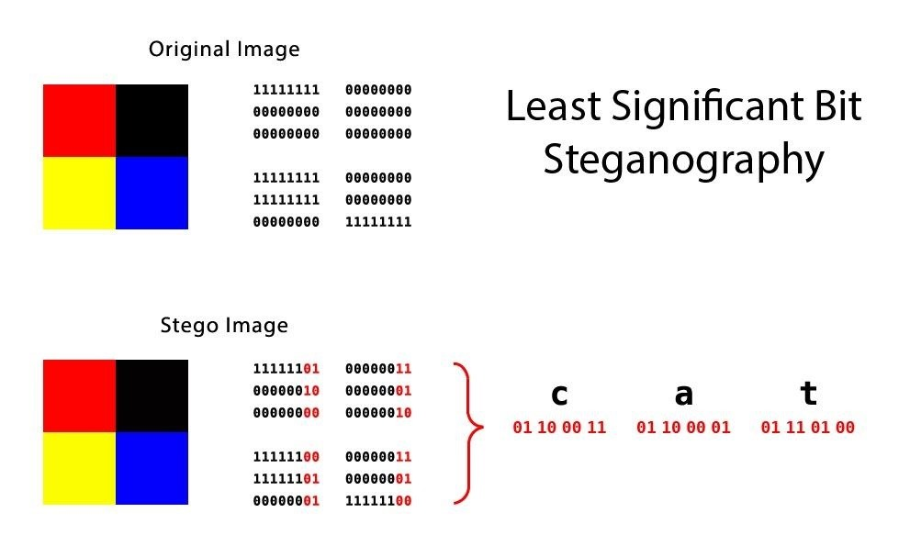
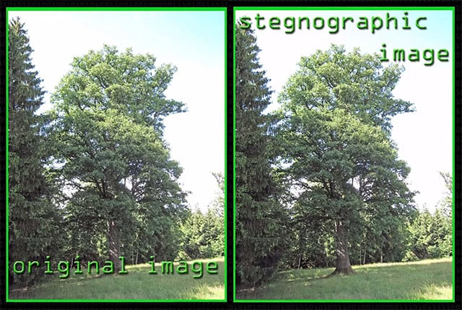
Different Types of Steganography
Text Steganography
There is steganography in text files, which entails secretly storing information. In this method, the hidden data is encoded into the letter of each word.
Image Steganography
It is image steganography, which entails concealing data by using an image of a different object as a cover. Pixel intensities are the key to data concealment in image steganography.

Slide 7
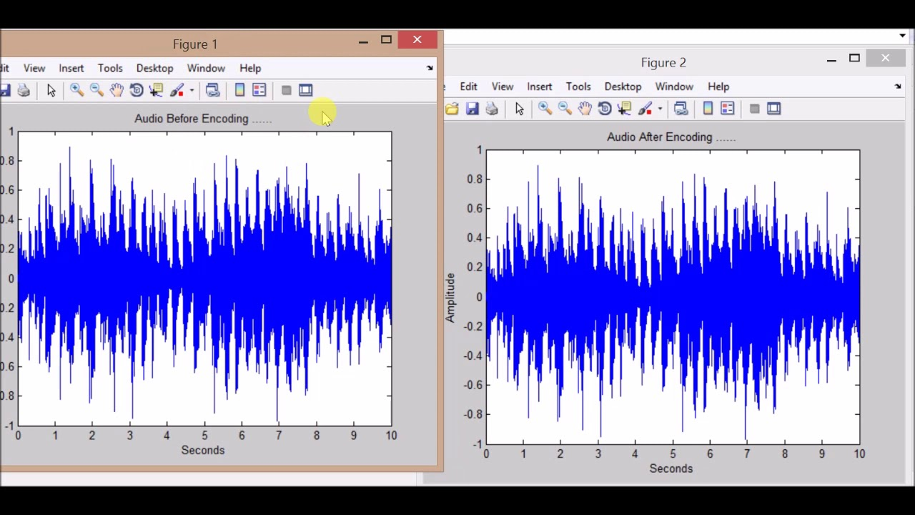

Audio Steganography
It is the science of hiding data in sound. Used digitally, it protects against unauthorized reproduction. Watermarking is a technique that encrypts one piece of data (the message) within another (the "carrier"). Its typical uses involve media playback, primarily audio clips.
Video Steganography
It is a method of secretly embedding data or other files within a video file on a compute
Network or Protocol Steganography
It involves concealing data by using a network protocol like TCP, UDP, ICMP, IP, etc., as a cover object. Steganography can be used in the case of covert channels, which occur in the OSI layer network model.

Slide 8
What is the advantage of steganography over cryptography?
The advantage of steganography over cryptography alone is that the intended secret message does not attract attention to itself as an object of scrutiny.
Plainly visible encrypted messages, no matter how unbreakable they are, arouse interest and may in themselves be incriminating in countries in which encryption is illegal

Slide 9
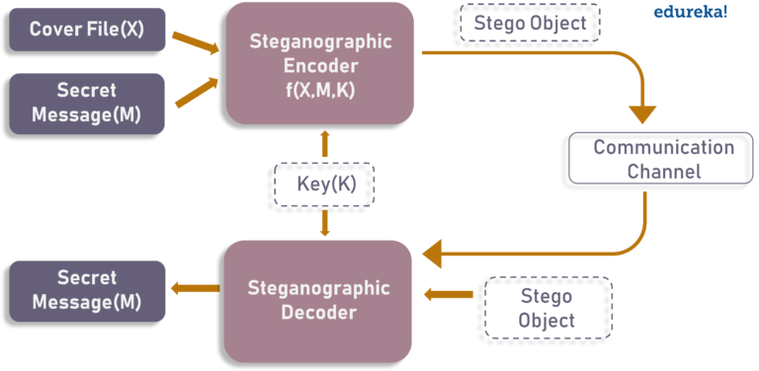
The general idea :
The diagram below depicts a basic steganographic model.
As the image depicts, both cover file(X) and secret message(M) are fed into steganographic encoder as input. Steganographic Encoder function, f(X,M,K) embeds the secret message into a cover file. Resulting Stego Object looks very similar to your cover file, with no visible changes.
This completes encoding. To retrieve the secret message, Stego Object is fed into Steganographic Decoder.

Slide 10
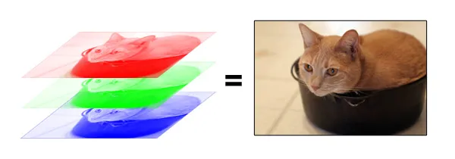
How does Steganography work? (Hiding an image inside another)
What is a digital image?
Digital image as a finite set of digital values
Pixel concept and color models
The RGB color model is an additive color model in which red, green and blue light are added together in various ways to reproduce a broad array of colors. The name of the model comes from the initials of the three additive primary colors, red, green, and blue. The main purpose of the RGB color model is for the sensing, representation and display of images in electronic systems, such as televisions and computers, though it has also been used in conventional photography.

Slide 11
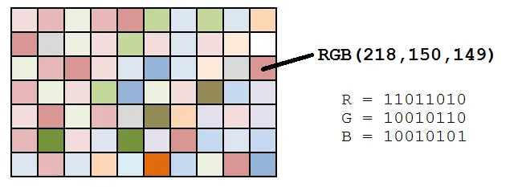
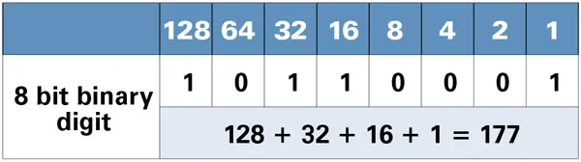
So, each pixel from the image is composed of 3 values (red, green, blue) which are 8-bit values (the range is 0–255)
As we can see in the image above, for each pixel we have three values, which can be represented in binary code (the computer language).
When working with binary codes, we have more significant bits and less significant bits, as you can see in this image .

Slide 12
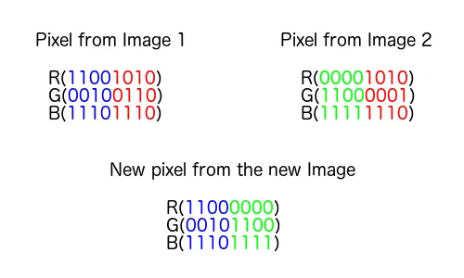
The leftmost bit is the most significant bit. If we change the leftmost bit it will have a large impact on the final value. For example, if we change the leftmost bit from 1 to 0 (11111111 to 01111111) it will change the decimal value from 255 to 127.
On the other hand, the rightmost bit is the less significant bit. If we change the rightmost bit it will have less impact on the final value. For example, if we change the leftmost bit from 1 to 0 (11111111 to 11111110) it will change the decimal value from 255 to 254. Note that the rightmost bit will change only 1 in a range of 256 (it represents less than 1%)

Slide 13
How to detect modified photos?
Histogram
Machine Learning

Slide 14
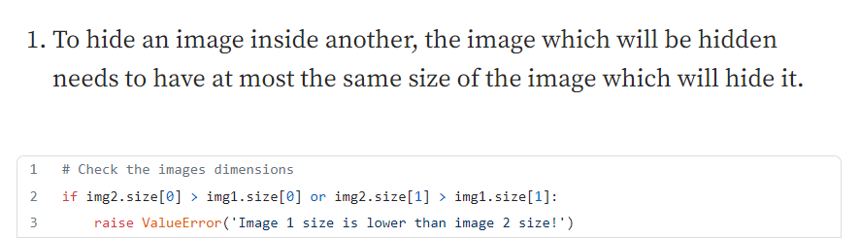
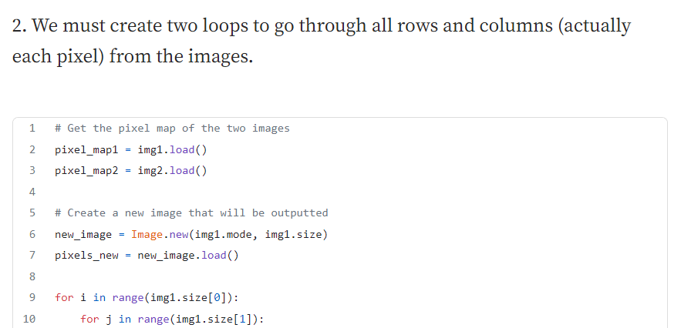
Code :

Slide 15
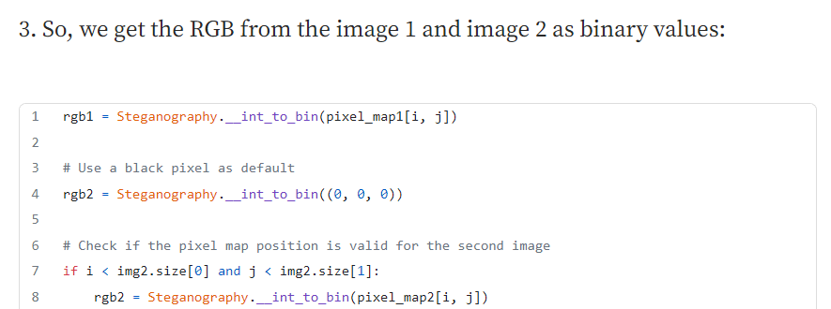
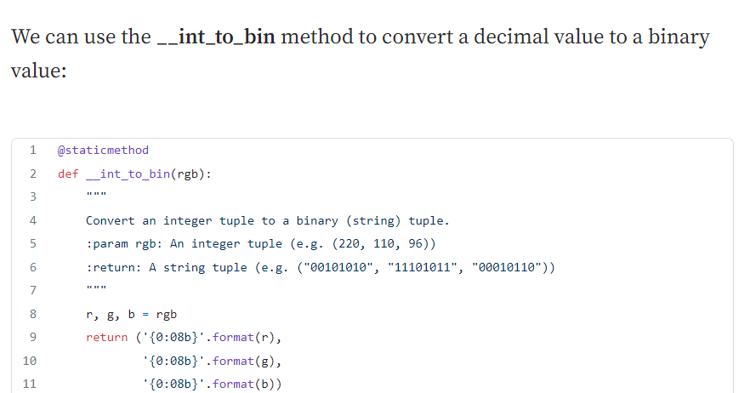

Slide 16
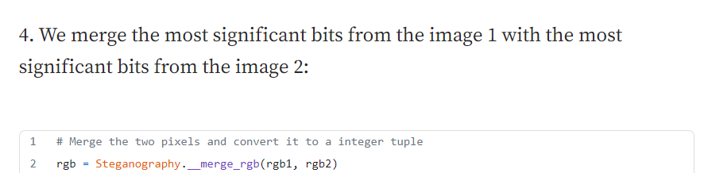
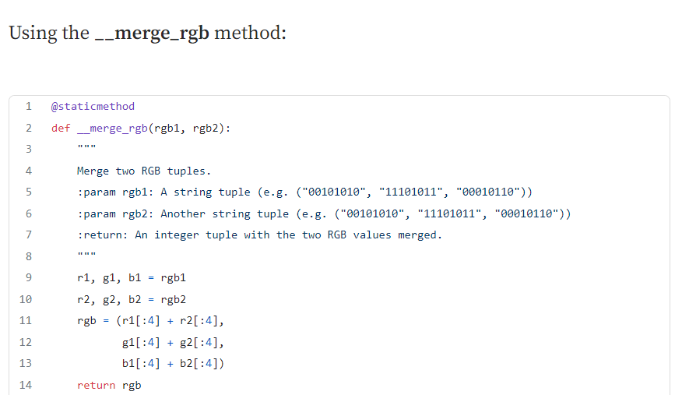

Slide 17
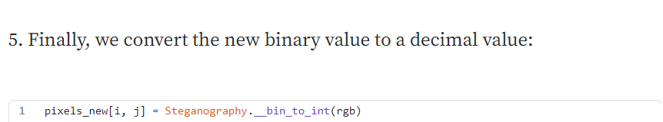
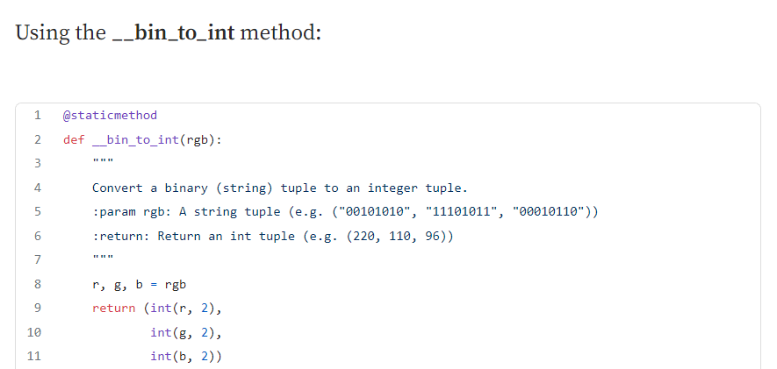

Slide 18
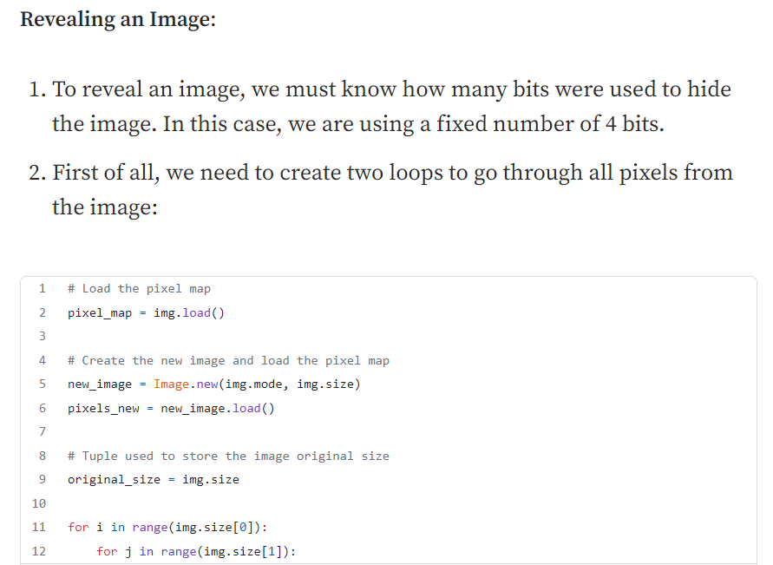
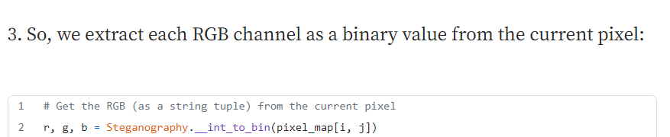

Slide 19
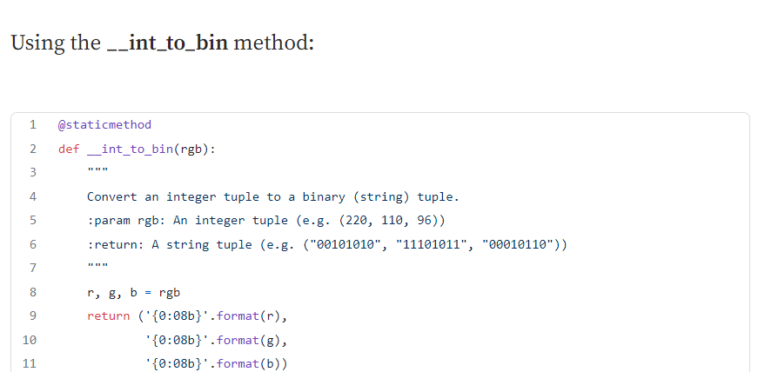
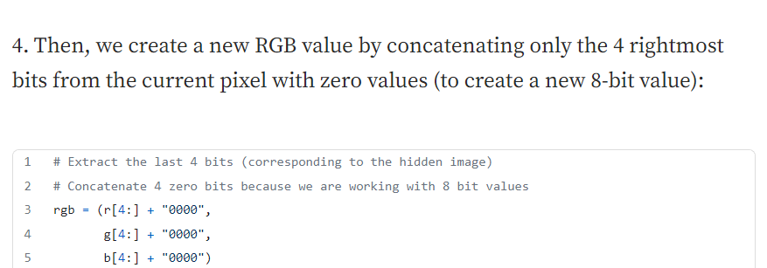

Slide 20
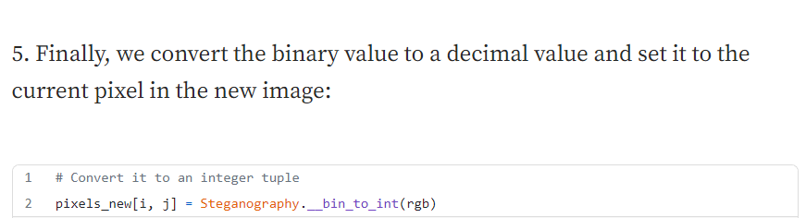
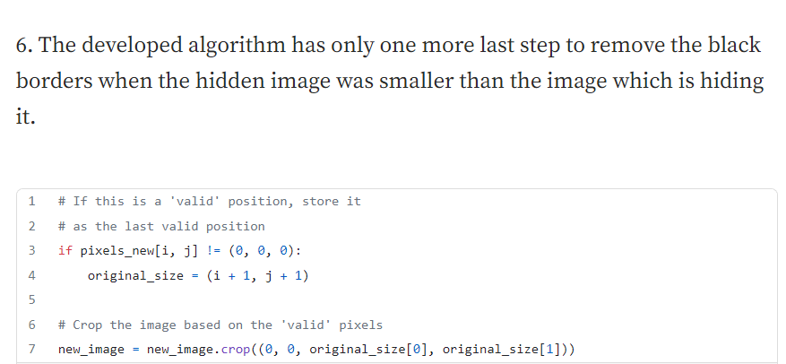

Slide 21
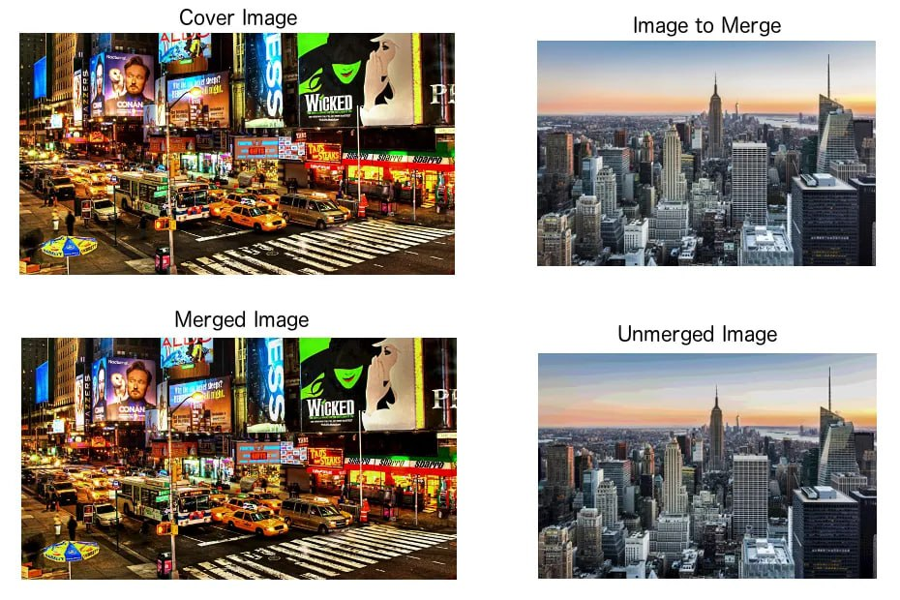
Output :

Slide 22
Source Code :
https://github.com/Islam-hady9/Image-processing-Project-Steganography-/blob/main/Steganography.py

