Slide 1


Multi-Layer Encryption
Islam Abdulhakem islam.abdulhakeem@msa.edu.eg 224179 Youssef Qotb Youssef.omar@msa.edu.eg 222657

Slide 2

Agenda
Testing & Results
Live Demo & Screenshots
References
Problem Statement
Cryptography Models
System Architecture

Slide 3

Problem Statement: Sensitive information is vulnerable to unauthorized access during storage and transmission. There is a need for a unified tool that demonstrates and compares various classical and modern encryption algorithms to help users understand and secure their data.
Objectives:
Implement multiple encryption and decryption algorithms (classical and modern).
Provide a simple interface for users to encrypt and decrypt messages.
Allow comparison of algorithm performance and security features.
Ensure correctness through comprehensive unit testing.

Slide 4

Cryptography Models
Vigenère Cipher:
Shift (Caesar) Cipher
Rail Fence Cipher
Autokey
Affine
AES-CBC

Slide 5
1. Vigenère Cipher
Type: Polyalphabetic substitution
Encryption: Ci = (Pi​+Ki​) mod 26
Decryption: Pi= (Ci​−Ki​ + 26) mod 26
Where:
Pi​: Plaintext letter index
Ki: Key letter index (repeated if shorter than plaintext)
Ci: Ciphertext letter index

Slide 6
2. Shift (Caesar) Cipher
Type: Monoalphabetic substitution
Encryption: Ci = (P+k) mod 26
Decryption: Pi = (Ci−k) mod 26
Where:
Pi: Plaintext letter index
k: Fixed key shift (e.g., 3)
Ci: Ciphertext letter index

Slide 7
3. Autokey Cipher
Type: Polyalphabetic substitution
Key: Starts with a keyword, followed by plaintext itself
Encryption: Ci = (Pi​+Ki​) mod 26
Decryption:
Use the keyword to decrypt initial letters
Then use recovered plaintext to continue
Pi​: Plaintext letter index
Ki: Key letter index (repeated if shorter than plaintext)
Ci: Ciphertext letter index

Slide 8
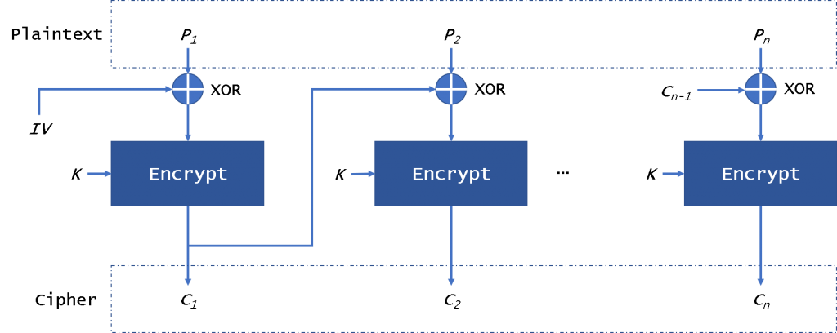
4.AES CBC-Mode

Slide 9
5. Affine Cipher
Type: Monoalphabetic substitution
Encryption: C = (aP + b) mod 26
Decryption: P = ( (C−b) / a)mod 26
Where:
a,b : Key values, with gcd⁡ (a,26) = 1

Slide 10
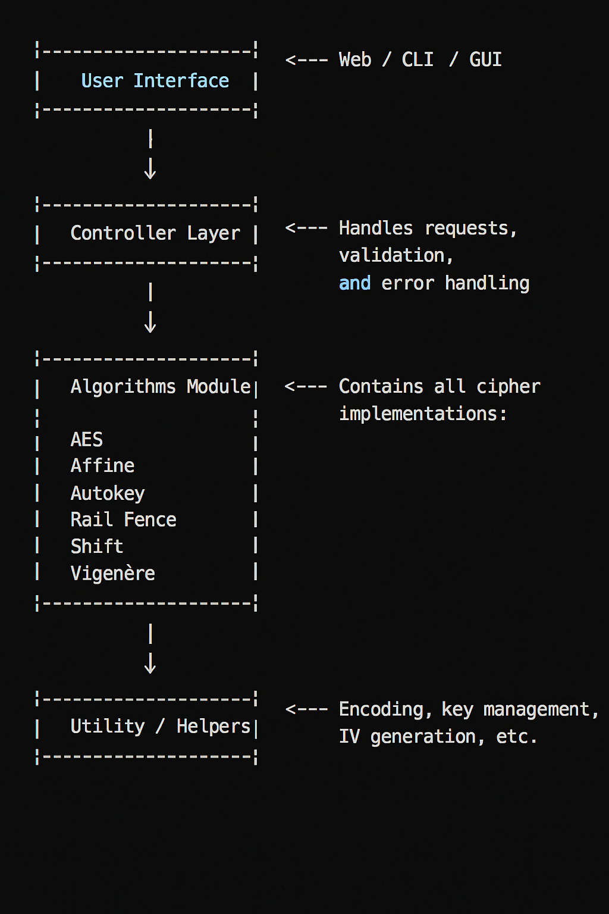
System-Arc and Implementation
Data Flow:
User provides input (text, key, algorithm) via UI.
Controller validates input and calls the appropriate algorithm.
Algorithm module performs encryption/decryption.
Utility functions assist with encoding, key/IV handling, etc.
Result is returned to the user.

Slide 11
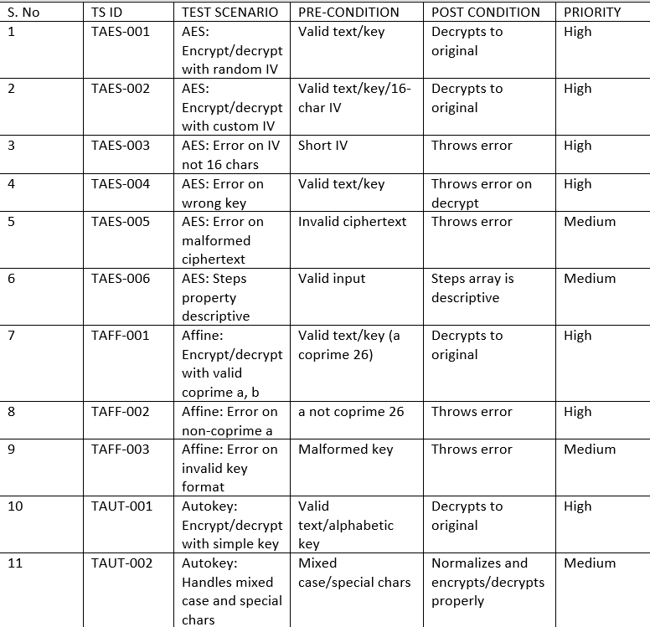
Testing and Results

Slide 12
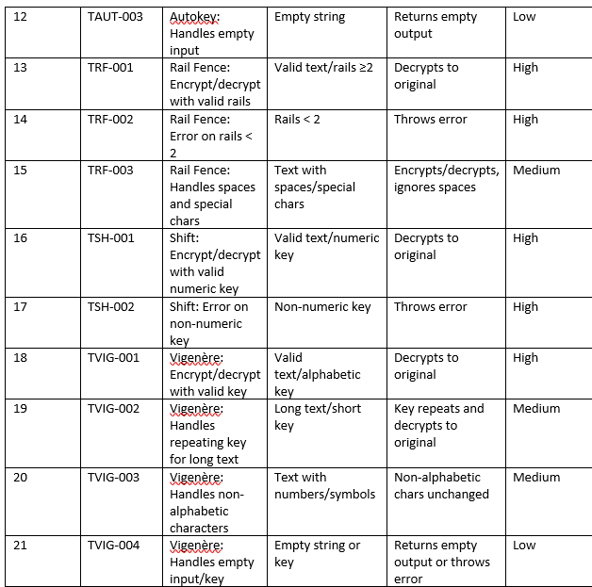
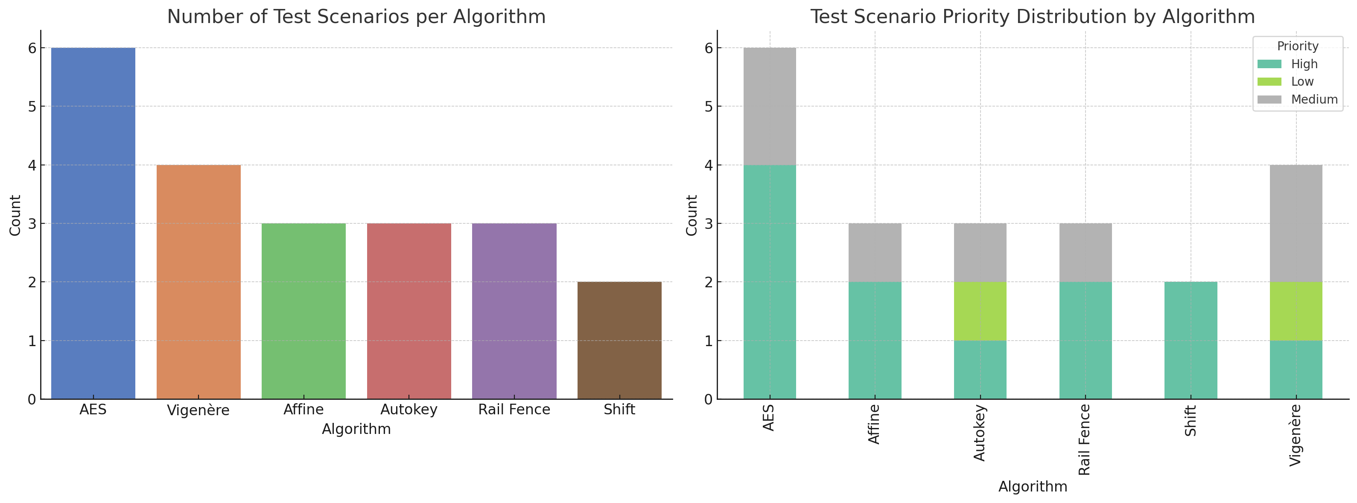
Testing and Results

Slide 13
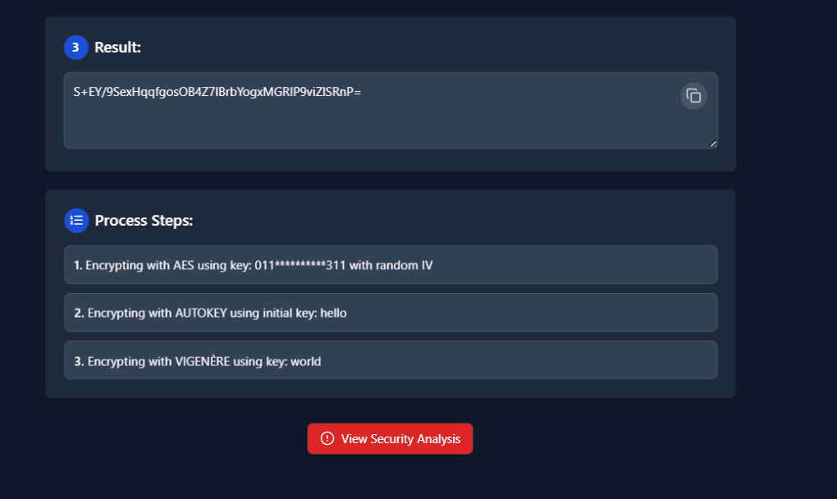
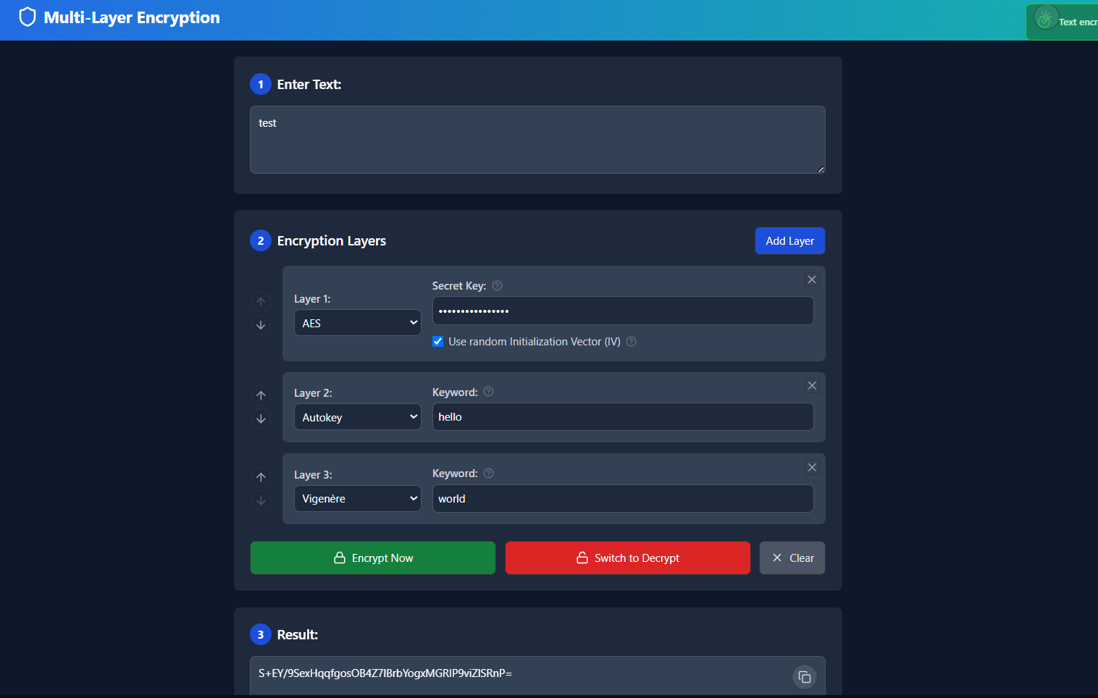
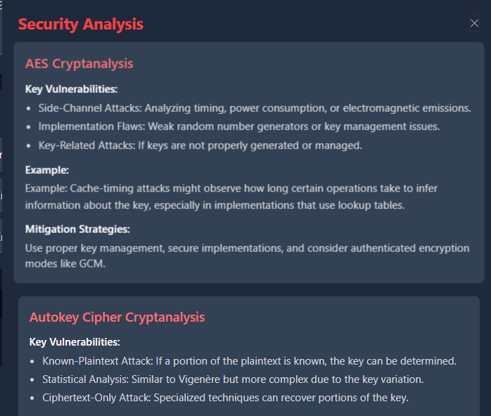
System Screenshots

Slide 14
Future Work
Designed for future enhancements, including:
Stronger encryption modes
Server-side security improvements
Advanced cryptanalysis tools
More cryptographic algorithms

Slide 15
Conclusion
CipherCraft is a prototype web app that blends classical and modern ciphers.
Supports customizable, multi-layer encryption.
Provides real-time insights into each encryption step and its security.
Not yet production-ready for secure deployment.

Slide 16
References
[1] Z. Z. Mammeri, Cryptography: Algorithms, Protocols, and Standards for ComputerSecurity, John Wiley & Sons, 2024.https://onlinelibrary.com/9781394207510
[2] Y. A. Younis, K. Kifayat, Q. Shi, E. Matthews, G. Griffiths, and R. Lambertse,“Teaching cryptography using Cypher (interactive cryptographic protocol teachingand learning), 2020. https://doi.org/10.1145/3410352.3410742
[3] CrypTool Project, https://www.cryptool.org.
[4] A. S. Al-Bayati, Enhancing Performance of Hybrid AES, RSA and Quantum Encryp-tion Algorithm, Ph.D. dissertation, Anglia Ruskin Research Online (ARRO), 2023Al-Bayati, Anwer S. (2023).https://hdl.handle.net/10779/aru.23768127.v1.
[5] D. Cevallos-Salas, J. Estrada-Jiménez, and D. S. Guamán, “Application layer secu-rity for internet communications: A comprehensive review, challenges, and futuretrends,2024, Elsevier.10.1016/j.compeleceng.2024.109498
[6] NIST, FIPS 1997 - Advanced Encryption Standard (AES).https://doi.org/10.6028/NIST.FIPS.197-upd1

