Slide 1
Performance Enhancement of RTAB-map Utilizing
ORB-SLAM2 Depth Information
Islam Ali | Zifei Jiang
iaali@ualberta.ca | zifei.jiang@ualberta.ca

Slide 2
Agenda
Introduction
Problem Definition
Literature Review
Methodology and Procedure
Performance Evaluation
Significance of Proposed Research

Slide 3
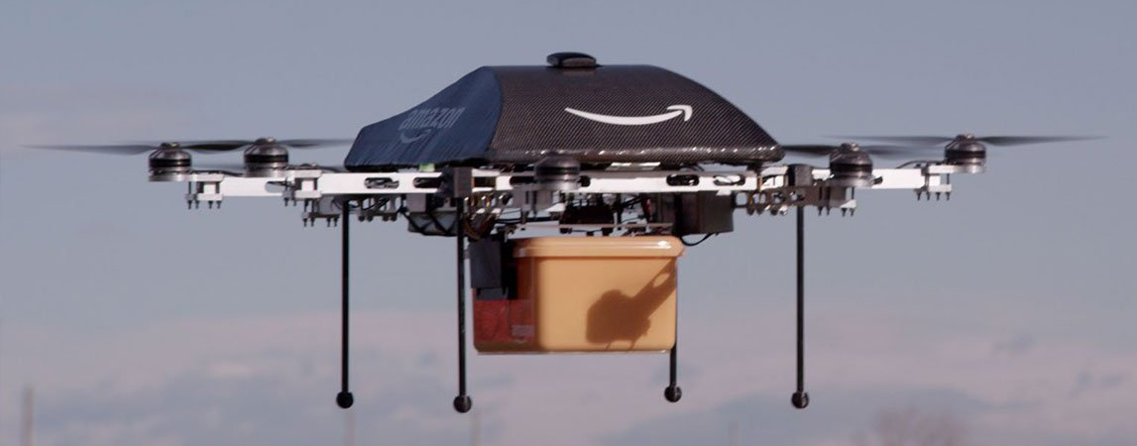
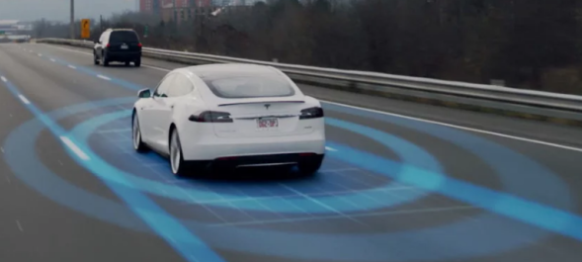
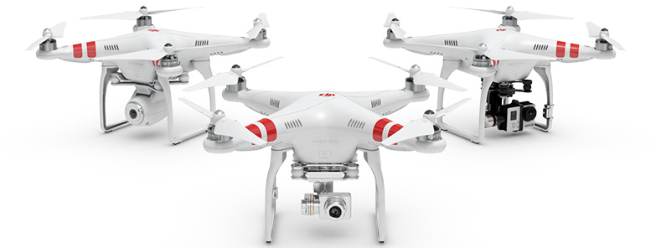
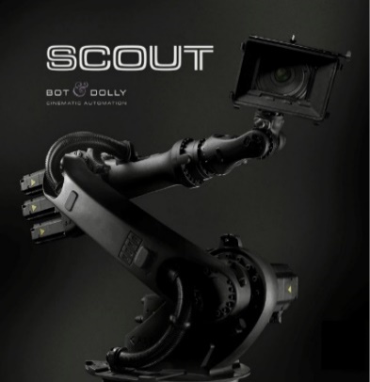

Introduction
Wide Spectrum of Applications …
https://www.amazon.com/Amazon-Prime-Air/b?node=8037720011
https://techcrunch.com/2016/08/11/teslas-autopilot-2-0-said-to-add-triple-camera-system-and-more-radar/
http://www.dji.com/newsroom/news/tags/phantom-2-vision-plus
http://www.datixinc.com/will-robot-job-2050/bot-and-dolly-scout/
https://www.ald.softbankrobotics.com/en/cool-robots/nao

Slide 4
Introduction
Wide spectrum of applications in many industries and disciplines sharing the similar needs in terms of perception of the world.
Perception of the world became possible and feasible by the introduction of different types of low-cost sensors such as :
Cameras, LiDARs, Radars, IMUs, GPS, among many others

Slide 5
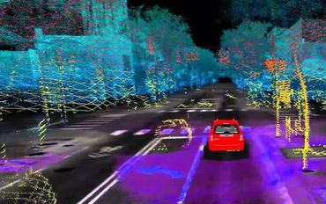
Problem Definition
Autonomous robotics are playing a vital role in all aspects of our lives and communities.
The ability of the robot to have accurate perception of the surroundings and sense of location is essential.
SLAM was the answer to both question, as it provides a model of the environment, and localize the robot inside it.
https://paperswithcode.com/task/simultaneous-localization-and-mapping

Slide 6
Problem Definition
Studies shown that, RTAB-Map and ORB-SLAM 1&2 are two state-of-the-art algorithms solving the SLAM problem.
Both algorithms outperform most of the classical and modern SLAM systems.
However, both suffer from performance issues under certain conditions and can provide wrong estimations for both the trajectory and the mapping.

Slide 7
Problem Definition
Looking into the details of RTAB-Map and ORB-SLAM2, we can infer potentials for Integration for a more reliable solution.
The original RTAB-Map pointed out the possibility of integration and the performance gain modestly.
In this work, we explore the possibility of embedding the depth information extracted from ORB-SLAM2 into RTAB-Map for performance enhancement.

Slide 8
Literature Review
RTAB-Map
Open source graph-based SLAM, deeply integrated to ROS.
Mapping is separated from Odometry for efficiency.
Map created directly from depth information without optimization.
ORB-SLAM
Ver. 1 → Monocular only, while Ver. 2 → Stereo and RGB-D
Optimization is done on camera poses and features points in the map (two levels of optimization)
ORB features are used in all stages (e.g. tracking, loop closure, ..)
Running 3 parallel threads for efficiency (tracking, local mapping, and loop closure)

Slide 9
Literature Review
RTAB-Map vs. ORB-SLAM 2
 | RTAB-Map | ORB-SLAM2
Advantages | Can accept a wide range of sensors as inputs. Better trajectory estimation. Better loop closure mechanism based on BoW. Works better outdoors. Dense map generation. Better RMS trajectory error. | Work with Monocular, Stereo, and RGB-D camera. Better odometry measurements Small number of outliers Works better indoors Strong loop closure resulting in rejection of false estimates. Better Max. trajectory error.
Disadvantages | Bad odometry measurements. Repeated surfaces due to odometry noise. Performance depends on the environment when using internal odometry engine. Lack of map optimization. | Long initialization / re-initialization time. Sparse non-detailed map. Missing loop closure and allow the trajectory drift to be visible.

Slide 10
Methodology and Procedure
Baseline Evaluation
Depth Info. Extraction and Utilization
System Validation

Slide 11
Methodology and Procedure
Baseline Evaluation
Depth Info. Extraction and Utilization
System Validation
Baseline performance is the performance of both RTAB-Map and ORB-SLAM2 on the selected datasets.
KITTI (for outdoor), and TUM RGB-D (for indoor)
Accuracy performance metrics are available in a number of studies, and can be replicated during the course of the research work.

Slide 12
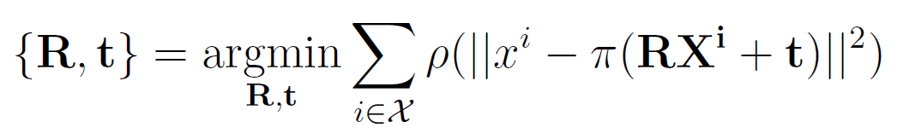
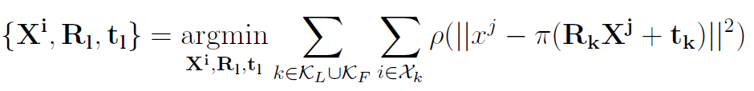
Methodology and Procedure
Baseline Evaluation
Depth Info. Extraction and Utilization
System Validation
RTAB-map only perform local optimization on camera poses to minimize the re-projection error between matched 3D points in world coordinate frame and the camera observation.
ORB-SLAM2 optimize the feature points in the map, and can provide more accurate depth information for feature points in keyframes.

Slide 13
Methodology and Procedure
Baseline Evaluation
Depth Info. Extraction and Utilization
System Validation
In this work, we will utilize the optimized keyframe generated by ORB-SLAM2 inside the RTAB-Map pipeline.
Objectives are to achieve:
Better trajectory accuracy
More reliable point cloud map

Slide 14
Methodology and Procedure
Baseline Evaluation
Depth Info. Extraction and Utilization
System Validation
System will be developed under ROS environment.
Validation will be conducted using unified datasets exploiting different scenarios, and having a ground truth.
Datasets selected are KITTI and TUM RGB-D.
Covering indoor/outdoor static/dynamic conditions.

Slide 15
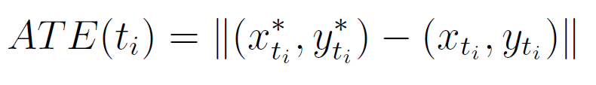
Performance Evaluation
In this work, we focus on Accuracy enhancement.
Absolute Trajectory Error (ATE) was adopted by many as a measure for accuracy, ATE is defined by:
To have a better representation of the error and its evolution, statistical measurements are applied to ATE.
Max / Min ATE Error
Root Mean Square Error (RMSE)
Mean, median, variance, and std. deviation.

Slide 16
Significance of Proposed Research
Extension of the boundaries of both Algorithms.
More robust and reliable SLAM solution.
Serve the ultimate objective of having an out-of-box SLAM system able to work under challenging conditions.

Slide 17

Questions

Slide 18
Thank You !

