Slide 1
Performance Enhancement of RTAB-map Utilizing
ORB-SLAM2 Depth Information
Project Progress Overview
Islam Ali | Zifei Jiang
iaali@ualberta.ca | zifei.jiang@ualberta.ca

Slide 2
Agenda
Introduction
Background : RTAB-Map
Background : ORB-SLAM2
RTAB-Map Vs. ORB-SLAM2
Problem Definition
Revisiting
System Block Diagram
Abstract Integration Structure
Detailed Block Diagram
Initial Baseline Results
KITTI & TUM datasets Results
Discussion
Open Questions

Slide 3
Introduction
In this presentation, we discuss the details of both ORB-SLAM2 and RTAB-Map as well as the integration details between the two.
Additionally, we present some of the baseline results and discuss their indications.
Finally, we conclude with some open questions that are yet to be answered in the course of the project.

Slide 4
Background : RTAB-Map

Slide 5
Background : ORB-SLAM2

Slide 6
RTAB-Map Vs. ORB-SLAM2

Slide 7
Problem Definition: Revisiting
Both ORB-SLAM2 and RTAB-Map are state-of-the-art SLAM algorithms but each has performance issues under certain conditions due to its architecture.
ORB-SLAM2 optimizes both camera poses and map points (2 levels of optimization) while RTAB-Map only optimize camera poses.
Integration of both algorithms can yield more reliable solution and can achieve better performance under wider range of scenarios.

Slide 8
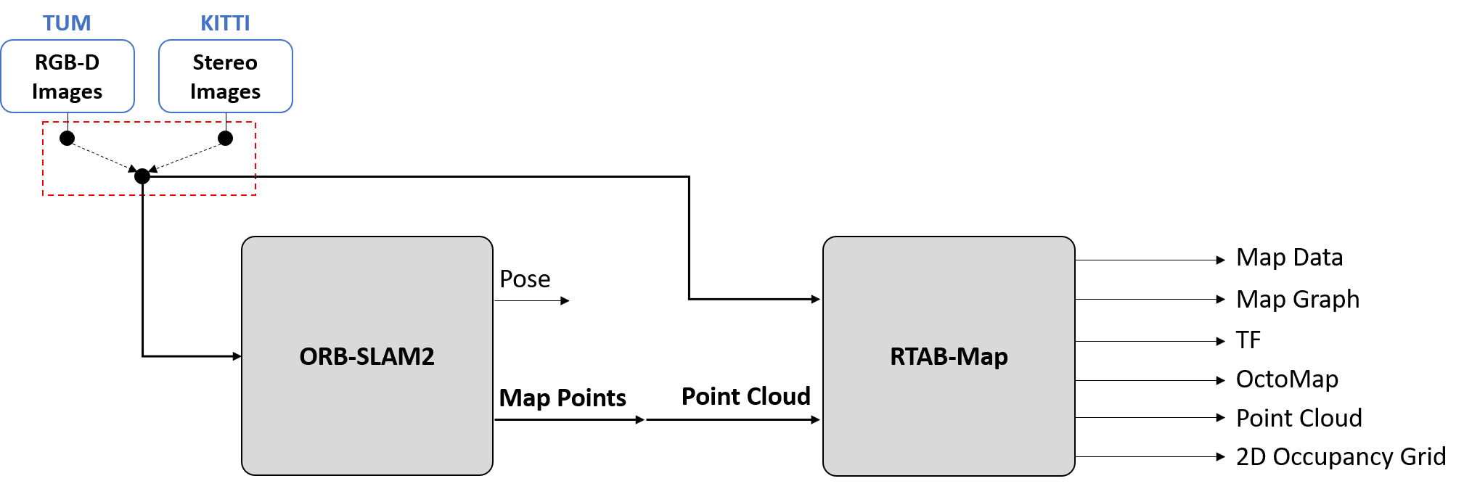
System Block Diagram: Abstract
In a nutshell, we are trying to utilize the optimized map points from ORB-SLAM2 in RTAB-Map in order to enhance its accuracy.
Input controls are dependent on the dataset under test (DUT) and is sent to both ORB-SLAM2 and RTAB-Map.

Slide 9
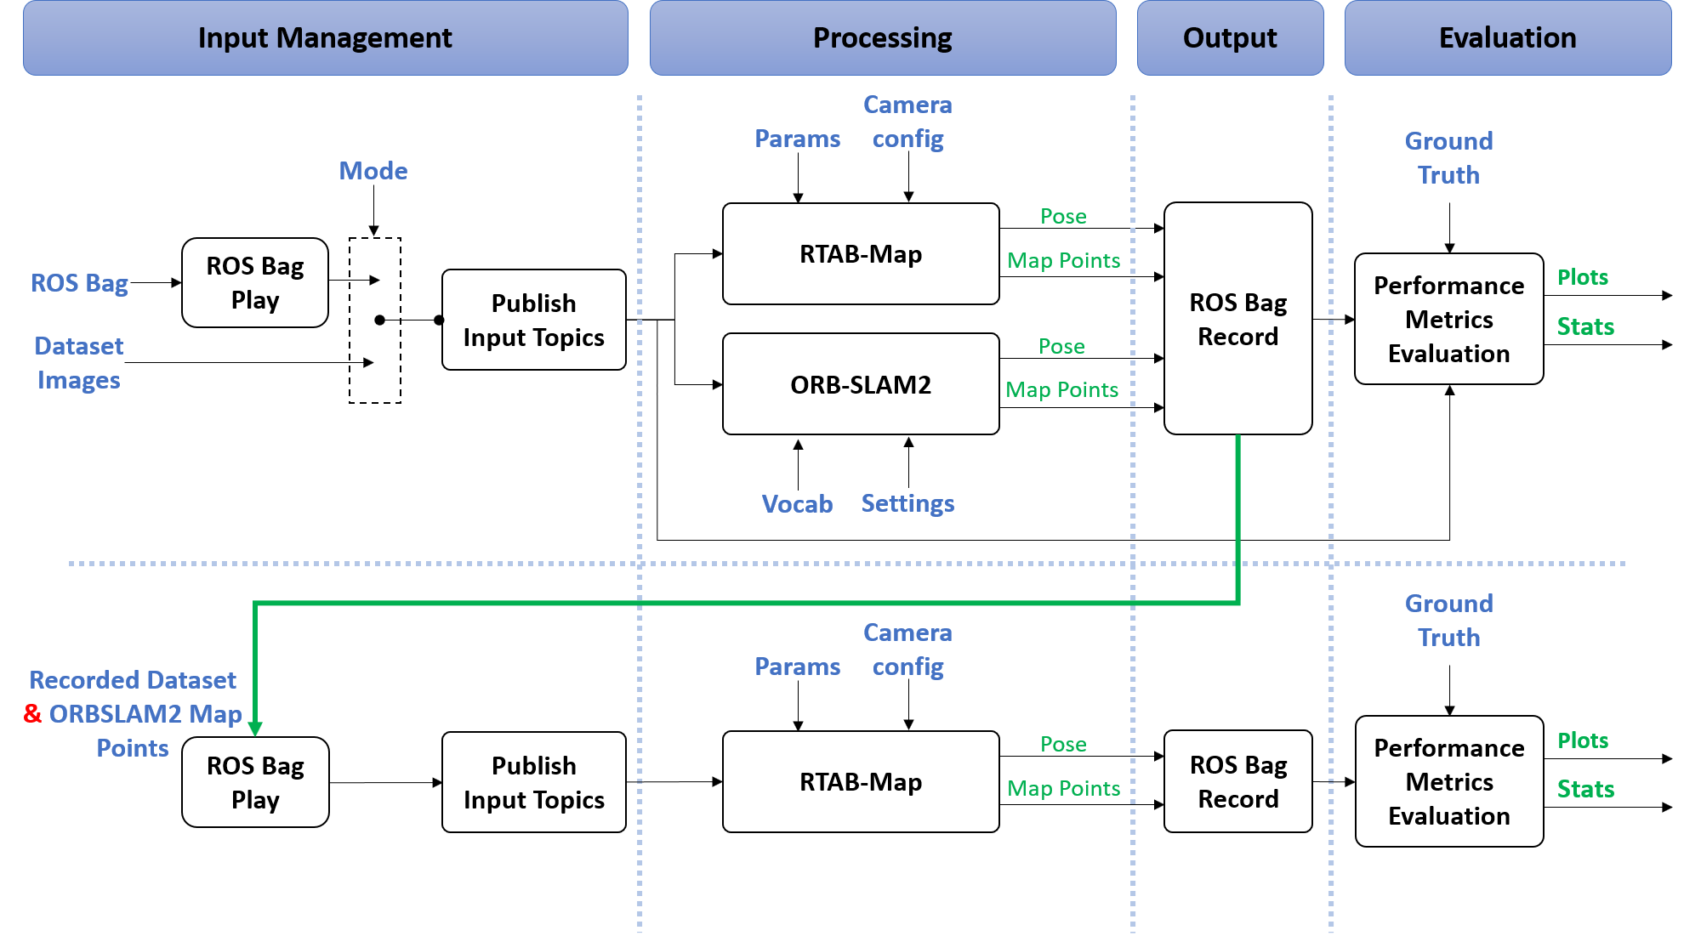
System Block Diagram: Detailed

Slide 10
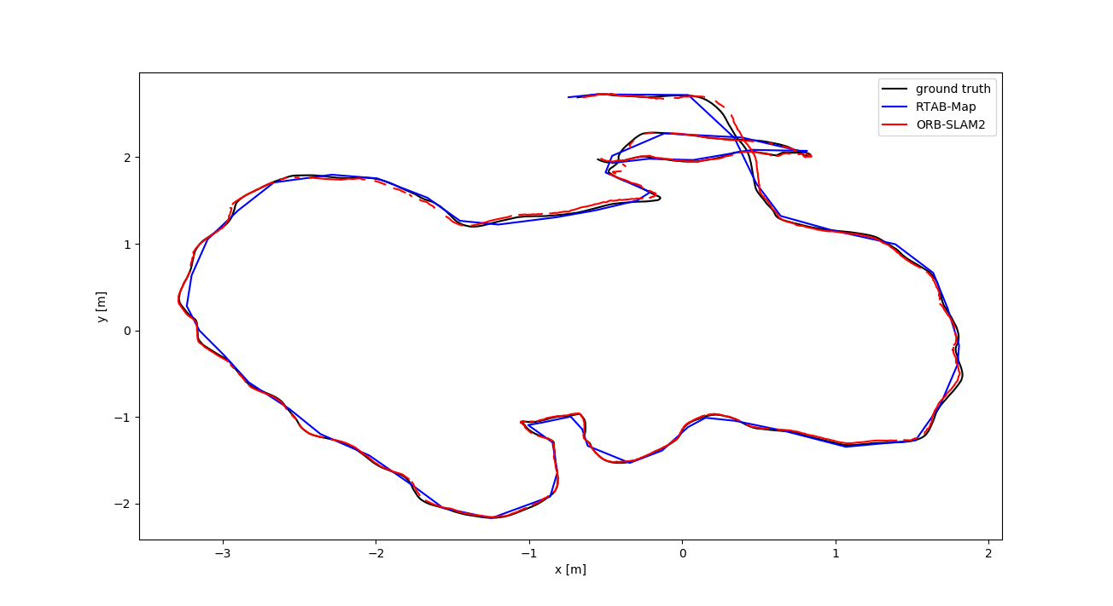
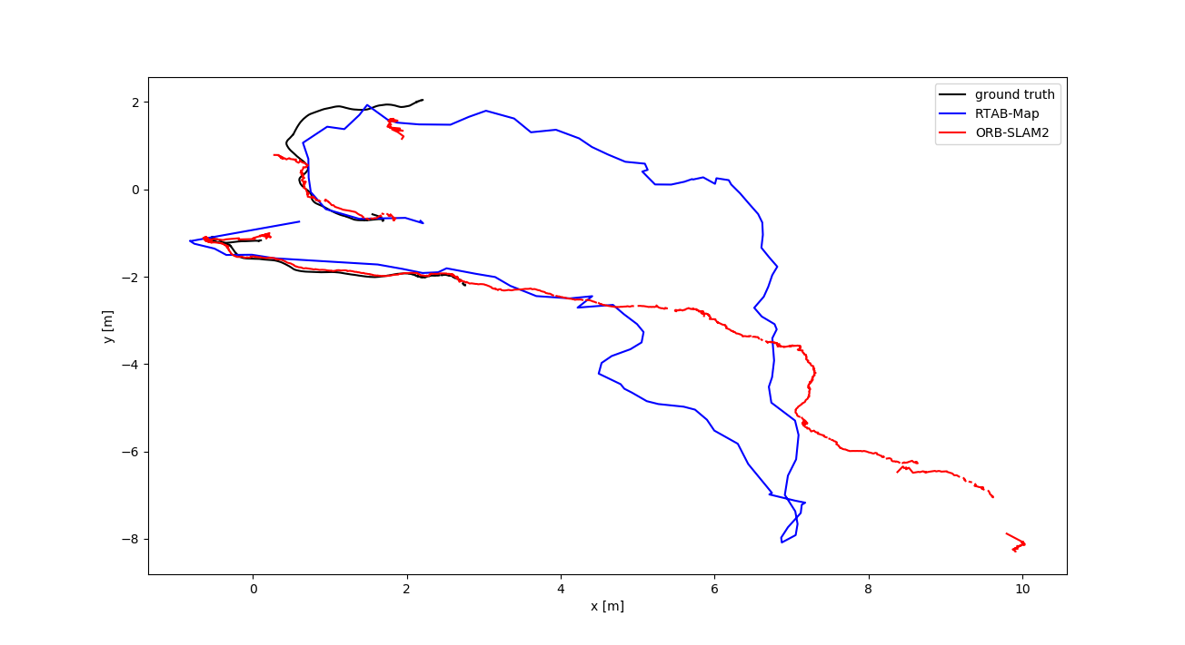
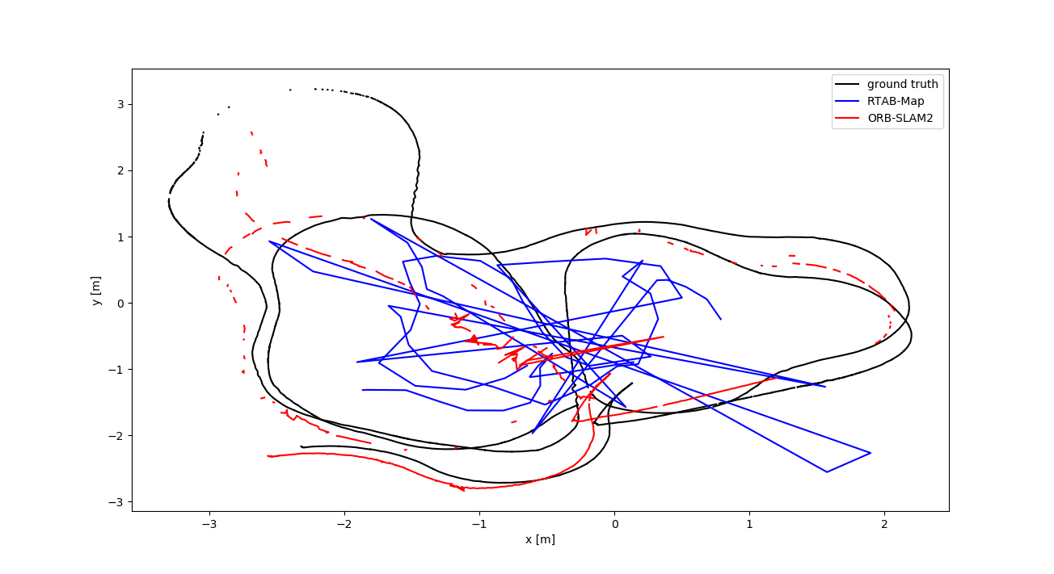
Initial Baseline Results
TUM RGB-D Plots:
Freiburg2 trajectories have large errors when compared to freiburg3.
Different maybe in the un-distortion applied only to freiburg3.
?
?

Slide 11
Initial Baseline Results
TUM RGB-D Dataset Quantitive Results
Absolute Trajectory Error (m)
Sequence | SLAM system | RMSE | mean | median | std | min | max
Freiburg2 Large with loop | RTAB-Map | 0.396 | 0.363 | 0.360 | 0.159 | 0.129 | 0.691
 | ORB-SLAM2 | 0.155 | 0.124 | 0.102 | 0.093 | 0.015 | 0.830
Freiburg2 Pioneer slam | RTAB-Map | 1.594 | 1.220 | 0.967 | 1.028 | 0.314 | 7.112
 | ORB-SLAM2 | 0.526 | 0.350 | 0.230 | 0.385 | 0.033 | 3.065
Freiburg3 Long office household | RTAB-Map | 0.043 | 0.040 | 0.039 | 0.013 | 0.004 | 0.074
 | ORB-SLAM2 | 0.030 | 0.025 | 0.019 | 0.016 | 0.001 | 0.095
?
?

Slide 12
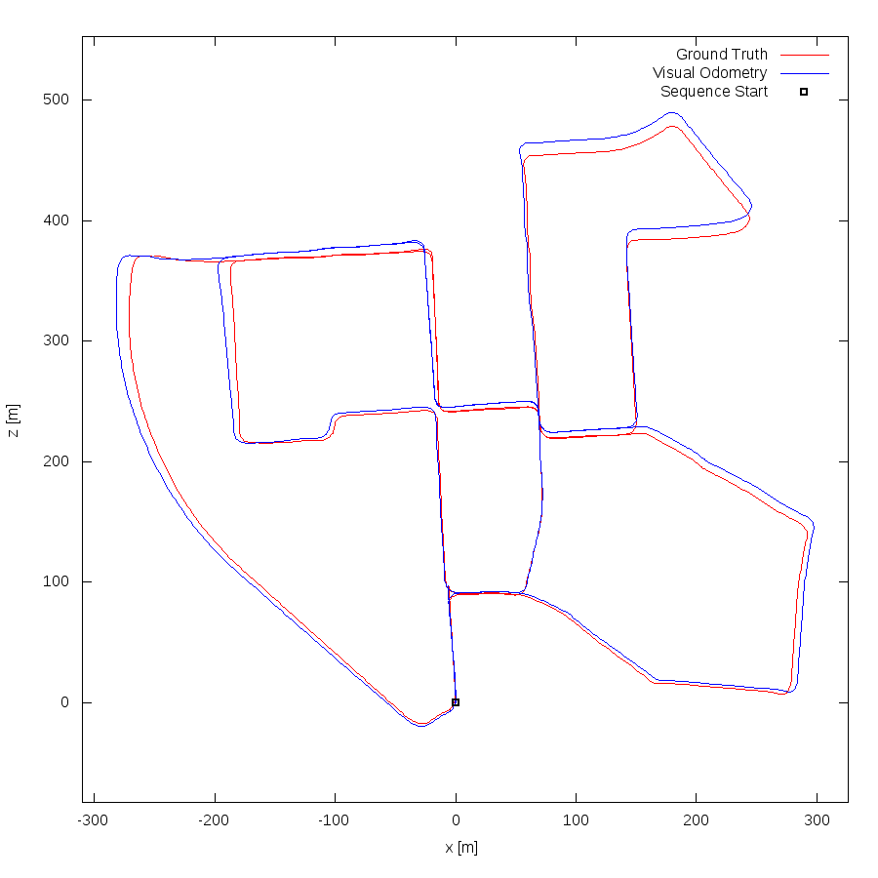
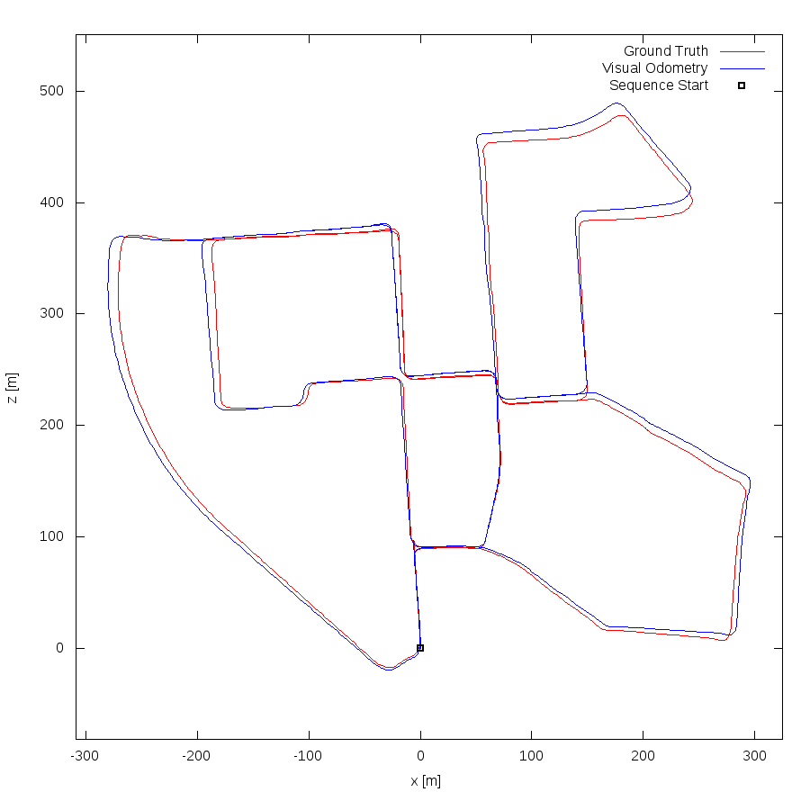
Initial Baseline Results
KITTI Stereo Plots:
Sequence 00
RTAB-Map (left) & ORB-SLAM2 (right)

Slide 13
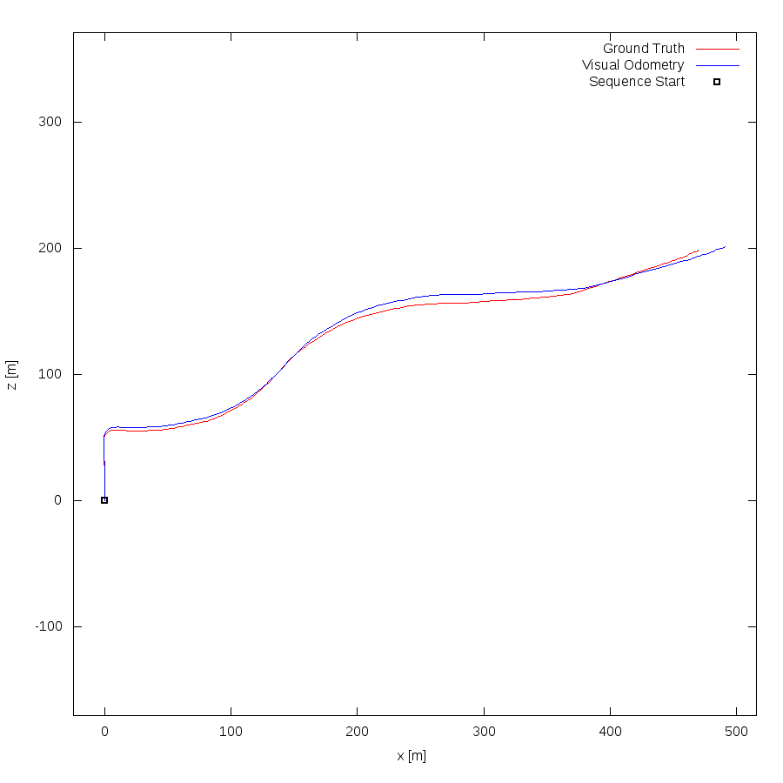
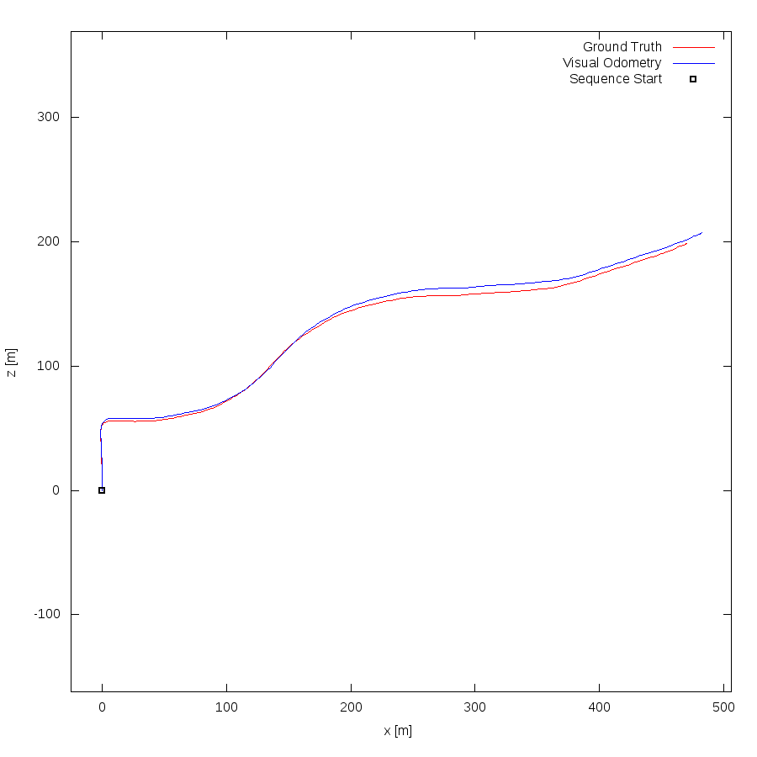
Initial Baseline Results
KITTI Stereo Plots:
Sequence 03
RTAB-Map (left) & ORB-SLAM2 (right)

Slide 14
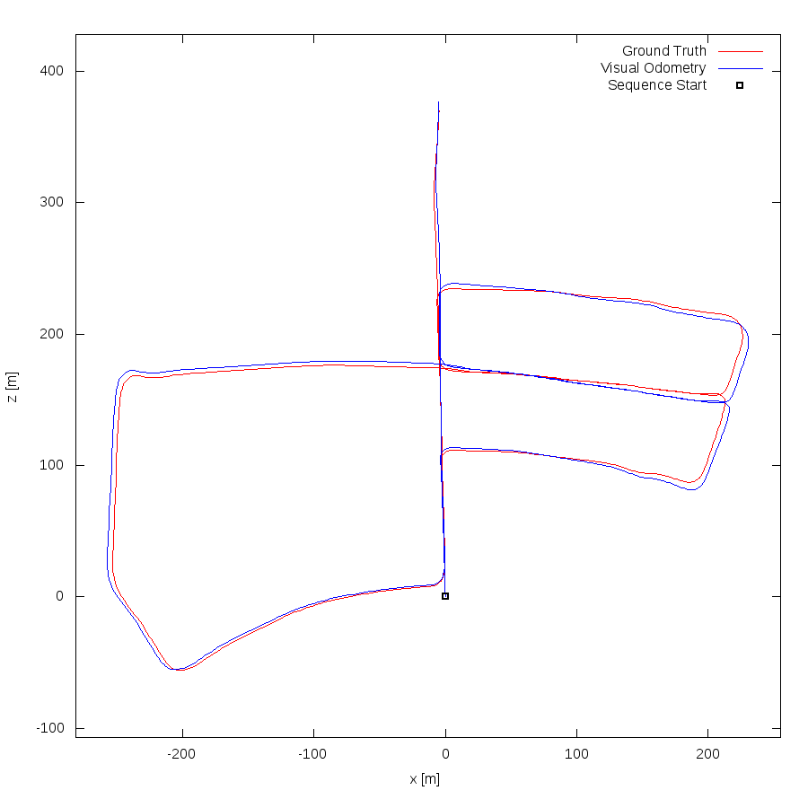
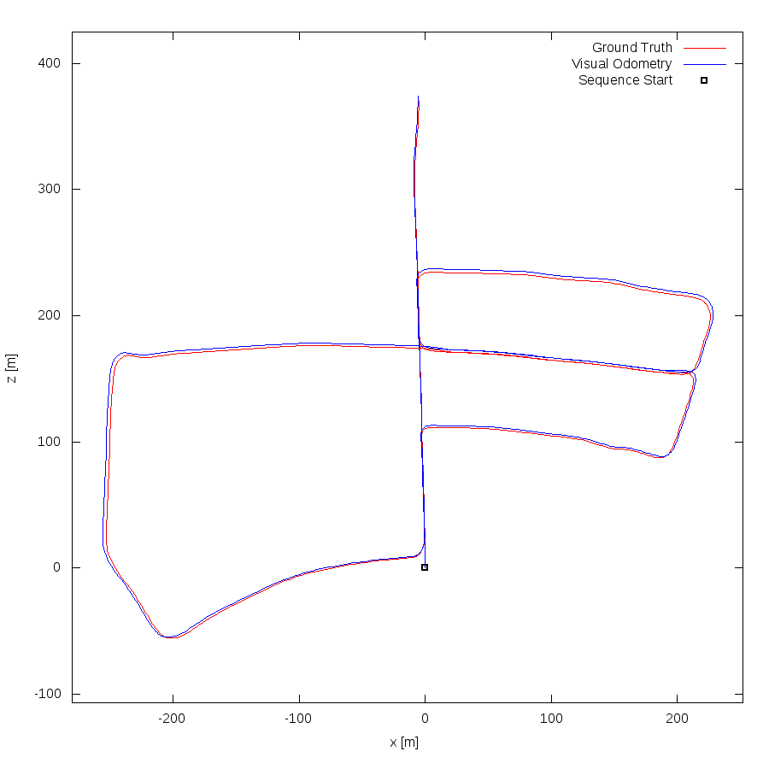
Initial Baseline Results
KITTI Stereo Plots:
Sequence 05
RTAB-Map (left) & ORB-SLAM2 (right)

Slide 15
Initial Baseline Results
KITTI Stereo Dataset Quantitive Results
Absolute Trajectory Error (m)
Sequence | SLAM system | RMSE | mean | median | std | min | max
Sequence 00 | RTAB-Map | 3.210 | 6.189 | 5.845 | 3.211 | 0.092 | 12.426
 | ORB-SLAM2 | 2.964 | 5.850 | 5.865 | 2.965 | 0.131 | 11.486
Sequence 03 | RTAB-Map | 6.476 | 10.329 | 10.190 | 6.488 | 0.096 | 21.573
 | ORB-SLAM2 | 4.623 | 7.709 | 7.690 | 4.631 | 0.049 | 14.979
Sequence 05 | RTAB-Map | 1.868 | 3.705 | 3.600 | 1.869 | 0.024 | 7.171
 | ORB-SLAM2 | 0.807 | 2.162 | 2.170 | 0.807 | 0.012 | 3.784

Slide 16
Open Questions
ORB-SLAM2 generates sparse maps (point clouds), would this be sufficient for RTAB-Map to utilize in its operation?
Is the synchronization block in RTAB-Map enough to handle the synchronization between input images and point cloud?
Are KITTI (Stereo) and TUM (RGB-D) enough to evaluate the system and to explore its corner cases?
TUM Dataset, is the lack of distortion is the reason behind the degraded performance in freiburg2 sequences?

Slide 17

Questions

Slide 18
Thank You !

