Slide 1
Performance Enhancement of RTAB-map Utilizing
ORB-SLAM2 Depth Information
Project Progress Overview
Islam Ali | Zifei Jiang
iaali@ualberta.ca | zifei.jiang@ualberta.ca

Slide 2
Agenda
Introduction
Background : RTAB-Map
Background : ORB-SLAM2
RTAB-Map Vs. ORB-SLAM2
Problem Definition
Revisiting
System Block Diagram
Abstract Integration Structure
Detailed Block Diagram
Initial Baseline Results
KITTI & TUM datasets Results
Discussion
Open Questions

Slide 3
Introduction

Slide 4
Background : RTAB-Map

Slide 5
Background : ORB-SLAM2

Slide 6
RTAB-Map Vs. ORB-SLAM2

Slide 7
Problem Definition: Revisiting

Slide 8
System Block Diagram: Abstract

Slide 9
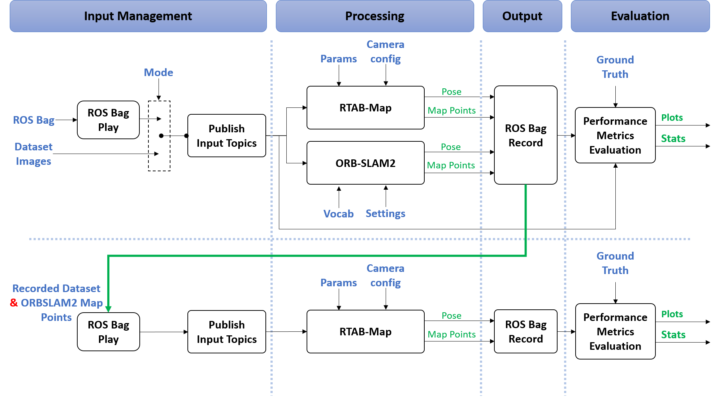
System Block Diagram: Detailed

Slide 10
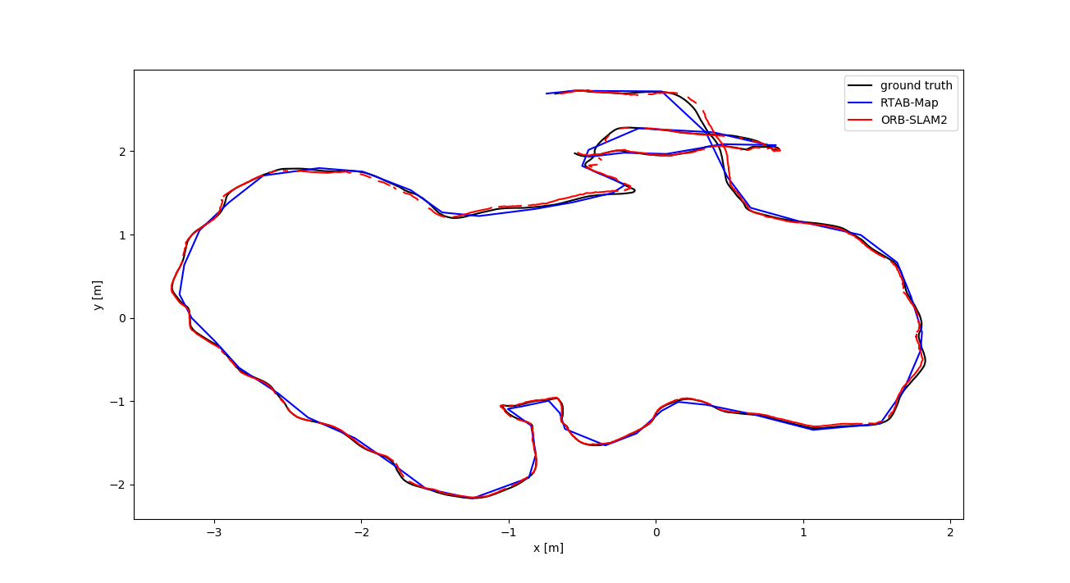
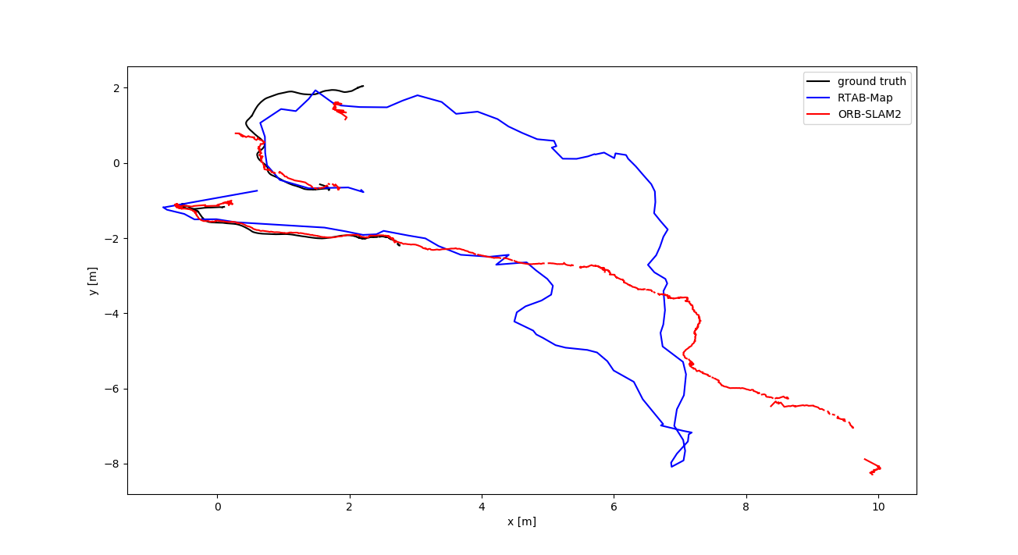
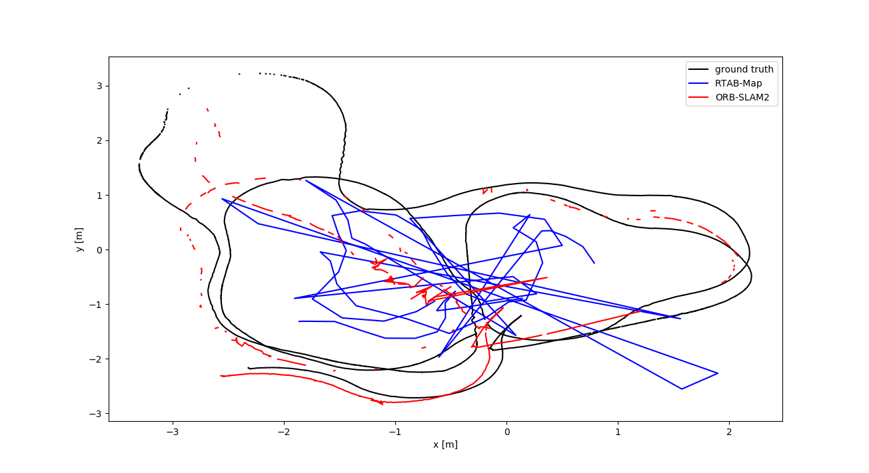
Initial Baseline Results
TUM RGB-D Plots:
Freiburg2 trajectories have large errors when compared to freiburg3.
Different maybe in the un-distortion applied only to freiburg3.
?
?

Slide 11
Initial Baseline Results
TUM RGB-D Dataset Quantitive Results
Absolute Trajectory Error (m)
Sequence | SLAM system | RMSE | mean | median | std | min | max
Freiburg2 Large with loop | RTAB-Map | 0.396 | 0.363 | 0.360 | 0.159 | 0.129 | 0.691
 | ORB-SLAM2 | 0.155 | 0.124 | 0.102 | 0.093 | 0.015 | 0.830
Freiburg2 Pioneer slam | RTAB-Map | 1.594 | 1.220 | 0.967 | 1.028 | 0.314 | 7.112
 | ORB-SLAM2 | 0.526 | 0.350 | 0.230 | 0.385 | 0.033 | 3.065
Freiburg3 Long office household | RTAB-Map | 0.043 | 0.040 | 0.039 | 0.013 | 0.004 | 0.074
 | ORB-SLAM2 | 0.030 | 0.025 | 0.019 | 0.016 | 0.001 | 0.095
?
?

Slide 12
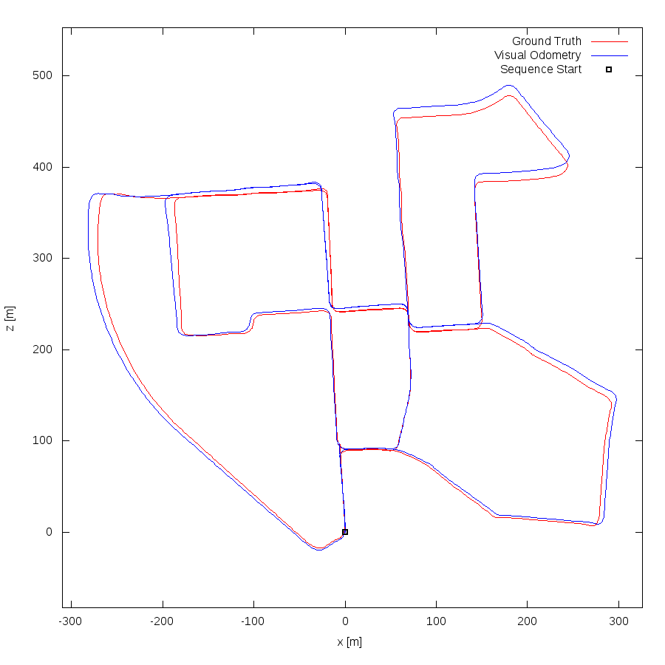
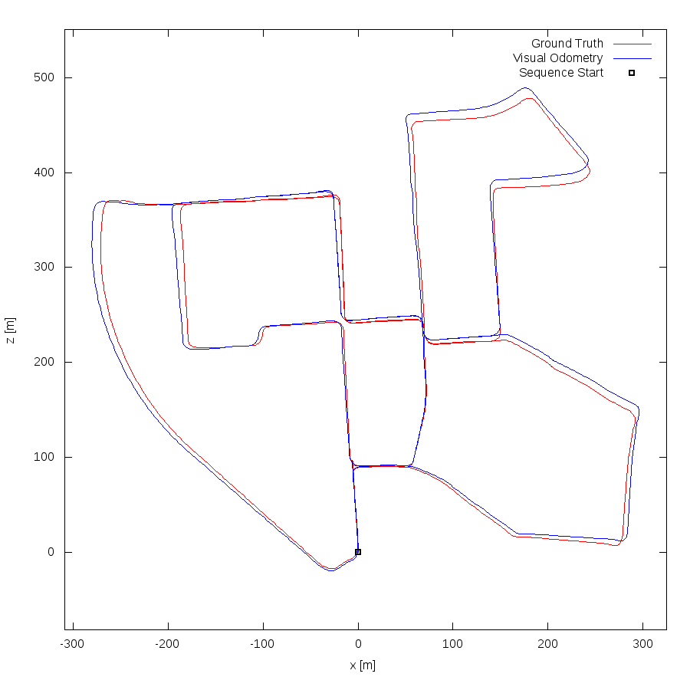
Initial Baseline Results
KITTI Stereo Plots:
Sequence 00
RTAB-Map (left) & ORB-SLAM2 (right)

Slide 13
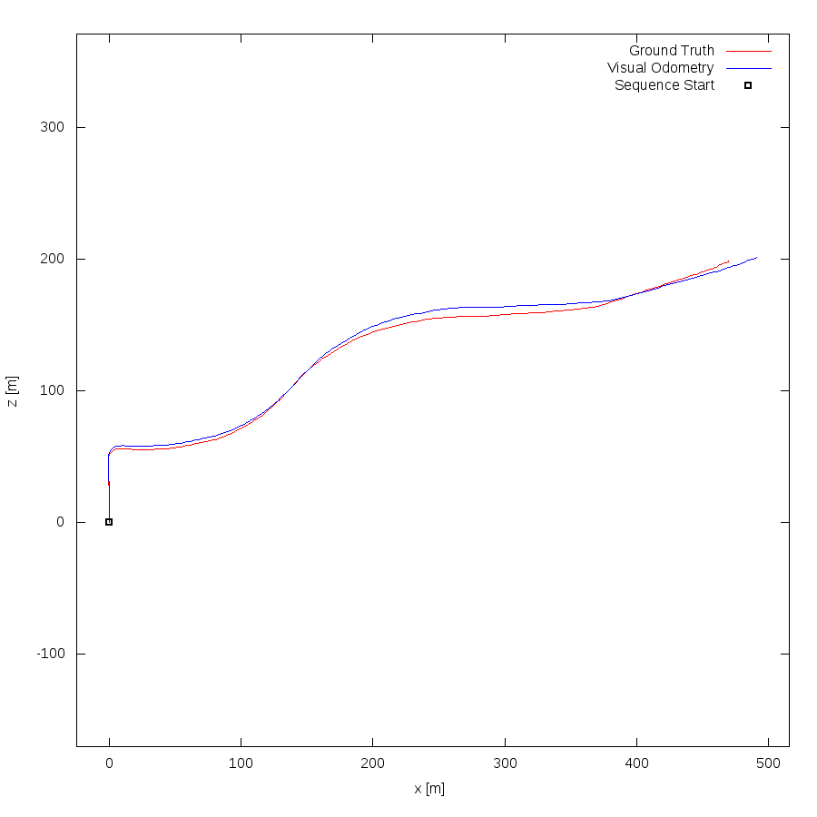
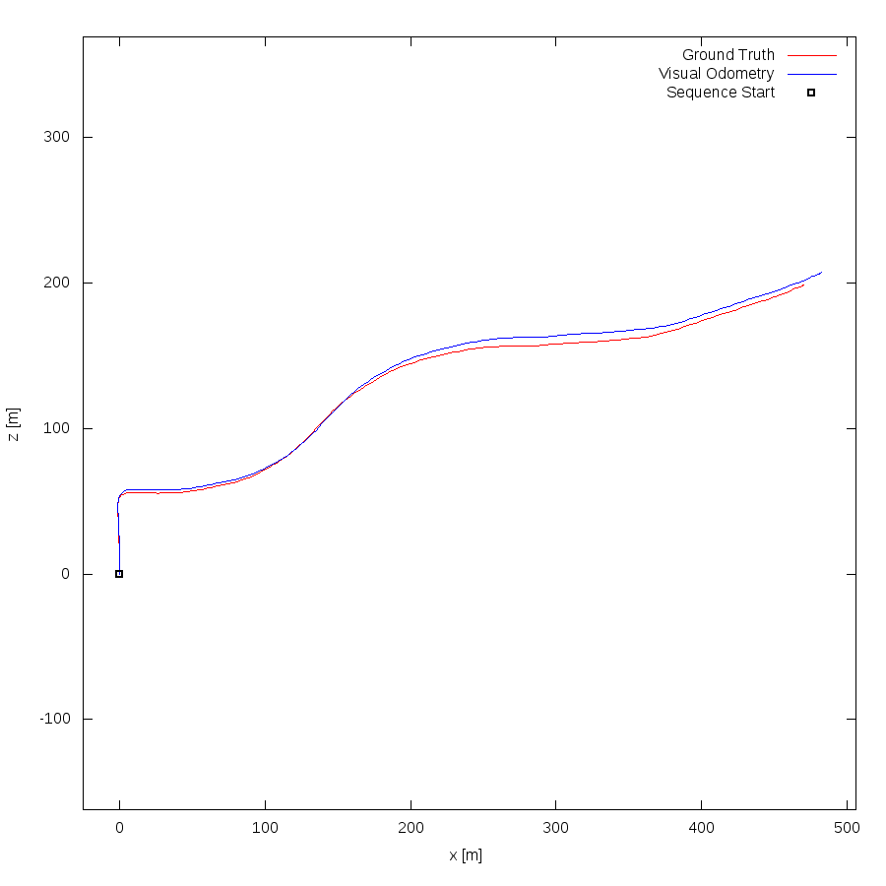
Initial Baseline Results
KITTI Stereo Plots:
Sequence 03
RTAB-Map (left) & ORB-SLAM2 (right)

Slide 14
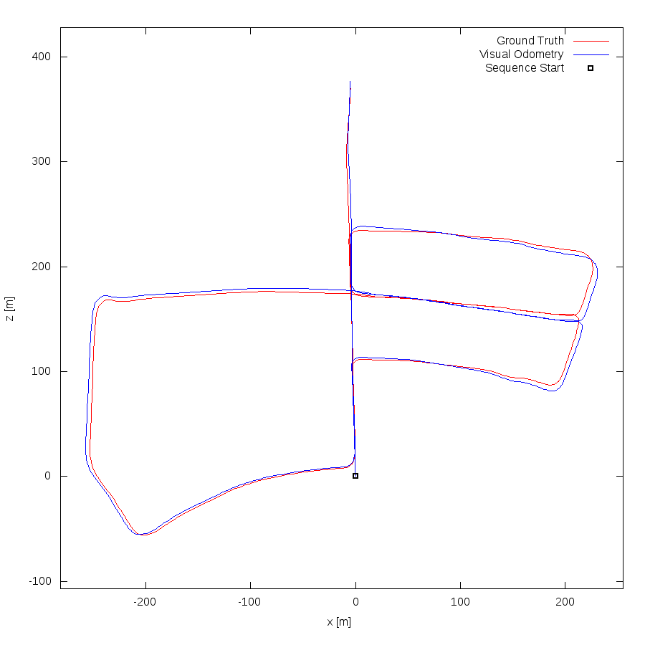
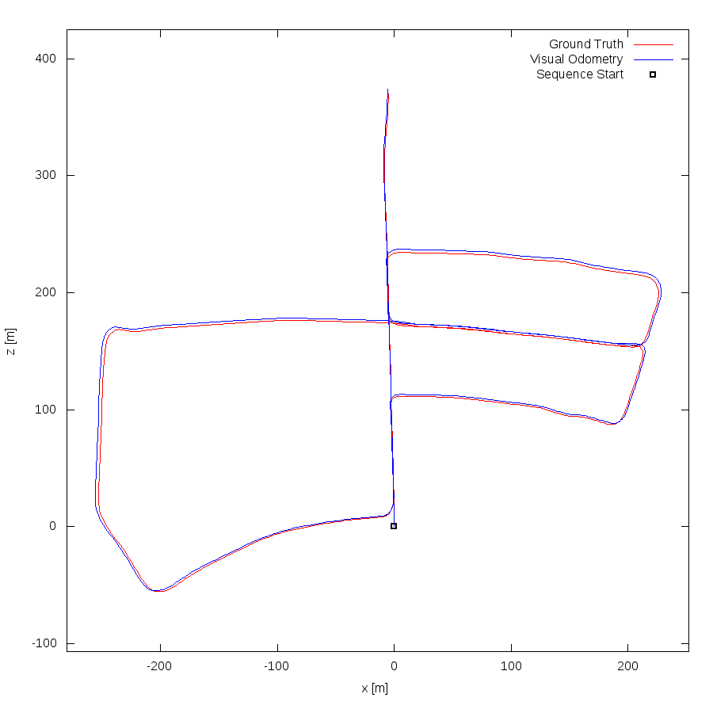
Initial Baseline Results
KITTI Stereo Plots:
Sequence 05
RTAB-Map (left) & ORB-SLAM2 (right)

Slide 15
Initial Baseline Results
KITTI Stereo Dataset Quantitive Results
Absolute Trajectory Error (m)
Sequence | SLAM system | RMSE | mean | median | std | min | max
Sequence 00 | RTAB-Map
 | ORB-SLAM2
Sequence 03 | RTAB-Map
 | ORB-SLAM2
Sequence 05 | RTAB-Map
 | ORB-SLAM2

Slide 16
Open Questions
ORB-SLAM2 generates sparse maps (point clouds), would this be sufficient for RTAB-Map to utilize in its operation?
Are Kitti (Stereo) and TUM (RGB-D) enough to evaluate the system and to explore its corner cases?
TUM Dataset, is the lack of distortion is the reason behind the degraded performance in freiburg2 sequences?

Slide 17

Questions

Slide 18
Thank You !

