Slide 1
Performance Enhancement of RTAB-map Utilizing
ORB-SLAM2 Depth Information
Project Progress Overview
Islam Ali | Zifei Jiang
iaali@ualberta.ca | zifei.jiang@ualberta.ca

Slide 2
Agenda
Introduction
Background : RTAB-Map
Background : ORB-SLAM2
RTAB-Map Vs. ORB-SLAM2
Problem Definition
Revisiting
System Block Diagram
Abstract Integration Structure
Detailed Block Diagram
Initial Baseline Results
KITTI & TUM datasets Results
Discussion
Open Questions

Slide 3
Introduction
In this presentation, we discuss the details of both ORB-SLAM2 and RTAB-Map as well as the integration details between the two.
Additionally, we present some of the baseline results and discuss their indications.
Finally, we conclude with some open questions that are yet to be answered in the course of the project.

Slide 4
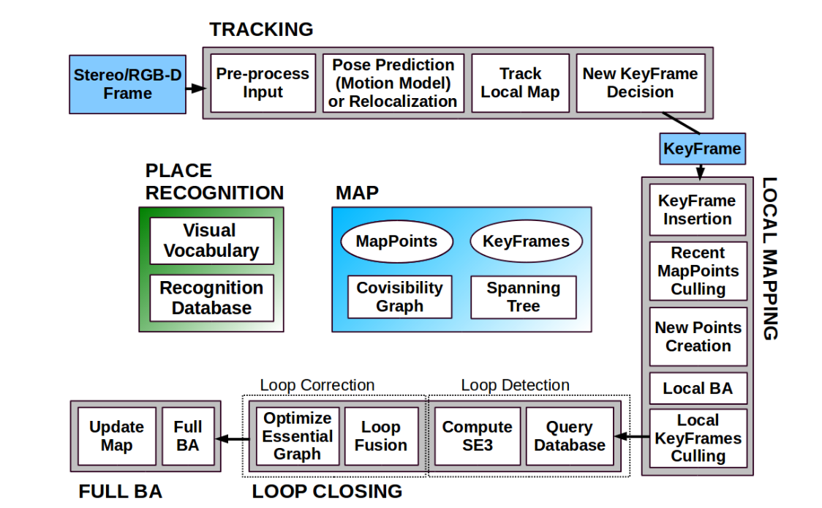
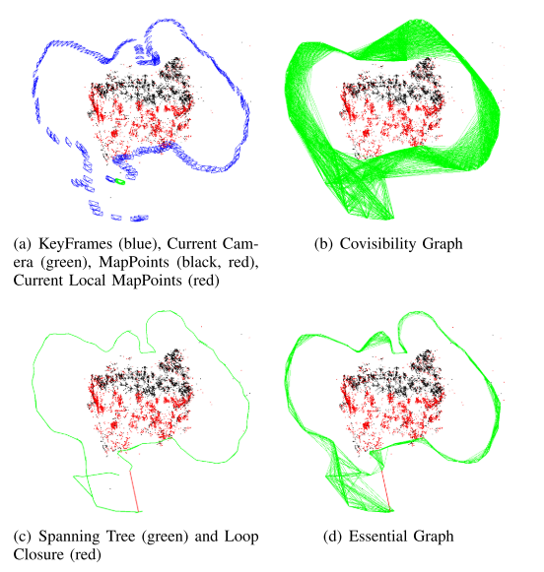
Background : ORB-SLAM2
Stereo Image enable easier map initialization
ORB-SLAM using both Homography, Fundamental matrix in visual odometry.
Local BA optimize a set of covisible frames and all map points seen in these frames
Full BA can be really costly and may not influence the result a lot.
When doing loop closing correction, orb-slam optimizes essential graph.

Slide 5
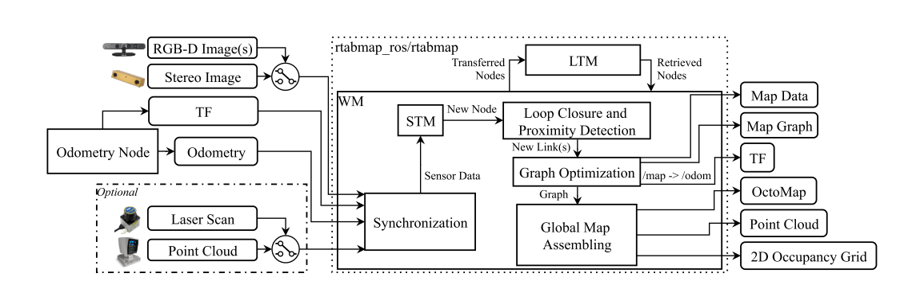
Background : RTAB-Map
The main character of RTAB-Map is Pose Graph Slam system, which enable the separation of Odometry and Map
In RTAB-Map paper, ORB-SLAM2 has been implemented as a Odometry part, and it out perform other method in the KITTI dataset.
Using ICP to estimate motion is easily to realize. RGB-D Slam in 2014 used ICP[1].
One big advantage of RTAB-Map system is the memory management. Many previous Slam system building dense map can only in small scale environments.[2]
RTAB-Map uses ray tracing to build a 3D grid map
[1] "3D Mapping with an RGB-D Camera", F. Endres, J. Hess, J. Sturm, D. Cremers, W. Burgard, IEEE Transactions on Robotics, 2014.
[2] T. Whelan, R. F. Salas-Moreno, B. Glocker, A. J. Davison, and S. Leutenegger, “ElasticFusion: Real-time dense SLAM and light source estimation,” Int. J. Robot. Res., vol. 35, no. 14, pp. 1697–1716, 2016.
[3]

Slide 6
RTAB-Map Vs. ORB-SLAM2
A number of studies were conducted to compare SLAM systems including ORB-SLAM 1&2 and RTAB-Map:
[1] Ragot, N., Khemmar, R., Pokala, A., Rossi, R., & Ertaud, J. Y. (2019, July). Benchmark of Visual SLAM Algorithms: ORB-SLAM2 vs RTAB-Map. In 2019 Eighth International Conference on Emerging Security Technologies (EST) (pp. 1-6). IEEE.
[2] Giubilato, R., Chiodini, S., Pertile, M., & Debei, S. (2018, June). An experimental comparison of ros-compatible stereo visual slam methods for planetary rovers. In 2018 5th IEEE International Workshop on Metrology for AeroSpace (MetroAeroSpace) (pp. 386-391). IEEE.
[3] Filipenko, M., & Afanasyev, I. (2018, September). Comparison of various slam systems for mobile robot in an indoor environment. In 2018 International Conference on Intelligent Systems (IS) (pp. 400-407). IEEE.
[4] Ibragimov, I. Z., & Afanasyev, I. M. (2017, October). Comparison of ros-based visual slam methods in homogeneous indoor environment. In 2017 14th Workshop on Positioning, Navigation and Communications (WPNC) (pp. 1-6). IEEE.
[5] da Silva, B. M., Xavier, R. S., do Nascimento, T. P., & Gonsalves, L. M. (2017, November). Experimental evaluation of ROS compatible SLAM algorithms for RGB-D sensors. In 2017 Latin American Robotics Symposium (LARS) and 2017 Brazilian Symposium on Robotics (SBR) (pp. 1-6). IEEE.
[6] Gaspar, A. R., Nunes, A., Pinto, A., & Matos, A. (2017, November). Comparative Study of Visual Odometry and SLAM Techniques. In Iberian Robotics conference (pp. 463-474). Springer, Cham.

Slide 7
RTAB-Map Vs. ORB-SLAM2
A number of studies were conducted to compare SLAM systems including ORB-SLAM 1&2 and RTAB-Map:
[1] Ragot, N., Khemmar, R., Pokala, A., Rossi, R., & Ertaud, J. Y. (2019, July). Benchmark of Visual SLAM Algorithms: ORB-SLAM2 vs RTAB-Map. In 2019 Eighth International Conference on Emerging Security Technologies (EST) (pp. 1-6). IEEE.
[2] Giubilato, R., Chiodini, S., Pertile, M., & Debei, S. (2018, June). An experimental comparison of ros-compatible stereo visual slam methods for planetary rovers. In 2018 5th IEEE International Workshop on Metrology for AeroSpace (MetroAeroSpace) (pp. 386-391). IEEE.
[3] Filipenko, M., & Afanasyev, I. (2018, September). Comparison of various slam systems for mobile robot in an indoor environment. In 2018 International Conference on Intelligent Systems (IS) (pp. 400-407). IEEE.
[4] Ibragimov, I. Z., & Afanasyev, I. M. (2017, October). Comparison of ros-based visual slam methods in homogeneous indoor environment. In 2017 14th Workshop on Positioning, Navigation and Communications (WPNC) (pp. 1-6). IEEE.
[5] da Silva, B. M., Xavier, R. S., do Nascimento, T. P., & Gonsalves, L. M. (2017, November). Experimental evaluation of ROS compatible SLAM algorithms for RGB-D sensors. In 2017 Latin American Robotics Symposium (LARS) and 2017 Brazilian Symposium on Robotics (SBR) (pp. 1-6). IEEE.
[6] Gaspar, A. R., Nunes, A., Pinto, A., & Matos, A. (2017, November). Comparative Study of Visual Odometry and SLAM Techniques. In Iberian Robotics conference (pp. 463-474). Springer, Cham.

Slide 8
RTAB-Map Vs. ORB-SLAM2
Comparison of ROS-based Visual SLAM methods in
homogeneous indoor environment
Setup:
LRF, monocular camera, stereo camera, Kinect 2.0 depth sensor.
Processing was done on mounted laptop device.
Testing data:
Self gathered dataset included navigating the robot along segmented straight lines.
Evaluation:
HectorSLAM Lidar data are treated as ground truth.
Max. and Avg. deviation of trajectory was used as performance metric.

Slide 9
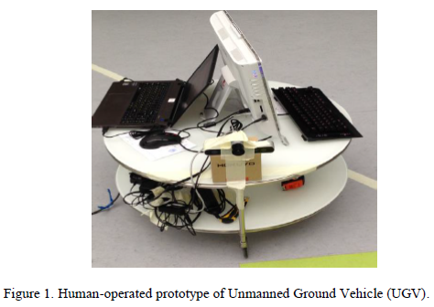
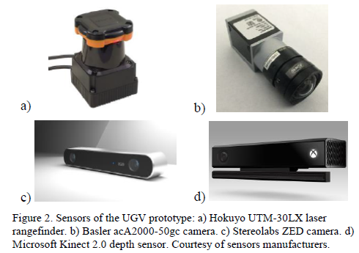
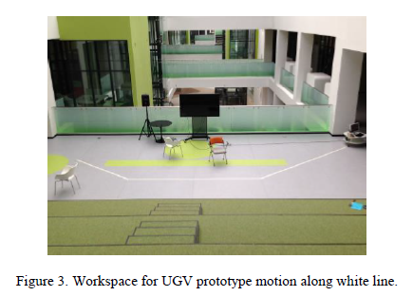
RTAB-Map Vs. ORB-SLAM2
Comparison of ROS-based Visual SLAM methods in
homogeneous indoor environment

Slide 10
RTAB-Map Vs. ORB-SLAM2
Comparison of ROS-based Visual SLAM methods in
homogeneous indoor environment
Key Findings:
ORB-SLAM point cloud is very sparse and has very little details.
ORB-SLAM created less amount of outliers.
RTAB-Map created a dense point cloud with a small number of outliers but greater than ORB-SLAM
RTAB-Map showed repeated surfaces in the generated map.
RTAB-Map suffered odometry noise.
ORB-SLAM both average and maximum trajectory deviation was less than that of RTAB-Map while RTAB-Map map quality was better due to its density.

Slide 11
RTAB-Map Vs. ORB-SLAM2
Comparative Study of
Visual Odometry and SLAM Techniques
Setup:
ORB-SLAM2: 16G RAM, 8 CPUs, 240G SSD, 512G HDD
RTAB-Map: Virtual machine, 7G RAM, 4 CPUs, 512G SSD
Testing data:
KITTI and MIT State Center datasets were used for evaluation.
Evaluation:
Ground truth data provided with each dataset was used.
Max. and Avg. errors of trajectory was used as performance metric.
CPU utilization and execution time were reported as indicators for efficiency.

Slide 12
RTAB-Map Vs. ORB-SLAM2
Comparative Study of
Visual Odometry and SLAM Techniques
Key Findings:
ORB-SLAM2 generated better trajectories in most of the cases.
ORB-SLAM2 can lose a lot of loop closure opportunities when compared to other methods.
RTAB-Map showed better efficiency and smaller execution time when depending on internal odometry options, however, higher CPU utilization.
RTAB-Map is dependent on the environment and can suffer empty space anomalies in indoor environments.

Slide 13
Problem Definition: Revisiting
Both ORB-SLAM2 and RTAB-Map are state-of-the-art SLAM algorithms but each has performance issues under certain conditions due to its architecture.
ORB-SLAM2 optimizes both camera poses and map points (2 levels of optimization) while RTAB-Map only optimize camera poses.
Integration of both algorithms can yield more reliable solution and can achieve better performance under wider range of scenarios.

Slide 14
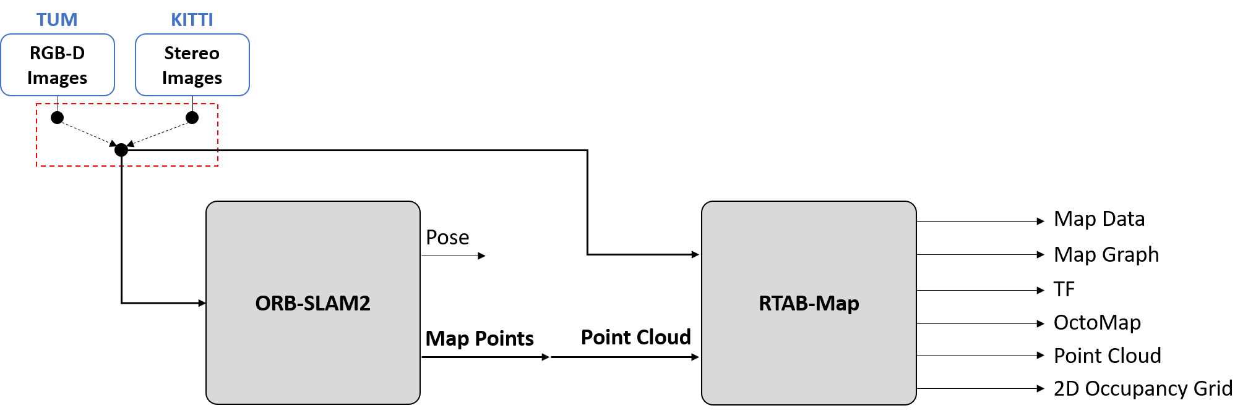
System Block Diagram: Abstract
In a nutshell, we are trying to utilize the optimized map points from ORB-SLAM2 in RTAB-Map in order to enhance its accuracy.
Input controls are dependent on the dataset under test (DUT) and is sent to both ORB-SLAM2 and RTAB-Map.

Slide 15
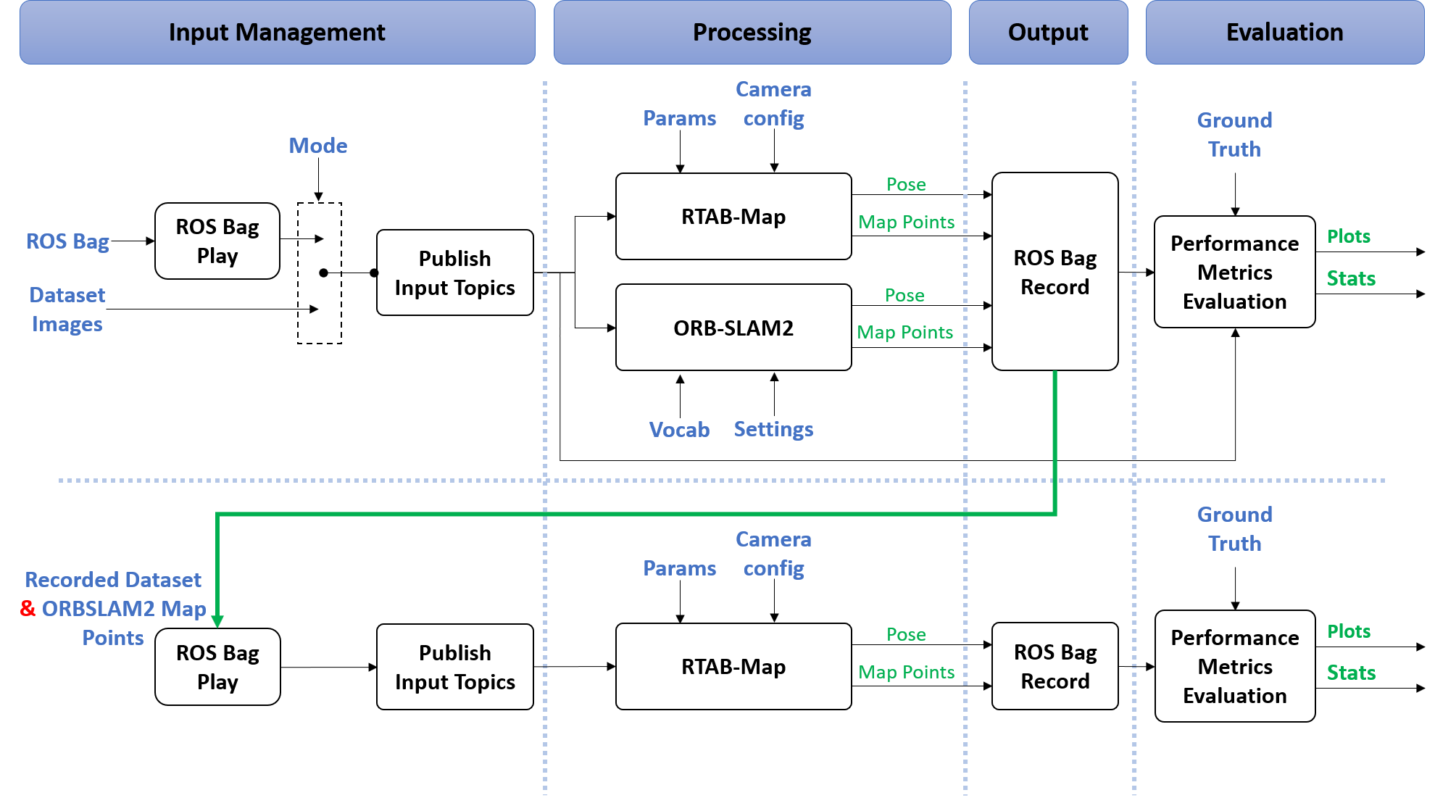
System Block Diagram: Detailed

Slide 16
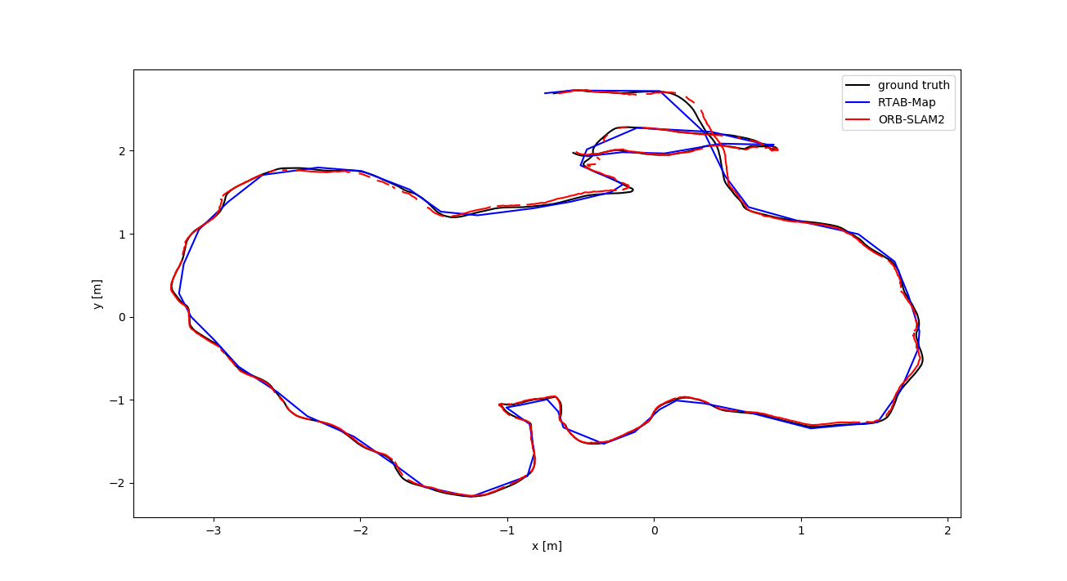
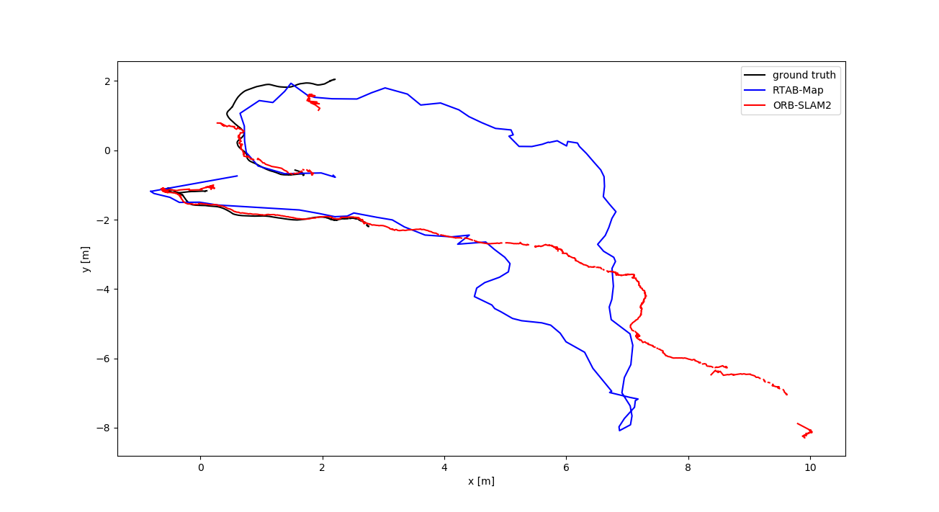
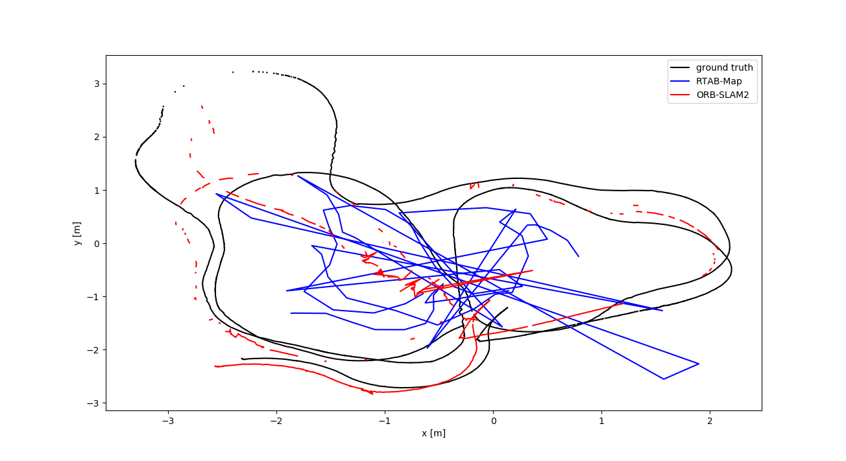
Initial Baseline Results
TUM RGB-D Plots:
Freiburg2 trajectories have large errors when compared to freiburg3.
Different maybe in the un-distortion applied only to freiburg3.
?
?

Slide 17
Initial Baseline Results
TUM RGB-D Dataset Quantitive Results
Absolute Trajectory Error (m)
Sequence | SLAM system | RMSE | mean | median | std | min | max
Freiburg2 Large with loop | RTAB-Map | 0.396 | 0.363 | 0.360 | 0.159 | 0.129 | 0.691
 | ORB-SLAM2 | 0.155 | 0.124 | 0.102 | 0.093 | 0.015 | 0.830
Freiburg2 Pioneer slam | RTAB-Map | 1.594 | 1.220 | 0.967 | 1.028 | 0.314 | 7.112
 | ORB-SLAM2 | 0.526 | 0.350 | 0.230 | 0.385 | 0.033 | 3.065
Freiburg3 Long office household | RTAB-Map | 0.043 | 0.040 | 0.039 | 0.013 | 0.004 | 0.074
 | ORB-SLAM2 | 0.030 | 0.025 | 0.019 | 0.016 | 0.001 | 0.095
?
?

Slide 18
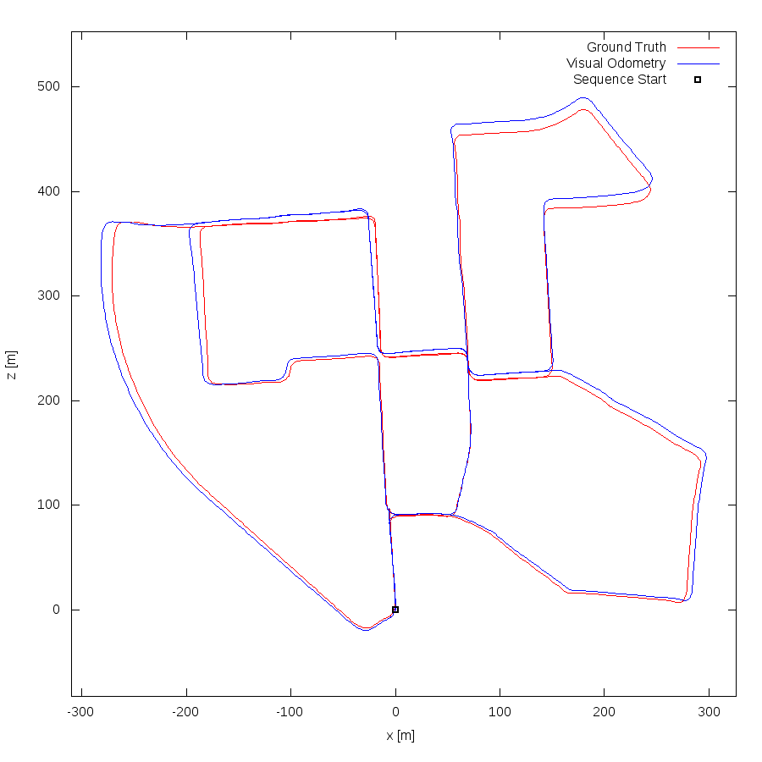
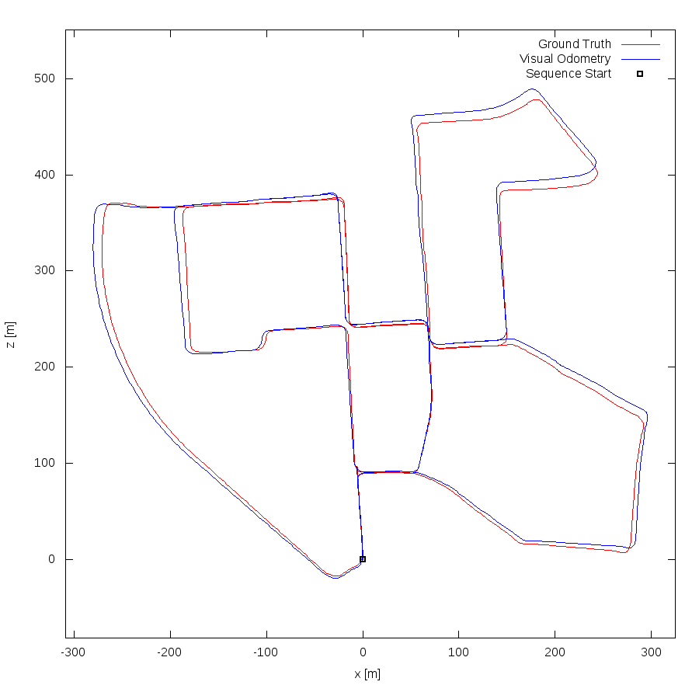
Initial Baseline Results
KITTI Stereo Plots:
Sequence 00
RTAB-Map (left) & ORB-SLAM2 (right)

Slide 19
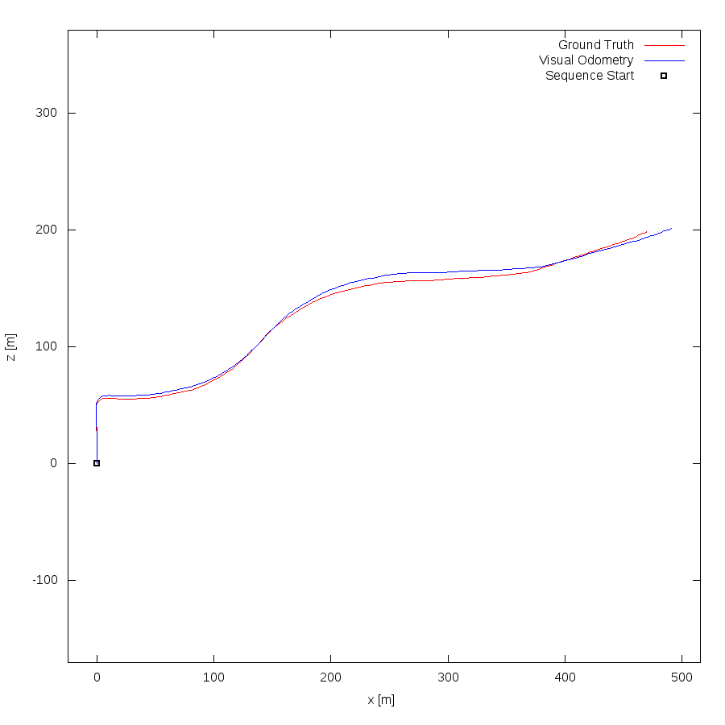
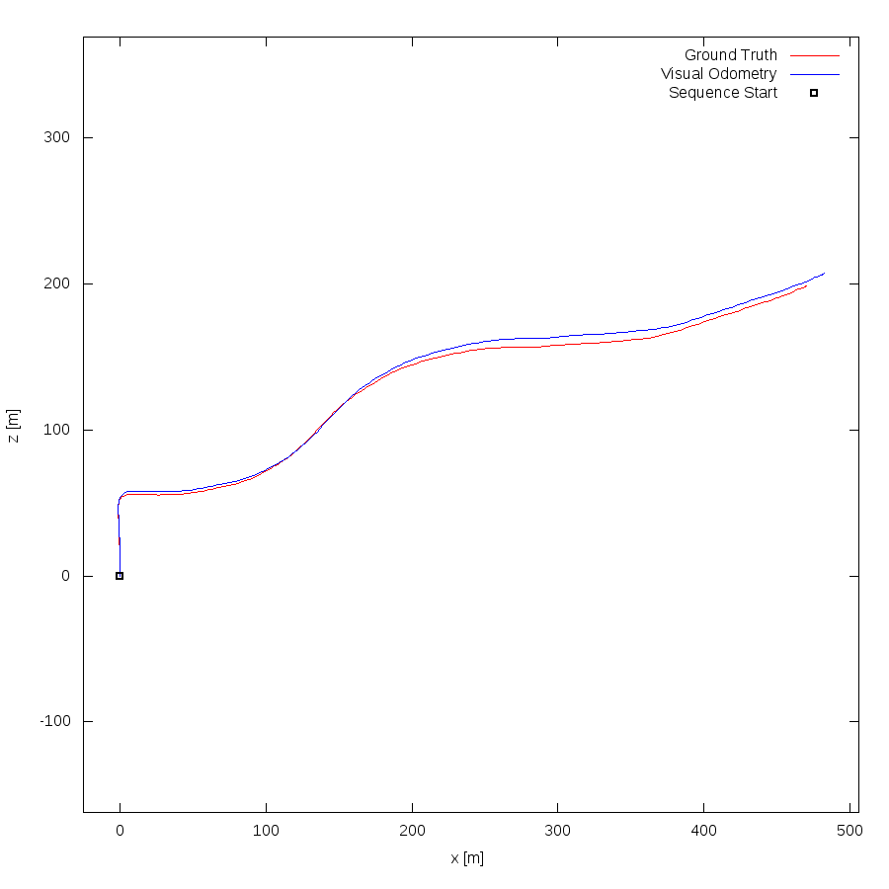
Initial Baseline Results
KITTI Stereo Plots:
Sequence 03
RTAB-Map (left) & ORB-SLAM2 (right)

Slide 20
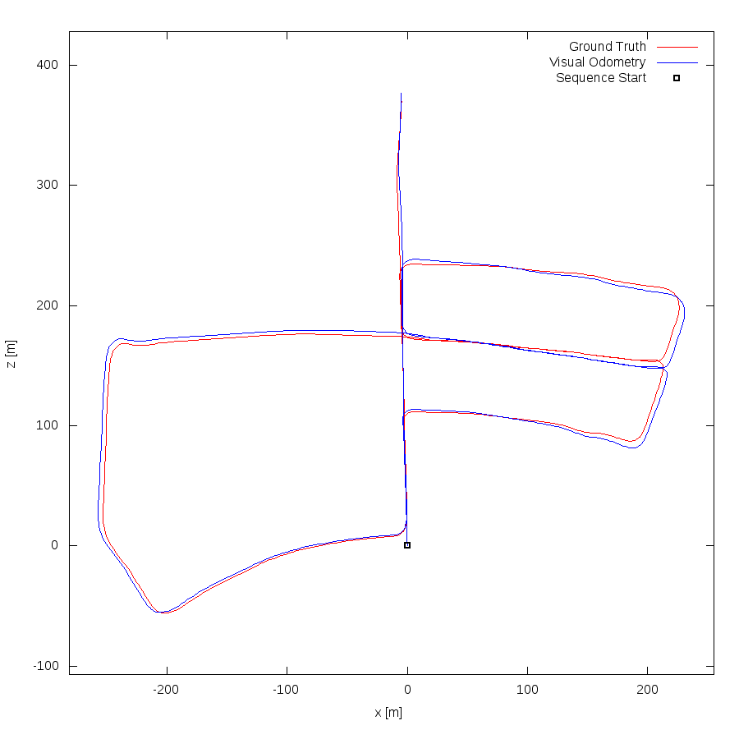
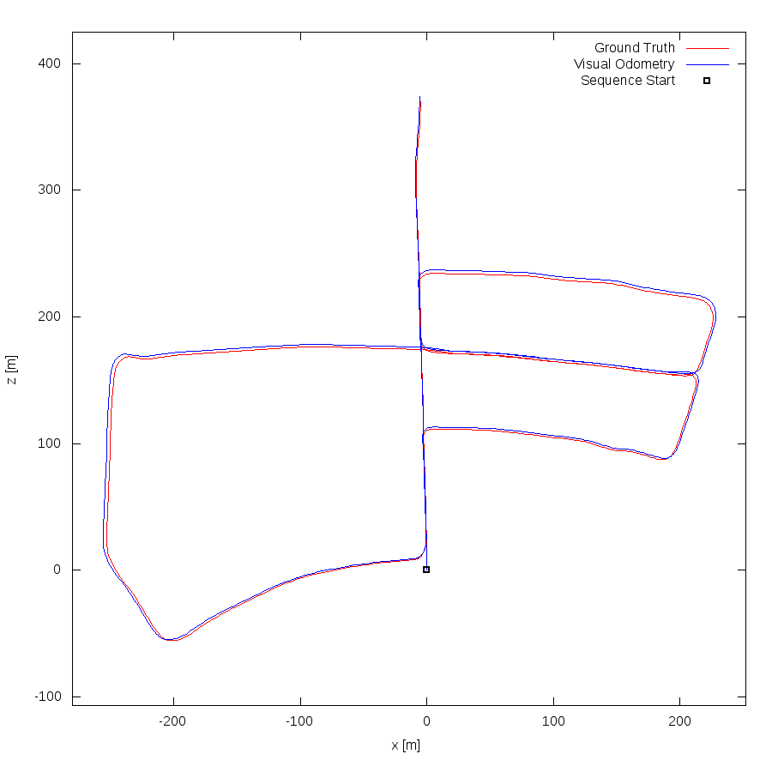
Initial Baseline Results
KITTI Stereo Plots:
Sequence 05
RTAB-Map (left) & ORB-SLAM2 (right)

Slide 21
Initial Baseline Results
KITTI Stereo Dataset Quantitive Results
Absolute Trajectory Error (m)
Sequence | SLAM system | RMSE | mean | median | std | min | max
Sequence 00 | RTAB-Map | 3.210 | 6.189 | 5.845 | 3.211 | 0.092 | 12.426
 | ORB-SLAM2 | 2.964 | 5.850 | 5.865 | 2.965 | 0.131 | 11.486
Sequence 03 | RTAB-Map | 6.476 | 10.329 | 10.190 | 6.488 | 0.096 | 21.573
 | ORB-SLAM2 | 4.623 | 7.709 | 7.690 | 4.631 | 0.049 | 14.979
Sequence 05 | RTAB-Map | 1.868 | 3.705 | 3.600 | 1.869 | 0.024 | 7.171
 | ORB-SLAM2 | 0.807 | 2.162 | 2.170 | 0.807 | 0.012 | 3.784

Slide 22
Open Questions
ORB-SLAM2 generates sparse maps (point clouds), would this be sufficient for RTAB-Map to utilize in its operation?
Is the synchronization block in RTAB-Map enough to handle the synchronization between input images and point cloud?
Are KITTI (Stereo) and TUM (RGB-D) enough to evaluate the system and to explore its corner cases?
TUM Dataset, is the lack of distortion is the reason behind the degraded performance in freiburg2 sequences?

Slide 23

Questions

Slide 24
Thank You !

