Slide 1
Permutations Decrease and Conquer
Islam Abdulhakeem 224179

Slide 2
You are given a positive integer n, you have to find all possible permutations of the sequence from 1 to n.
Ex:
n = 1
P = [1]
n = 2
P = [12,21]
n = 3
P = [312,132,123,321,231,213]
…..

Slide 3
Strategy Decrease and Conquer by 1
The strategy given is Decrease-and-Conquer, which means that the problem will be decreased by 1 each recurrence in order to achieve all of the possible permutations.

Slide 4
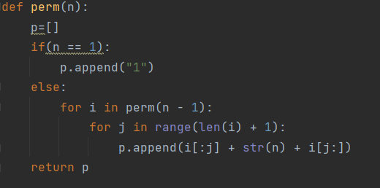
The Code Implementation

Slide 5

Analysis
$T\left(n\right)=T\left(n−1\right)+\sum_{i=1}^{n!}{\sum_{f=0}^{n}{1}}$ ,$T\left(1\right)=1$
$$T\left(n\right)=T\left(n−1\right)+(n+1)n!$$ $T\left(n−1\right)=T\left(n−2\right)+n(n−1)!$
$T\left(n\right)=T\left(n−2\right)+\left(n+1\right)n!+n\left(n−1\right)!$
$T\left(n\right)=T\left(n−k\right)+\left(n+1\right)n!+ …+\left(n−k+2\right)\left(n−k+1\right)!$
At k = n – 1
T(n)= 1+….+$n(n−1)!$ $+\left(n+1\right)n!=nn!=n!$

Slide 6
Analysis
Best Case 1 At n = 1
Average Case = Worst Case = n!

Slide 7
Thank you

