Slide 1
Car accidents Severity
Classification models

Slide 2
Data acquisition and cleaning
Data Originally obtained from GISWEB and mainly represent Collisions provided by SPD and recorded by Traffic records (Timeframe from 2004 till Present). The dataset to be used has 38 different Feature, and the target variable will be 'SEVERITYCODE', as it is a measure of the severity of the accident which varies between 1 and 2 (1 represents Property Damage Only Collision and 2 represents Injury Collision). The dataset needed some preparation to be fit for analysis before modeling. From the 38 Feature of this dataset, many are not useful for this model and many of the features need to be converted to numerical type, using label encoding which will create new numerical columns. Missing values was tested for significancy before dropping it from the dataset. The imbalance of targeted label was solved by dropping labeled data (Rows) from the dataset to reach a balanced dataset.
The provided dataset contains 194,673 entries (rows), with 38 different features (columns). Each entry contains information regarding an accident incident.

Slide 3
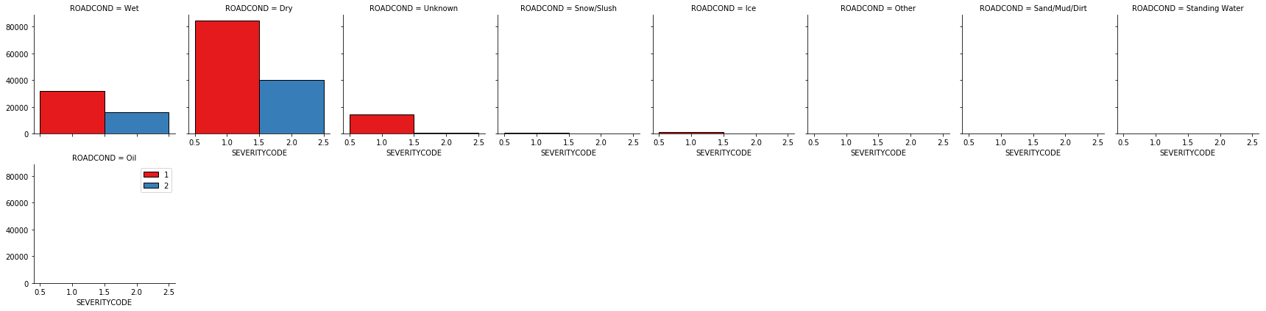
Exploratory data analysis
Different EDA was performed to understand the data and the different relations between our target variable and features, we have plotted histograms and bar charts (In the notebook below) between different features and the target including the address type of collisions whether alley, intersection or block, road and light condition, number of people and cars in the collision, Collison type and junction type. We have used two models for predicting our target which are Decision Tree and Logistic regression in order to predict the severity of accident. different evaluation metrics used to include Log Loss, F1 score and Jaccard similarity score.

Slide 4
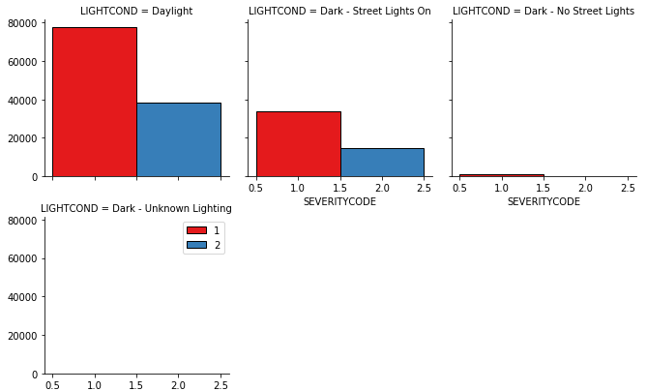
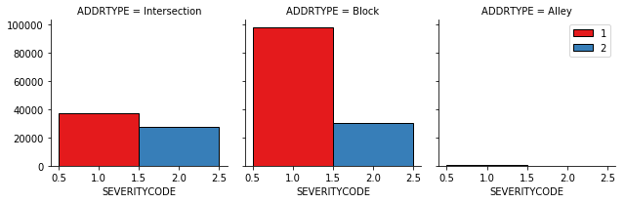
Exploratory data analysis

Slide 5
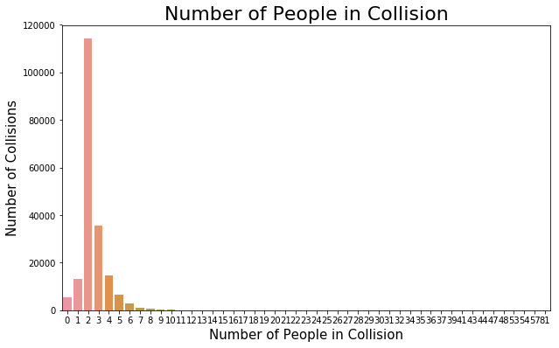
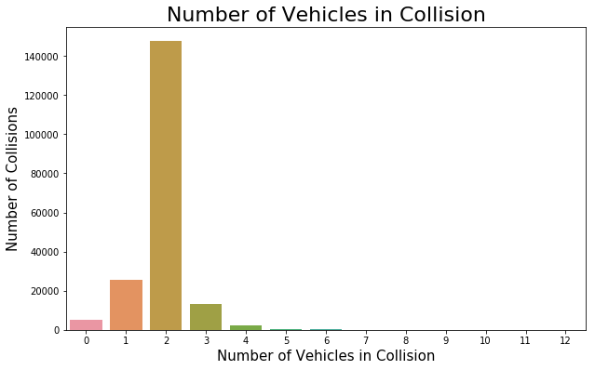
Exploratory data analysis

Slide 6
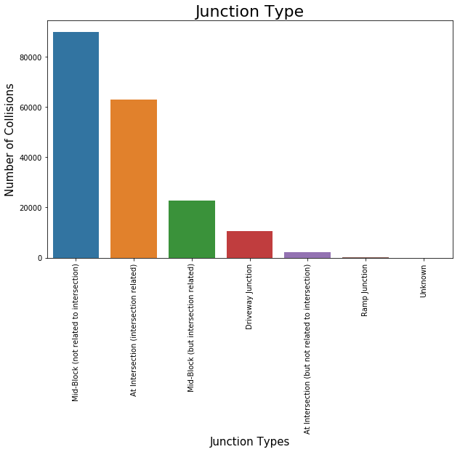
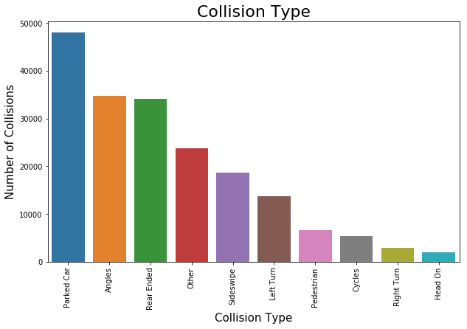
Exploratory data analysis

Slide 7
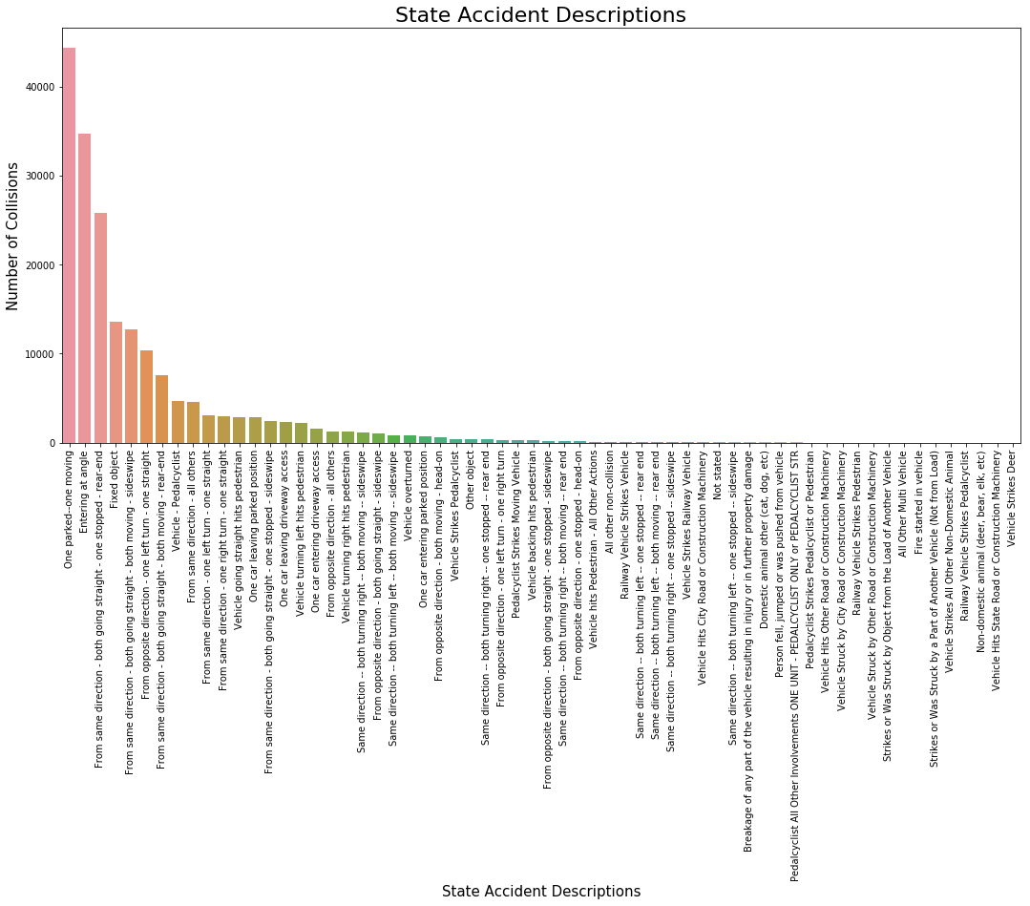
Exploratory data analysis

Slide 8
Conclusion
As mentioned in the methodology section two models were developed and different metrics used to evaluate our models and the results as follows :-
Model | Jaccard Similarity Score
Decision Tree | 73%
LR | 70%
Model | F1 Score
Decision Tree | 66%
LR | 58%
Model | Log Loss
Decision Tree | NA
LR | 57%

