Slide 1
SPL-1(SE305) Final Presentation
“ Data Classification using Decision Tree & Random Forest ”
Presented By: Islam Bin Md. Junaed
Roll: BSSE ROLL NO. -1134
EXAM ROLL NO. - 1135
Supervisor: Dr. Md. Shariful Islam

Slide 2
Decision Tree

Slide 3
What is Decision Tree?
Decision Tree is one of the easiest and popular “Classification Algorithm” to understand and interpret.
*In machine learning “Classification” is a two step process-
-> Learning Step (Training Data)
-> Prediction Step (Predict the response for given Data)
Don’t Understand?
Step Forward………

Slide 4
A person loves to play cricket
In general,
A Decision Tree asks a question….
……And then Classifies the person based on answer
True
False
The Person is awesome…
The Person is slightly less than awesome…
-NOT A BIG DEAL!!!
Right??

Slide 5
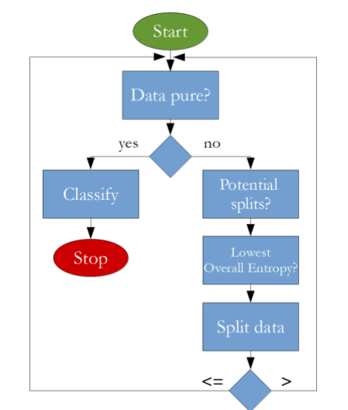
The algorithm that is going to be implemented looks like this:
Source: Google

Slide 6
TOOLS
Data: IRIS Flower Data Set
Language: PYTHON
Tutorial Link: https://www.youtube.com/watch?v=y6DmpG_PtN0&list=PLPOTBrypY74xS3WD0G_uzqPjCQfU6IRK-&index=1

Slide 7
GOALS
We’ll read Numeric data from File & Implement the algorithm. After that we’ll calculate Accuracy, Precision, Recall and F-measure to see how accurately and precisely that tree classifies New Unknown flowers.

Slide 8
Following Steps
Import Data File (Using Numpy & Pandas)
Get it into right format for our Algorithm
We’ll only have to Execute Three more steps to reach our goal
First: Split our Data Frame into “Training and Testing data Frame
Then: We’ll run the Decision Tree algorithm on the training data to create our tree
Finally: We’ll calculate the Accuracy, Precision, Recall & F-measure to see how well that tree classifies new unknown data

Slide 9
Import Data
df = pd.read_csv('IRIS.csv')
1st import data file to project file
Then use pd for pandas to import and read file.

Slide 10
Train-Test-Split
Split the Data Set into Two part is good strategy
Train
Test
Where we use Two part of the sample for actual Training and reaming sample for Testing model
By using this we’ll get a good idea on the accuracy of the model.
Because, the model didn’t go through this test part before

Slide 11
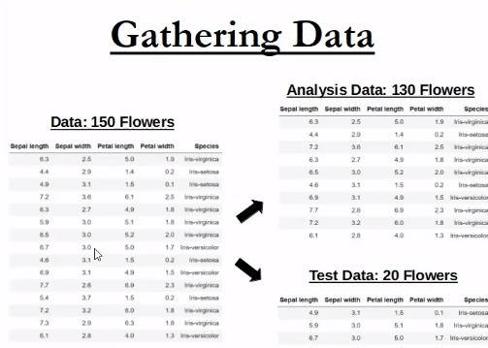
Example
Suppose this is a set of 150 data
The training part is 130 &The testing part is remaining 20 which are totally unknown to testing part!
def train_test_split(df, test_size):
return train_df, test_df

Slide 12
Data Pure?
In this part we are checking if data is pure or not?
If it finds pure data then it’ll tae Decision
Else algorithm will run again
def check_purity(data): label_column = data[:, -1] unique_classes = np.unique(label_column) if len(unique_classes) == 1: return True else: return False

Slide 13
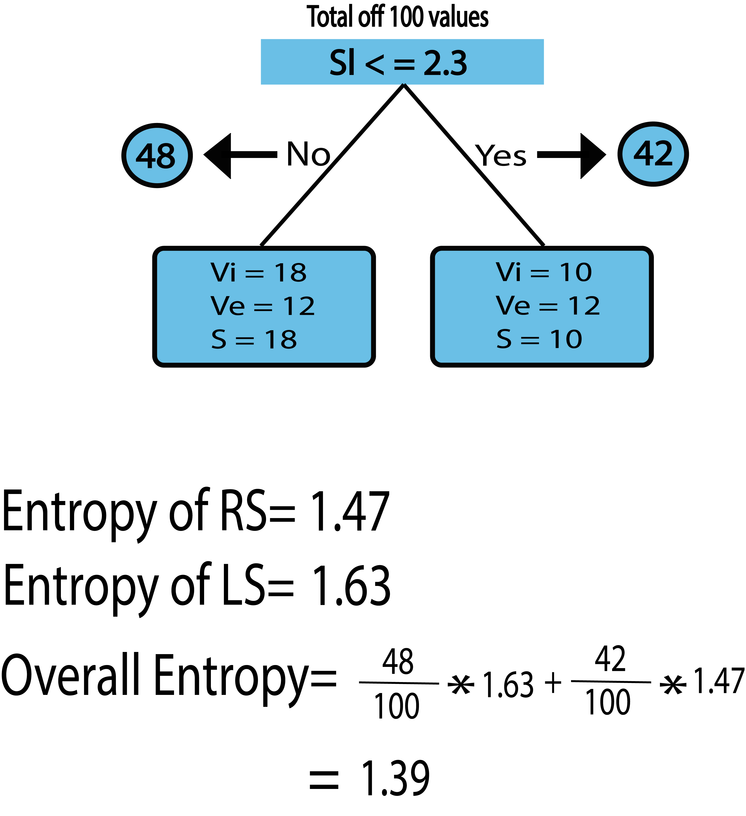
Here comes the main point, Entropy an information theory metric that measures the impurity or uncertainty in a group of observations. It determines how a decision tree chooses to split data. For our algorithm, we’ve to calculate Entropy for all the value of all features. We assumed “Minimum Entropy Value” as the root and split the tree. How we Calculated Entropy:

Slide 14
Classify Data
A decision tree Classifier generates the actual prediction at the leaf nodes , more information can be stored at the leaf nodes…
def classify_data(data): return classification

Slide 15
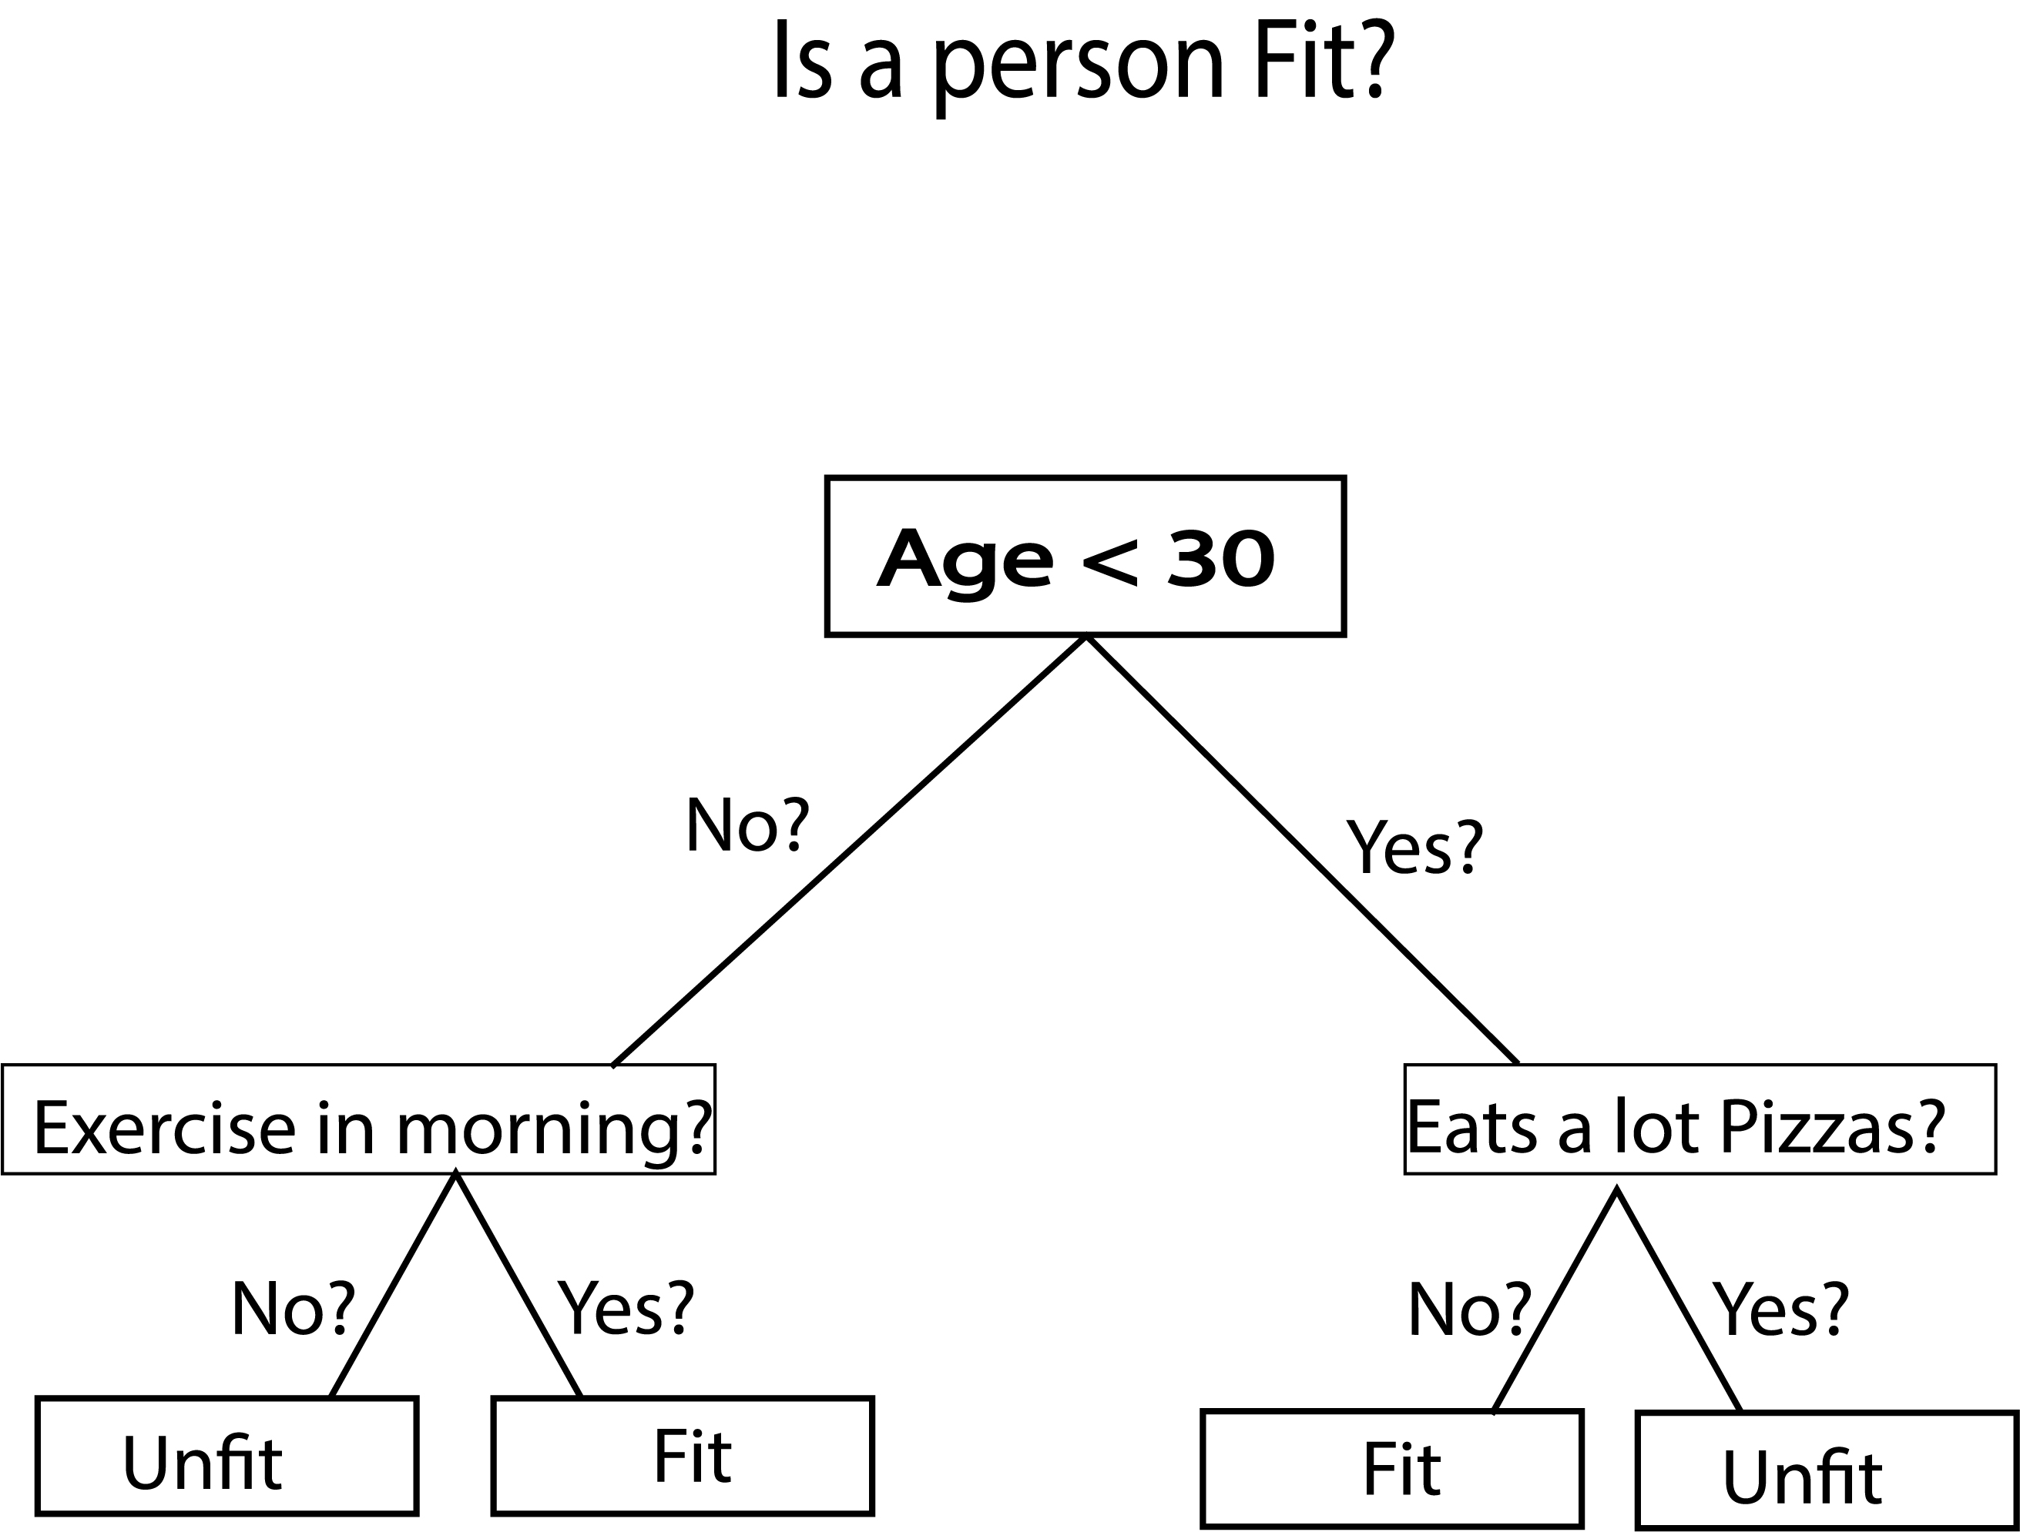
Leaf data have been shown as results as they fulfilled all the conditions of our tree…..
How the Algorithm works

Slide 16
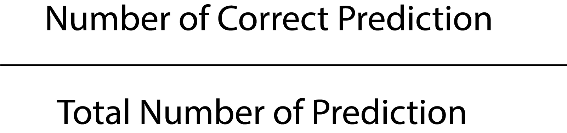
The number of correct prediction made divided by the total number of predictions made – Accuracy=
Calculate – Accuracy, Recall. Precision, Re-Call
Re-call: The percentage of the total relevant documents in a dataset retrieved by your search
Recall = A/A + B * 100%
Precision: The percentage of relevant documents in relation to the number of documents retrieved
Precision = A/A + C * 100%
F- measure: The harmonic mean of precision and recall
F=2 * Recall * Precision / (Recall + Precision)

Slide 17
!!Thank You!!

