Slide 1
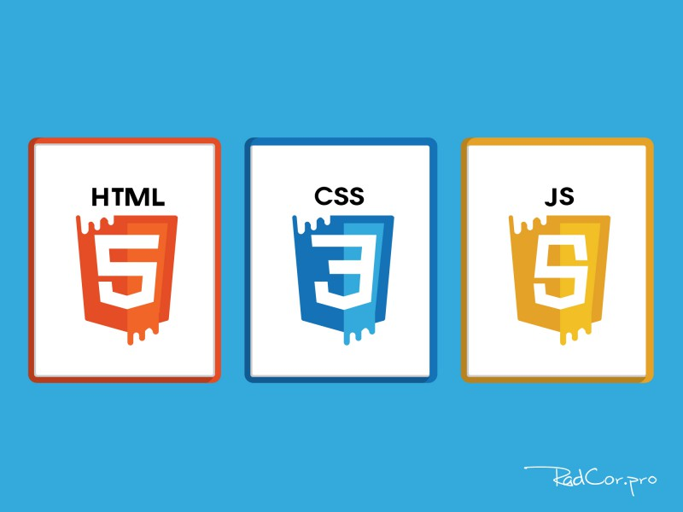
Sayt yaratish uchun dasturlash tilari

Slide 2
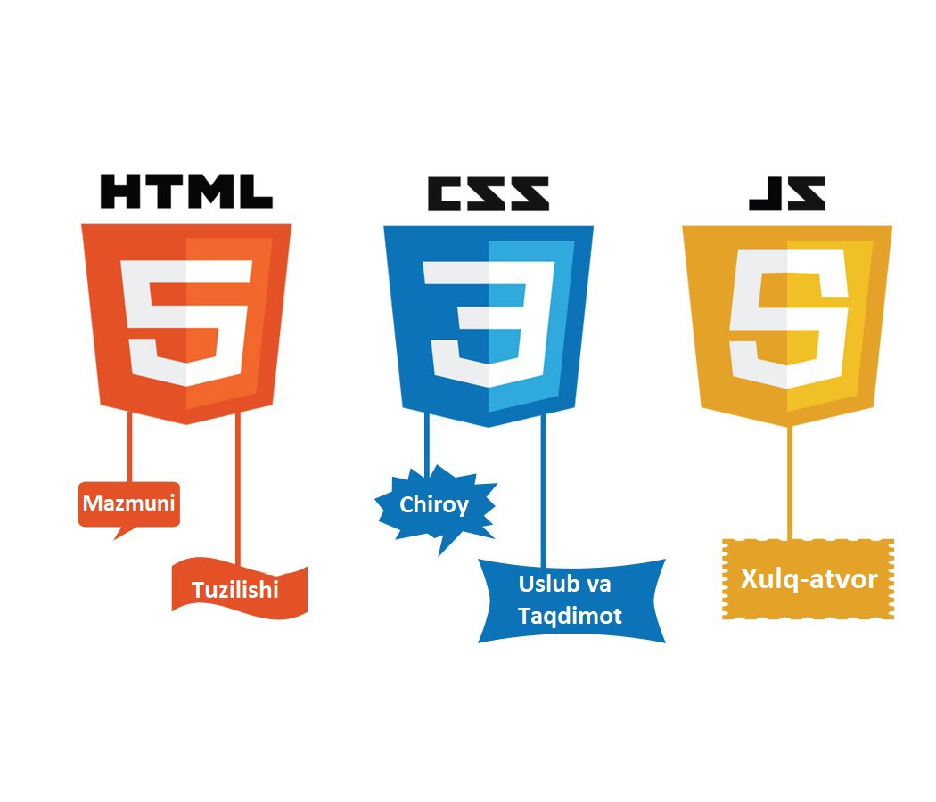

Slide 3
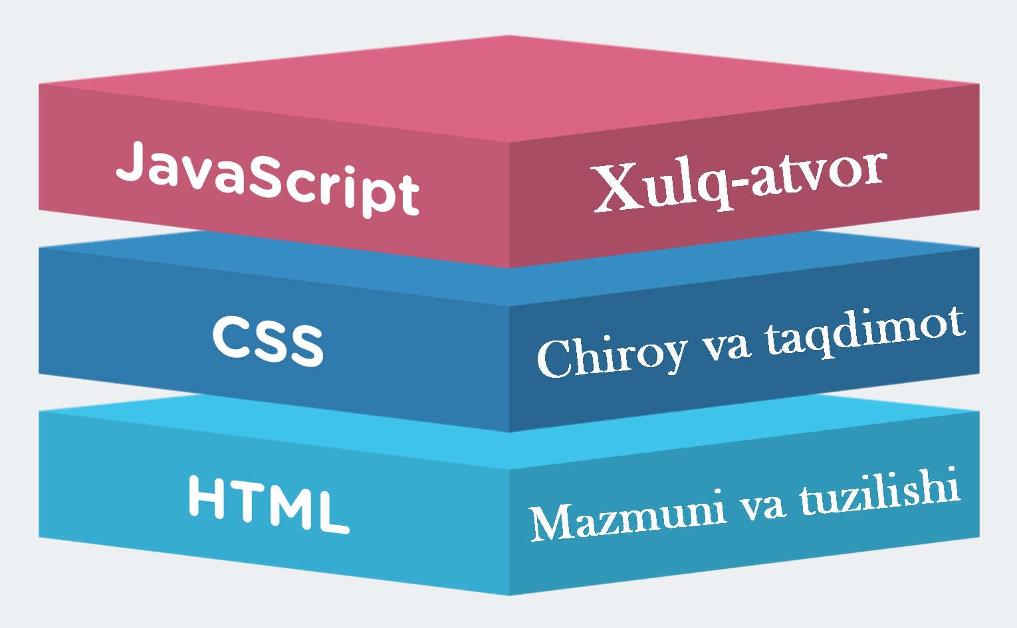

Slide 4
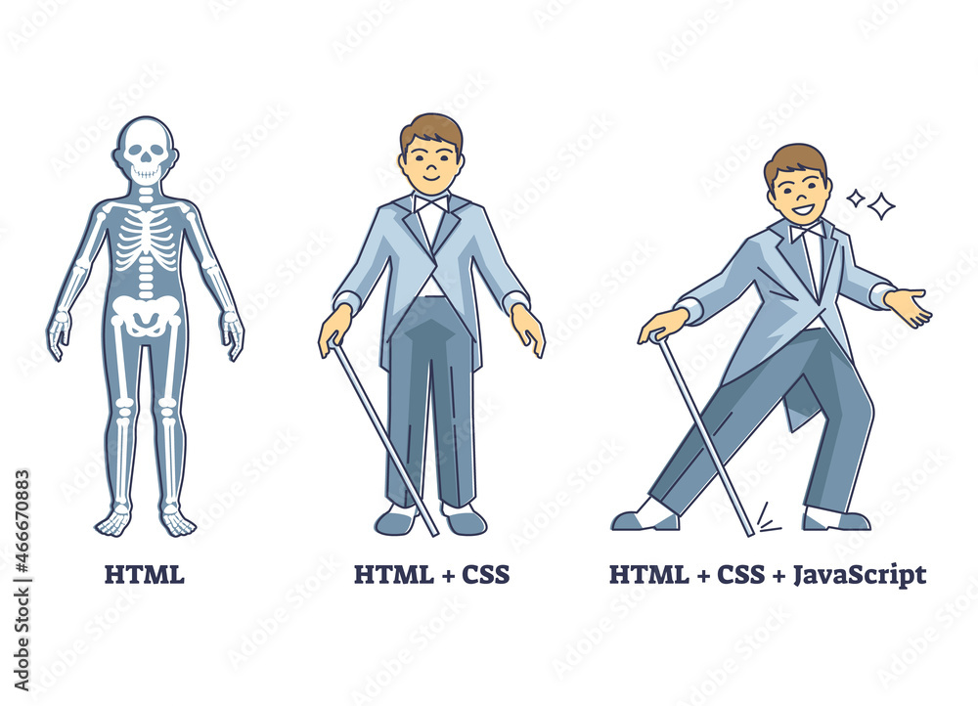

Slide 5
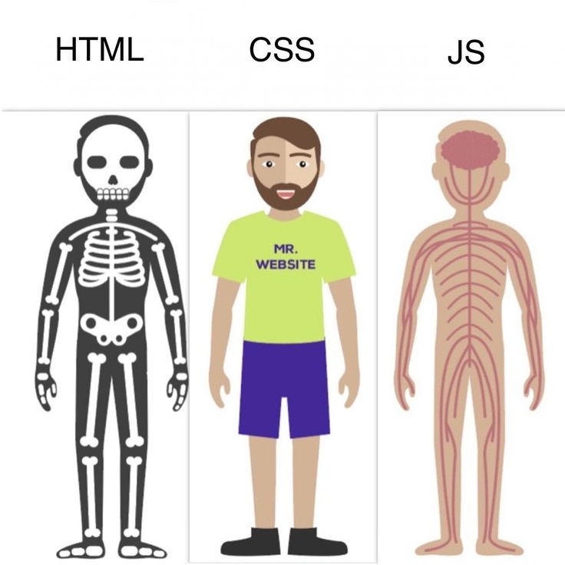

Slide 6
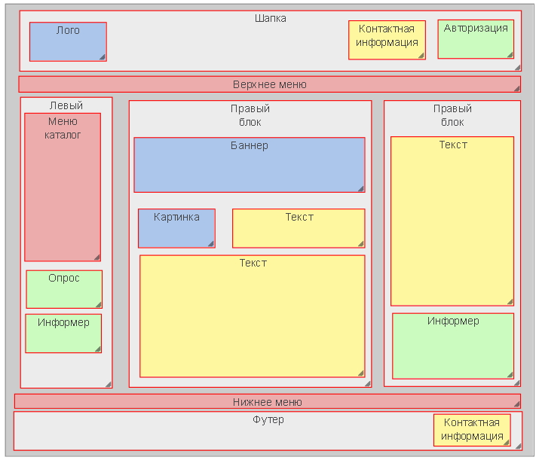

Slide 7
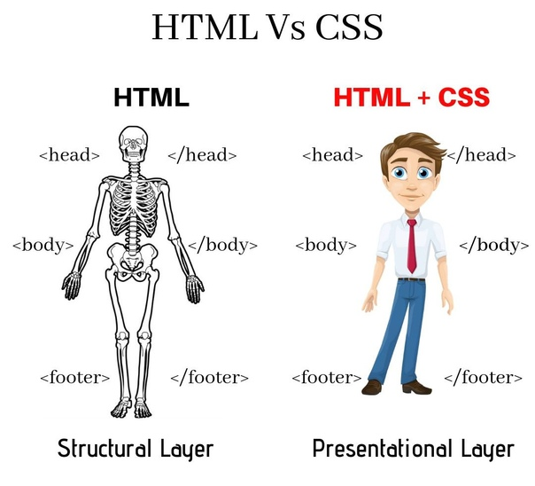

Slide 8
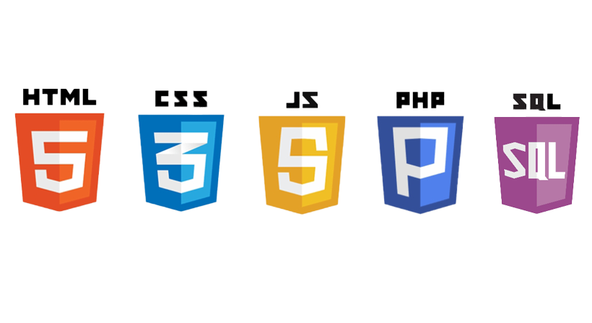
Murakkab sayt

Slide 9
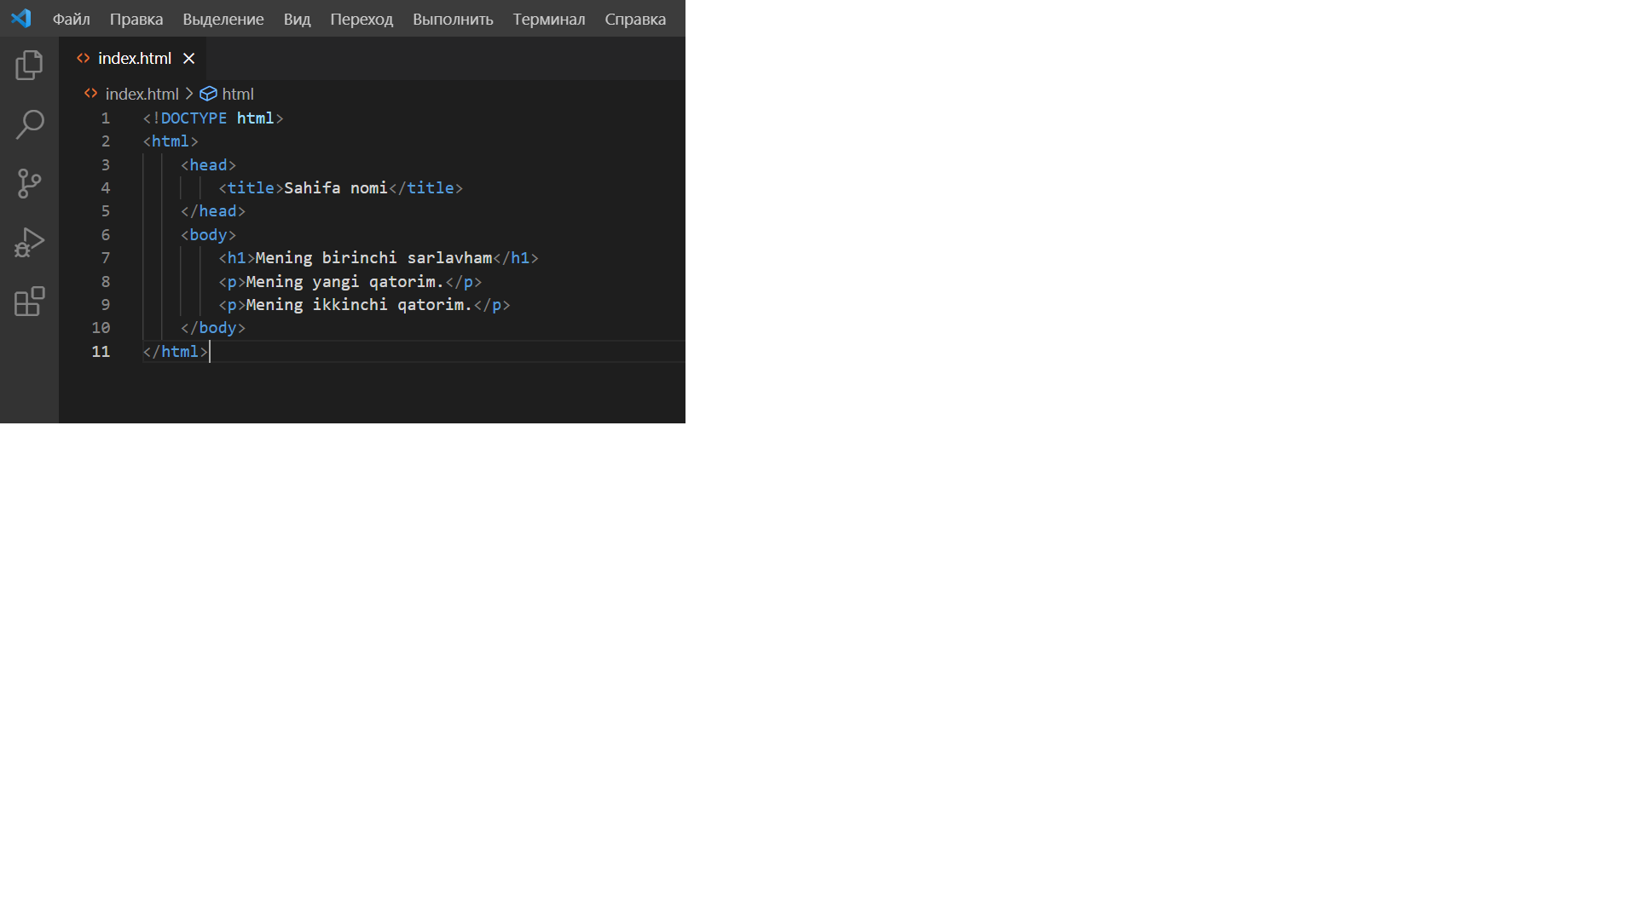
HTML hujjat

Slide 10
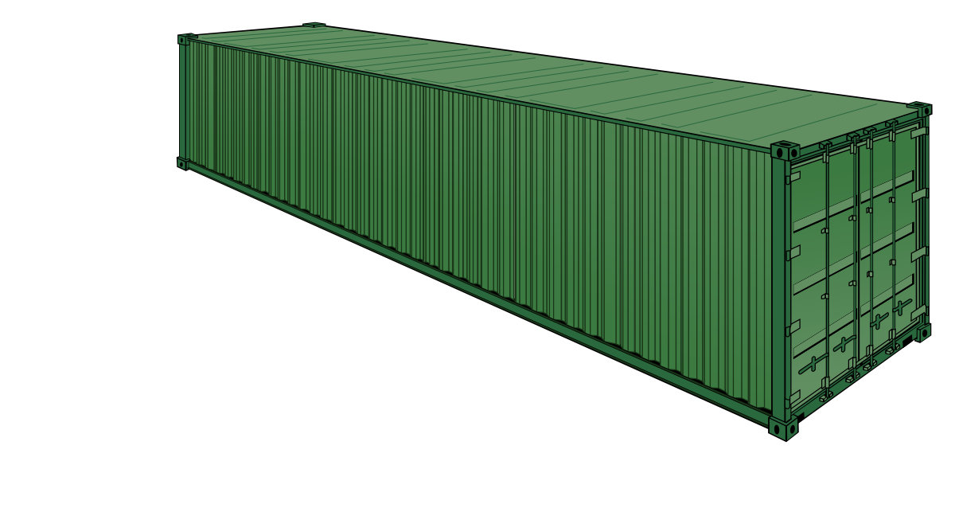
HTML hujjat
<html>………………………………</html>
<head>………………………………</head>
<body>………………………………</body>

Slide 11
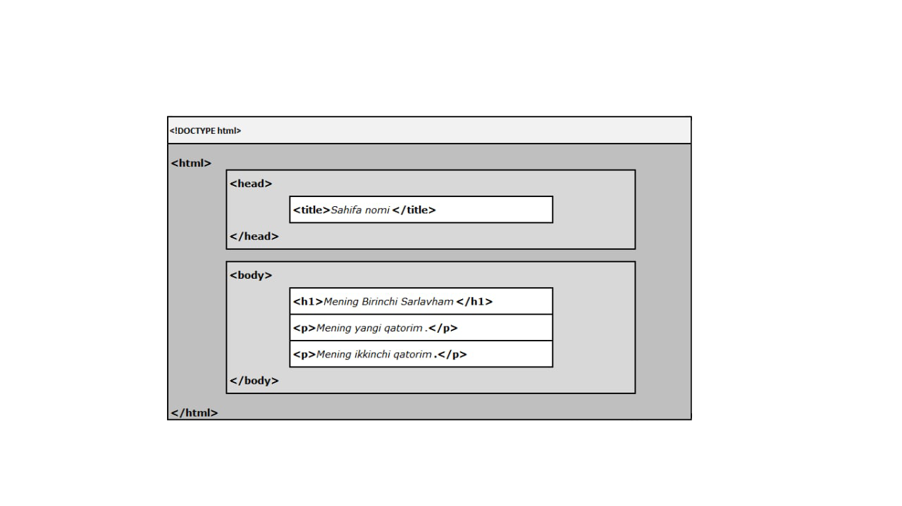
HTML Jujjat

Slide 12
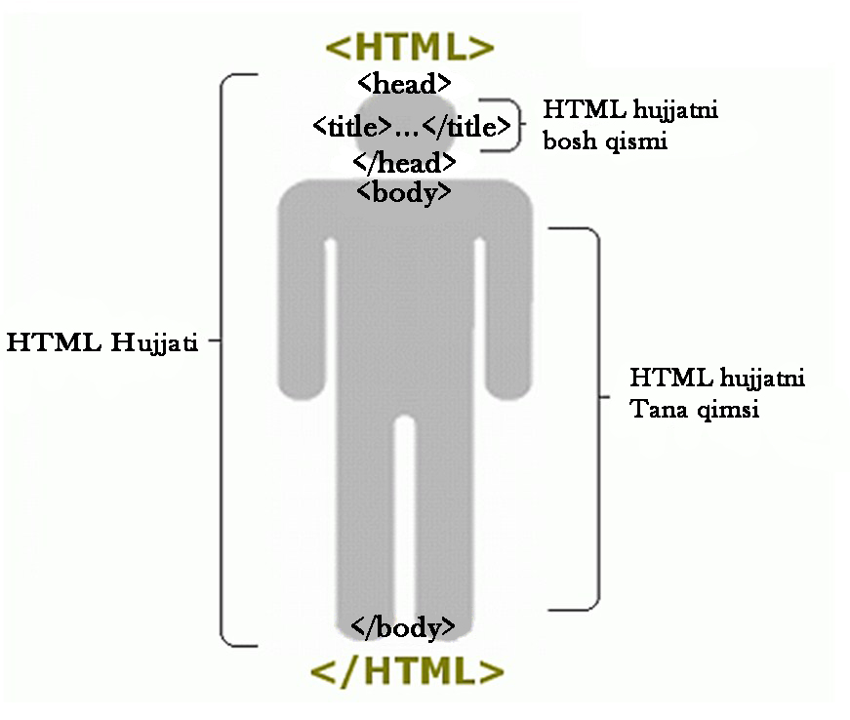

Slide 13
HTML juftlik va juftsiz
<h1>…</h1>
<p>…</p>
<a>..</a>
<br>
<hr>
<img>
Juftlik kodalr
Juftsiz kodlar

Slide 14
HTML juftliklar
<h1>………………………………</h1>

Slide 15
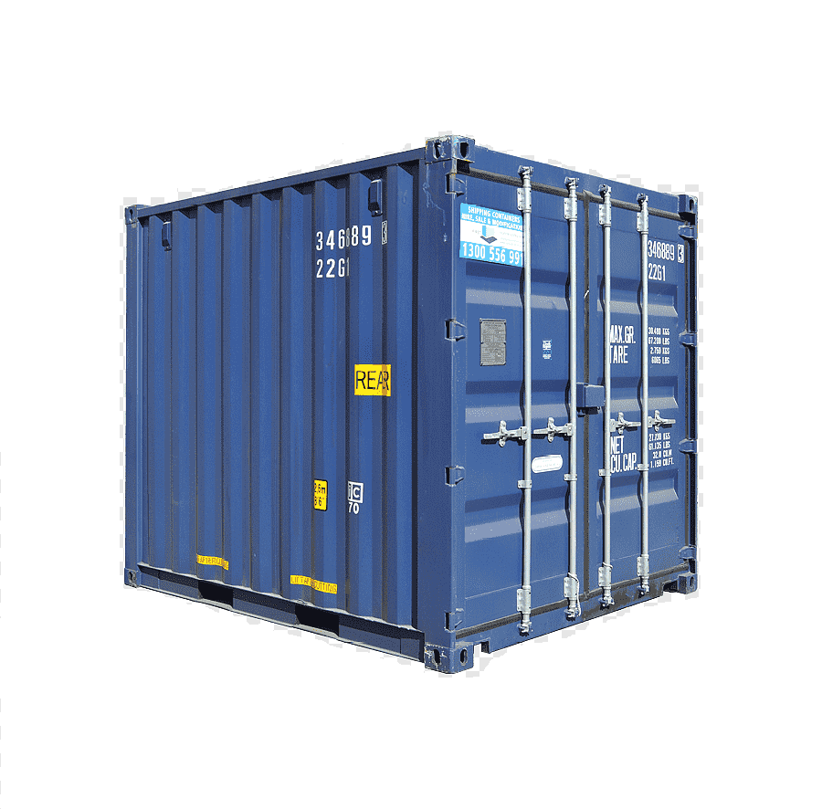
HTML juftliklar
<b>…………………..……….</b>

Slide 16
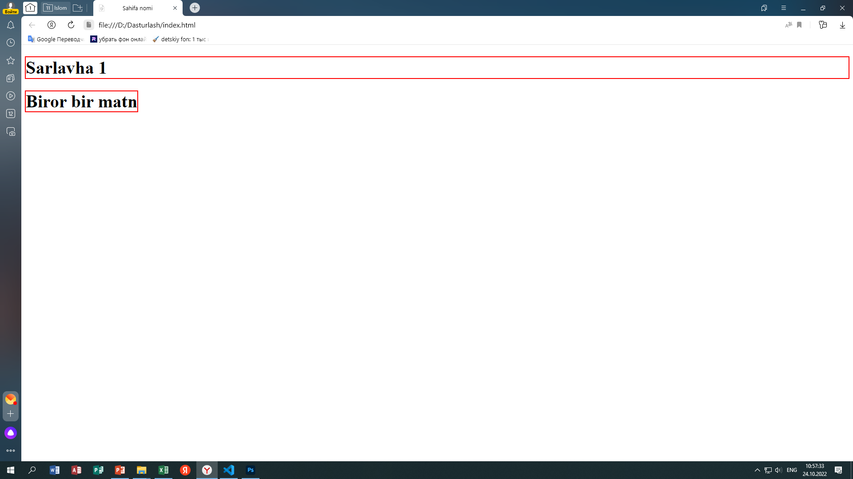
<h1>………………….</h1> <b>…………………..</b>

Slide 17
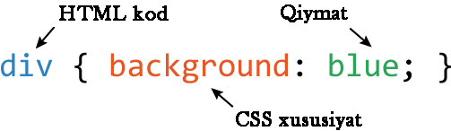
CSS Sintaksis

Slide 18
CSS ni HTML ga ulashni 3 ta turi mavjud
1 – Tashqi CSS
2 – Ichki CSS
3 – O’rnatilgan CSS

