Slide 1



Controller Area Network (CAN)
Islam Ehab

Slide 2


Agenda
TM4C123GH6PM CAN Specifications
CAN TM4C123GH6PM Functional Description
Transmit Overview
Receive Overview
Message Objects Overview
Errors Detection
Testing Modes
Interrupts
TM4C123GH6PM CAN Configurations

Slide 3
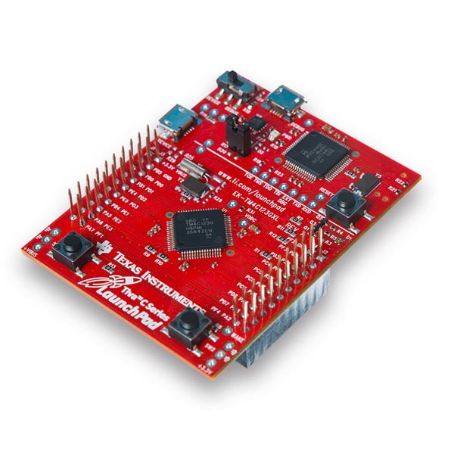
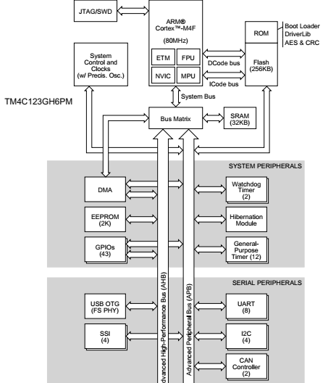
TM4C123GH6PM Microcontroller

Slide 4
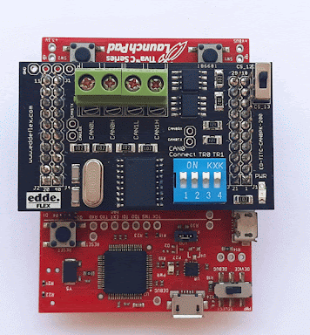
TM4C123GH6PM CAN Specifications
CAN Protocol Version: 2.0 Part A/B.
No. of Channels: 2 (CAN0 and CAN1).
Bit Rate: Up to 1 Mbps within network length less than 40 meters.
Message Objects: 32 message objects with individual identifier mask.
Acceptance Filter: Mask ID for each message object can be used beside ID filtering
Programmable FIFO mode for storing multiple received messages.

Slide 5
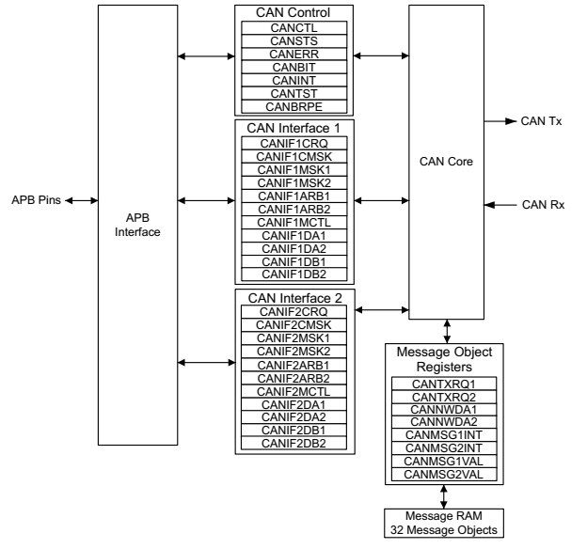
CAN TM4C123GH6PM Functional Description
CAN Module Consists of:
1- CAN Core which consists of:
a. CAN Protocol Controller
b. Message Handler
2- Message Object Memory
3- CAN Register Interface

Slide 6
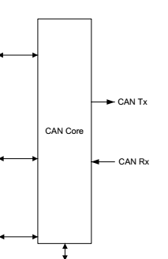
CAN TM4C123GH6PM Functional Description –
1- CAN Core
Protocol Controller (Inside CAN Core):
Transfers and receives serial data from CAN Bus.
Passes the data to the message handler.
Message Handler (Inside CAN Core):
Loads data to the appropriate message object based on filtering and identifies set in the message object memory.
Responsible of generating interrupts based on events on the CAN Bus.

Slide 7
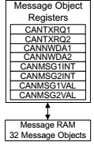
CAN TM4C123GH6PM Functional Description –
2- Message Object Memory
Set of 32 identical memory blocks.
Hold the current configuration status, and actual data for each message object.
Accessed via either of the CAN message object register interfaces.

Slide 8
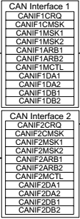
CAN TM4C123GH6PM Functional Description –
3- CAN Register Interface
Two interface register sets.
Used to access message memory to read or write to each message object.
Allow parallel access to the CAN Controller message object as one interface register for transmitting and the other for receiving.

Slide 9
Transmit Overview
Transmit Overview
ID Formats
Transmit Interrupts
Frame Types
Priority

Slide 10
Transmit Overview - ID Format
ID Format
Standard 11-bit
Extended 29-bit
To choose Extended ID, Set XTD bit in CANIF2ARB2 register

Slide 11
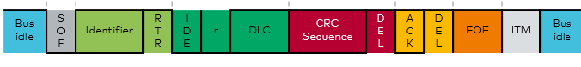
Transmit Overview - Frame Types
Frame Types
Data Frame
Remote Frame
Remote Frames are sent by the transmitter to Request Data.
CAN Controller can auto-respond to the Remote Frame by setting RMTEN bit in CANIFnMCTL register.

Slide 12
Transmit Overview - Priority
Controlled by the message object number
Lowest number means highest priority
Message numbers from 1 to 32
Note: This prioritization is separate from message identifier which made by the CAN Bus.
Ex: Message object 1 and message object 2 transmitted at the same time, message object 1 will be transmitted even if it’s message identifier value is higher than message object 2.

Slide 13
Transmit Overview - Interrupts
Interrupt for each message object when successfully transmit a frame.
Can be enabled or disabled by TXIE bit in CANIFnMCTL register

Slide 14
Receive Overview
Receive Overview
ID Formats
Message Lost
Receive Interrupt
Priority
Frame Types

Slide 15
Receive Overview - ID Format
ID Format
Standard 11-bit
Extended 29-bit
To choose Extended ID, Set XTD bit in CANIFnARB2 register

Slide 16
Receive Overview - Frame Types
Frame Types
Data Frame
Remote Frame
Remote Frames are received by receiver to Request Data.

Slide 17
Receive Overview - Priority
Controlled by the message object number
Lowest number means highest priority
Message numbers from 1 to 32
Note: This prioritization is separate from message identifier which made by the CAN Bus.
Ex: Message object 1 and message object 2 transmitted at the same time, message object 1 will be transmitted even if it’s message identifier value is higher than message object 2.

Slide 18
Receive Overview - Interrupts
Interrupt for each message object when successfully reception of a frame.
Can be enabled or disabled by RXIE bit in CANIFnMCTL register

Slide 19
Receive Overview - Message Lost
When CAN Controller received data, the NEWDAT bit in CANIFnMCTL register is set, and the CPU clears it automatically when it reads the message object.
However, if the CAN Controller received a new data (message) and the NEWDAT bit is already set, the previous data will be lost and MSGLST bit in CANIFnMCTL register will be set to indicate that.

Slide 20
Message Objects Overview
There are 32 Message Objects in TM4C123GH6PM.
Can be used to transmit or receive frames.
Each message object has its own interrupt ID.
There are 2 modes for message objects in receiving:
Normal Mode: CAN Controller receives one message object
FIFO Mode: Configure CAN Controller to concatenate two or more message objects into a FIFO buffer.
Note: the identifiers and masks (if used) of these message objects have to be programmed to matching values.
To enable FIFO Mode, clear EOB bit in CANIFnMCTL register, but in the last message object, set it to indicate that this is the last entry in the buffer

Slide 21
Errors Detection
Error Detections
Error Counters
Error Status Bits

Slide 22
Errors Detection – Error Counters
Error Counters
Transmit Error Counter
(From 0 to 255)
Receive Error Counter
(From 0 to 127)
Received Error Passive Bit (If Receive Error Counter > 127)
You can Find these counters at CANERR register

Slide 23
Errors Detection – Error Status Bits
Error Status Bits
Bus-Off
Warning (error warning limit > 96)
CRC Error
(0x6)
Error Passive
Last Error Code
Stuff Error (0x1)
Format Error (0x2)
ACK Error (0x3)
Bit 1 Error (0x4)
Bit 0 Error (0x5)

Slide 24
Testing Modes
Testing Modes
Silent
Loopback
Basic
Loopback with Silent
Testing mode enabled by setting TEST bit in CANCTL register

Slide 25
Testing Modes – Silent Mode
Used to analyze the traffic on a CAN bus without affecting it by the transmission of dominant bits (Acknowledge Bits, Error Frames).
In Silent mode, CAN controller is able to receive valid Data & Remote Frames, while it can only sends recessive bits & cannot start a transmission.
If the CAN Controller should send a dominant bit (ACK bit, active error flag, overload flag), the bit is rerouted internally to make the Controller monitor it, although the CAN bus remains In recessive state.
Enabled by setting SILENT bit in CANCTL register.

Slide 26
Testing Modes – Loopback Mode
Used for Self-Test functions.
CAN Controller internally routes the CANnTx signal to CANnRx signal and stores the received messages (if they passed filtering) into the message buffer.
In loopback mode, ACK errors are ignored to be independent from external simulation.
Enabled by Setting LBACK bit in CANCTL register.

Slide 27
Testing Modes –
Loopback with Silent Mode
Used to allow the CAN Controller to be tested without affecting a running CAN system connected to the CANnTx and CANnRx signals.
In this mode, the CANnRx signal is disconnected from the CAN Controller and the CANnTx signal is held recessive.
Enabled by setting both LBACK and SILENT bits in CANCTL register

Slide 28
Testing Modes – Basic Mode
Allows the CAN Controller to be operated without the Message RAM.
The CANIF1 registers are used as the transmit buffer.
The CANIF2 registers are used as a receive buffer.
In Basic Mode, accepting filters are disabled, all message-object-related control and status bits and control bits of the CANIFnCMSK registers are not evaluated, and also message object number is also not evaluated.
Enabled by setting BASIC bit in CANCTL register

Slide 29
Interrupts
Interrupt Sources
Error Interrupt
Message Object Interrupts (Transmit/Receive)
Transmit OK
Last Error Code
Receive OK
Error Warning
Bus-Off
Status Interrupts
If multiple interrupts are pending, CANINT register points to the highest priority pending interrupt.
CAN Interrupts enabled by setting IE bit in CANCTL register

Slide 30
Interrupts – Message Object Interrupts
Interrupt can be generated when successfully transmit or receive a frame
The interrupt identifier INTID in CANINT register indicates the cause of the interrupt (message object interrupt, status interrupt or error interrupt).
Enabled by Setting TXIE/RXIE bit in CANIFnMCTL register.
Message interrupt is cleared by - Clearing INTPND bit in CANIFnMCTL register. - Reading CANSTS register.

Slide 31
Interrupts - Status Interrupts
Highest priority in CAN interrupts.
Interrupt generated when there’s a change of RXOK (Receive Ok), TXOK (Transmit Ok), and LEC (Last Error Code) bits in CANSTS register.
Enabled by setting SIE bit in CANCTL register.
Status interrupt is cleared by reading CANSTS register.

Slide 32
Interrupts - Error Interrupts
Interrupt generated when there’s a change in BOFF (Bus-Off) and EWARN (Error Warning) bits in CANSTS register.
Enabled by setting EIE bit in CANCTL register.
Error Interrupts cleared by reading CANSTS register.

Slide 33
TM4C123GH6PM CAN Configurations
CAN Configurations
Initialization
Message Object Transmission
Message Object Reception

Slide 34
TM4C123GH6PM CAN Configurations –
Initialization
Enable CAN Module Clock from RCGC0 Register.
Enable corresponding GPIO Module clock, set AFSEL bits for alternate function, and configure PCTL bits (value 8) for CAN pins.
Set INIT bit in CANCTL to start initialization mode and CCE bit to enable access to CANBIT register.
Set Corresponding Bit Timing values in CANBIT register.
Note: If baud rate > 63, then the last 4 bits of its value will be saved in CANBRPE register.
Clear CCE bit in CANCTL register after setting bit timing values and clear INIT bit to exit initialization mode.
Optional: Enable Status/Error interrupts if needed by setting SIE/EIE bit and also IE bit in CANCTL register

Slide 35
TM4C123GH6PM CAN Configurations –
Message Object Transmission
In IF1CMASK register, set WRNRD bit to specify a write operation, set DATAA & DATAB bits to enable data registers, and set CONTROL bit if you want to transfer control bits to interface registers.
Set ARB bit if you want to transfer ID,DIR,XTD, and MSGVAL bits to interface registers.
Set CLRINTPND bit in CANIF1MCTLR if you want to clear INTPND bit.
Set the Mask ID (If 29-bit, the most 13 bits are saved in CANIF1MSK2 and the least 16-bit are saved in CANIFMSK1). However if 11-bit, they saved in CANIFMSK2[12:2].
Set the Message ID in CANIF1ARB1 and CANIF1ARB2 with the same bits location as Mask ID (If 29-bit, set XTD bit in CANIF1ARB2).

Slide 36
TM4C123GH6PM CAN Configurations –
Message Object Transmission Cont
Set DIR bit to indicate transmit, and MSGVAL bit to indicate that message is valid in CANIF1ARB2 register.
In CANIF1MCTL Register
Optionally, set UMASK bit to enable the mask for acceptance filter, set TXIE bit to enable INTPND to be set after success Tx and set RMTEN bit to enable TXRQST bit to be set on the reception of a matching remote frame for auto-transmission.
Set EOB bit for single message object. Finally Configure DLC bits.
Load Data into CANIF1(DA1, DA2, DB1, DB2) registers.
Set Message object number in CANIF1CRQ register.
Set TXRQST bit in CANIF1MCTL to indicate that the message object is ready for Tx.
Note: In my CAN Driver, you may find a lot of if conditions to check user given parameters, and I didn’t follow data sheet procedure 100%, but it should work.

Slide 37
TM4C123GH6PM CAN Configurations –
Message Object Reception
As described in “Message Object Transmission”, configure CANIF2CMASK register, except the WRNRD bit will be cleared to specify a read operation.
Configure CANIF2MSK1 and MSK2 registers as described at “Message Object Transmission” section.
Configure CANIF2ARB1 and ARB2 registers as described at “Message Object Transmission” section.
Configure CANIF2MCTL register as described at “Message Object Transmission” section.
Set the message object number in CANIF2CRQ register
You can see that CAN Interface registers 1 used for transmission, and CAN Interface registers 2 used for reception.

Slide 38
References
Tiva™ TM4C123GH6PM Microcontroller Data Sheet.

Slide 39
Thank You
You can find the CAN Driver for TM4C123GH6PM with its documentation Here

