Slide 1
Data Analyst Nanodegree
Session 8
Conducted by: Hamza
Notes:
https://udacity.zoom.us/j/7991233356

Slide 2
agenda
Project
Multivariate plots
Fancy packages [plotly – Dtale]
Breakout rooms

Slide 3
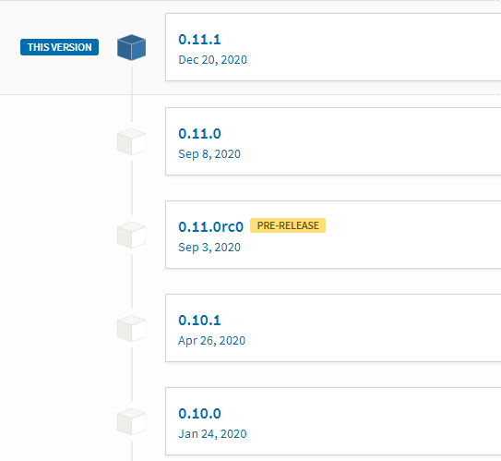
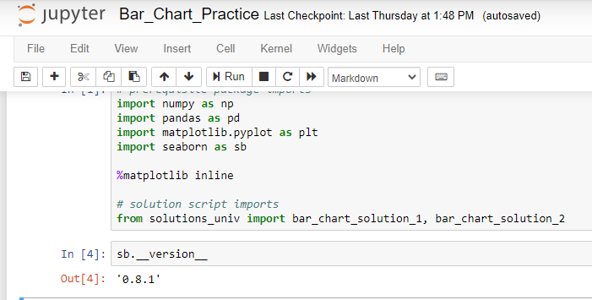
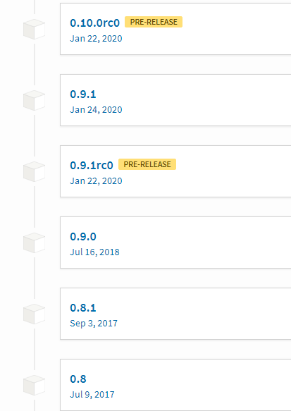
seaborn
Is it different?
https://seaborn.pydata.org/whatsnew.html

Slide 4
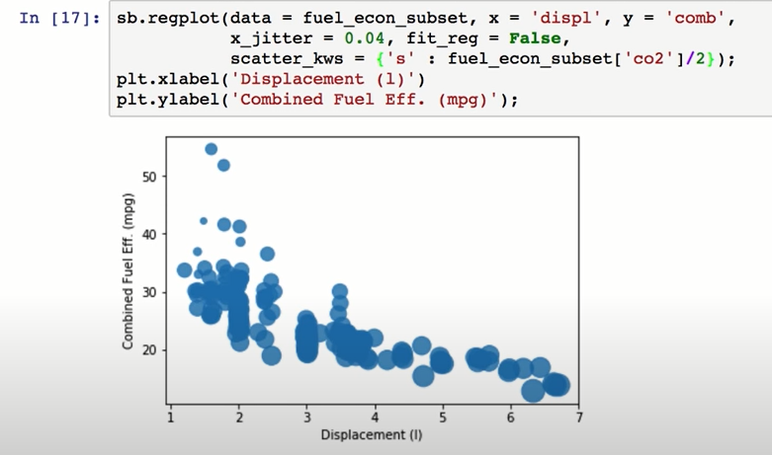
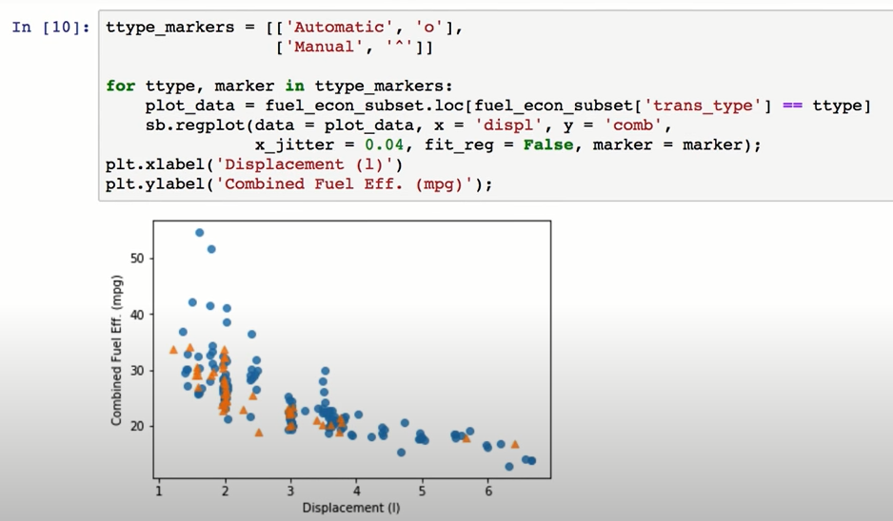
Better option?
Notes:
Scatterplot instead of regplot
Marker set easily
Lesson 5 concept 2
Scatter_kws

Slide 5
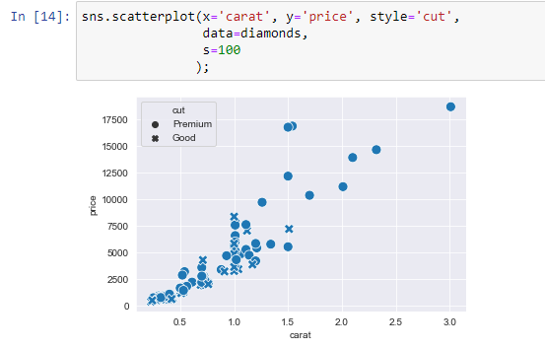
Solution

Slide 6
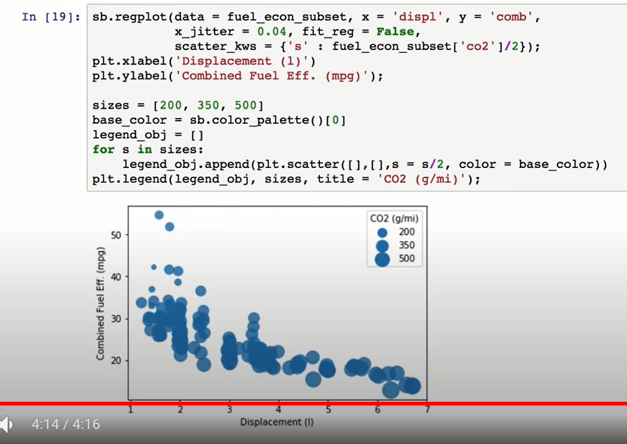
Only option for legend?
Notes:
Check youtube videos

Slide 7
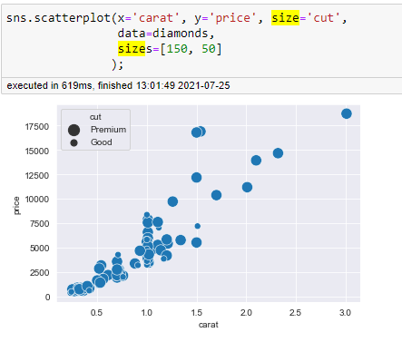
solution
Notes:
I think Something is wrong with this example.
CO2 is continuous not categorical

Slide 8
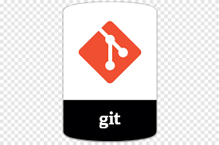
Scatter plot repo

Slide 9
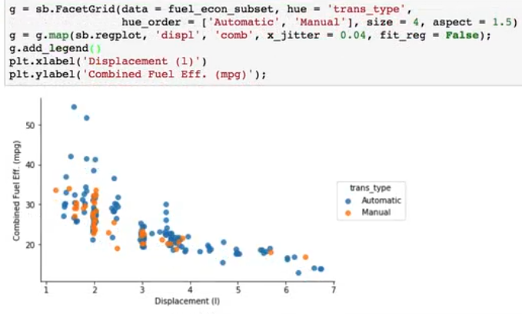
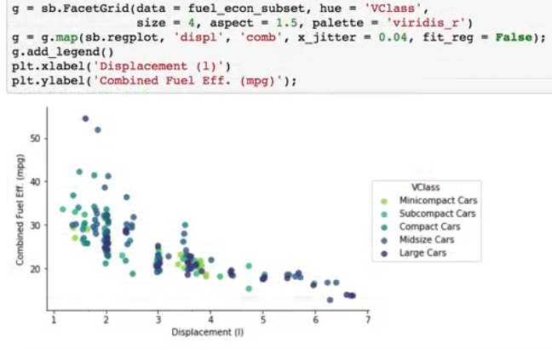
Do we need facet grid?

Slide 10
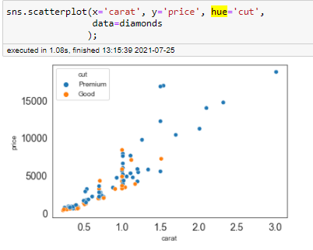
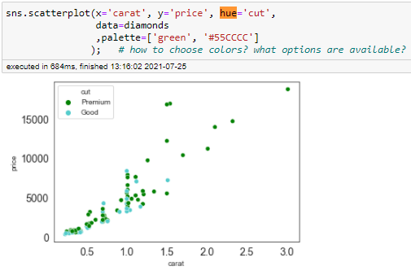
solution

Slide 11
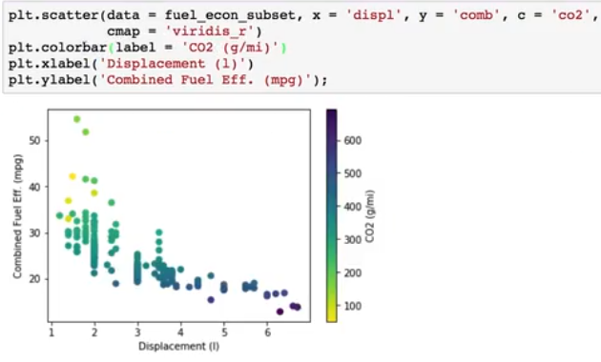
For numeric variables
We needed this
Notes:
We used only matplotlib
Any better options?

Slide 12
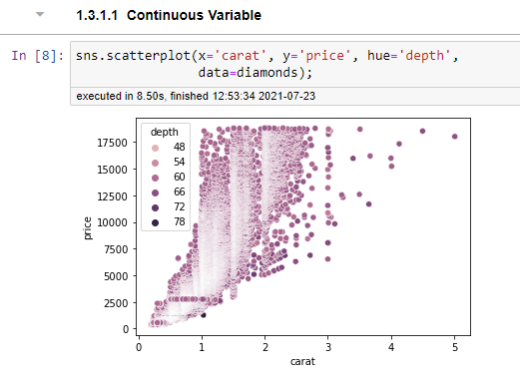
solution

Slide 13
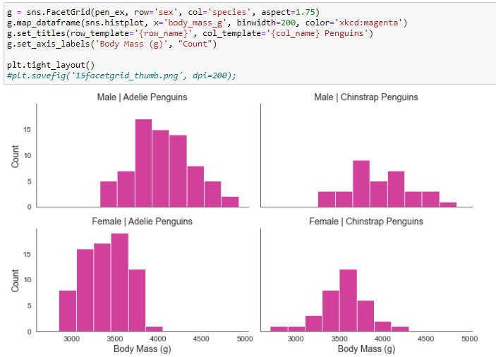
Do we really need facet grid?
Notes:
We will explore facetgrid repo later

Slide 14
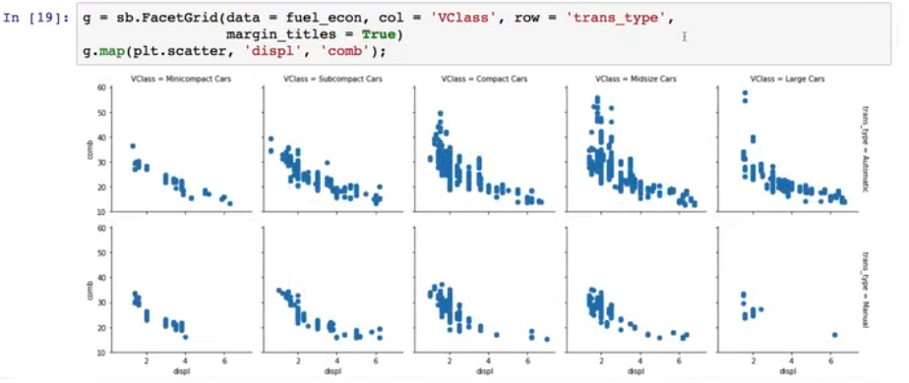
Udacity facet grid
Notes:
Can we use seaborn instead of matplotlib scatter?
Sure

Slide 15
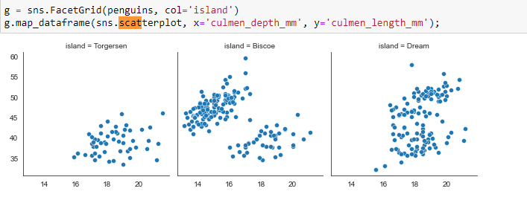

Slide 16
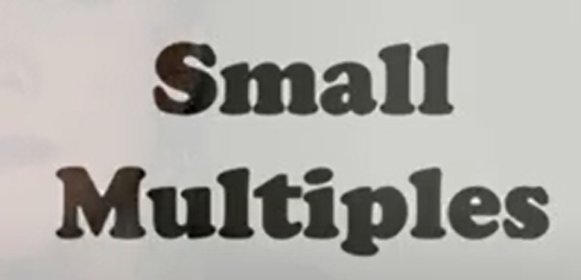
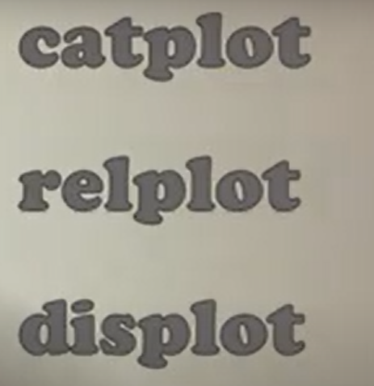
facetgrid

Slide 17
facetgrid repo

Slide 18
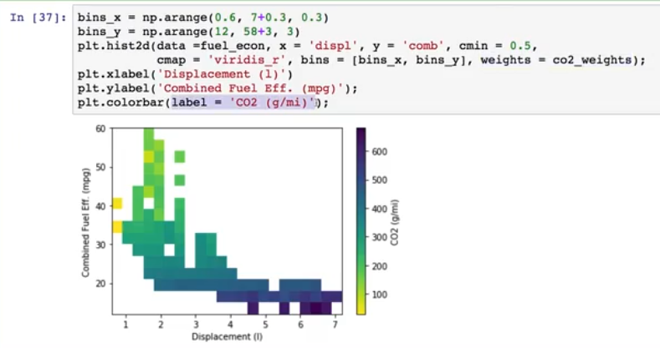
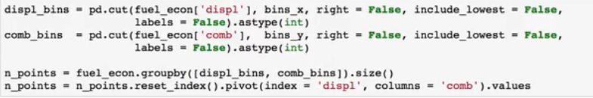
Any solution via seaborn?
Notes:
Lesson 5 concept 6 v2
Multivariate visualization adaptation

Slide 19
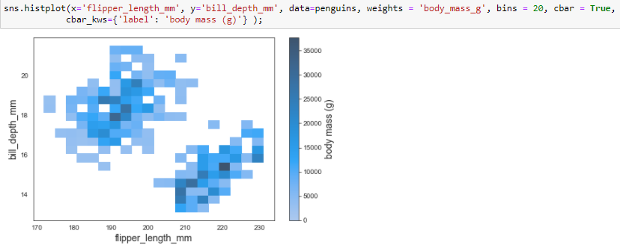
Maybe a solution
Still testing
Check hist repo [last plot]

Slide 20
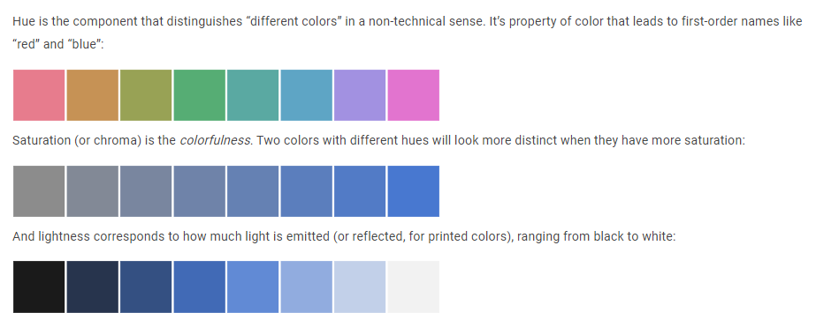
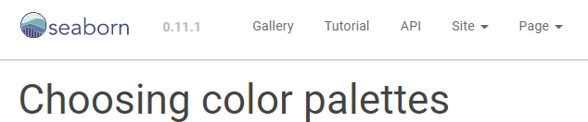
Discuss how to choose palette?
When to choose each of these?
Notes:
Choosing color palettes — seaborn 0.11.1 documentation
https://seaborn.pydata.org/tutorial/color_palettes.html
The most important function for working with color palettes is, aptly, color_palette(). This function provides an interface to most of the possible ways that one can generate color palettes in seaborn. And it’s used internally by any function that has a palette argument.

Slide 21
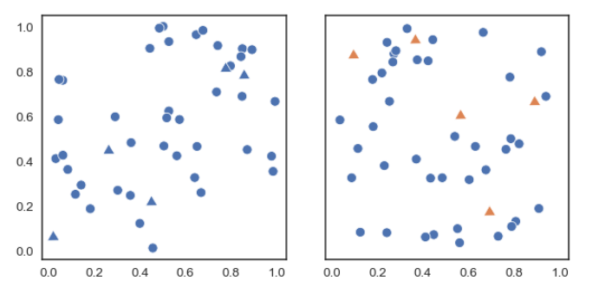
Vary hue to distinguish categories

Slide 22
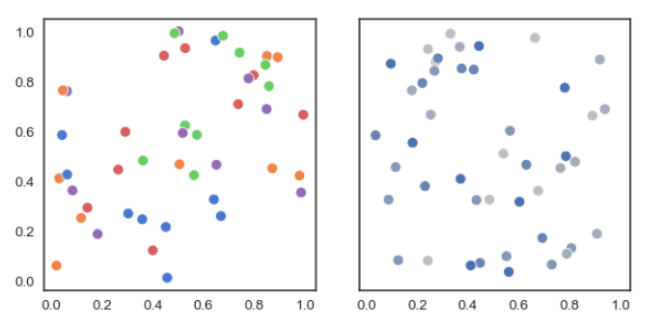
Vary hue to distinguish categories
Notes:
Most people would be able to quickly ascertain that there are five distinct categories in the plot on the left and, if asked to characterize the “blue” points, would be able to do so.

Slide 23
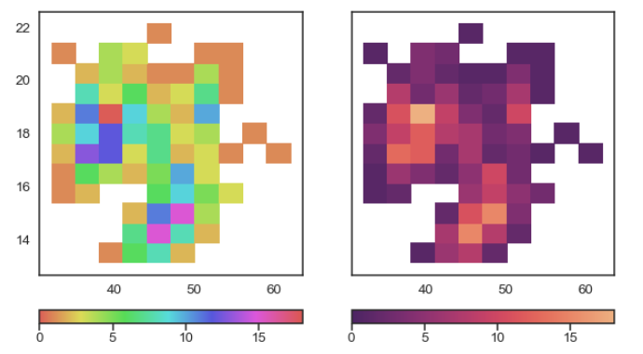
Vary luminance to represent numbers¶
Notes:
With the hue-based palette, it’s quite difficult to ascertain the shape of the bivariate distribution. In contrast, the luminance palette makes it much more clear that there are two prominant peaks.

Slide 24
How to choose color palettes?
qualitative palettes
sequential palettes
diverging palettes

Slide 25
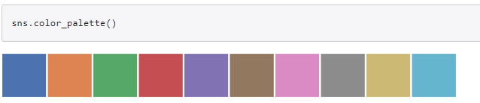
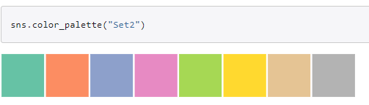
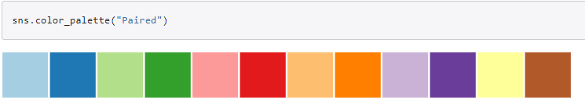
Qualitative color palettes

Slide 26
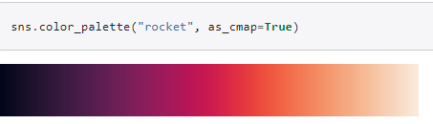
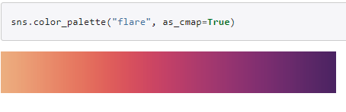
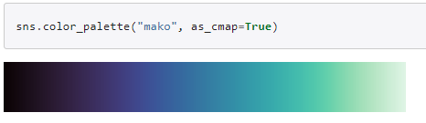
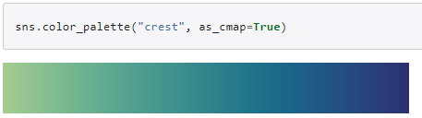
Sequential color palettes
lines and points?
Heatmaps?
Notes:
Some seaborn functions will default to a sequential palette when you are mapping numeric data. (For historical reasons, both categorical and numeric mappings are specified with the hue parameter in functions like relplot() or displot(), even though numeric mappings use color palettes with relatively little hue variation).
Perceptually uniform palettes
Because they are intended to represent numeric values, the best sequential palettes will be perceptually uniform, meaning that the relative discriminability of two colors is proportional to the difference between the corresponding data values.
Which one can be used for lines and plots?
Which can be used for heatmaps?
Left for heatmaps (colors approaching white would be useful for very low values – but they can’t map points or lines on a background)

Slide 27
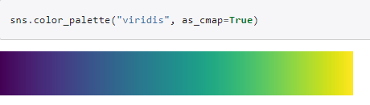
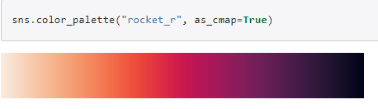
Matplotlib – and reverse!
Notes:
It is also possible to use the perceptually uniform colormaps provided by matplotlib, such as "magma" and "viridis":
As with the convention in matplotlib, every continuous colormap has a reversed version, which has the suffix "_r":

Slide 28
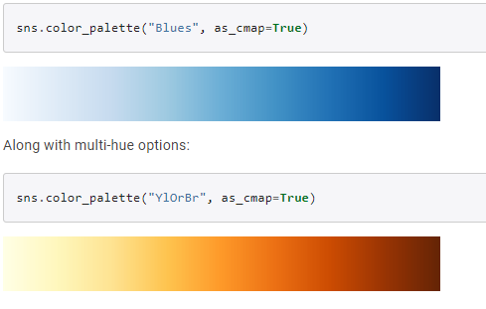
Sequential Color Brewer palettes

Slide 29
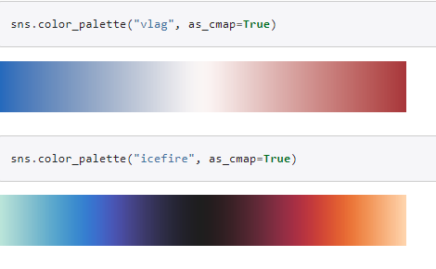
Diverging color palettes
When to use?
Notes:
Seaborn includes two perceptually uniform diverging palettes: "vlag" and "icefire". They both use blue and red at their poles, which many intuitively processes as “cold” and “hot”:

Slide 30
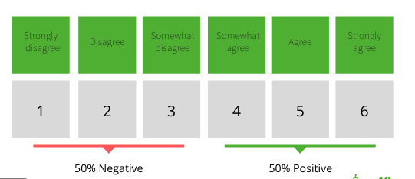
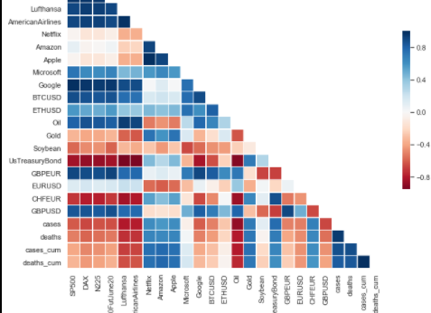
Diverging palettes

Slide 31
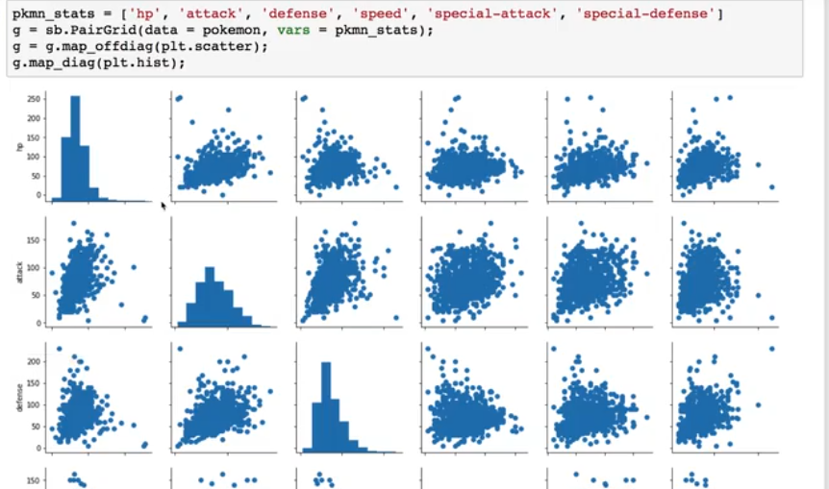
Can seaborn offer something here?
Also what’s the difference
between pairgrid and pairplot?
Notes:
Check the video for Kimberly

Slide 32
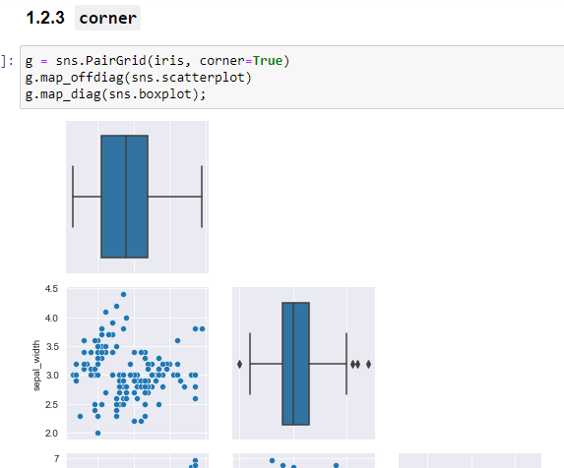
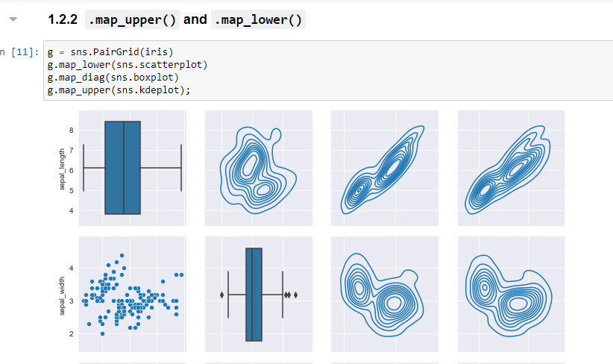
Ofcourse

Slide 33
pairgrid repo

Slide 34

Add a simple exercise for this
https://www.kaggle.com/learn/feature-engineering

Slide 35
Project
visualization
exploratory
quick
Not clean
explanatory
polished
Makes sense

Slide 36
Choose dataset
Explore Your Data
Document your Story
Create your Slide Deck
Review and Submit the Project

Slide 37
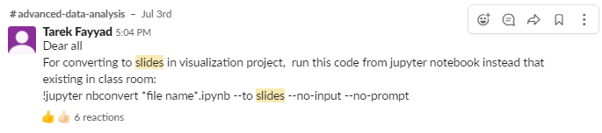
Thanks to tarek
Pinned to channel

Slide 38
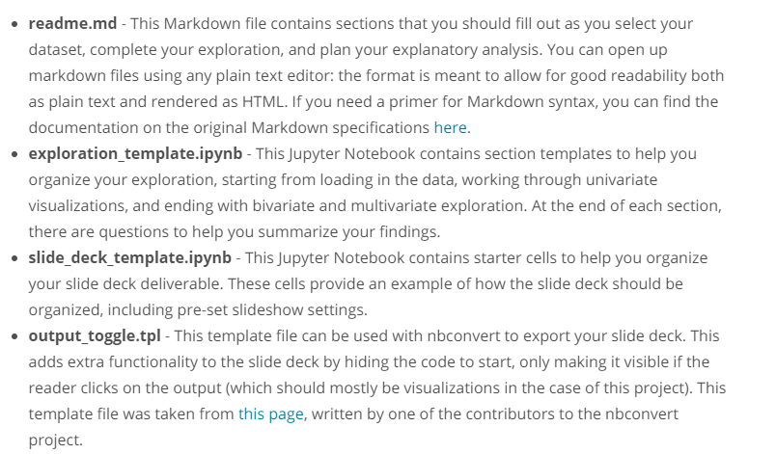
Rubric
https://review.udacity.com/#!/rubrics/1795/view

Slide 39
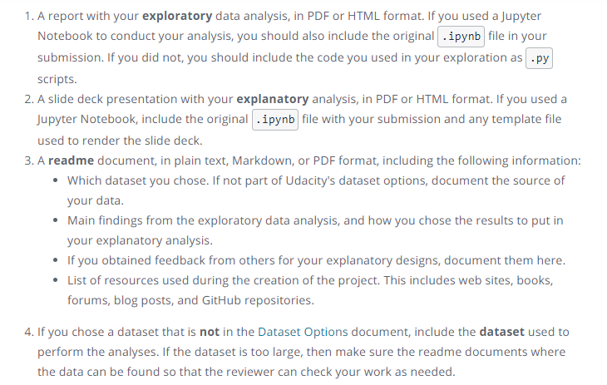
Submission

Slide 40

What’s for next time?
Notes:
Time to work individually on projects
We will have checkpoints to discuss
And a chance to collaborate

Slide 41
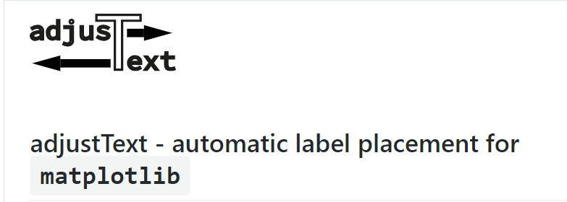
Helper package
https://github.com/Phlya/adjustText/wiki
Notes:
Phlya/adjustText: A small library for automatically adjustment of text position in matplotlib plots to minimize overlaps.
https://github.com/Phlya/adjustText

Slide 42
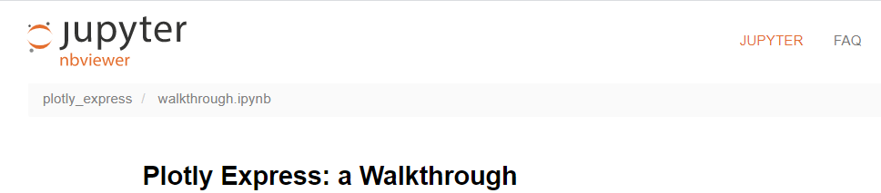
Plotly
https://nbviewer.jupyter.org/github/plotly/plotly_express/blob/gh-pages/walkthrough.ipynb

Slide 43
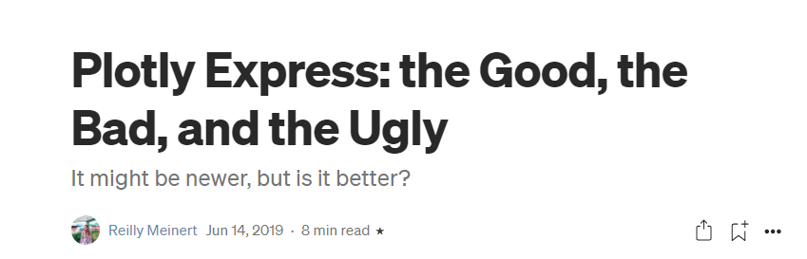
Other side
Notes:
Plotly Express: the Good, the Bad, and the Ugly | by Reilly Meinert | Towards Data Science
https://towardsdatascience.com/plotly-express-the-good-the-bad-and-the-ugly-dc941649687c

Slide 44

Dtale
https://www.analyticsvidhya.com/blog/2021/06/exploring-pandas-dataframe-with-d-tale/
http://alphatechadmin.pythonanywhere.com/dtale/main/1

Slide 45
Breakout 1
https://www.kaggle.com/alexisbcook/scatter-plots

