Slide 1
agenda
Get resources
Try using resources [univariate – bivariate]
Breakout room

Slide 2
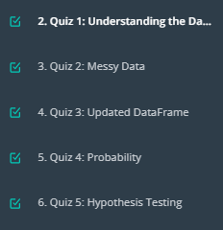
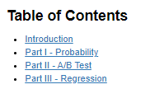
A/B testing Project

Slide 3
Part II - A/B Test
state your hypothesis

Slide 4

Part III - A regression approach

Slide 5
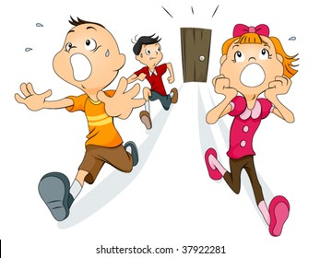
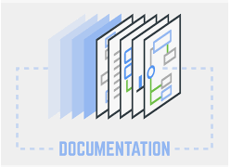
Where to start?

Slide 6
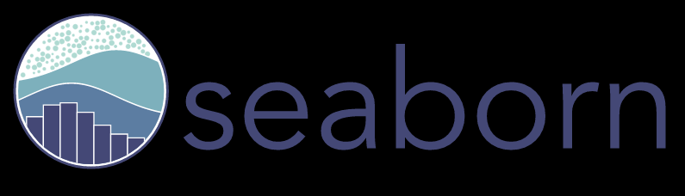
Seaborn documentation

Slide 7

Wait

Slide 8
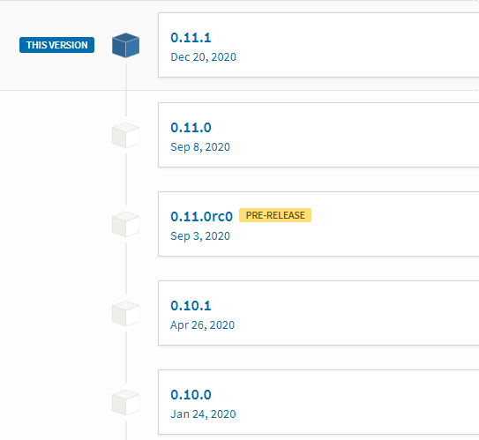
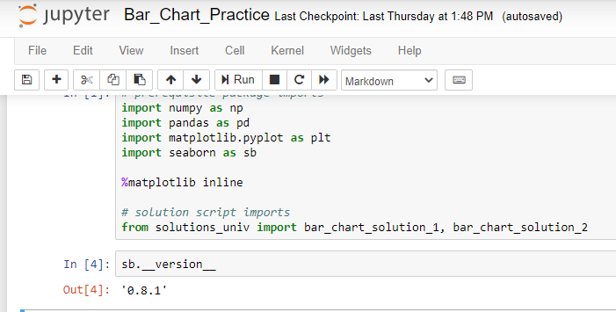
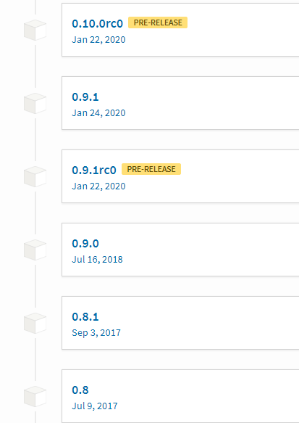
seaborn
Is it different?
https://seaborn.pydata.org/whatsnew.html

Slide 9
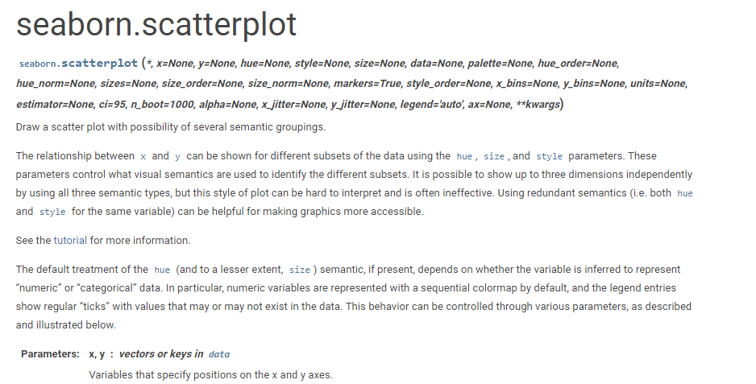
https://seaborn.pydata.org/index.html ➔ Head to tutorials
Notes:
Isn’t all the documentation like this?

Slide 10
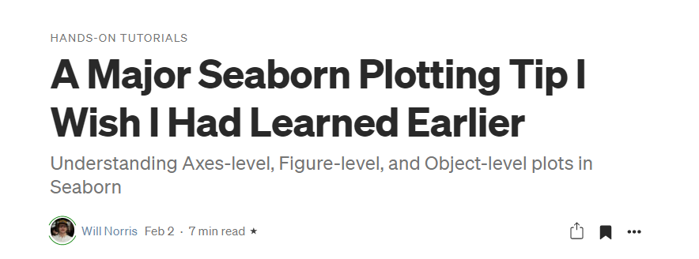
Major concept
Notes:
A Major Seaborn Plotting Tip I Wish I Had Learned Earlier | by Will Norris | Towards Data Science
https://towardsdatascience.com/a-major-seaborn-plotting-tip-i-wish-i-had-learned-earlier-d8209ad0a20e

Slide 11
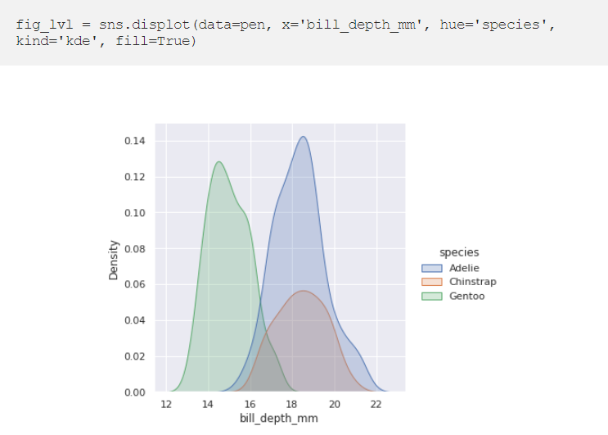
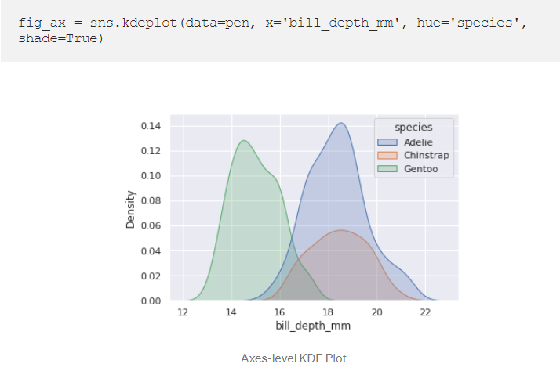
Figure-level & Axes-level functions
Any difference?
Notes:
Fig level
Vs axis level
Legend position
Also I used fill one time and shade another time

Slide 12

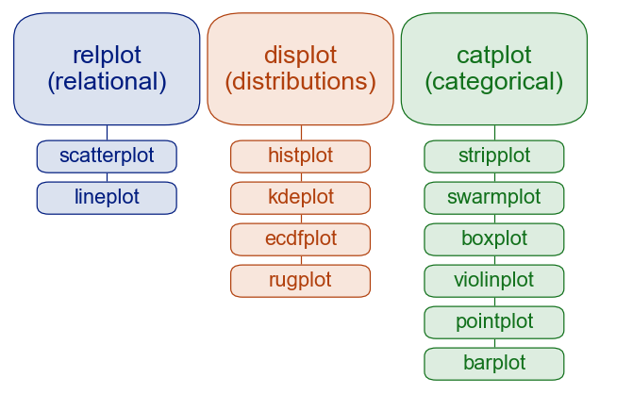
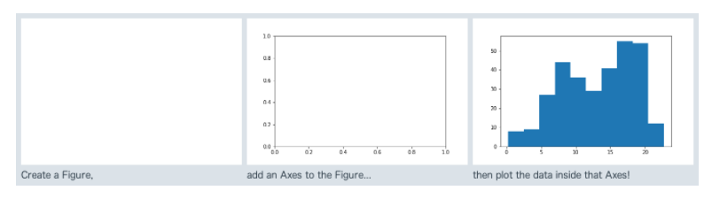
Notes:
Since we don't have a Figure area to plot inside, Python first creates a Figure object. And since the Figure doesn't start with any Axes to draw the histogram onto, an Axes object is created inside the Figure. Finally, the histogram is drawn within that Axes.

Slide 13
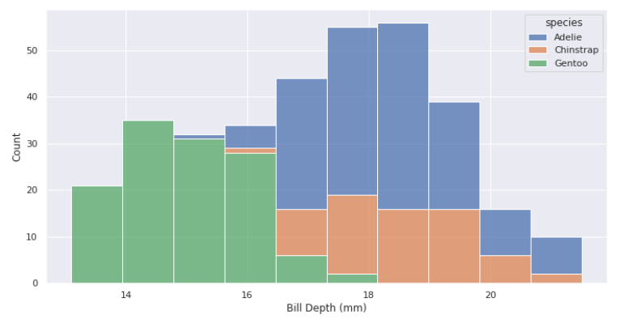
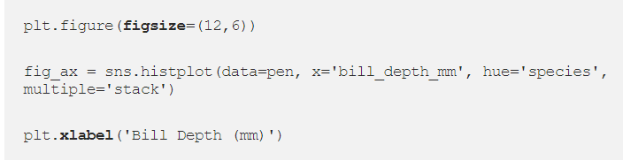
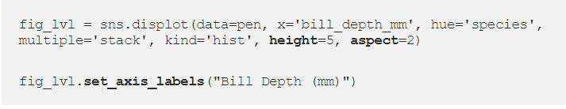
Changing Figure Size and Labeling Axes
Notes:
Difference in plot is in the legend
When we use an axes-level plot, we essentially are working with a fancy looking Matplotlib object. This leaves us a ton of further customization to be done with the Matplotlib functionality that many people are already accustomed to using.
It is harder to find the arguments for the figure level

Slide 14

طب ليه التعسيف؟

Slide 15
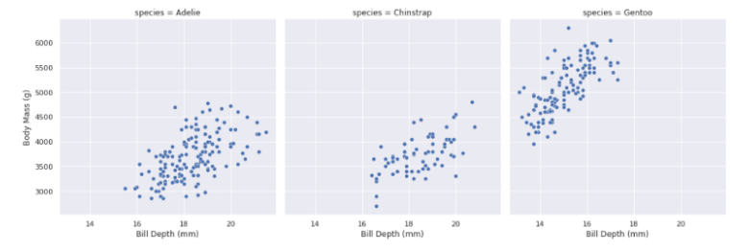
Subplots
How to?

Slide 16
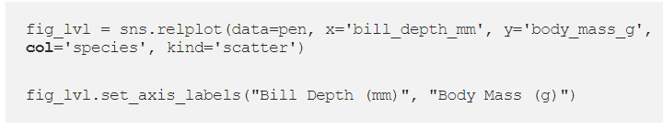
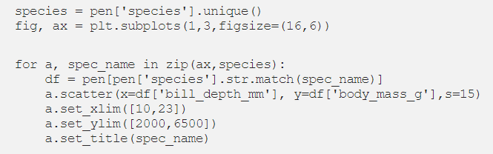
Subplots
Notes:
I chose to use a for loop to step through each axis and each species name. This way you can do things like set your x and y boundaries without repeating the same code for each axis

Slide 17
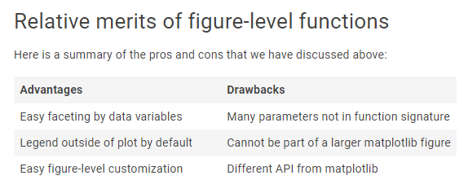
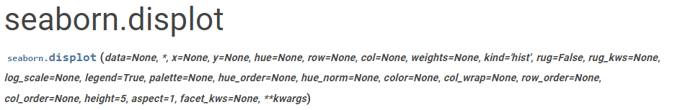
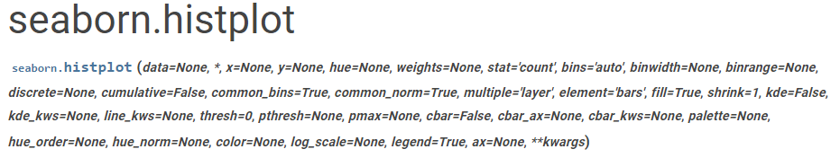
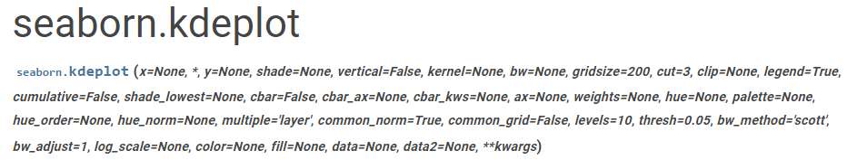
Why not figure?

Slide 18
More info?
Notes:
A Major Seaborn Plotting Tip I Wish I Had Learned Earlier | by Will Norris | Towards Data Science
https://towardsdatascience.com/a-major-seaborn-plotting-tip-i-wish-i-had-learned-earlier-d8209ad0a20e

Slide 19
Back to documentation

Slide 20
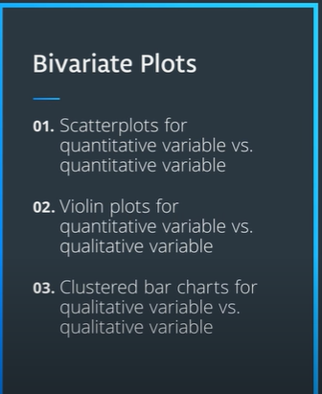
Keep in mind
Univariate plots:
Distribution vs count

Slide 21
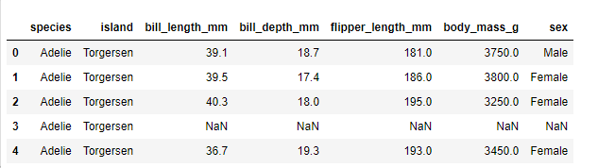
Pick a column
Resources?
Notes:
Next page

Slide 22
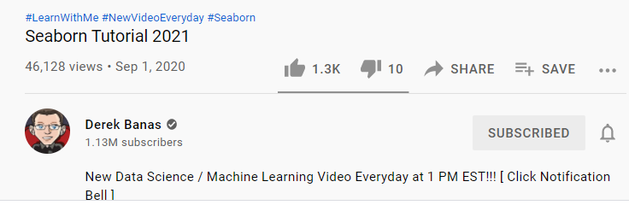
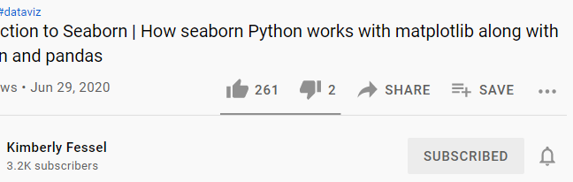
Updated!!!
Notes:
(1) Seaborn Tutorial 2021 - YouTube
https://www.youtube.com/watch?v=6GUZXDef2U0
(1) Introduction to Seaborn | How seaborn Python works with matplotlib along with seaborn and pandas - YouTube
https://www.youtube.com/watch?v=vaf4ir8eT38&list=PLtPIclEQf-3cG31dxSMZ8KTcDG7zYng1j

Slide 23
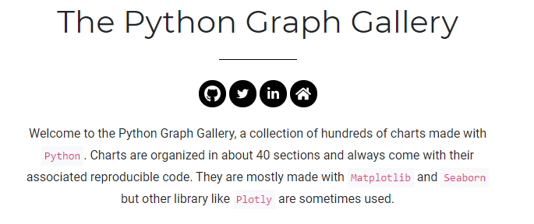
https://www.python-graph-gallery.com/
Notes:
Python Graph Gallery
https://www.python-graph-gallery.com/

Slide 24
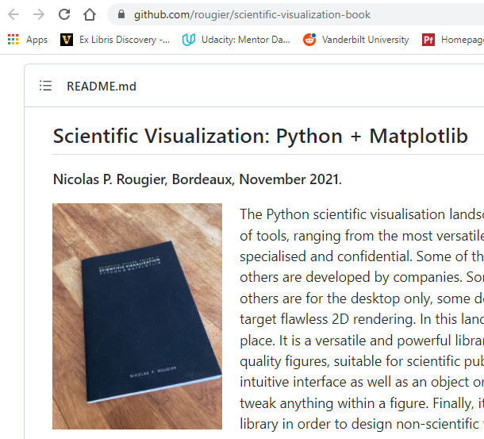
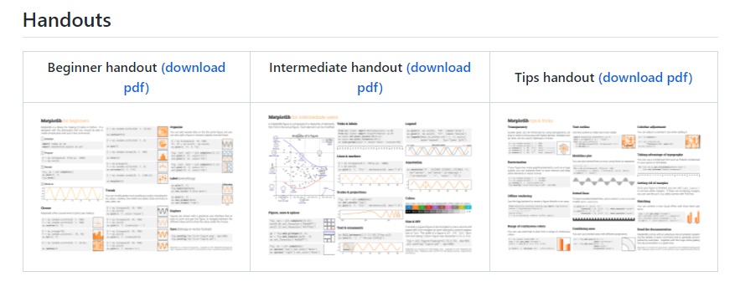
matplotlib
Notes:
https://github.com/matplotlib/cheatsheets
https://github.com/rougier/scientific-visualization-book

Slide 25
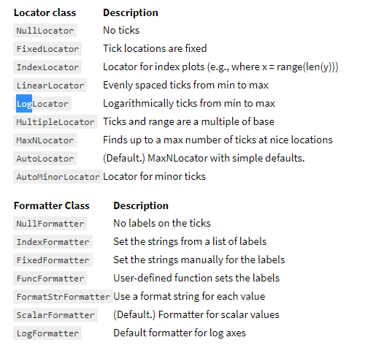
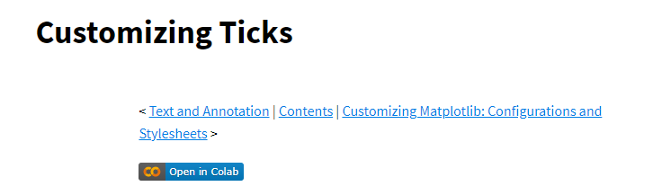
Notes:
Customizing Ticks | Python Data Science Handbook
https://jakevdp.github.io/PythonDataScienceHandbook/04.10-customizing-ticks.html
jakevdp/PythonDataScienceHandbook: Python Data Science Handbook: full text in Jupyter Notebooks
https://github.com/jakevdp/PythonDataScienceHandbook

Slide 26
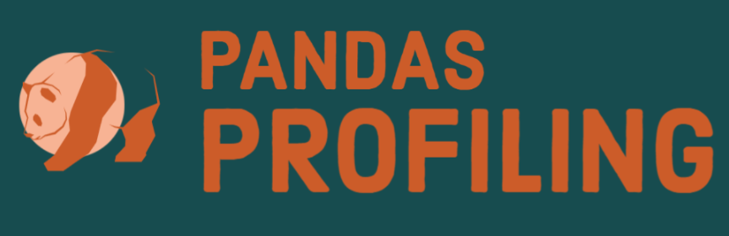
Other libraries

Slide 27
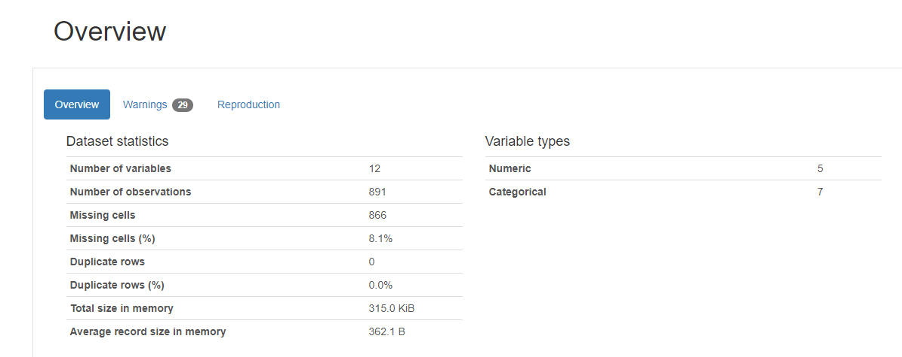
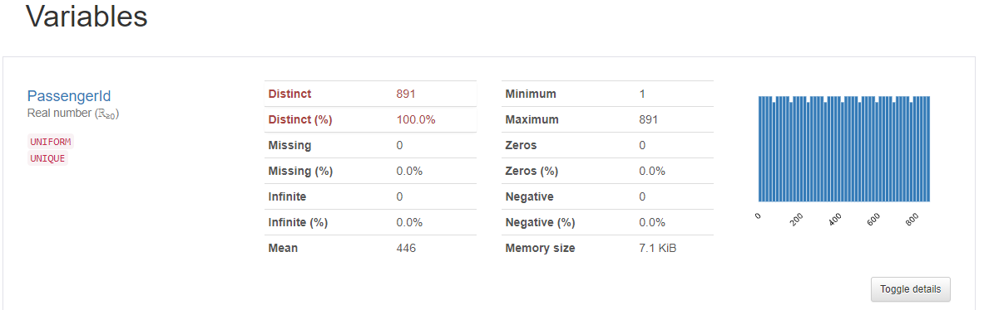
Pandas profiling report
https://pandas-profiling.github.io/pandas-profiling/examples/master/titanic/titanic_report.html
Notes:
Titanic Dataset
https://pandas-profiling.github.io/pandas-profiling/examples/master/titanic/titanic_report.html

Slide 28
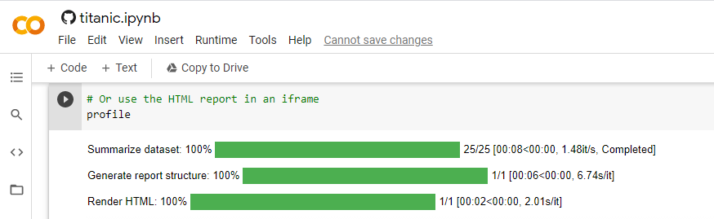
Pandas profiling google colab
https://colab.research.google.com/github/pandas-profiling/pandas-profiling/blob/master/examples/titanic/titanic.ipynb#scrollTo=pX825i8GgNuQ
Notes:
titanic.ipynb - Colaboratory
https://colab.research.google.com/github/pandas-profiling/pandas-profiling/blob/master/examples/titanic/titanic.ipynb#scrollTo=pX825i8GgNuQ

Slide 29
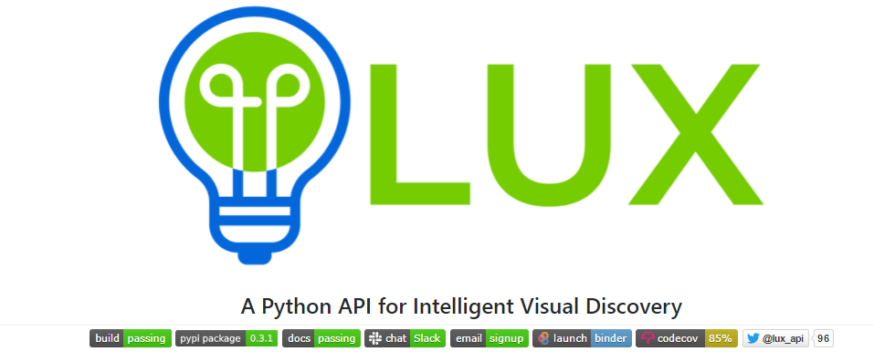
lux
https://awesomeopensource.com/project/lux-org/lux
Notes:
Lux
https://github.com/lux-org/lux

Slide 30
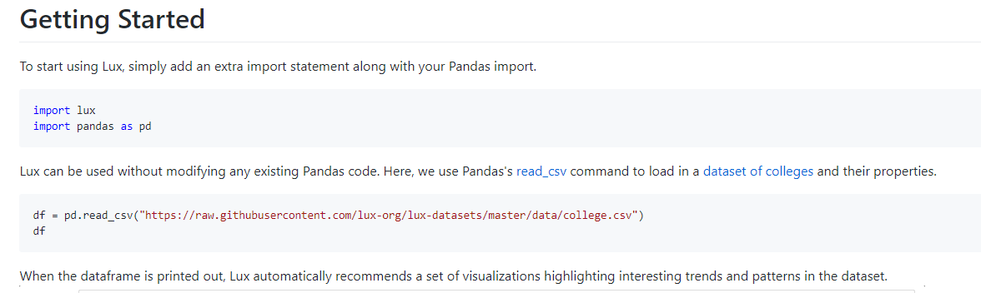

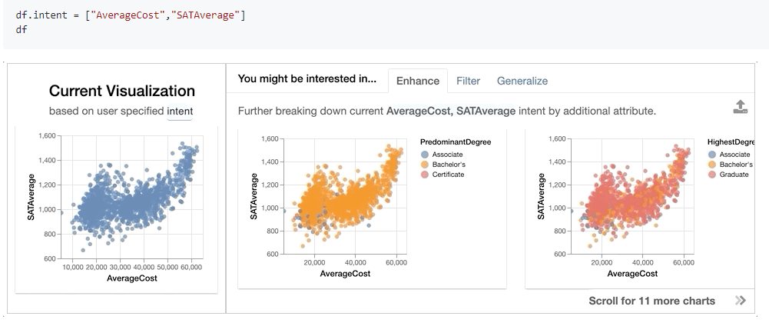
lux

Slide 31
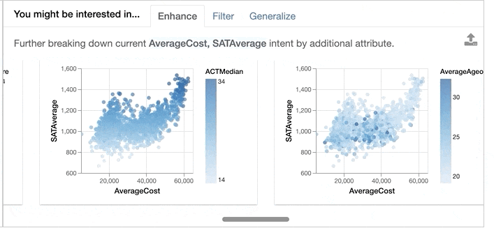
lux
Easy programmatic access and export of visualizations:
Selected Vis objects can be translated into Altair, Matplotlib

Slide 32
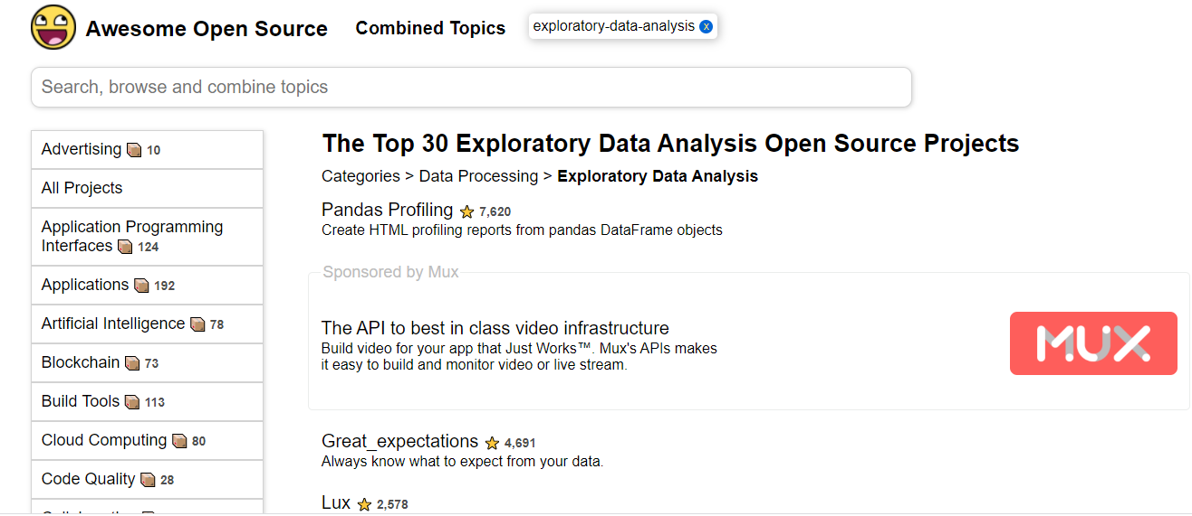
More info?
Notes:
The Top 30 Exploratory Data Analysis Open Source Projects
https://awesomeopensource.com/projects/exploratory-data-analysis

Slide 33
Activity
Kaggle learn
https://www.kaggle.com/learn
Notes:
https://www.kaggle.com/mahmoudhamza/exercise-bar-charts-and-heatmaps/edit
https://www.kaggle.com/alexisbcook/scatter-plots

Slide 34
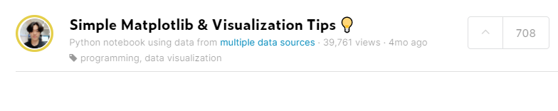
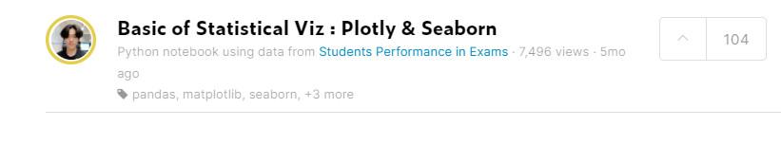
advanced
Notes:
Simple Matplotlib & Visualization Tips 💡 | Kaggle
https://www.kaggle.com/subinium/simple-matplotlib-visualization-tips
Basic of Statistical Viz : Plotly & Seaborn | Kaggle
https://www.kaggle.com/subinium/basic-of-statistical-viz-plotly-seaborn

