Slide 1

INTRO TO
LINUX COURSE
8/8/2026

Slide 2
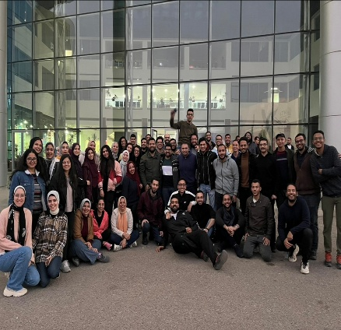
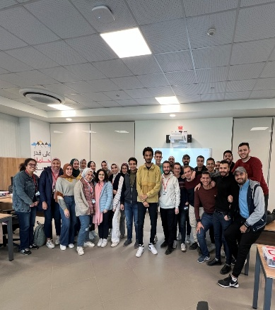

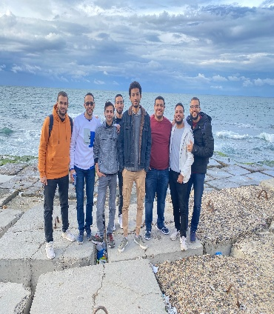
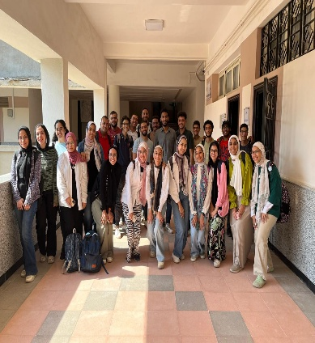



Know your Trainer
Work Experience:
ITI Intake 43 (9 months program)
ES Track (Smart Village)
Cpp + Problem Solving
ITI Intake 1 (4 months program)
ES Track G3/G4(Knowledge City)
ARM Architecture
IMT
Dokki Branch
C / AVR Architecture
ITI Intake 1 (3 months program)
eMobility Track (Smart Village)
Cpp + Problem Solving
ITI
Summer Training (Helwan)
IoT
+ Many More Online Courses
Instructor @
Software Engineer @
,

Slide 3
Objectives
Linux Administration
  Gain sufficient skills to perform core system administration tasks on any Linux distribution.
  Develop a good working knowledge of Linux using both the graphical user interface and command line interface.
  Be familiar with Linux system structure and components.

Slide 4
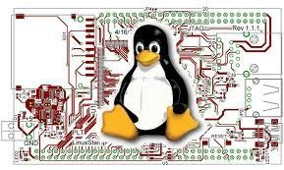
Linux history

Slide 5
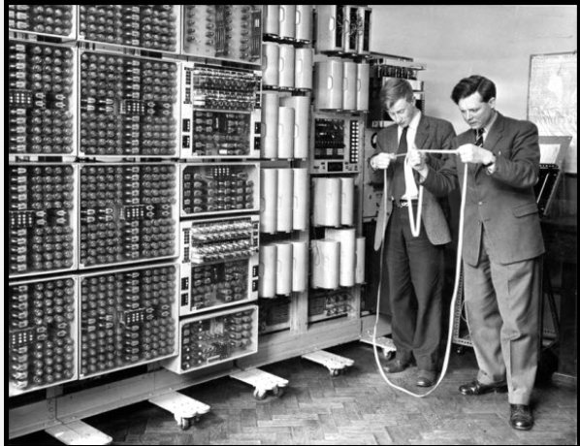


Multics
In the 60s computers were huge and expensive.
Researchers wanted an OS that would allow many users to share a single computer simultaneously.
A project called Multics was started by MIT, Bell Labs.
Notes:
It Introduced many ideas that are standard today:
1- Hierarchical file systems
2- User Permissions
3- Security
4- Multiple Users
5- Dynamic Linking

Slide 6
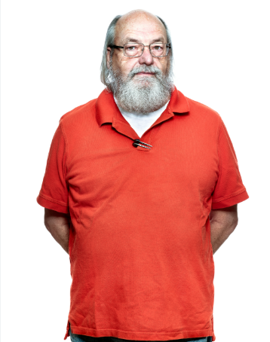
Unix
In 1969 Bell labs withdrew from Multics project.
But one researcher at Bell Labs, Ken Thompson, still wanted a simple OS to run a game he had written.
He decided to start working on a new OS himself.
His friend made a play on “Multics” – called it “UNIX”
Notes:
It was complex and taking too long.

Slide 7

Unix
Soon, Dennis Ritchie joined the project.
At that time OSs were almost always written in assembly.
Dennis developed the C Programming language.
Unix was rewritten in C.
This was revolutionary because now UNIX could be recompiled for different hardware instead of being rewritten from scratch in assembly.
Notes:
At that time Oss were almost always written in assembly. Made it difficult to move to different computers.

Slide 8
Unix
During 1980s, many companies created their own UNIX versions and they sold it for money.
Sun Microsystems → Solaris
IBM → AIX
Silicon Graphics → IRIX

Slide 9
Linux History
In the 60s and early 70s, programmers were used to
distribute the source code with their programs.
Unix, a family of multitasking, multiuser computer operating systems, was developed in the 1970s at the Bell Labs research center by Ken Thompson, Dennis Ritchie, and others.
But, things started to change in the late 70s/early 80s when manufacturers stopped providing source code.
Notes:
What does source code mean ?

Slide 10
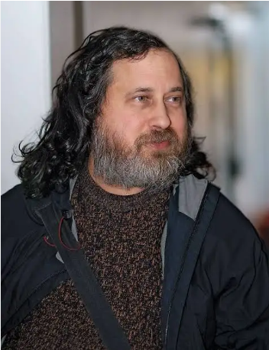
Richard Stallman (Free SW Movement)
Richard Stallman Explains Everything

Slide 11
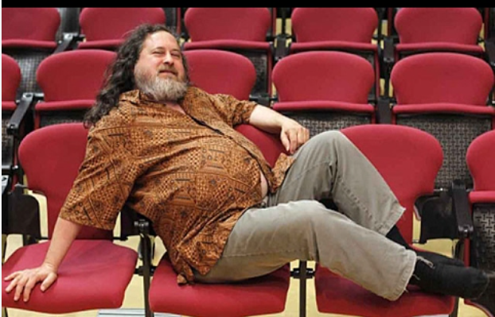
Richard Stallman
Richard Stallman Talks About Ubuntu

Slide 12
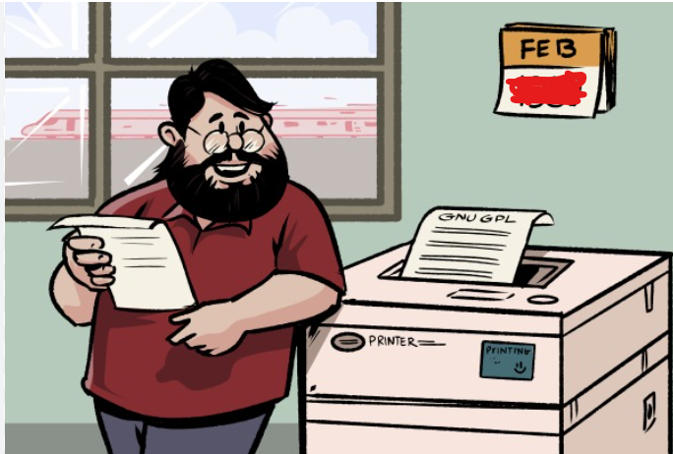
Linux History (cont’d)
In the late 1970s and early 1980s, Stallman had been working as a hacker at the Artificial Intelligence Laboratory(AI Lab) of the (MIT).
They had a printer in the lab which sometimes jammed.
He decided to modify its source code himself so he can add a notification feature.
Notes:
Hacker not a Cracker
In the late 1970s and early 1980s, Stallman had been working as a hacker at the Artificial Intelligence Laboratory(AI Lab) of the (MIT).
At the time, the lab had a culture of sharing SW source code so anyone could fix bugs or add features.
He decided to modify its source code himself so it can notify the people on the network that it needs a human intervention instead of waiting until someone discovers this coincidentally .

Slide 13

Linux History (cont’d)
The lab later in 1980 received a new, faster laser printer from Xerox.
The new printer had the same problem, but this time the driver software was proprietary.
Xerox refused to share their printer’s source code.
This event convinced him that people need to be free to
  Understand how their software works.
  Modify the software to meet their needs.
  Share improvements with others.

Slide 14

Linux History (cont’d)
On September 27, 1983, Stallman announced the GNU
Project.
The GNU Project aims at developing a complete operating system offering the freedoms to
  Run
  Study
  Modify and
  Distribute.
Notes:
GNU = GNU not UNIX

Slide 15
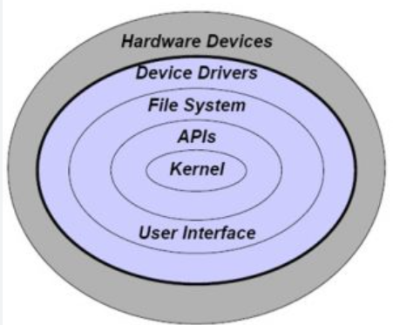
Linux History (cont’d)
By the early 1990s there was almost enough available software to create a full operating system. However, the GNU kernel, called Hurd, failed to attract enough development effort, leaving GNU incomplete.

Slide 16
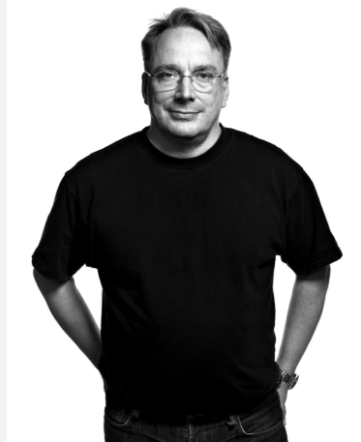
Linux History (cont’d)
In 1991, in Finland, a student, Linus Torvalds, began a project that later became the Linux kernel. He wrote the program specifically for the hardware he was using 80386 processor. Development was done on MINIX using the GNU C compiler.
As Torvalds wrote in his book 'Just for Fun', he eventually ended up writing an operating system kernel. On 25 August 1991 (age 21)

Slide 17
Linux History (cont’d)
In 1992, he suggested releasing the kernel under the GNU Project.
Linux and GNU developers worked to integrate GNU components with Linux to make a fully functional and free operating system.
GNU/Linux 1992 (complete, open source, UNIX-like operating system)
https://www.gnu.org.ua/
https://youtu.be/XMm0HsmOTFI - Watch This (Subtitles available)

Slide 18


Slide 19
Why Linux

Slide 20
Why Linux
Free, Safe, Robust.
Source code of all related SW is available (Open Source)
Ported to a large variety of CPU architectures (X86, ARM, PowerPC, etc).
Large device drivers coverage.
Hosting huge number of languages & libraries.
Software is highly modularized, making it easy to build something new.
Large Community.

Slide 21
Why Linux (cont’d)
Linux is everywhere. It's on your servers and in your phones, cars, watches, toasters, refrigerators... and desktops.
You need to switch to Linux if
  You love free stuff
  You’re obsessed with customizing things
  You love creating things
  You love being part of a group and working with others
  You love the idea of choice

Slide 22

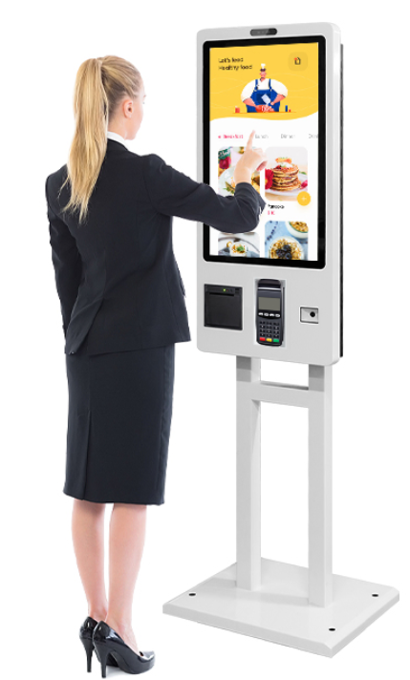
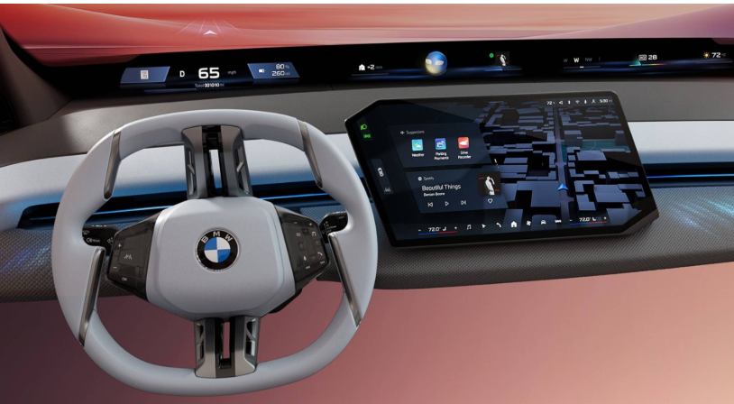
Why Linux (cont’d)

Slide 23
Different Linux distributions

Slide 24
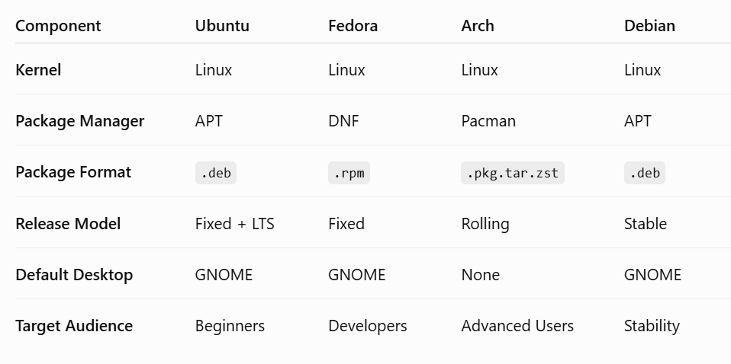
Different Linux Distributions

Slide 25

Linux is like Lego

Slide 26
Different Linux Distributions
(PC)
RedHat
  RedHat Enterprise
  Centos
  Fedora
Debian
  Debian
  Ubuntu
SUSE
  SUSE Enterprise
  Open SUSE
(Embedded)
Ångström distribution
Embedded Debian
Ubuntu Phone
– Tizen
– Firefox OS

Slide 27
Get a Taste of Linux

Slide 28

Get a Taste of Linux

Slide 29
Graphical Installation of Linux

Slide 30

Ubuntu Installation
Focal Fossa
Ubuntu Version’s code names are made of two words, first being an adjective and the second one is an animal name with the same first letter.

Slide 31
Exploring Ubuntu GUI

Slide 32
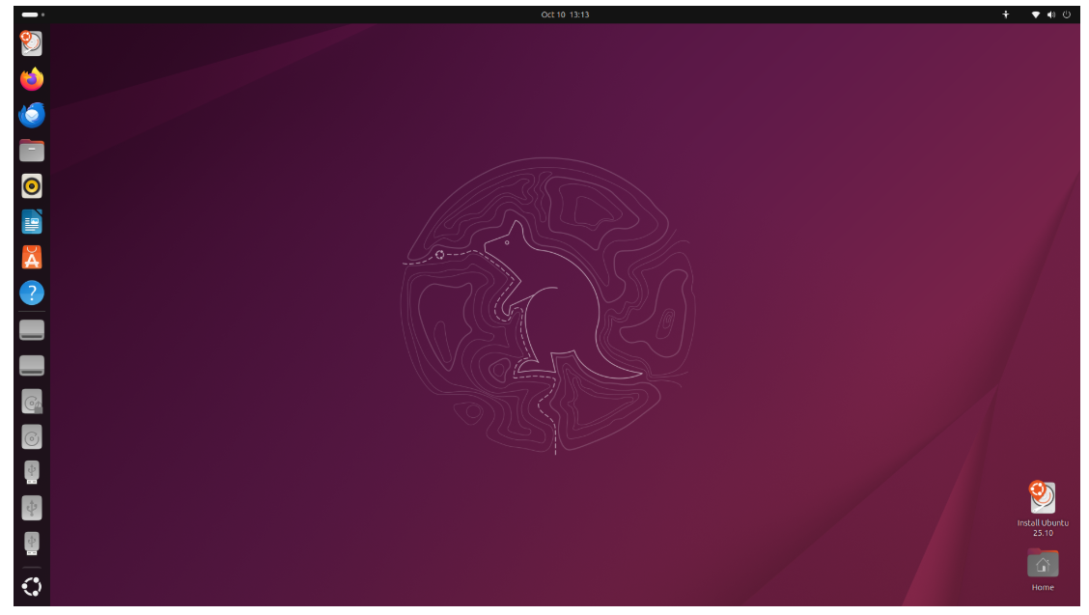
Linux GUI
Desktop

Slide 33

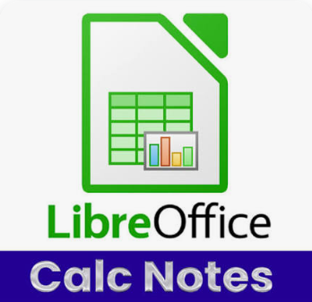
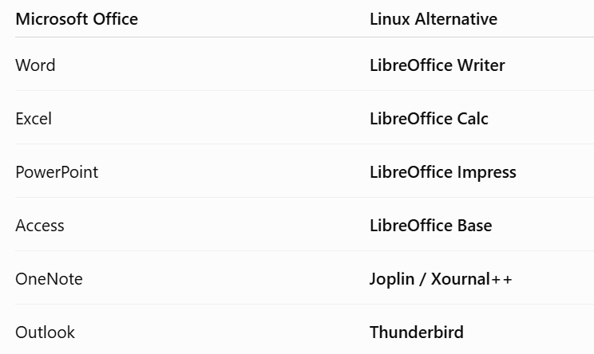



Linux GUI

Slide 34

Linux App Center

Slide 35
Linux System Structure & Principles

Slide 36
Linux System Structure
BootLoader (grub, uboot, vivi)
Kernel (www.kernel.org)
Filesystem (FHS)
  init process
  shell (bash & ash & sh)
  Services manager
  Scripts & Environment variables
  Linux commands
  Applications (user apps, GUI, …)

Slide 37
Linux System Principles
Everything is a file (including hardware).
Consists of small, single-purpose programs.
Ability to chain programs together to perform complex tasks.
Users usually avoids user interfaces.

Slide 38
Root Filesystem Hierarchy Standard (FHS)

Slide 39
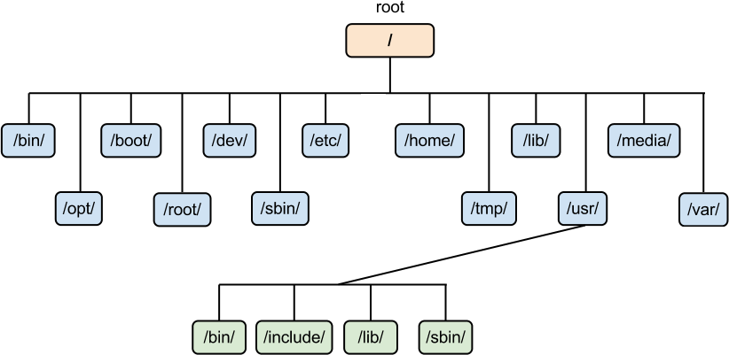
FileSystem Hierarchy Standard

Slide 40
FileSystem Hierarchy Standard
/
/bin
/sbin
/boot
/dev
/etc
/home
/root
/lib
/media
/opt
/proc
/usr
/var
root directory
commands & executable files
system commands & executable files kernel & bootloader
hardware device files (nodes) configuration files and startup scripts users home directories
root home directory shared library files
mount points for storage media
third parity applications virtual process files
other users applications & libraries files that change a lot

Slide 41
Graphical User Interface

Slide 42
Introduction to the command line

Slide 43
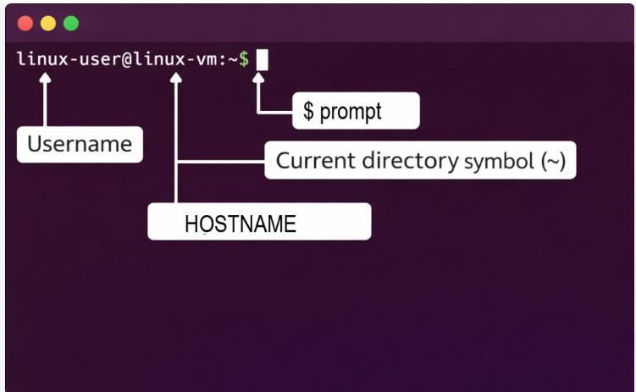
Terminal
Shortcut to open a new terminal : CTRL + ALT + T
Prompt : linux-user@linux-vm:~$
Command : what comes after the ‘$’ or ‘#’
Username : linux-user
Hostname : linux-vm
~ : current working directory “Home”
$ or # : $ indicates Normal User, # indicates the root user.
The Cursor is blinking after “$” waiting for your command

Slide 44
Terminals Vs Shells
When you open GNOME Terminal on Ubuntu:
Terminal is the GUI Application.
It takes your commands and pass them to the shell “sh, bash, zsh, PowerShell”

Slide 45
Command Line
Command syntax
command [option(s)] [parameter(s)] command –(one_character_option) command –-(full_word_option)
  Boldface is used for as-is text
  Arguments or option-arguments enclosed in the '[' and ']' notation are optional and can be omitted.
  Arguments separated by the '|' vertical bar notation are mutually- exclusive.
  Ellipses ( "..." ) are used to denote that one or more occurrences of an option or operand are allowed.

Slide 46
Why do we use commands ?
Faster
Automation
Precise
Works for Remote Machines that does not have GUI
More Fun

Slide 47
Browsing and Exploring Filesystem

Slide 48
Browsing and exploring File System
Relative Path
Absolute Path

Slide 49
Browsing and Exploring Filesystem
cd | change | directory
cd | dir-name | go to dir
cd | – | go previous
cd | . | go to current
cd | .. | go up
pwd
print current working directory
ls | list | files | in current directory
ls ls ls ls | –l –lh another-path –a |  | long list long list, human read list another folder list all with hidden
Absolute and Relative Path names.

Slide 50
Creating files and directories

Slide 51
Creating files and directories
touch touch touch | create a new file-name file1 file2 file3 |  |  | file
mkdir mkdir | create dir-name | a | directory
file-name rules: 1- Alphanumeric (a-zA-Z0-9) 2- Special characters except ‘/’ 3- No Extensions in Linux “file.txt” txt is considered as part of the file name. 4- To hide a file precede it with ‘.’ 5- Files in Linux are case sensitive.

Slide 52
Copying and moving files

Slide 53
Copying and moving files
cp copy files and directories
cp source destination cp –p source destination cp –r source destination
Preserve attributes
with contents
mv
mv source
move & rename files & directories
destination
If in same dir, it’s considered rename.
If to another partition or directory,
it’s considered move.

Slide 54
Removing files and directories

Slide 55
Removing files and directories
rmdir
remove empty directory
rmdir empty-dir-name
rm remove files and dirs rm file-name
rm –r dir-name

Slide 56
Getting Help (man pages)

Slide 57
Getting Help
Help commands
man command
System-wide documentation system that provides short reference manuals (pages) for individual commands, API functions, concepts, configuration file syntax, file formats and is organized in sections (1 for user commands, 2 for system calls...). That's the traditional Unix documentation system.
info command
Another documentation system originating in the GNU project
help command
Built-in command in the bash shell (and that shell only) that documents some of the built-in commands and keywords of that shell. That's an internal documentation system of that shell.
--help
Command type
type
Display information about command type
Man Pages
man man
Display manual page descriptions
man -f command
whatis command
Search the manual page names and descriptions
man -k pattern apropos pattern
For more info regarding getting help -> LINK

Slide 58
Text Editors

Slide 59
Text Editors
GUI-based editors
  gedit
Terminal-based editors
  nano
    Simplest text based editor
  vi/vim
    More powerful but complex

Slide 60
Text Editors (vi / vim)
Default editor in all Unix operating systems
vi in Linux is usually vim (vi improved)
Supports syntax highlighting
VI three basic modes
  Command mode
    Perform commands to delete, copy, ..
  Edit mode
    Enter text into the file
  Last line mode
    To access it, enter a colon (:) while being in the command mode

Slide 61
Text Editors (vi / vim) (cont’d)
Open file
  vi filename
Now you are in the command mode
To enter edit (insert) mode (i)
To exit edit (insert) mode (Esc), now you are in the command mode
To enter and exit visual mode (v)
On command mode you can enter last line mode by (:)
  Exit without saving changes (:q!)
  Save changes and exit (:wq)
  Save changes and stay (:w)
For more info, tutorials and games about VIM → LINK

Slide 62
Text Files Utilities

Slide 63
Text Files Utilities
Viewing file contents
cat file-name
more file-name
less file-name
Scrolling keys for the more command
Space bar: moves forward on screen
b: move back one screen
Enter: line by line
/string: search forward for pattern
n: find the next occurrence
q: quit and return to the terminal prompt
g/G: g→ Go to the beginning of the file, G → Go to the end of the file [less]
head –n file-name
tail -n file-name
diff or diff –s or diff -q
Comparing two files

Slide 64
Wildcard Characters

Slide 65
Wildcard characters
Wildcards are useful in many ways for a GNU/Linux system and for various other uses.
Commands can use wildcards to perform actions on more than one file at a time, or to find part of a phrase in a text file.
  Asterisk (*): represent 0 or more character
    ls f*
  Question mark (?): character represents any single character
    ls fil?
  Square bracket([ ]): represent a range of characters for a single character position.
    ls [a-f]*
  Curly brackets ({}): This wildcard will copy anything that matches either wildcard(s), or exact name(s) written inside the curly brackets
    cp { *.doc, *.pdf } /home/ubuntu
For more info about wildcards → LINK

Slide 66
System Info Commands

Slide 67
System Info Commands
whoami
  Print effective current user
hostname
  Show or set the system’s host name
date
  Print or set the system date and time
uptime
  Tell how long the system has been running
uname –a
  Print system information

Slide 68
System Info Commands
free
  Display amount of free and used memory
df
  Report file system disk space usage
file file-name
  File type
du [-sh] file-name or folder-name
  Estimate file space usage
uname –a
  Print system information

Slide 69
System Info Commands
lsusb
  List USB devices
lspci
  Display info about the CPU arch
lsmod
  List loaded modules
dmesg
  Used to examine or control the kernel ring buffer.
    Ex) To display USB messages
      dmseg | grep –i usb

Slide 70
References
Linux From Scratch
  http://www.linuxfromscratch.org/lfs/
Linux Documentation project ( HowTos - Guides – FAQs )
  http://www.tldp.org/

Slide 71

Ramy Adel Abdelrazek
rami.adel.abdelrazek@gmail.com

