Slide 1

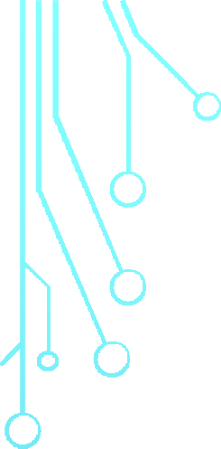




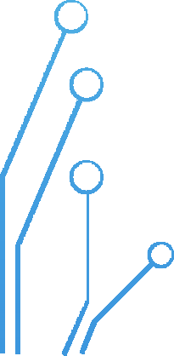


Cloud and Virtualization Concepts

Slide 2
Why learn virtualization?
Modern computing is more efficient due to virtualization
Virtualization can be used for mobile, personal and cloud computing
You can also use virtualization in your personal life

Slide 3
THIS CONTENT WILL HELP YOU
Understand the benefits of virtualization
Be able to describe virtualization, virtual machines and hypervisors
Describe typical data center components that are virtualized
Become familiar with VMware technology popular in industry

Slide 4


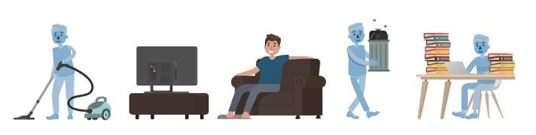
VIRTUALIZATION BENEFITS
Have you ever wished you could clone yourself?
If you could, would you be more efficient? Would you do more?
Virtualization enables computers to be more efficient in a similar fashion
Computers that use virtualization optimize the available compute resources

Slide 5
Simply put, virtualization is an idea that has been around for decades, originating in the 1960s and mainframe computers.
Cloud and Virtualization Concepts will lead you topic-by-topic to build your understanding of:
what virtualization is, and how it can be used,
the main components involved in virtualization,
as well as VMware's role in the virtualization industry and,
how knowledge of virtualization can lead to great career opportunities.
While virtualization has been a part of the IT landscape for decades, it is only recently (in 1998) that VMware delivered the benefits of virtualization to industry- standard x86-based platforms,

Slide 6
Course Objectives
By the end of this course, you should be able to meet the following objectives:
  Explore creating virtual machines and the benefits
  Move from a physical environment to a virtual one
  Understand how individuals and businesses benefit from virtualization
  Describe virtualization, virtual machines, hypervisors, and VMware vSphere components
  Describe the concepts of server, network, storage, and desktop virtualization
  Understand cloud concepts such as types of cloud computing and popular cloud deployment models
  Understand container technology including concepts such as containers, Docker, and
Kubernetes
  Explore how containers and virtual machines enable cloud computing, DevOps, and cloud- native technology

Slide 7
Course Overview
The Cloud and Virtualization Concepts course consists of eight modules.
  Module 1: Introduction to Virtualization
  Module 2: Introduction to cloud and VMs
  Module 3: The Hypervisor
  Module 4: The Data Center
  Module 5: The Virtual Data Center
  Module 6: The Cloud
  Module 7: Container Technology
  Module 8: VMware Virtualization Solutions

Slide 8

WHAT IS
VIRTUALIZATION?

Slide 9
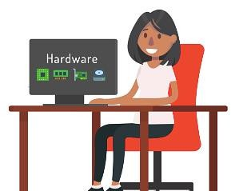
HARDWARE AND SOFTWARE
Do you use a smartphone, laptop or home computer?
Smartphones, laptops or home computers are hardware
Similar to how your brain controls your actions, software controls hardware
There are different types of software that control computer actions

Slide 10


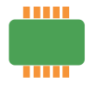



HARDWARE
Processor | Also called CPU (Central Processing Unit)
RAM | Random Access Memory
Read-Only Memory | Non-volatile memory that stores BIOS *BIOS is a type of software responsible for turning on (booting) computer
Motherboard | Printed Circuit Board (PCB ) that holds the processor, RAM, ROM, network and Input/Output (I/O) and other components
Chipset | A collection of microchips on motherboard that manage specific functions
Storage | A persistent (non-volatile) storage device such as a Hard Drive Disk or S olid S tate Drive

Slide 11
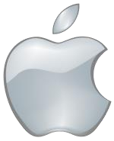
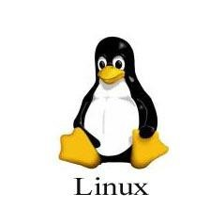
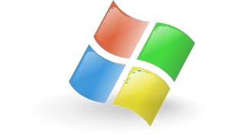
SOFTWARE
System software is necessary for hardware to function
Operating system (OS) controls the hardware
Application software tells your system to execute a task you want done

Slide 12
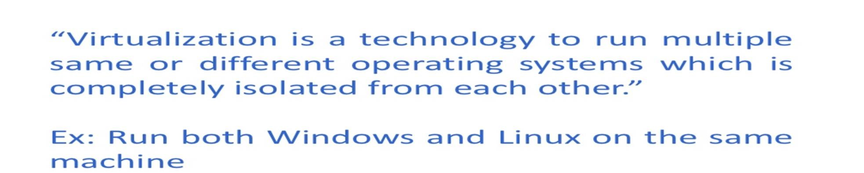
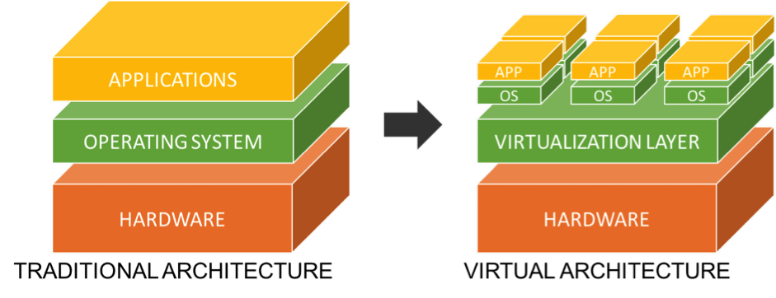


Slide 13
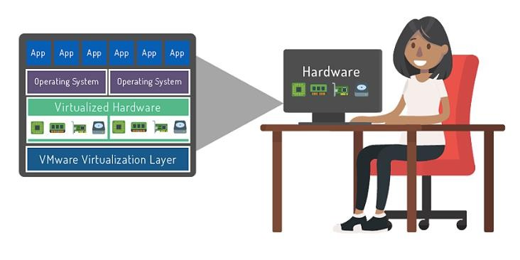
Now that you are aware of the roles of hardware and software, the concept of virtualization will be easier to grasp. Virtualization is the “layer” of technology that goes between the physical hardware of a device and the operating system to create one or more copies of the device.

Slide 14
WHAT IS A VM ?

Slide 15
WHAT IS A VM?
VM stands for “Virtual Machine”
Virtualization creates virtual hardware by cloning physical hardware
The hypervisor uses virtual hardware to create a virtual machine (VM)

Slide 16
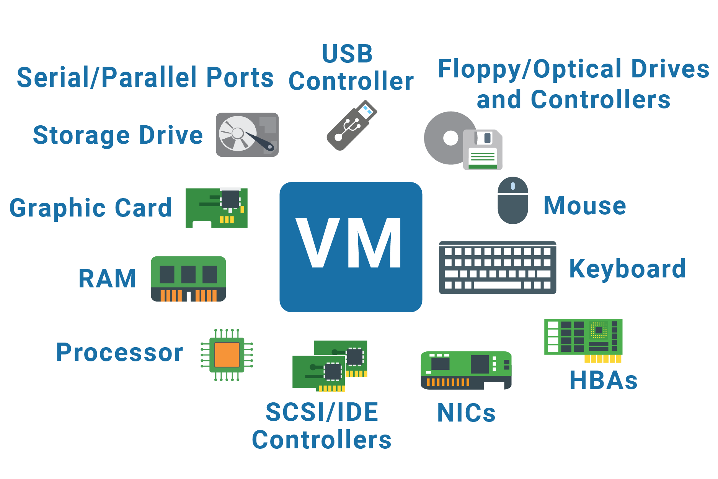

Slide 17
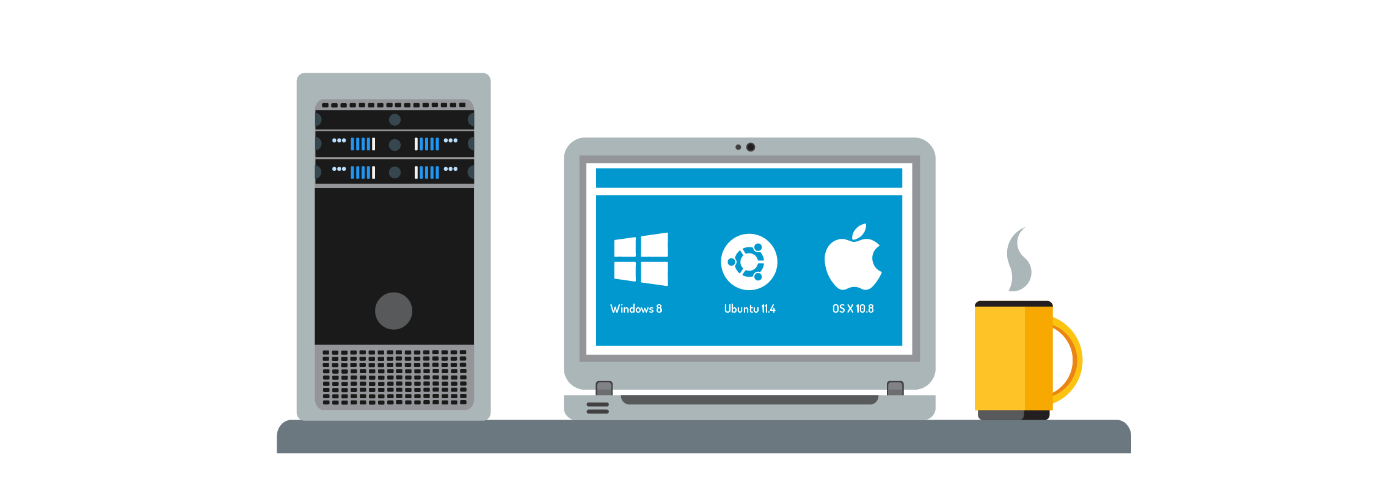
A VM is a set of files
With a hypervisor running VMs, one computer can run multiple OS simultaneously
A VM can run applications like a physical machine

Slide 18
CLOUD COMPUTING
A pool of resources that can be rapidly provisioned in an automated, on-demand
manner.
Value of cloud computing is :
  Economies of scale
  Elastic enough to scale with the needs of your organization.
  Cost and operational benefits
  Easily accessed by users no matter where they reside

Slide 19
virtualization benefits for our environment
Using virtual machines results in more compute power from a single server.
When fewer servers are used, it results in less energy cons umption.
The long term outcome of virtualization is less space and power used in data centers.
Knowing your carbon footprint has environmental and cost benefits.

Slide 20
THE HYPERVISOR

Slide 21
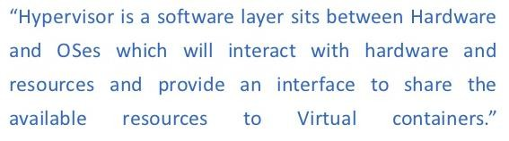
WHAT IS A HYPERVISOR?

Slide 22
Hypervisor is Software installed on top of hardware (a server) that creates the virtualization layer
Hosts VMs
The hypervisor pulls physical resources (i.e., CPU, RAM) from the server and turns them into virtual hardware

Slide 23
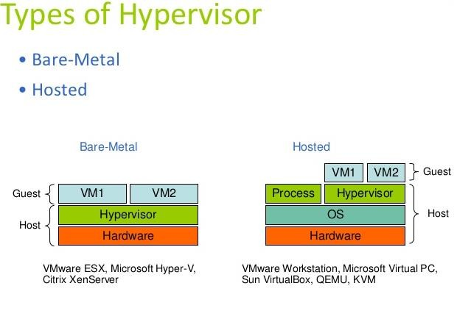

Slide 24
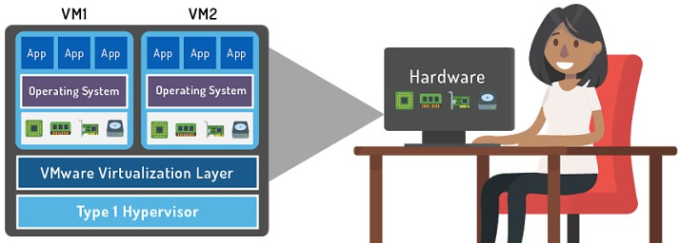
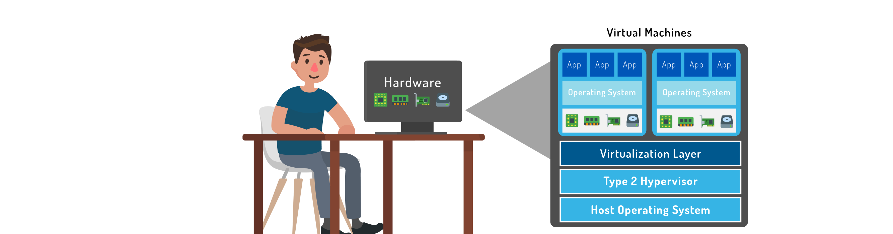
Type 1 Hypervisor – Bare metal hypervisor (VMware ESXi)
Type 2 Hypervisor – Hosted hypervisor (VMware Workstation)

Slide 25
VIRTUAL MACHINE FILES
VMs can be exported and moved to other hosts
Files are created by the hypervisor and stored in a directory
Example for VM files:
File Type | File Name | Description
Log File | <vmname>.log | Keeps a log of VM activity
Disk File | <vmname>.vmdk | Stores content of VM’s disk drive
Snapshot Files | <vmname>.vmsd and <vmname>.vmsn | Stores information about VM snapshots (saved VM state)
Configuration File | <vmname>.vmx | Stores information about VM name, BIOS, guest OS, and memory

Slide 26
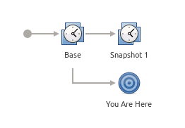
WHAT IS A SNAPSHOT?
Working on a VM and need to save progress or state?
Snapshots are saved as files in the VM folder (<vmname>.vmx)
What is saved by a snapshot?
  State of VM disks
  Contents of VM memory
  VM settings

Slide 27
INSTALL VMWARE

Slide 28
CREATE VIRTUAL MACHINE ON VMWARE

Slide 29
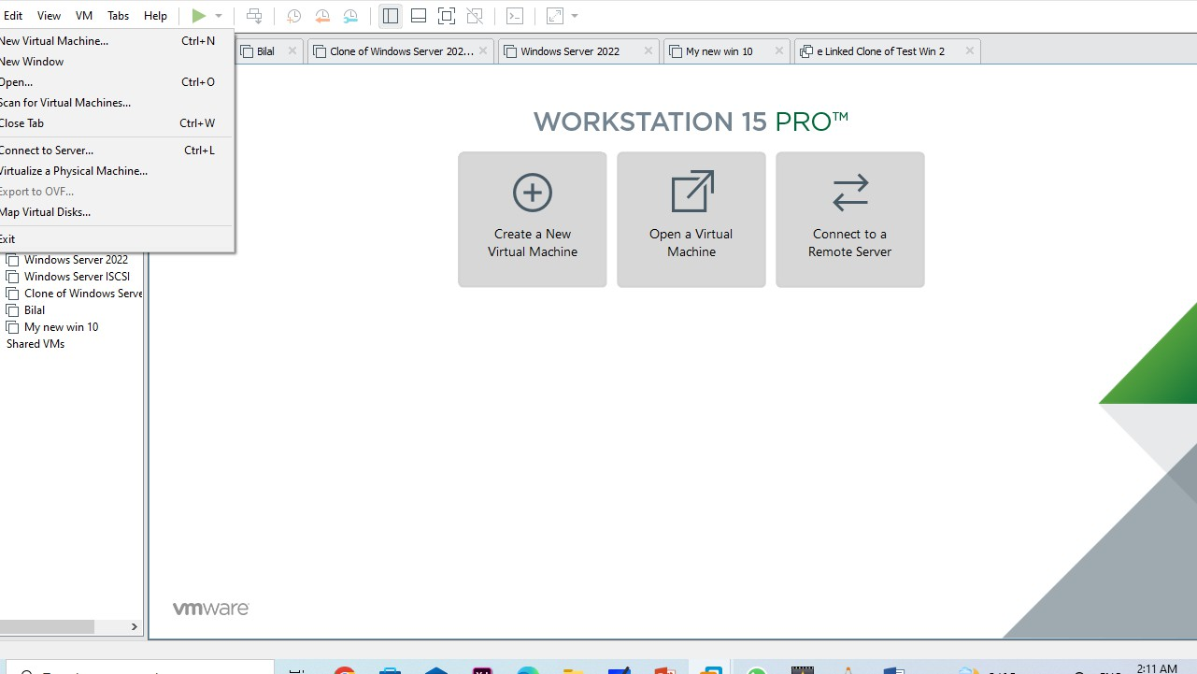

Slide 30
BOOTING FROM VMWARE

Slide 31
INSTALL WINDOWS 10 ON VMWARE

Slide 32
THE DATA CENTER

Slide 33
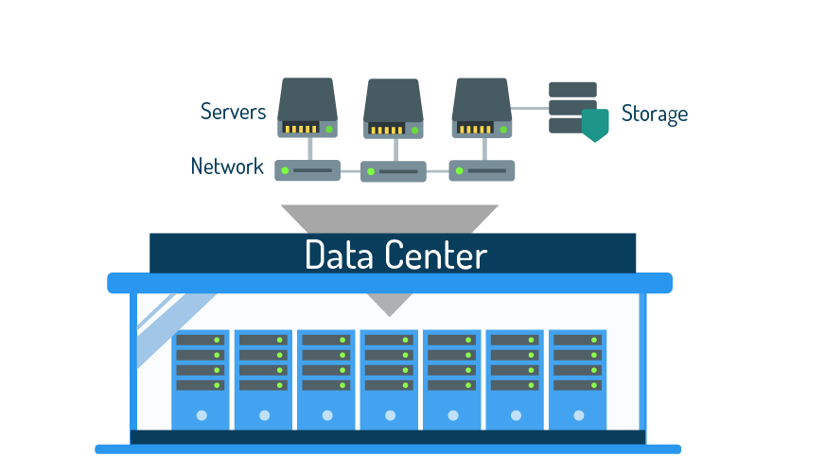
WHAT IS A DATA CENTER?
Hardware infrastructure that supports virtualization
Focus is on processing large amounts of data
What are the three main components?
  Compute
  S torage
  Networks

Slide 34
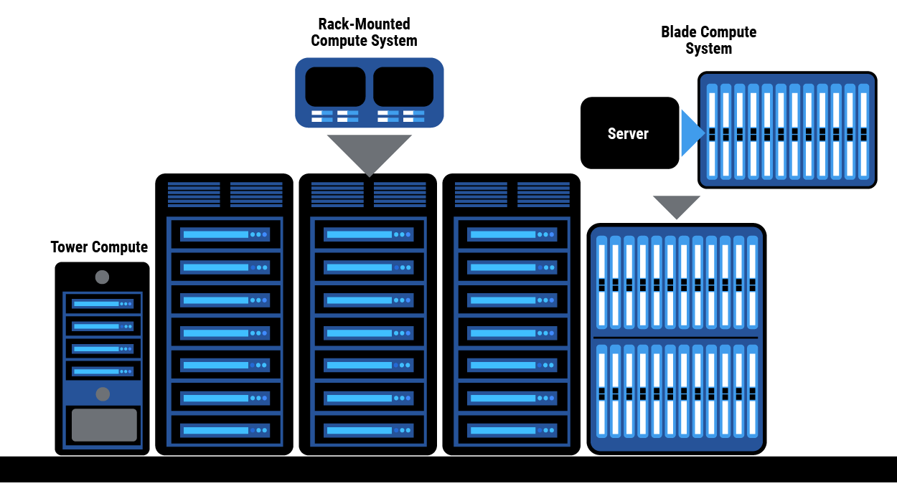
COMPUTE SYSTEMS
Hardware and operating system software that runs applications
Difference between a PC and a server
- PCs have a user-friendly interface while servers focus on running programs
Types of servers:
  Tower
  Blade server
  Rack-mounted server

Slide 35
COMPUTE SYSTEMS
What is the architecture of a server?
Architecture means the type of processor used by the server.
Data centers typically use servers with an x86 architecture.
Classic architecture is 32-bit and in 2003 the 64-bit extension was released for x86 architecture.
Virtualization technology is compatible with 64-bit but not 32-bit.

Slide 36
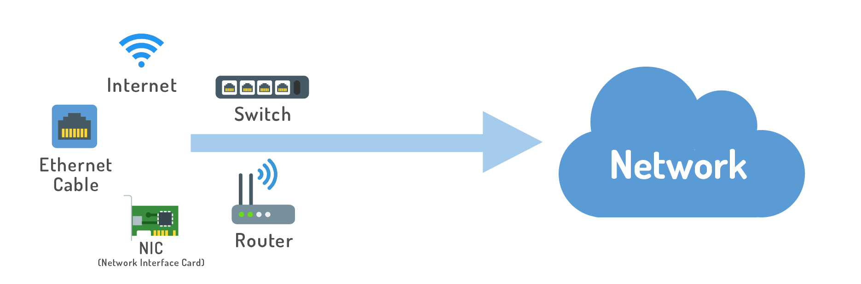
NETWORKS
Transfer data across the data center so devices can communicate
What type of hardware is used for networking?
  Switches, Network Interface Card (NIC), Router, Ethernet Cable

Slide 37
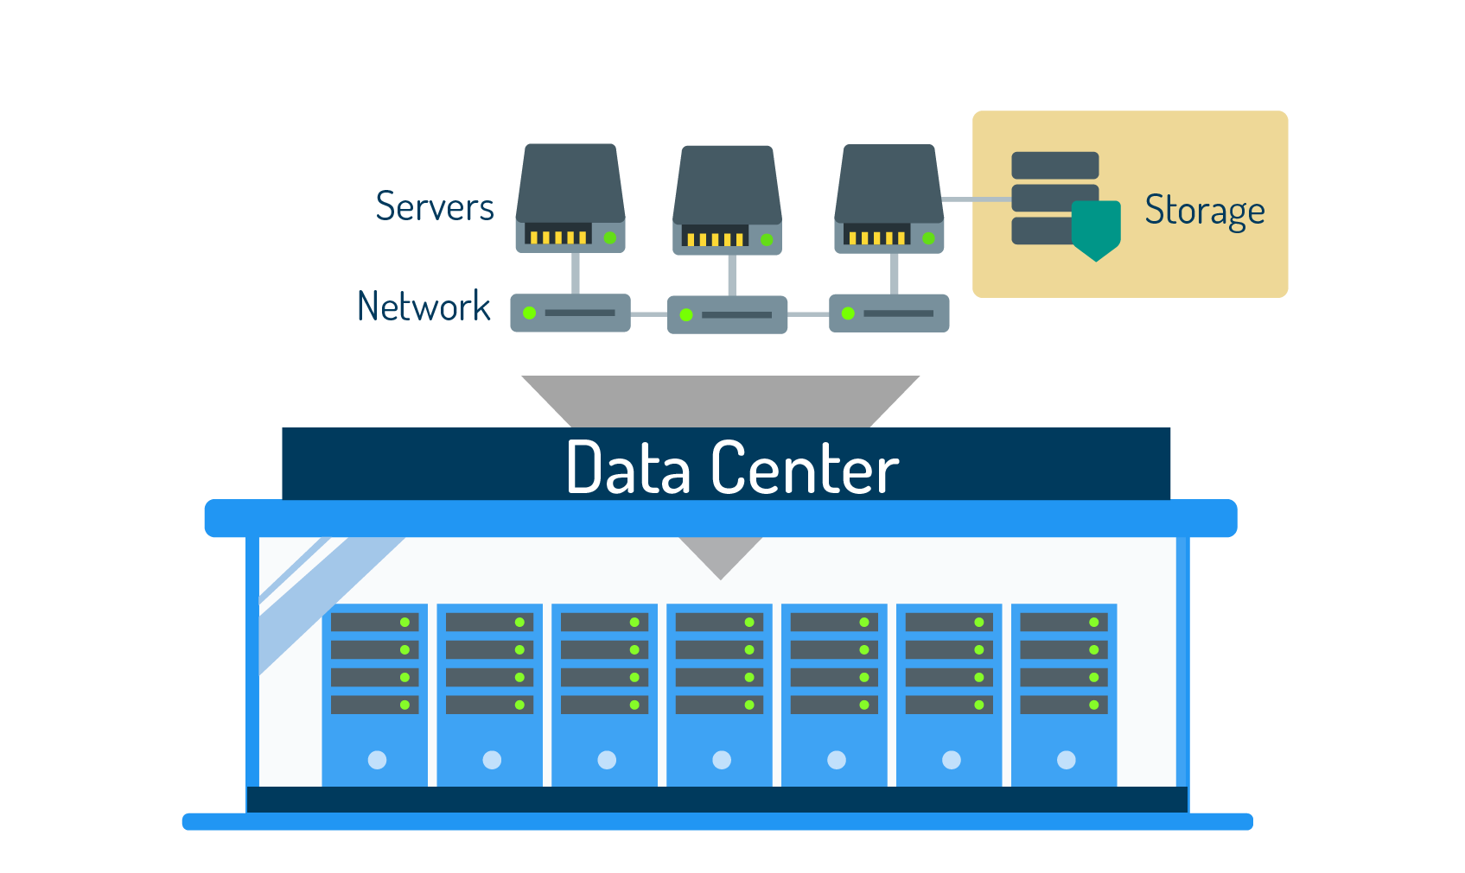
STORAGE
A data center needs to accommodate high levels of data
Compute memory is not adequate
Data centers use devices built specifically for storing data
Data center storage should have two features: availability and redundancy

Slide 38
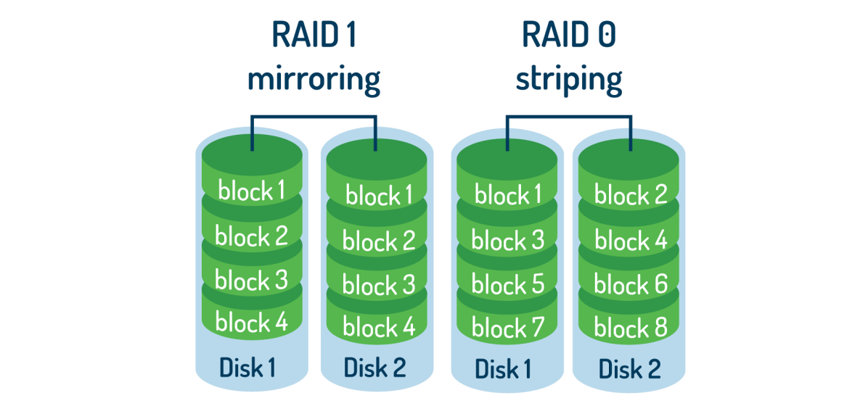
STORAGE - RAID
Redundant Array of Independent Disks
Hard drives linked together to create a large volume of
redundant storage
What are the three methods of writing to RAID?
  Mirroring
  Striping
  Parity
What do the RAID numbers mean (i.e., 0, 1, 5)?
Levels of RAID are used to identify types of RAID and what storage availability and redundancy they offer (i.e., 1 = mirroring, 5 = parity)

Slide 39
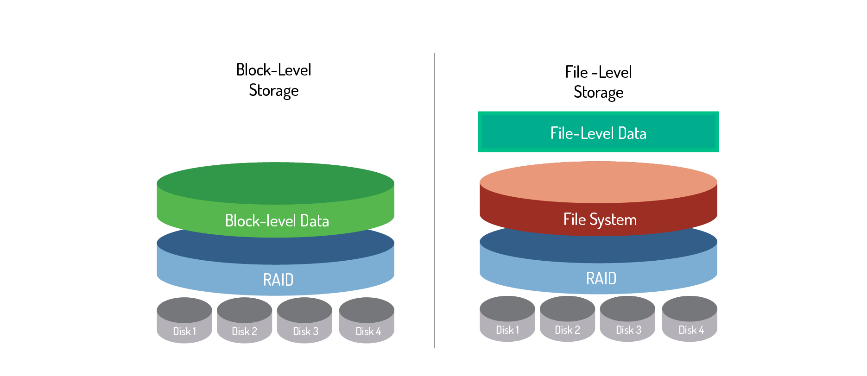
STORAGE - BLOCK VS. FILE-LEVEL
Block-Level Storage – Data is written to and accessed from storage volumes (blocks)
File-Level Storage – Data is written to disks but accessed from the default file system

Slide 40
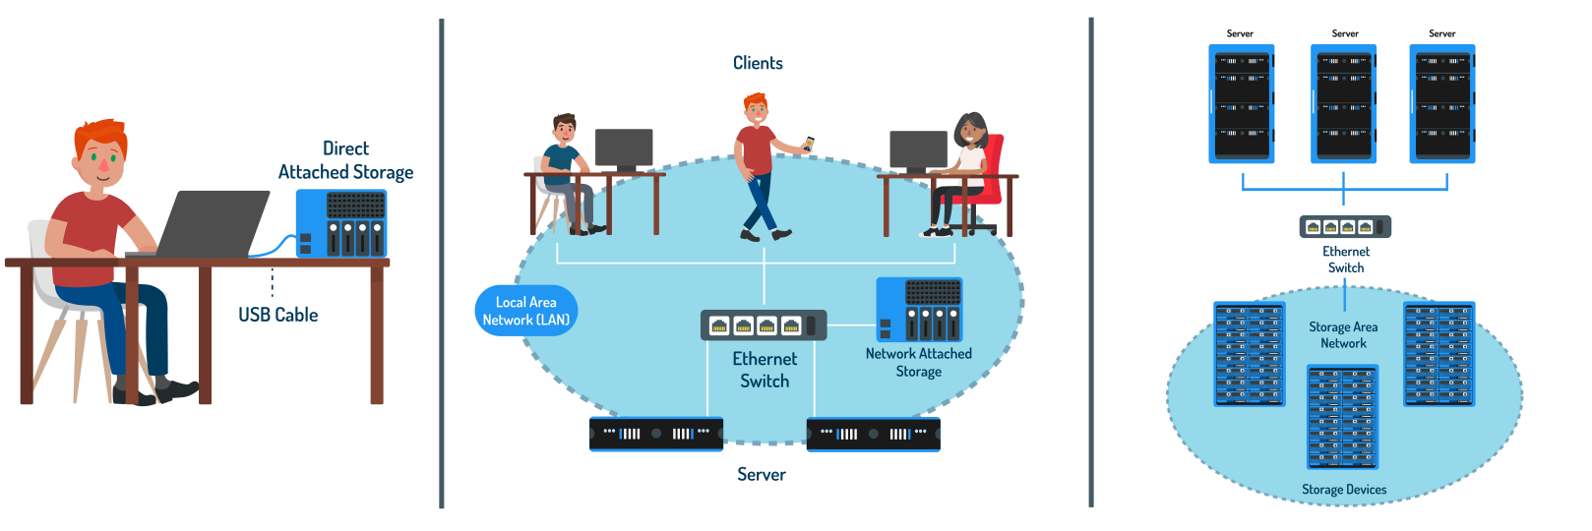
STORAGE – TYPES OF DATA CENTER STORAGE
DAS (Direct Attached Storage) – Storage device is directly attached to a server (block-level)
NAS (Network Attached Storage) – Storage device is attached to a network, servers on the network can access device (file-level)
SAN (Storage Area Network) – Clustered storage devices on their own network that
servers can connect to (block-level)

Slide 41
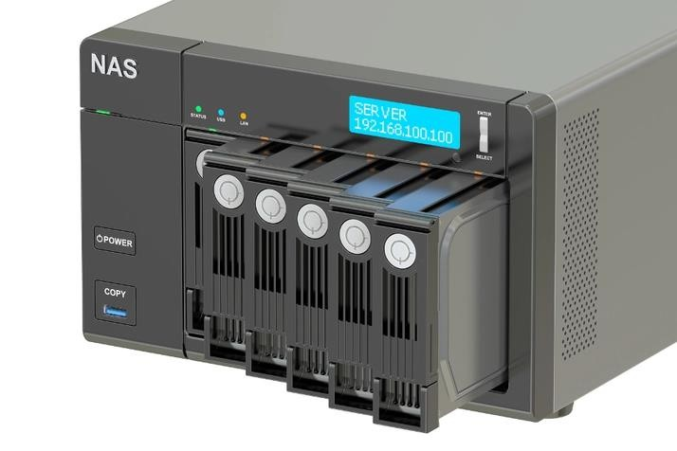
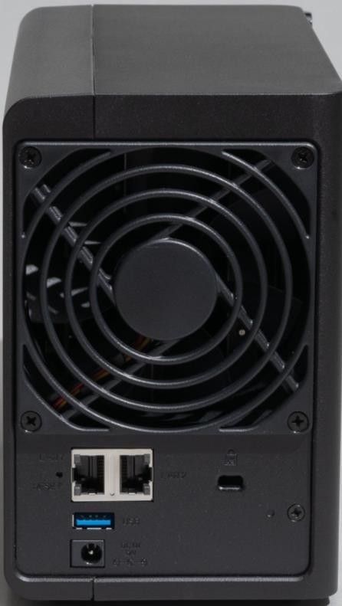
STORAGE TYPE
NAS (Network Attached Storage)

Slide 42
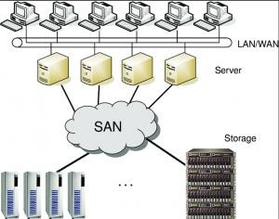

Slide 43
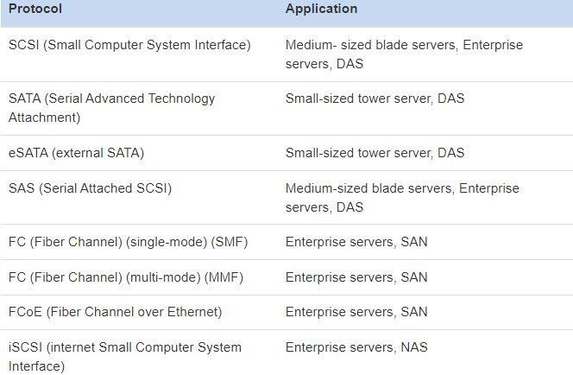

Slide 44
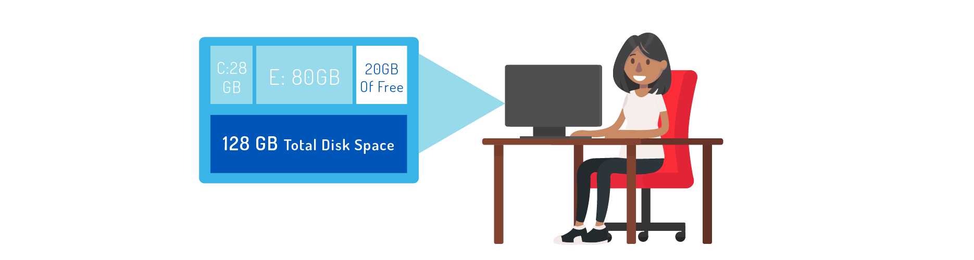
STORAGE PROVISIONING
Thick provisioning: Disk space is strategically pre-allocated to a server, or a VM.
This means that the logical space provided by partitioning is equal to the amount of actual physical space set aside on the physical disk.

Slide 45
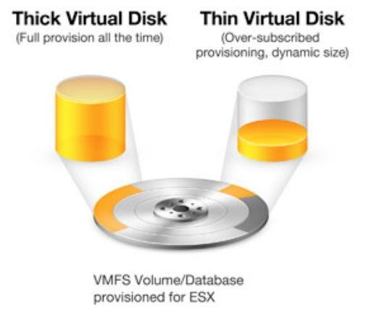

Slide 46
THE VIRTUAL DATA CENTER

Slide 47
BENEFITS OF A VIRTUAL DATA CENTER
Data centers use a lot of hardware and virtualization makes hardware more efficient
Increased computing resources results in higher availability of applications
Less labor needed to monitor data center (administrator can monitor from their desk using a program)
Software-defined data center (SDDC): Hypervisor pools physical
data center resources into a virtual data center

Slide 48
WHAT IS VSPHERE?
S uite of virtualization technology designed for larger enterprise data center management
vS phere virtualization tools include:
  ESXi: Type 1 Hypervisor
  vC enter: Management software (installed on management server)
  vSphere Client: Program that configures the vCenter, host, and operates its virtual machines
  vSphere Host Client: Program that only configures the host and operates its virtual machines

Slide 49
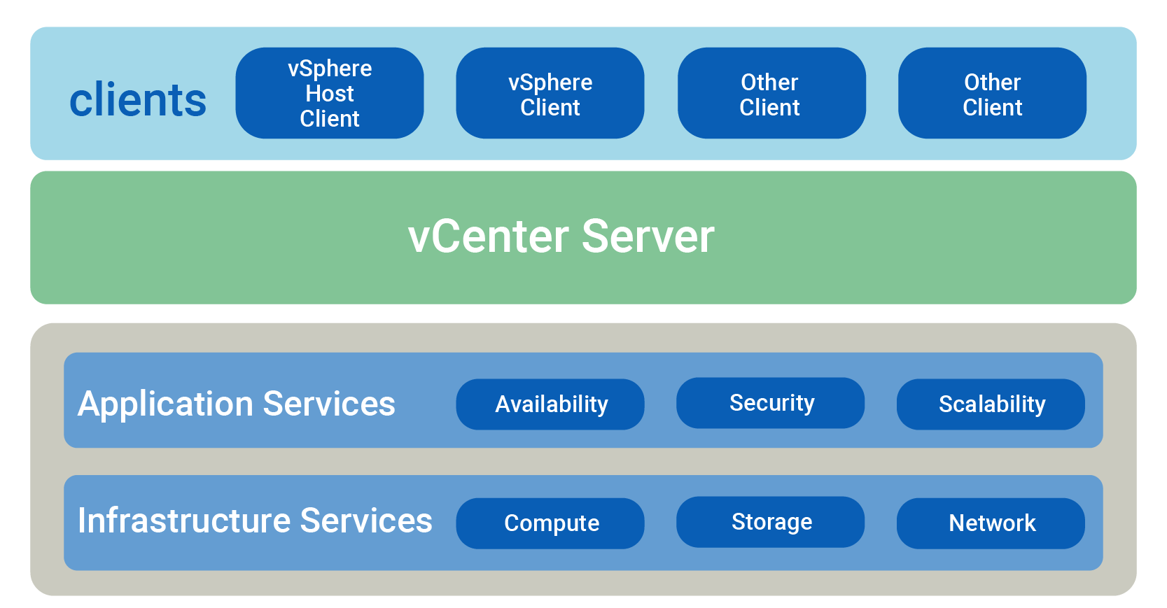
WHAT IS VSPHERE?

Slide 50
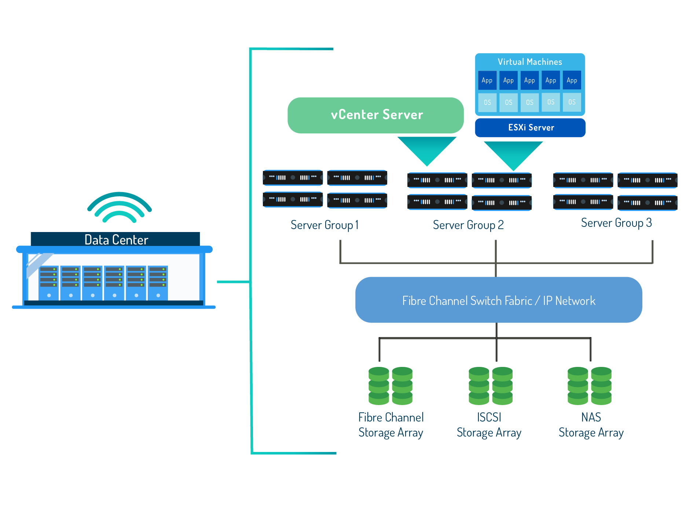

VSPHERE

Slide 51
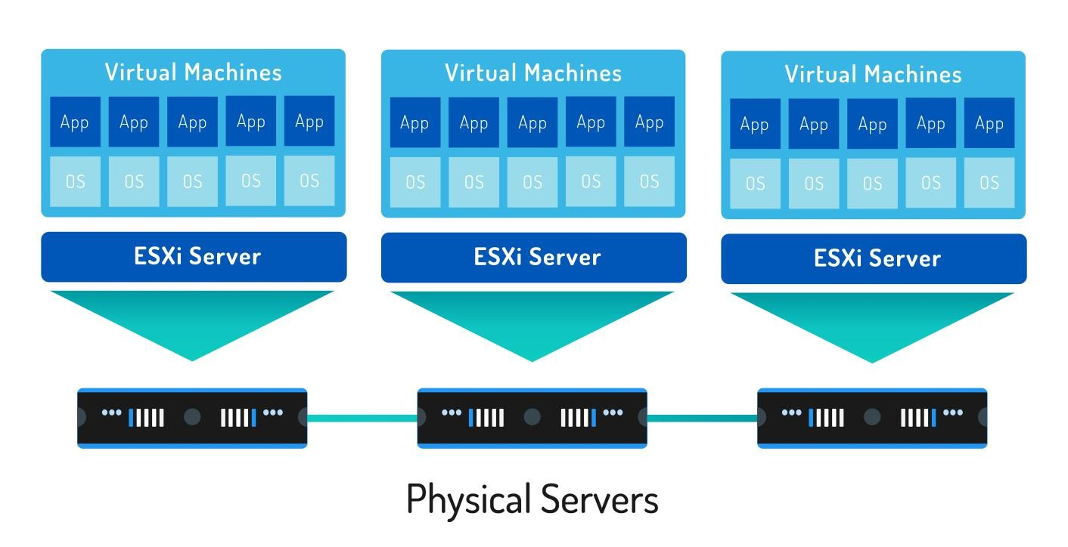
WHAT IS ESXI?
ESXi is VMware’s Type 1 hypervisor software installed directly on the physical server and creates the virtual layer
Components of ES Xi:
  Unix Microkernel
  VMware Kernel
(VMkernel)

Slide 52
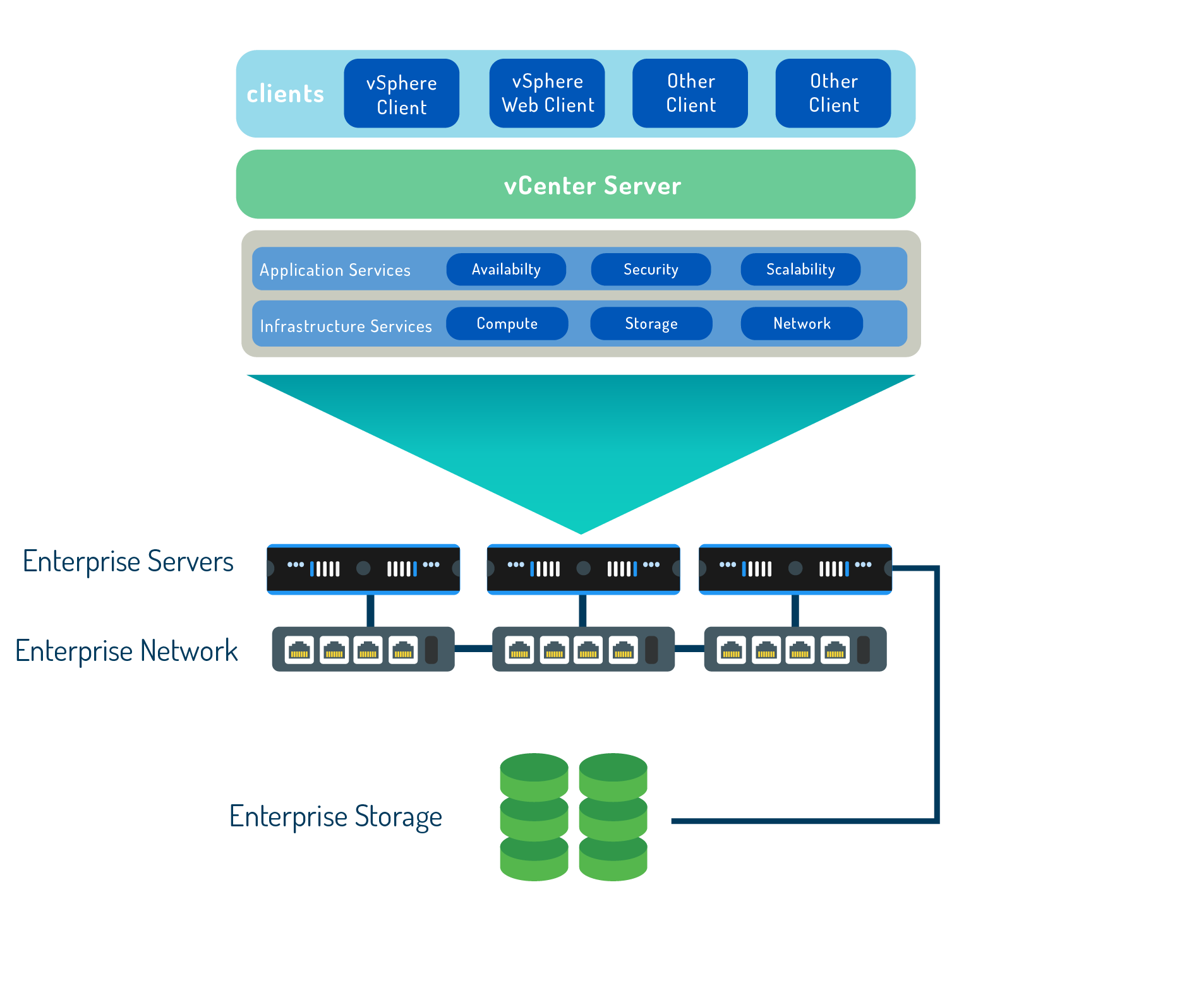
VCENTER
vCenter: Software installed on a dedicated server to manage ESXi servers and other components of a virtualized data center.

Slide 53
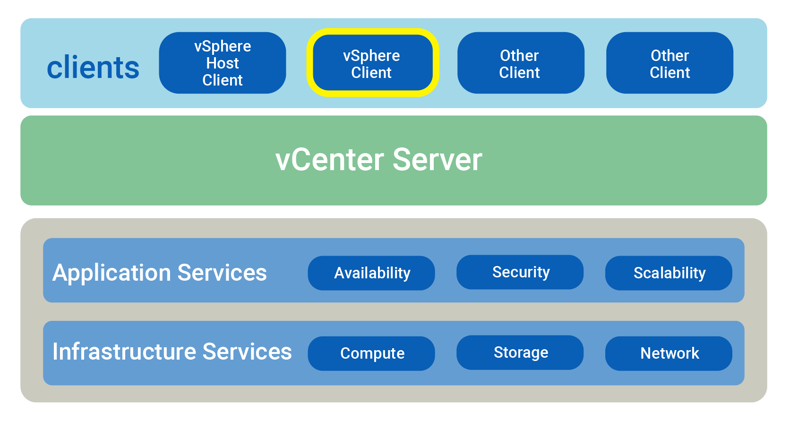
VSPHERE CLIENT
vSphere Client: Program with a graphical user interface (GUI) that allows data center administrators to connect to vCenter and ESXi remotely.

Slide 54
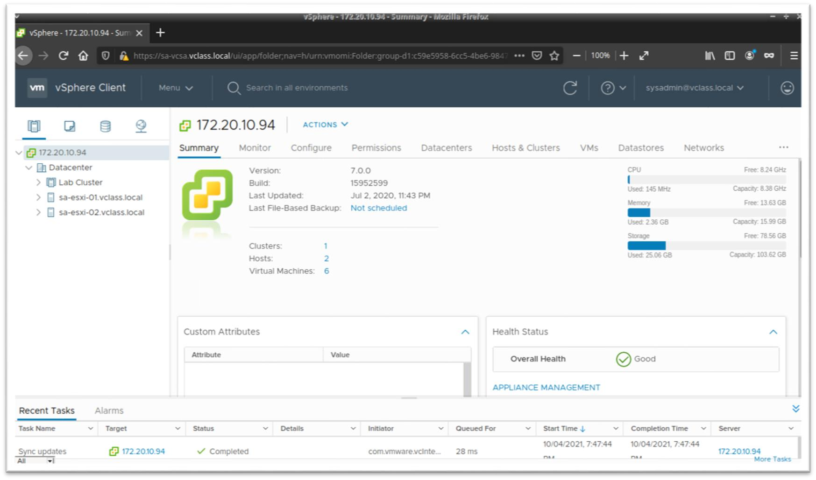
VSPHERE CLIENT

Slide 55

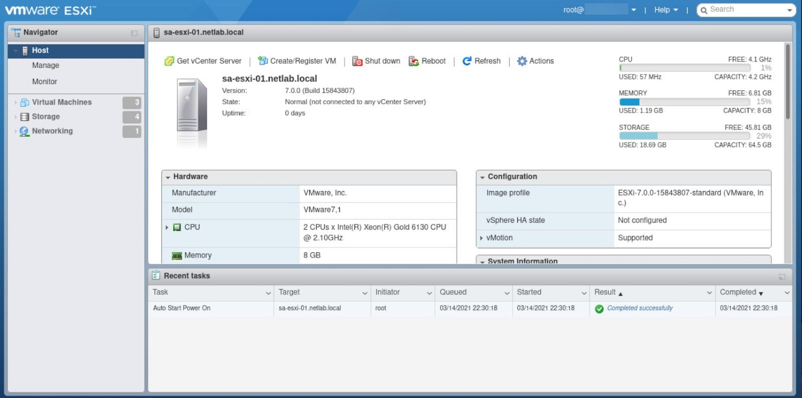
VSPHERE HOST CLIENT

Slide 56
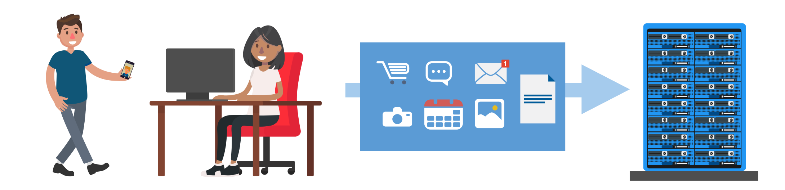
SERVER VIRTUALIZATION
Results in increased efficiency of data center servers because multiple VMs can be hosted on one server
Computing resources can be distributed to customers using less hardware

Slide 57
STORAGE VIRTUALIZATION

Slide 58
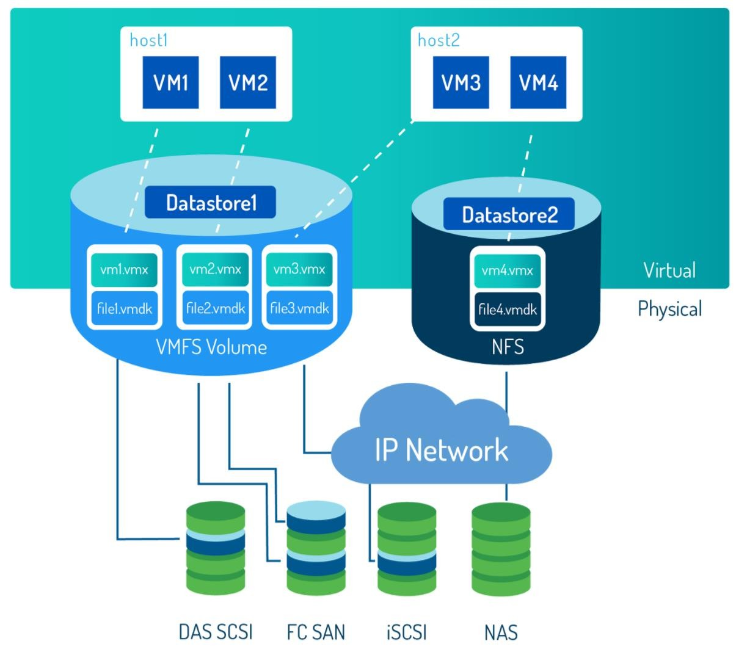
STORAGE VIRTUALIZATION
S torage capacity is pooled and distributed to
the VMs
  Physical storage devices are partitioned into logical storage (LUNs )
  LUNs are used to create a
datastore
How do VMs access data center storage?
  VMs are stored as VMDK (.vmdk) files on datastore
  VM configuration files (VM settings)
are stored as VMX (.vmx) files

Slide 59
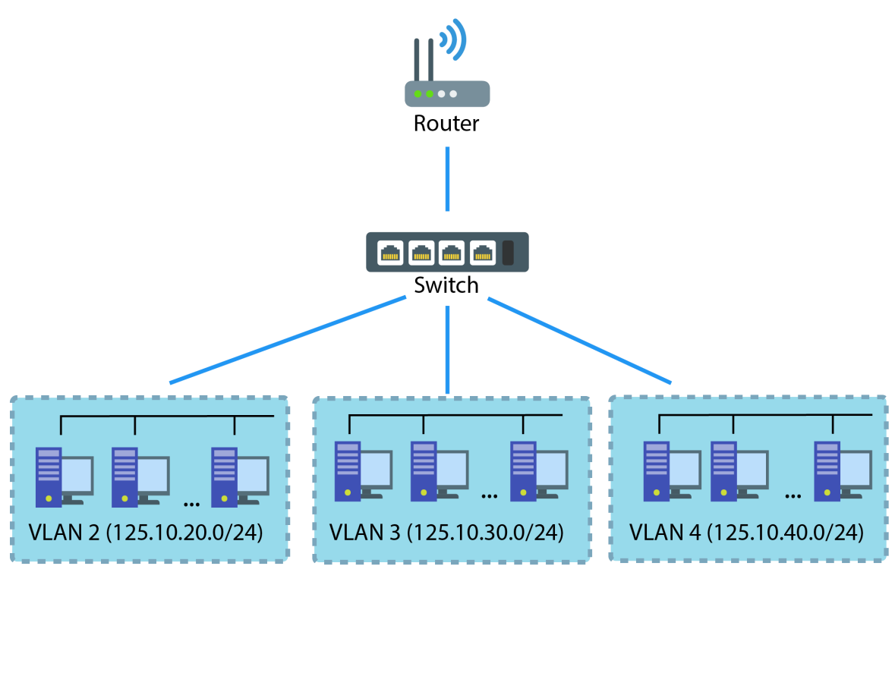
NETWORK VIRTUALIZATION
Physical components that make up the physical network are virtualized to create a virtual network
What is a vS witch?
- Virtual switch that virtual devices can
connect to in order to communicate
with each other
What is a vLAN?
- Virtual Local Area Network that is segmented into groups of ports isolated from one another, creating different network segments

Slide 60
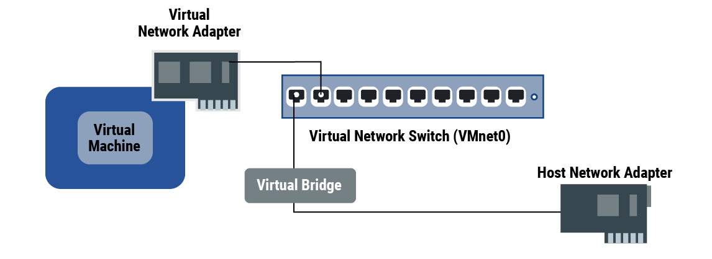
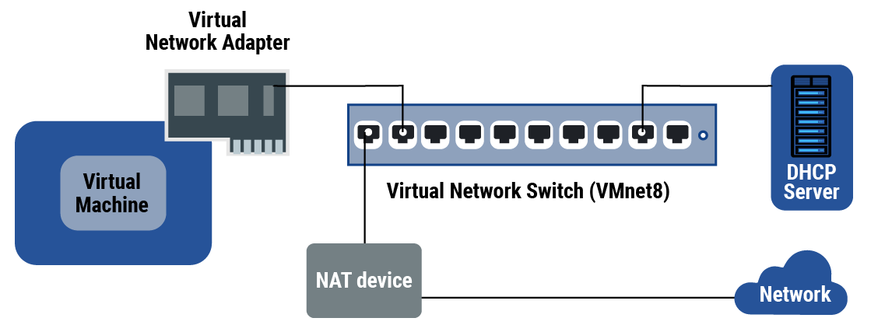
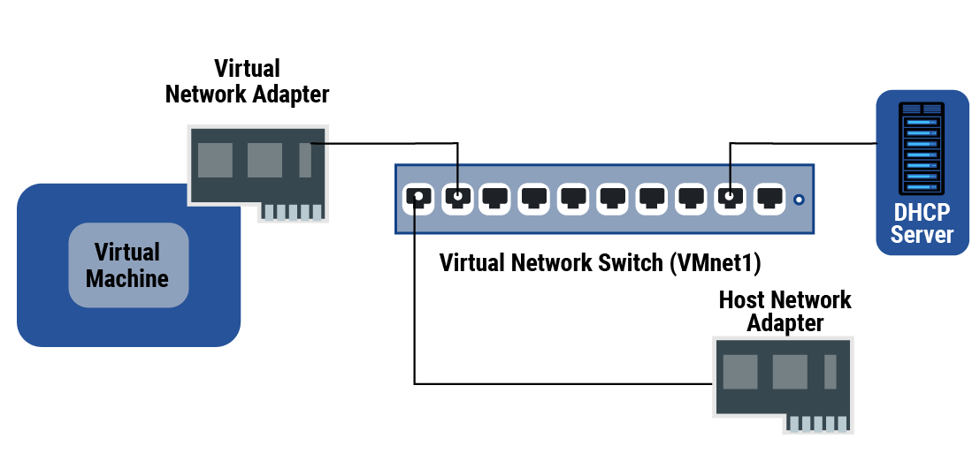
TYPES OF VIRTUAL NETWORKS
Bridged Network: The host server and the VM are connected to the same network, and the host shares its IP address with the VM
NAT: VMs use an IP translated from the host’s IP (using NAT device) and communicate on a private network set up on the host computer
Host-only Network: VMs use a private network but do not have translated IP addresses to connect to an external network, therefore can only communicate to other VMs on the isolated host network

Slide 61
APPLICATION AND DESKTOP VIRTUALIZATION
Why use virtualized applications?
  Some applications have specific system requirements
  VMware ThinApp creates a packaged virtual app, that contains the program and system requirements, and delivers it to the end-user
What is desktop virtualization?
  Designed to solve computing resource issues faced by the mobile workforce (workers that need computing without the hardware)
  VMware Horizon takes the resources needed to create a desktop environment from data centers and delivers it to the end-user’s device

Slide 62
WHAT IS CLOUD ???

Slide 63
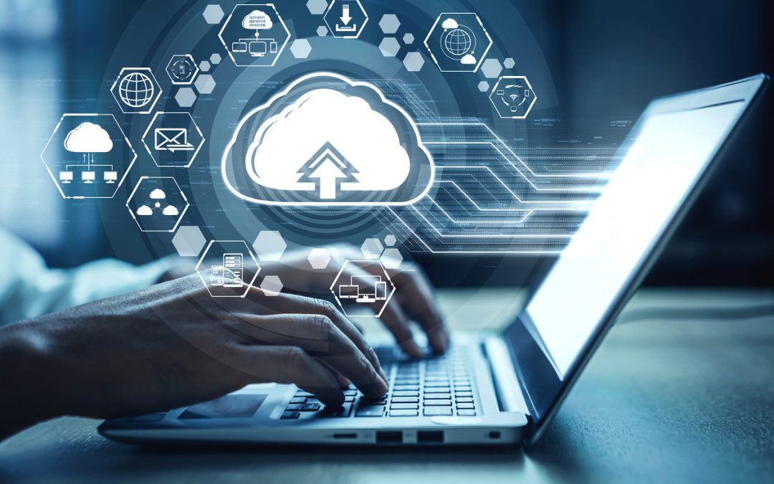

Slide 64
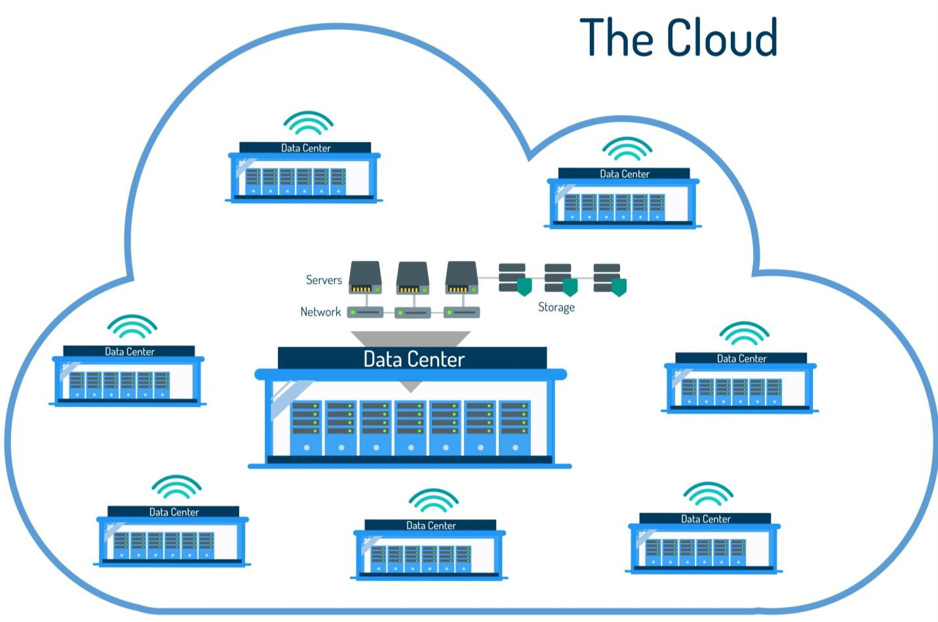
THE CLOUD
Cloud computing is the delivery of shared computing resources (software and/or data) on-demand through the internet

Slide 65
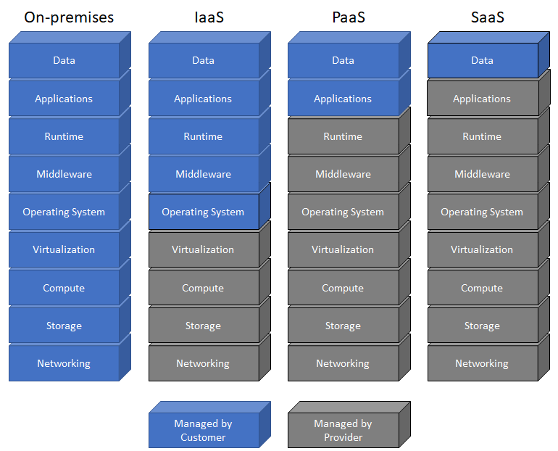
Cloud computing service models

Slide 66
CLOUD COMPUTING SERVICE MODELS
Software as a service (SaaS).
  Customers are provided access to an application running on a cloud infrastructure.
  but the customer has no knowledge of, and does not manage or control, the underlying cloud infrastructure.
Platform as a service (PaaS).
  Customers can deploy supported applications onto the provider’s cloud infrastructure,
  but the customer has no knowledge of, and does not manage or control, the underlying cloud infrastructure.
  The company owns the deployed applications and data, and it is therefore responsible for the security of those applications and data.
Infrastructure as a service (IaaS).
  Customers can provision processing, storage, networks, and other computing resources, and deploy and run operating systems and applications.
  the customer has no knowledge of, and does not manage or control, the underlying cloud infrastructure. The customer has control over operating systems, storage, and deployed applications, along with some networking components (for example, host firewalls).
  The company owns the deployed applications and data, and it is therefore responsible for the security of those applications and data.

Slide 67
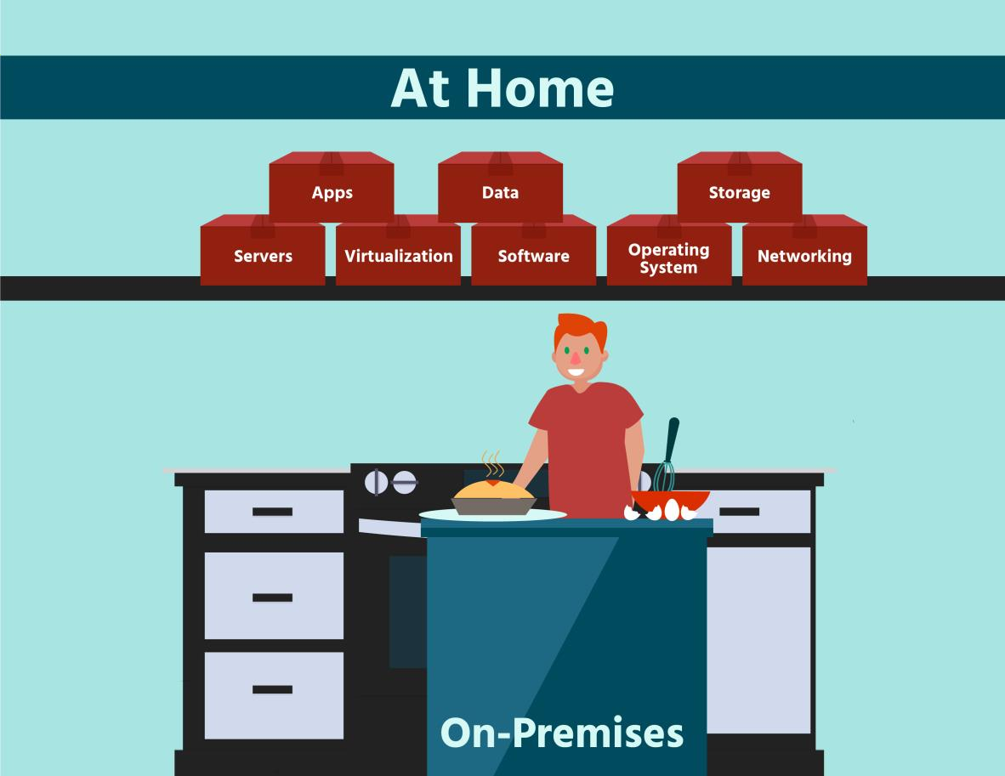
TYPES OF CLOUD COMPUTING
On-premise (private cloud): You are responsible for all of your IT infrastructure (software and hardware)

Slide 68
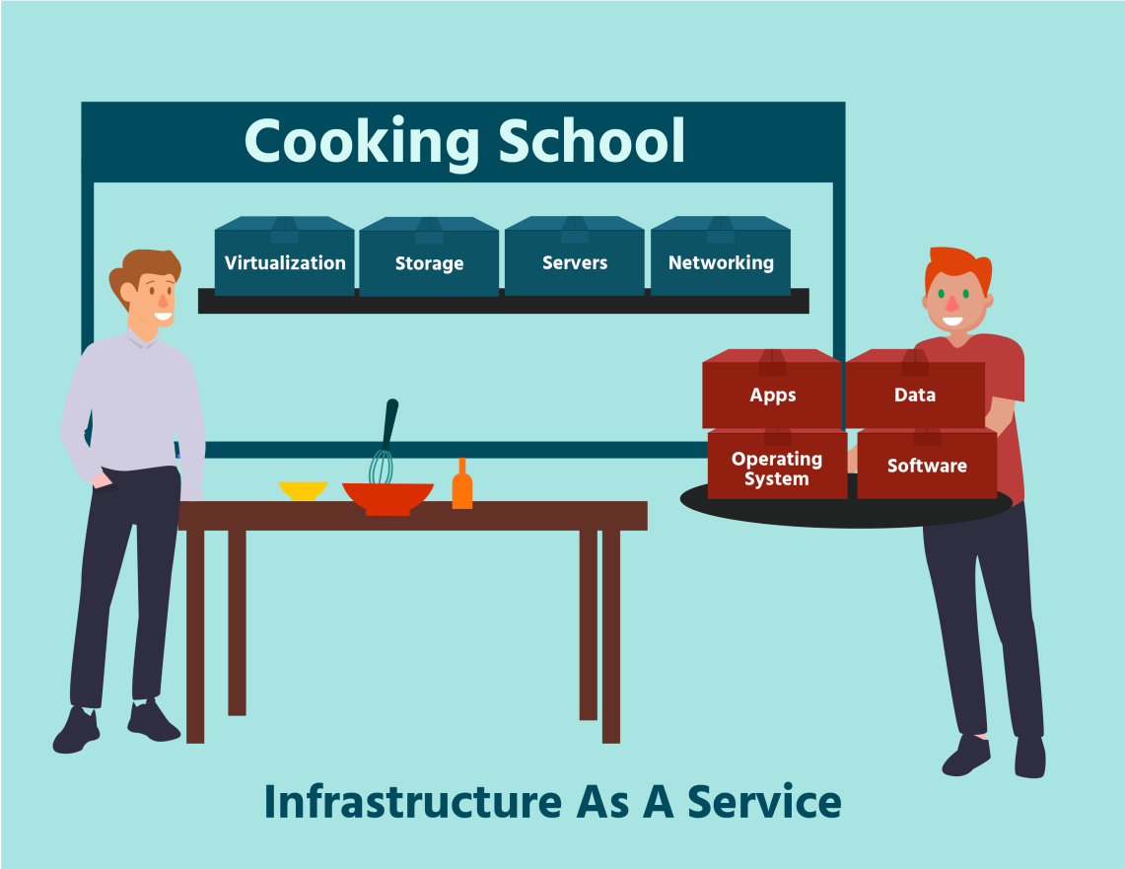
TYPES OF CLOUD COMPUTING
Infrastructure-as-a-service (IaaS): You are responsible for applications, data, OS, and software. Cloud provider manages your virtualization, storage, servers, and networking.

Slide 69

TYPES OF CLOUD COMPUTING
Platform-as-a-service (PaaS): You are responsible for applications, and data. Cloud provider manages your OS, software, virtualization, storage, servers, and networking.

Slide 70

TYPES OF CLOUD COMPUTING
Software-as-a-service (SaaS): You are not responsible for any infrastructure. Cloud provider manages your OS, software, virtualization, storage, servers, and networking.

Slide 71
CLOUD COMPUTING DEPLOYMENT MODELS:
Public.
  A cloud infrastructure that is open to use by the general public. It’s owned, managed, and operated by a third party (or parties), and it exists on the cloud provider’s premises.
Community.
  A cloud infrastructure that is used exclusively by a specific group of organizations.
Private.
  A cloud infrastructure that is used exclusively by a single organization. It may be owned, managed, and operated by the organization or a third party (or a combination of both), and it may exist on premises or off premises.
Hybrid.
  A cloud infrastructure that comprises two or more of the aforementioned deployment models, bound by standardized or proprietary technology that enables data and application portability (for example, fail over to a secondary data center for disaster recovery or content delivery networks across multiple clouds).

Slide 72


CLOUD DEPLOYMENT MODELS
Private Cloud: organization has complete control over the IT infrastructure.
Community Cloud: different organizations have control over the IT infrastructure.

Slide 73


CLOUD DEPLOYMENT MODELS
Public Cloud: the cloud provider owns the IT infrastructure and organizations rent IT resources in the cloud.
Hybrid Cloud: organization has its own cloud but also rents IT resources on the public cloud.

Slide 74
VMWARE SOLUTIONS

Slide 75

VMOTION
Moves running virtual machines from one ESXi host to another ESXi host without service interruption (live migration)
Increases availability of data and computing resources

Slide 76

STORAGE VMOTION
Moves the disks and configuration files of a running virtual machine from one datastore to another datastore without service interruption
Increases availability of storage

Slide 77

HIGH AVAILABILITY (HA)
Pools servers (hosts) and the VMs that reside on them in a cluster so that in the event of a failure, the virtual machines on a failed host are restarted on alternate hosts

Slide 78

DISTRIBUTED RESOURCE SCHEDULER (DRS)
What problem does DRS solve?
HA clusters need to be monitored and managed. DRS implements a shared management interface so that the cluster’s resources can be monitored and managed
vSphere Storage Distributed Resource Scheduler provides the same solution for storage clusters

Slide 79

FAULT TOLERANCE (FT)
A secondary copy of that virtual machine and its files is created on another
ESXi host and datastore
Using FT, the transfer to a different server is seamless and will not be noticeable to the end-user

Slide 80

REPLICATION
vSphere Replication makes copies of VMs in a different physical location, useful for data protection and disaster recovery
Works with vSphere Client to allow
admins to monitor

