Slide 1
KiCK OFF_0 (IOT_Security)
Submitted to:
Dr. Hassan Mostafa

Slide 2
Agenda
Draft Plan for thesis research and Milestones
Papers Skimmed So Far and there findings (8,9,13,17,18,19,and 99)
Next Steps

Slide 3
Draft Plan for thesis research and Milestones
Feb.17 | March | April | May | June | July | Augu. | Sept. | Octob | Nove | Dece. | Jan 18
Papers Survey (28)
Short list 5
Matlab
Matlab
Matlab
FPGA
FPGA
FPGA
FPGA
ASIC
ASIC
Short list 10
Main Point
BrainStorm
MS1: Simulation
MS2:RTL & FPGA
MS3: ASIC (Std_cells)
MS4: Documentation&
Paper Submission

Slide 4
Git and GitHub for CM and Backup
GitHub Project and GitHub desktop to be used for Project Configuration Management.
https://github.com/IslamHelmy/MasterThesis

Slide 5
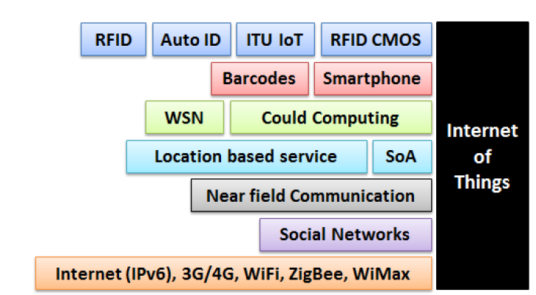
Papers Skimmed So Far and there findings (8,13)
Main Aspects of Secutiry:
Authentication (Man in the Middle attack)
Data Integrity (too short passwords) , i.e protection is low.
Privacy of user Data
Digital Forgetting
Security Protection mechanisms:
Trust & reputation Mechanism
Comm security such as end2end encryption
Privacy of comm and user data
Securing services and apps

Slide 6
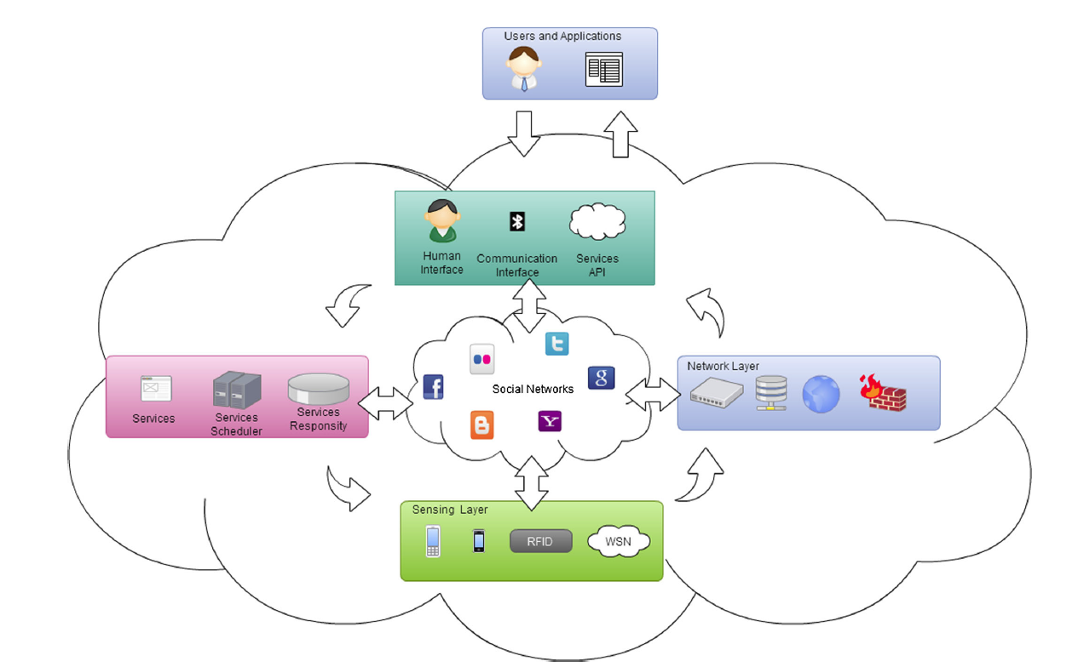
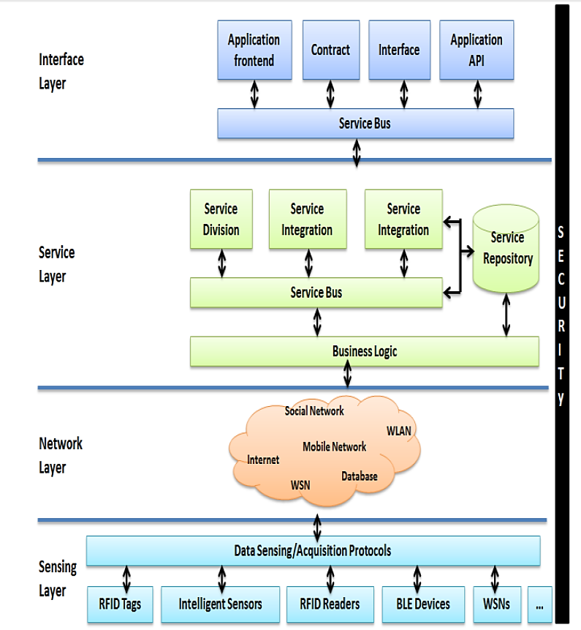
Papers Skimmed So Far and there findings (8,13)
Architecture for the Social IoT
Service-oriented architecture for IoT

Slide 7
Papers Skimmed So Far and there findings (9)
Technically, the following issues should be addressed:
(1) the definition of security and privacy from the social, legal and cultural perspectives;
(2) the trust mechanism
(3) The communication security
(4) the privacy of communication and user data; and
(5) security of services and applications.
@ RFID
ECC
Blocktag
(unauth. Tracing)
Security Schemes
Data Exchange
@ WSN
AES
TEA
Notes:
The applications of IoT might be affected by pervasive threats such as RFID tags attacks and data leakage.
In RFID systems, a number of security schemes and authentication protocols have been proposed to cope with security threats.
low-cost symmetric-key cryptography algorithms, such as:
Advance Encryption Standard (AES),
Tiny Encryption Algorithm (TEA)
Elliptic curve cryptography (ECC)
The adaption of the existing Internet standards for interoperable protocols;
the security assurance for compassable services. The challenges in security and privacy protection are summarized as resilience to attacks,
data authentication, access control, and client privacy.

Slide 8
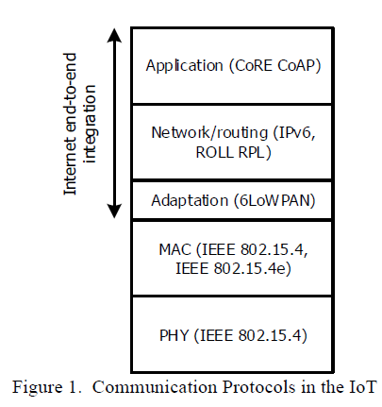
Papers Skimmed So Far and there findings (99,19)
Providing End2End Security with LowPower within Lossy NW (Protocols such as ROLL aim to secure lower layers from the described attacks while conserving resources).
There are more than one security level:
Security for Phy,Mac Layer communication
Security for NW Layer
Routing security
Application Layer security
Notes:
Routing Over Low power and Lossy networks

Slide 9
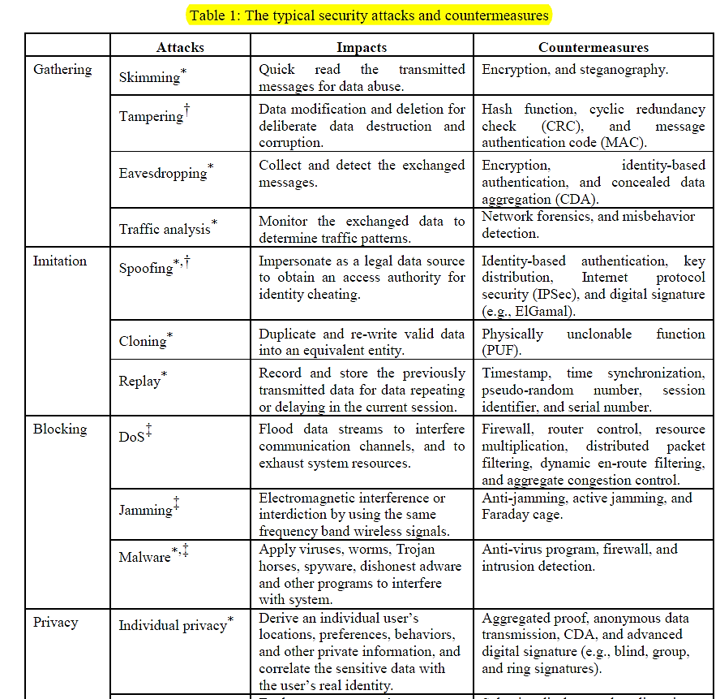
Papers Skimmed So Far and there findings (17)
Notes:
Main Security Attacks:
Gathering
Blocking
Privacy Attack
Imitation
Security Componenets:
System Security (overall Framework)
Network Security (Sensing,RFID, and WSNs)
Application Security (IOT Apps)

Slide 10
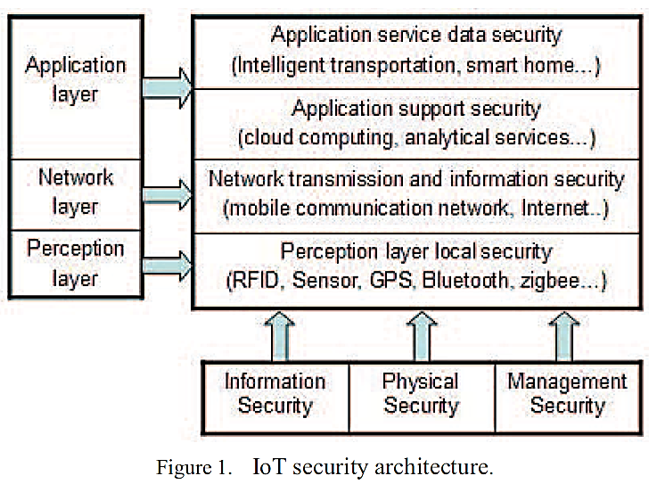
Papers Skimmed So Far and there findings (18)
The structure of IoT is generally divided into three layers
Perception Layer Sec. Problems
Node Capture
Fake Node
DOS Attack
Timing attach
Routing threats
Network Layer Sec. Problems
illegal access
networks, eavesdropping information, confidentiality
damage, integrity damage, DoS attack, Man-in-the middle
attack, virus invasion, exploit attacks
Application Layer Sec. Problems

Slide 11
Next Steps
Future Skimming of Papers (20,22,23,24,25,26,27,28)
Identify the 5 Main Papers needed for the research.
Anything else Suggested by Dr.
1
2
3

Slide 12
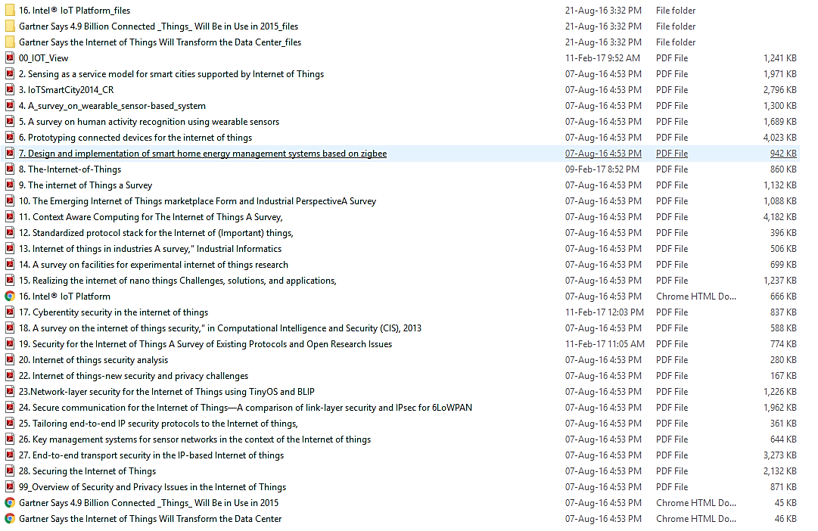
Papers List for referencing

Slide 13
Thank You , Any Questions ?

