Slide 1
Village scenario
Submitted By : Shifat Naznin ID: 011 142 059
Dolon Banik
ID: 011 142 029

Slide 2
Introduction
It’s OpenGL 2D project
Triangle and Circle used for tree
Circle used for cloud
Rectangle & Triangle used for house
Circle & Rectangle used for car
Day & Night mode
Movement

Slide 3
Shifat Naznin | Dolon Banik
Tree | House
Cloud , Moon | Car
Animation Function | SpinDisplay Function

Slide 4
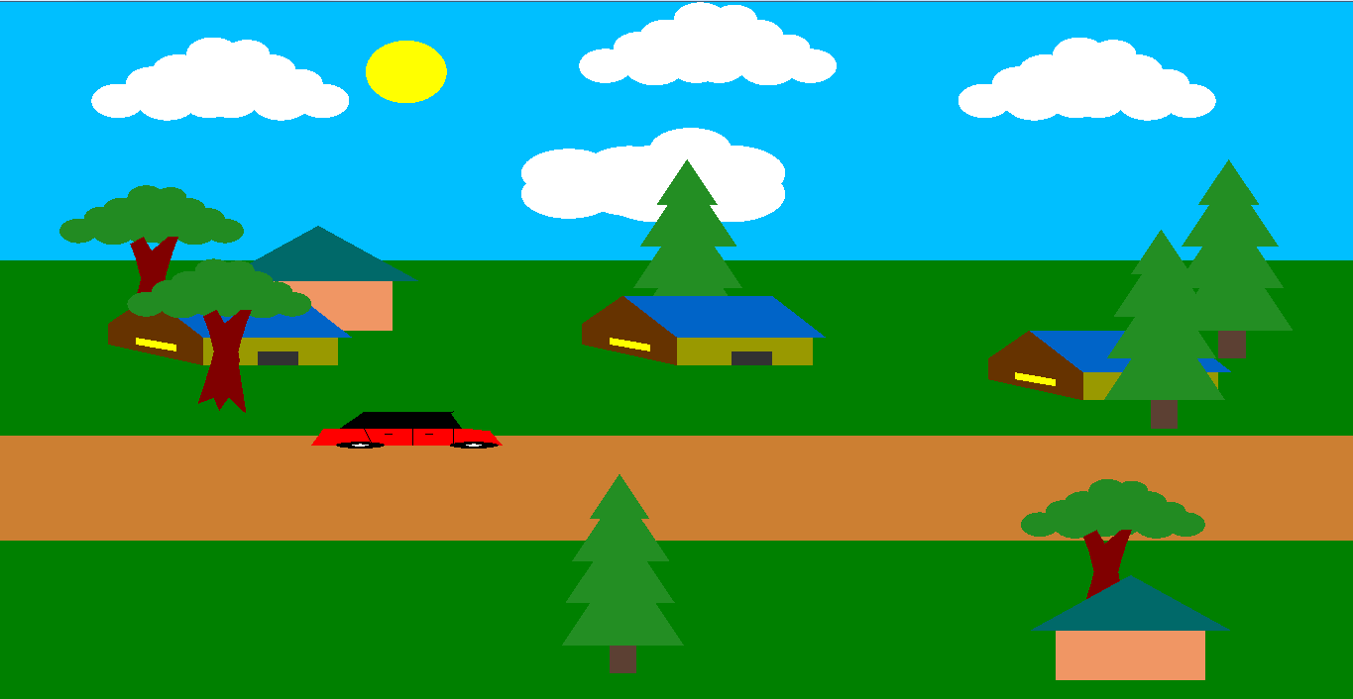

Slide 5
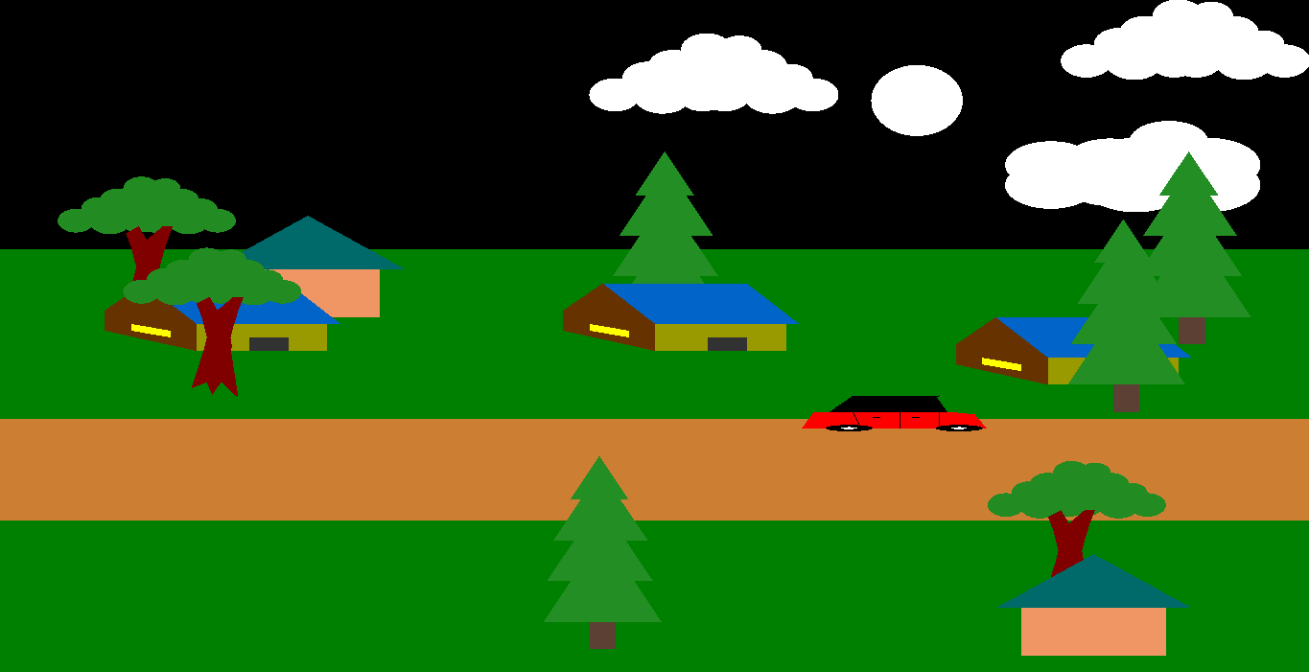

Slide 6
That’s all for now!!!
Thank You

