Slide 1
PLANE SHOOTER
Name: Md. Al-Hasan
ID: 011 142 062

Slide 2
INTRODUCTION
It is a simple project based on shooting.
There will be two groups
White one which will be player group
Red one which will be enemy group
If one plane of enemy group crossed you or touched you then you will be dead.
If you destroy your own group plane, your score will be deducted 1.And if you leave them you will get 1 point
If you destroy enemy plane your score will increase 3.

Slide 3
TASK
Initially I need to make player and enemy object.
Then I try to create bullet for shooting.
Give necessary condition to move Player, Enemy and bullet.
Logical condition to destroy enemy.
Updating scores of player.

Slide 4
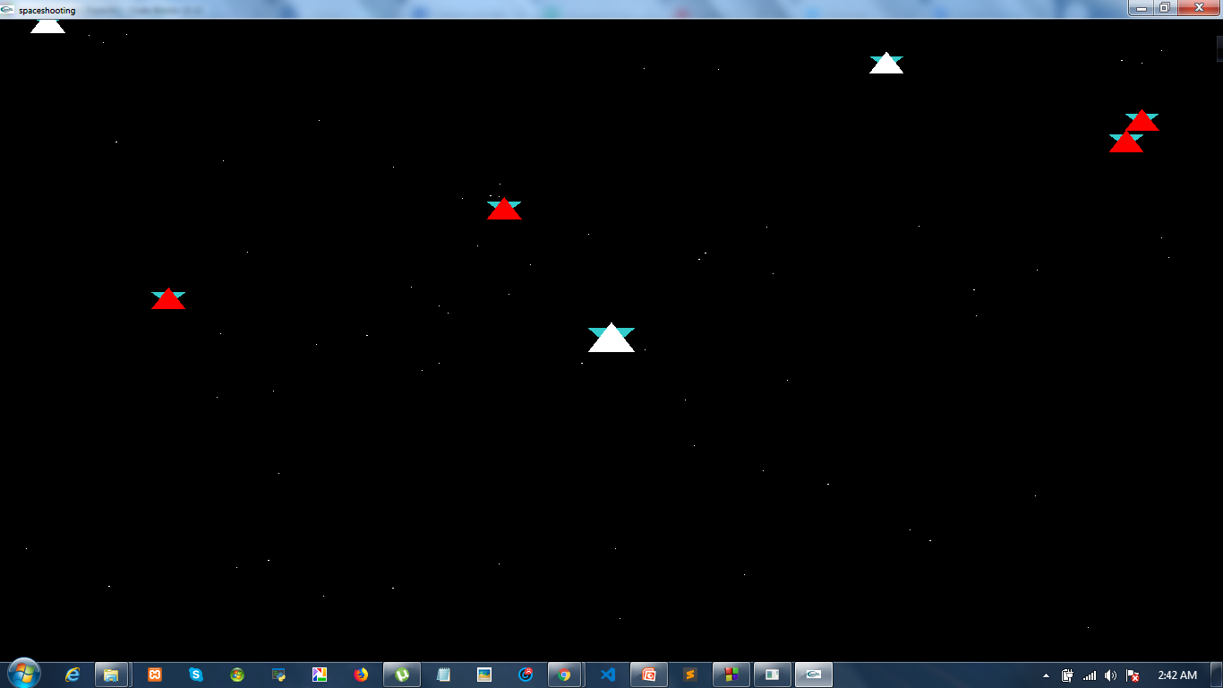
Enemy and Player group

Slide 5
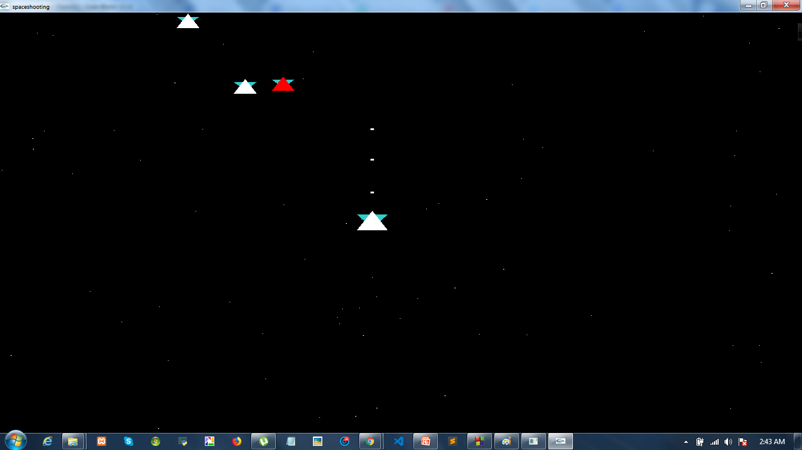
Player Shooting

Slide 6
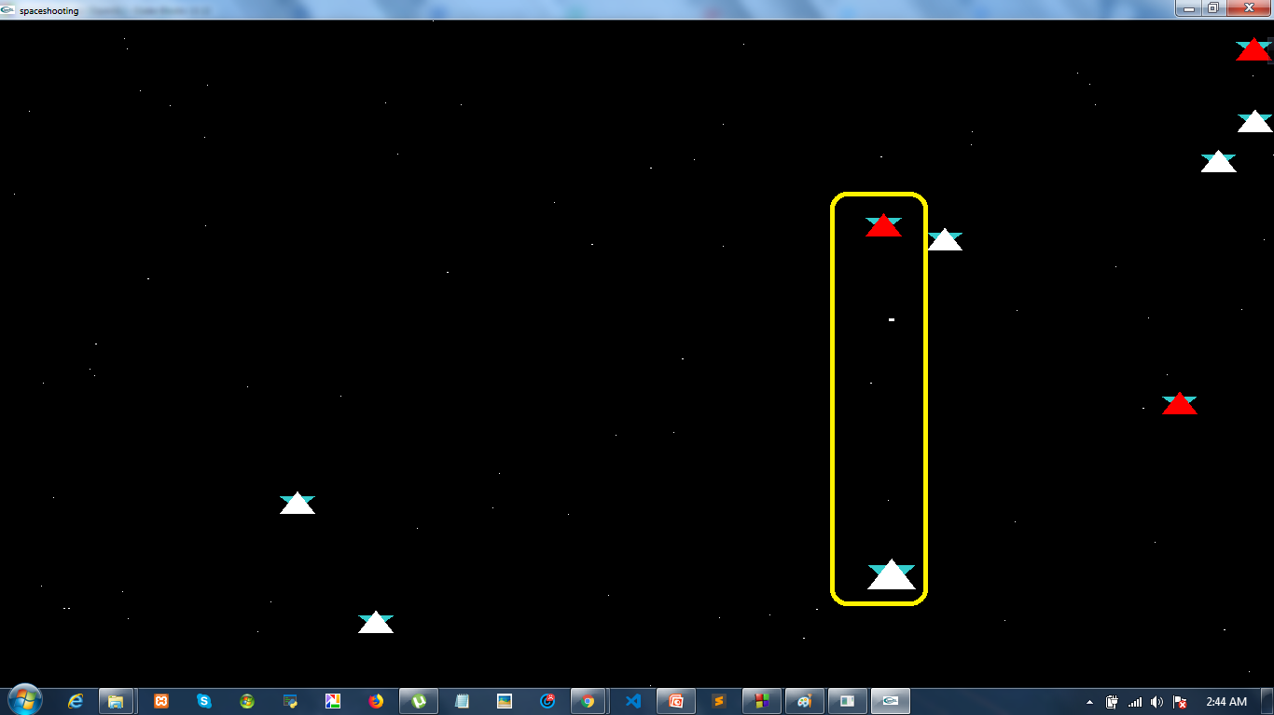
Shooting an enemy

Slide 7
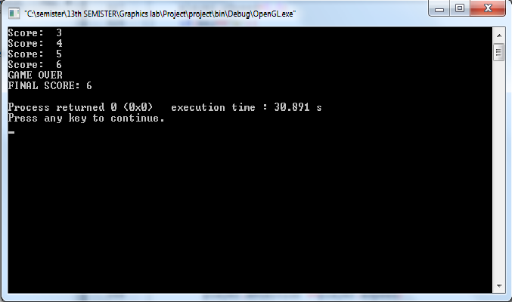
Player Score

