Slide 1
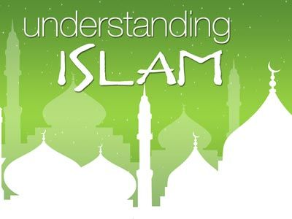

Slide 2
Think Pair Share
What do you know about Islam?

Slide 3
Islam Today: Demographics
There are an estimated 1.2 billion Muslims worldwide
Approximately 1/5th of the world's population
Growth without missionary efforts
Where Do Muslims Live?
Only 18% of Muslims live in the Arab world
20% are found in Sub-Saharan Africa
30% in the South Asian region of Pakistan, India and Bangladesh
The world's largest single Muslim community is in Indonesia
The Top 9: 1) Indonesia, 2) Pakistan, 3) Bangladesh, 4) India, 5) Turkey, 6) Iran, 7) Egypt, 8) Nigeria, and 9) China

Slide 4
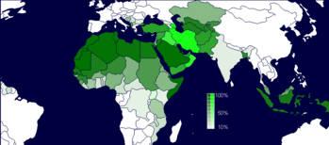
The Islamic Map

Slide 5
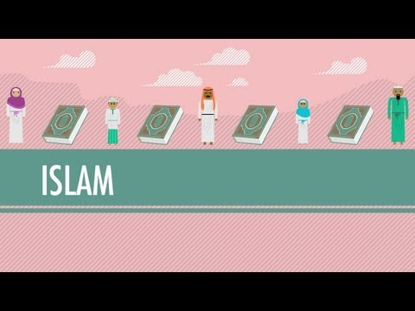
Crash Course Introduction

Slide 6

Two Main Braches of Islam
There are two main branches of Islam today
Sunni recognize the male heirs of the first 4 elected (according to Muhammad's instruction) caliphs (or spiritual heads) after Muhammad’s death
Shiite recognize the decedents of only the 4th caliphs—Ali (M’s son-in-law & cousin), the only true descendent of Muhammad
In all other ways Sunni and Shiite are very similar
http://english.alarabiya.net/en/views/news/middle-east/2014/11/08/Sunni-extremism-vs-Shiite-extremism.html

Slide 7
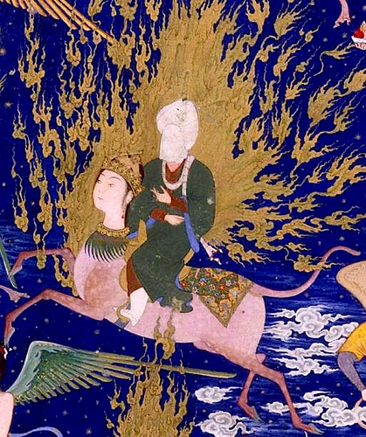
Understanding Muhammad: His Life and Times

Slide 8
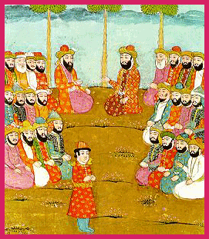
The Life of Muhammad: The early years
Muhammad was born in Mecca around the year 570 (A city of western Saudi Arabia)
Mecca was not a kind, friendly culture
These tribes all worshiped many different gods (polytheistic)
Muhammad began working as a merchant and was known for his trustworthiness
Muhammad and Khadija (wife) had 4 daughters and 2 sons

Slide 9
The Life of Muhammad: The Visions and the Message
Fifteen years after his marriage, he began to have visions and hear mysterious voices
When Muhammad was about 40 years old an angel appeared to him in the form of a man
This revelation was soon followed by others about the one true God
The key message:
Unlike Jesus (who Christians believe was God's son) Muhammad was a mortal, albeit with extraordinary qualities
He preached a strong social justice message about equality and poverty

Slide 10
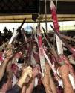
The Life of Muhammad: The Trouble
Muhammad slowly began to attract some followers, most of them young and of modest social standing
The ruling elite feared Muhammad and his followers and began to persecute them
Muhammad's prestige grew much larger after the war and the subsequent surrender of the Meccans

Slide 11

The Life of Muhammad: Conclusion
Muhammad's life was cut short by his sudden death on June 8, 632 at about 60 years old
Within 100 years, Islam spread across the world, occupying more territory than the Roman Empire

Slide 12
Koran (or the Qur'an)

Slide 13
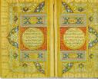
Koran (or the Qur'an)
Introduction
God's revelations to Muhammad
The Creation of the Book

Slide 14
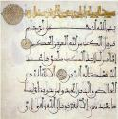
Koran (or the Qur'an)
The Content
A) The Koran as a book is comparable in length to the Gospels
B) Chapters of the Koran follow in descending order of length
C) Many commandments, few stories
D) Introduced life after death and heaven & hell (divine reckoning)

Slide 15
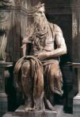
Muslims view other religions:
Muslims believe that God had previously revealed Himself to the earlier prophets of the Jews and Christians
Muslims therefore accept the teachings of both the Jewish Torah and the Christian Gospels
They believe that Islam is the perfection of the religion
Moses

Slide 16
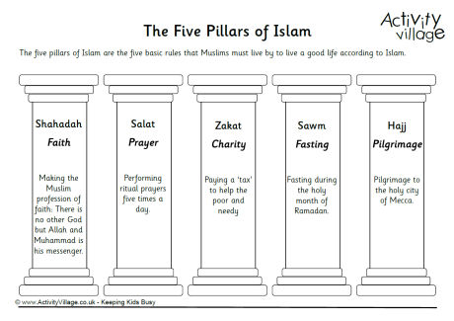
The Five Pillars
The believer worships God directly without the intercession of priests or clergy or saints.
The believer's duties are summed up in five simple rules, the so-called Five Pillars of Islam:

Slide 17
Six Articles of Belief
1. Belief in one God (Allah)
2. Belief in all the prophets and messengers sent by God.
124,000 prophets, of whom 313 are also messengers
25 of these messengers are very important (mentioned in the Quran)
3. Belief in the books sent by God:
The Suhuf scripts of Abraham
The Tawrat sent to Moses--Torah
The Zabur sent to David--Psalms
The Injil sent to Jesus--Gospels
The Qur'an sent to Muhammad--Koran
4. Belief in the Angels of whom four are held in high esteem and are named in the Quran and the Hadith (additional book about M)
Like Gabriel who spoke with M
5. Belief in the Day of Judgment when you die and in the life after death
Heaven and hell
6. Belief in Fate (predestination) Muslims believe in divine destiny
God wrote down all that has happened and will happen

Slide 18
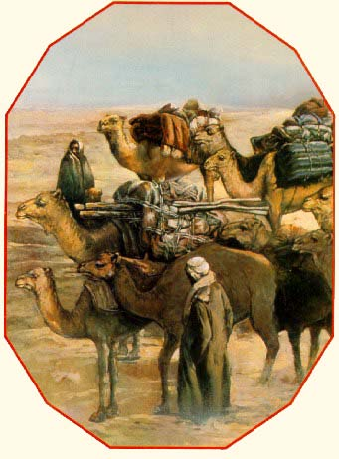
The Brief History of the Islamic World (in 4 parts)

Slide 19
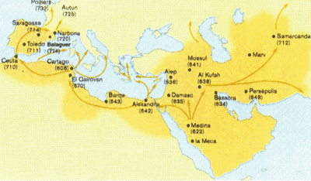
I. The Spread of Islam
During the 8th Century (700s AD), one hundred years after M’s death, Islam spreads through three continents
The empire spread from Spain to the edge of India
Map of the expansion of Islam. 7th-8th centuries

Slide 20

II. The Spread of Islam and the first Renaissance:
Baghdad (Iraq) became the center of learning and innovation
While Europe was the Dark Ages:
A)
B)
C)

Slide 21

II. The Spread of Islam and the first Renaissance:
The Muslims:
1) Translated
2) Invented
3) Understood
4) Developed
5) Utilized
6) Refined
7) Advanced

Slide 22

III. Christian vs. Muslim (The Crusaders)
11th century (1,000 AD), however, Christians and Muslims were headed for a crash course.
No one thought that the Crusaders would ever come from Barbaric Europe
The rest of the Islamic world outside of the Holy City went on as usual
1186 AD, Saladin raided Jerusalem and wiped out the Crusaders

Slide 23
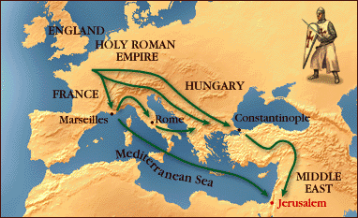
The Crusades

Slide 24
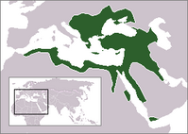
IV. The Ottoman Empire
The Ottoman Turkish Empire was an imperial power, centered around the borders of the Mediterranean Sea, that existed from 1299 to 1922
In the 16th and 17th centuries, the Ottoman Empire was among the world's most powerful political entities
The dissolution of the Ottoman Empire was a consequence of WWI when Allied forces, eventually defeated Ottoman forces in the Middle East

Slide 25

Fundamentalism vs. Liberalism in Today’s Islamic States

Slide 26

Liberalism in Islam
What happened to this once intellectual/enlightened empire?
Is today the Islamic Dark Ages?
Most say it was the rise of Fundamentalism
1) Church is State
2) Literal Interpretation of sacred Text
3) No secular creativity or ideas
4) Progress in bad
Liberal movements seek a new Renaissance

Slide 27

Liberalism in Islam
1) Human rights
2) Feminism

Slide 28

Liberalism in Islam
3) Political Secularism
Favor the idea of modern secular democracy with separation of church and state
4) Re-interpretation of the Quran
A) Criticise the literal interpretations of the Qur'an
B) Reject the authority of traditional scholars to issue a fatwa (no leader as voice of God)

Slide 29

Liberalism in Islam
5) Tolerance towards non-Muslims
6) Rejection of violence
7) Reliance on secular scholarship

Slide 30

Criticism of Liberal Islam
Producing a watered-down, inauthentic form of Islam as a compromise with Western society
Liberal Muslims are abandoning Islam and just imitating the West
Becoming cultural Muslims

