Slide 1
GARNET v2.2
Garnet.
Safe by default. Fast when needed. Joyful always.
A dual-mode, agent-native language platform.
"Where there is no vision, the people perish." — Proverbs 29:18
Four-model consensus floor · Claude Opus 4.6 · GPT-5.4 Pro · Grok 4.2 · Gemini 3.1 Pro
01 / 50

Slide 2
INTRO · 02
The Unreconciled Tension
RUST
RUBY
Unflinching safety.
Unbounded joy.
Memory safety without GC. Ownership, lifetimes, fearless concurrency. The compiler refuses to lie.
Cost: cognitive tax, no REPL, prototyping pain, DSL friction.
Developer happiness as first principle. Metaprogramming, blocks, DSLs, REPL-first. Code that breathes.
Cost: performance ceiling, GC pauses, weak concurrency.
The industry's forced choice — and Garnet's refusal of it.
02 / 50

Slide 3
INTRO · 03
The Thesis
A dual-mode, agent-native language platform that refuses the trade-off.
MANAGED MODE
@SAFE MODE
AGENT-NATIVE
Ruby-like surface. ARC default. DSLs and REPL.
Ownership and borrowing. Zero-cost. No GC on hot paths.
Memory primitives in the core. Typed actors. Harness layer.
The joy floor.
The rigor ceiling.
The systems built atop both.
03 / 50

Slide 4
RUST DEEP DIVE · 04
Rust's founding promise
Memory safety without garbage collection.
Mozilla's bet: prove that systems software can be safe at compile time, not at runtime.
The trinity.
Ownership. Borrowing. Lifetimes. Three rules that eliminate entire classes of bugs.
The cost paid up front.
Programmers carry the proof obligation. The compiler is the auditor.
04 / 50

Slide 5
RUST DEEP DIVE · 05
Ownership and borrowing — the core move
Every value has exactly one owner.
When the owner goes out of scope, the value is dropped.
Borrows are tracked: shared (&T) or mutable (&mut T), never both at once.
The result: no double-frees, no use-after-free, no data races — proved at compile time.
// rust
fn main() {
let s = String::from("hi");
let r = &s; // shared borrow
println!("{r}");
// &mut s here would error
}
05 / 50

Slide 6
RUST DEEP DIVE · 06
Lifetimes and the borrow checker
Lifetimes name the scope a reference is valid for.
The borrow checker proves that no reference outlives its referent.
'a is not decoration — it is a contract.
The compiler verifies that the contract holds across every call site.
The famous error messages.
Frustrating to learn, formative once internalized: the compiler teaches systems thinking.
06 / 50

Slide 7
RUST DEEP DIVE · 07
Zero-cost abstractions
Stroustrup's principle, finally honored.
What you don't use, you don't pay for. What you do use, you couldn't hand-code better.
Iterators compile to loops. Closures inline. Traits monomorphize.
The high-level surface evaporates into machine code with no runtime tax.
This is why Rust shows up in kernels, browsers, and embedded.
Performance you can audit, expressivity you can read.
07 / 50

Slide 8
RUST DEEP DIVE · 08
Fearless concurrency
Send and Sync as type-system guarantees.
Whether a value can cross threads — or be shared across them — is encoded in its type.
Data races are a compile error.
Not a lint. Not a runtime check. A type error.
The cost: async Rust is its own dialect.
Pin, Future, lifetimes-in-async — the boundary where Rust's elegance frays.
08 / 50

Slide 9
RUST DEEP DIVE · 09
The cognitive tax
Learning cliff, not curve.
Most newcomers describe a wall around month two: ownership clicks or it doesn't.
Fight-the-compiler fatigue.
Even experts report friction on greenfield code. The proof obligation never relaxes.
Where the tax is worth it — and where it isn't.
Hot paths, kernels, infra: yes. Glue code, scripts, exploration: questionable.
09 / 50

Slide 10
RUST DEEP DIVE · 10
Ecosystem strengths
Cargo: the gold standard.
Build, test, doc, publish, lock — one tool, one workflow, one mental model.
crates.io.
A registry that other languages quietly envy. Versioning, semver, features.
Tooling maturity.
rustfmt, clippy, rust-analyzer. The IDE story is finally first-class.
10 / 50

Slide 11
RUST DEEP DIVE · 11
Where Rust hurts
Prototyping speed.
The proof obligation is paid up front — even when you're still figuring out what you mean.
DSL expressiveness.
Macros help. They don't reach Ruby's surface fluency. They aren't supposed to.
REPL absence.
evcxr exists; it is not the workflow. Rust is compile-edit-debug, not converse-with-the-runtime.
11 / 50

Slide 12
RUST DEEP DIVE · 12
Verdict — unmatched rigor, bounded joy
Rust is the rigor ceiling.
There is nothing else like it in production. The proof obligations it demands buy guarantees no other mainstream language can offer.
And it is not what most code wants to be written in.
12 / 50

Slide 13
RUBY DEEP DIVE · 13
Ruby's founding promise
Developer happiness as first principle.
Matz: "I hope to see Ruby help every programmer in the world to be productive, and to enjoy programming."
Optimize for the human, not the machine.
Where Rust trusts the compiler, Ruby trusts the programmer's instinct.
Joy as a design axis.
Not a marketing word. A measurable property of a language's surface.
13 / 50

Slide 14
RUBY DEEP DIVE · 14
Everything is an object
Including integers. Including nil. Including classes themselves.
There are no primitives, no escape hatches, no second-class citizens.
Metaprogramming as first-class.
define_method, method_missing, class_eval — the language is its own toolbox.
Open classes.
Reopen any class anywhere. Power and danger in the same hand.
14 / 50

Slide 15
RUBY DEEP DIVE · 15
Blocks, procs, lambdas — the expressiveness engine
Blocks are the syntactic gift Ruby gave the world.
do...end and {...} are not afterthoughts — they are the substrate on which Rails, RSpec, Sinatra, and a generation of DSLs were built.
Procs and lambdas extend the gift to first-class values.
# ruby
[1, 2, 3].each do |n|
puts n * 2
end
double = ->(x) { x * 2 }
puts double.(21) # => 42
15 / 50

Slide 16
RUBY DEEP DIVE · 16
DSLs — the joy compounding
Rails.
ActiveRecord, routes, migrations — every Rails idiom is a Ruby DSL underneath.
RSpec.
describe, it, expect.to — tests that read like specifications because they are.
Sinatra, Capistrano, Chef, Puppet, Vagrant, Homebrew.
Two decades of Ruby's gift to operators, testers, and infrastructure engineers.
16 / 50

Slide 17
RUBY DEEP DIVE · 17
REPL-first workflow
irb is the language.
Not a debugger, not a side tool — the primary mode of exploration.
Type, see, refine.
Ruby rewards the conversational programmer. Hypothesis to confirmation in seconds.
This is a different model of work than Rust offers.
Both legitimate. Garnet wants both.
17 / 50

Slide 18
RUBY DEEP DIVE · 18
Where Ruby hurts
Performance ceiling.
MRI is fast enough for most web workloads — and a poor fit for hot paths, ML kernels, or systems code.
GC pauses.
Generational, incremental, improving — and still a tax that systems languages refuse to pay.
Concurrency story.
GVL, threads-but-not-really, Ractors as recent answer. The story is incomplete.
18 / 50

Slide 19
RUBY DEEP DIVE · 19
Ecosystem and ethos
RubyGems and Bundler.
Predates Cargo. Set the template for a generation of package managers.
MINSWAN.
"Matz is nice, so we are nice." A community ethos as load-bearing as the language.
Compounding kindness.
Ruby's ecosystem is small now. Its influence on every modern language remains enormous.
19 / 50

Slide 20
RUBY DEEP DIVE · 20
Verdict — unmatched joy, bounded rigor
Ruby is the joy floor.
There is nothing else like it for surface fluency, exploratory rhythm, or DSL compounding. Two decades have not produced a true successor.
And it is not what most performance-critical code wants to be written in.
20 / 50

Slide 21
GAP ANALYSIS · 21
The 34-dimension gap matrix — methodology
Thirty-four axes of comparison.
Safety, expressiveness, concurrency, memory model, tooling, learning curve, ecosystem, deployment, REPL, DSL surface, error model — each scored 0–10.
Comparators.
Rust, Ruby, Swift, TypeScript, Crystal, Elixir, Mojo, Pony — eight points in the design space.
Output.
A positioning matrix that names a vacancy: managed ergonomics with safe hot paths.
21 / 50

Slide 22
GAP ANALYSIS · 22
Safety axis
COMPILE-TIME
RUNTIME
RUST
Compile-time. Ownership-and-borrowing. Data races as type errors.
Cost: proof obligation paid by the human.
RUBY
Runtime. Exceptions as control flow. GC eliminates classes of bugs at a different price.
Cost: bugs found in production, not at compile time.
22 / 50

Slide 23
GAP ANALYSIS · 23
Expressiveness axis
SURFACE FLUENCY
SYSTEMS CONTROL
RUBY
Surface fluency. Blocks, metaprogramming, open classes, DSL compounding.
The programmer's intent reaches the reader unmediated.
RUST
Systems control. Macros, traits, monomorphization.
Expressivity is real but disciplined — and bounded by the type system.
23 / 50

Slide 24
GAP ANALYSIS · 24
Concurrency axis
Three traditions.
Shared-state with locks (Rust, Java). Actors with mailboxes (Erlang, Pony, Akka). Async with futures/tasks (Rust, JS, Python).
Each has a sound version and a folk version.
The sound versions require type-system support. The folk versions ship bugs.
Garnet's choice.
Typed actors as the default surface. Structured async underneath. Shared state only inside @safe.
24 / 50

Slide 25
GAP ANALYSIS · 25
Memory axis
ARC.
Swift's choice. Deterministic, compiler-inserted, no GC pauses. The managed-mode default for Garnet.
Ownership.
Rust's choice. Compile-time, zero runtime overhead, requires the proof obligation. Garnet's @safe default.
GC.
Ruby, Python, JVM. Throughput-friendly, pause-prone. Not Garnet's choice for either mode.
25 / 50

Slide 26
GAP ANALYSIS · 26
Tooling and ecosystem axis
Cargo set the bar.
Build, test, doc, lock, publish — one tool, one mental model.
Bundler set it earlier.
Ruby's ecosystem invented many of the patterns Cargo polished.
Garnet inherits both lessons.
garnet build, garnet test, garnet doc, garnet repl — first-class from rung 1.
26 / 50

Slide 27
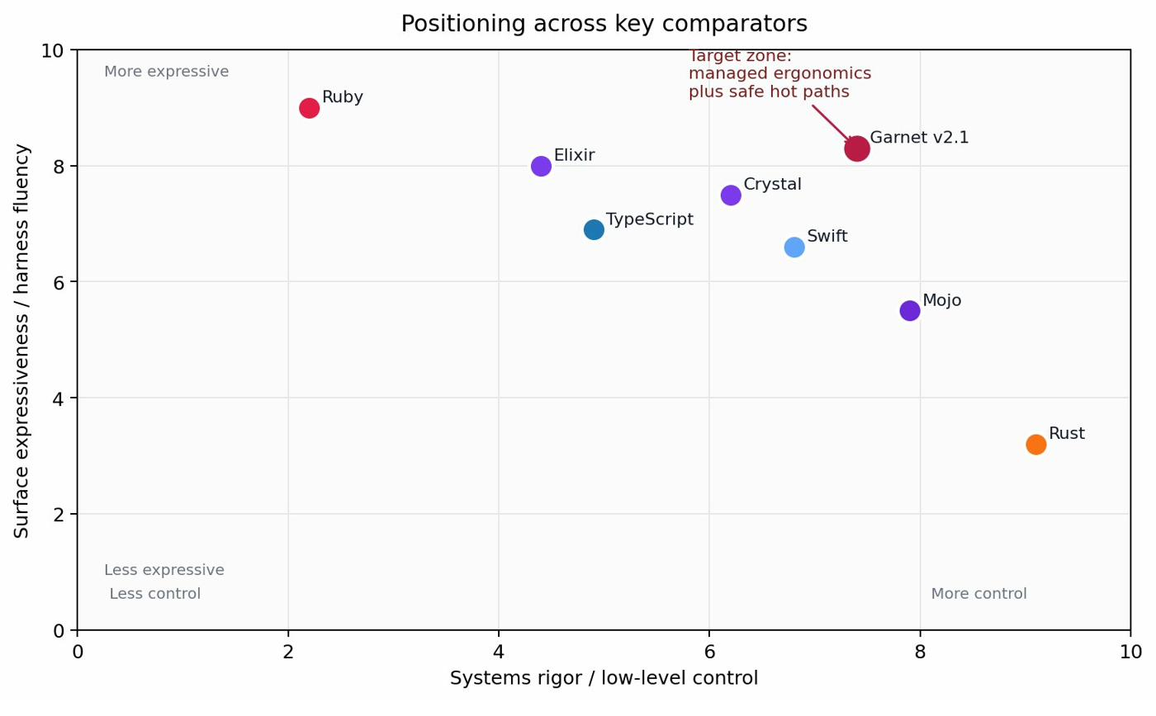
GAP ANALYSIS · 27
Garnet's target zone
Managed ergonomics with safe hot paths — a vacancy on the matrix.
TARGET ZONE
Ruby-like surface fluency.
Rust-grade safety on the hot paths the harness identifies.
No mainstream language sits here today — and the four-model consensus says no incremental change to Rust or Ruby reaches it.
27 / 50

Slide 28
SYNTHESIS · 28
Swift as production precedent
ARC + actors + Sendable.
Apple has shipped a dual-discipline runtime to hundreds of millions of devices.
The proof of concept is already deployed.
Garnet does not invent the architecture — it generalizes it past the Apple silo.
What Swift does not do.
Open ecosystem, Ruby-grade DSLs, agent-native memory primitives, harness layer.
28 / 50

Slide 29
SYNTHESIS · 29
Dual-mode design
MANAGED MODE · default
@SAFE MODE · opt-in
ARC. Ruby-like surface. Blocks, metaprogramming, REPL.
What you write when you don't yet know what you mean.
What most code stays as forever.
Ownership and borrowing. No GC. Zero-cost abstractions.
Annotated on the functions, modules, or actors that need it.
The harness identifies them; the programmer confirms.
29 / 50

Slide 30
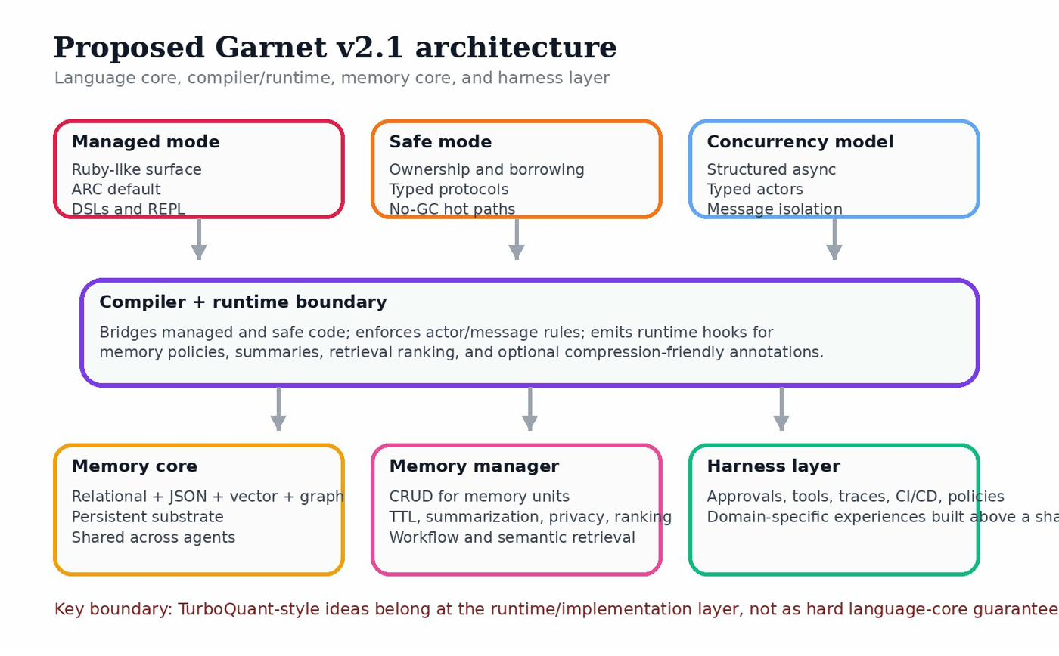
SYNTHESIS · 30
Proposed architecture
Language core · compiler/runtime · memory core · harness layer.
30 / 50

Slide 31
SYNTHESIS · 31
Managed mode — surface sample
# garnet · managed mode
actor Greeter
def initialize(@name : String); end
def greet(other)
puts "hello #{other}, from #{@name}"
end
end
g = Greeter.spawn(name: "garnet")
g.greet("jon")
31 / 50

Slide 32
SYNTHESIS · 32
@safe mode — surface sample
# garnet · @safe mode
@safe
def hot_loop(buf: own Buffer) -> own Buffer
let mut b = buf
for i in 0..b.len()
b[i] = b[i] * 2
end
return b
end
32 / 50

Slide 33
SYNTHESIS · 33
Mode boundary
Compile-time enforcement.
@safe boundaries are checked statically. Crossing them transfers ownership or borrows explicitly.
Runtime bridging.
ARC values entering @safe become owned. Owned values exiting @safe rejoin ARC. The bridge is typed.
No silent escape hatches.
Every crossing is named. Every name is checkable. The boundary is the thesis.
33 / 50

Slide 34
SYNTHESIS · 34
Affine type theory + RustBelt grounding
Affine, not linear.
Values may be used at most once. Drop is allowed. Linear types forbid drop; affine allows it. @safe lives here.
RustBelt / Iris / Coq.
The same machinery that proved Rust sound proves λ_safe sound. Garnet inherits the floor.
Mode boundary as a typed judgment.
Not folklore — a calculus with progress and preservation. Paper V is the artifact. (Gemini contribution.)
34 / 50

Slide 35
SYNTHESIS · 35
TurboQuant — runtime signal, not language guarantee
Where it lives.
Compiler/runtime layer. Optional codegen hint. Profiled, not promised.
Where it does not live.
The language core. No surface keyword. No type-system commitment. (Four-model consensus point 8.)
Why the boundary matters.
Performance ideas come and go. The language must not be hostage to any of them.
35 / 50

Slide 36
MEMORY ENGINEERING · 36
One Memory Core, many harnesses
The definitive architecture.
Every agent in a Garnet system reads from and writes to a shared Memory Core.
Harnesses are domain experiences.
Different surfaces, different policies, different UIs — all sitting atop the same substrate.
Memory is the platform.
Not a feature. Not a library. The thing the language is for.
36 / 50

Slide 37
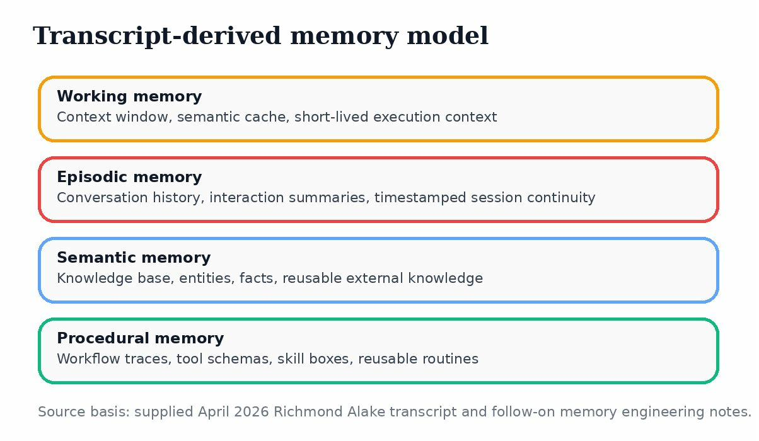
MEMORY ENGINEERING · 37
Four memory types
Working · episodic · semantic · procedural.
37 / 50

Slide 38
MEMORY ENGINEERING · 38
First-class memory primitives
Memory units are values.
Typed. Owned where they need to be. ARC-managed where they don't.
The four kinds are language-level.
working, episodic, semantic, procedural — surface keywords, not library imports.
Why this matters.
The compiler can reason about retention, ranking, and decay. Libraries cannot.
38 / 50

Slide 39
MEMORY ENGINEERING · 39
Memory Manager
CRUD for memory units.
Create, read, update, delete — typed, transactional, audited.
Lifecycle policies.
TTL, summarization triggers, privacy redaction, retention windows.
Retrieval ranking.
Workflow and semantic retrieval, scored against the harness's request.
39 / 50

Slide 40
MEMORY ENGINEERING · 40
Relevance + Recency + Importance
OQ-7. The decay formula.
score(m, q, t) = α · relevance(m, q)
+ β · recency(m, t)
+ γ · importance(m)
α, β, γ are tunable per harness. Recency decays with a configurable half-life. Importance is set at write time and decays slower.
The formula is a starting point — Paper V grounds it as a typed-resource decay over an affine memory store.
40 / 50

Slide 41
MEMORY ENGINEERING · 41
Typed actors + compiler-enforced protocols
Actors are the concurrency unit.
Each owns its state. Communication is by typed message.
Protocols are types.
A channel's type names the legal sequence of messages. The compiler enforces it.
Session-typed channels.
Borrowed from the formal-methods literature; shipped in a language meant for production.
41 / 50

Slide 42
MEMORY ENGINEERING · 42
Multi-agent consistency
OQ-8.
When N agents share one Memory Core, what consistency model holds?
The conservative answer.
Sequential consistency at the Memory Manager boundary. Agents see writes in a global order.
The Paper V answer.
A typed-actor protocol over the Memory Core that proves non-interference. (Gemini contribution.)
42 / 50

Slide 43
CONSENSUS · 43
Four frontier systems converged
Claude Opus 4.6 · GPT-5.4 Pro · Grok 4.2 · Gemini 3.1 Pro Deep Research
01
02
03
04
Dual-mode is necessary.
Swift is the precedent.
Affine, not linear.
Memory is core, not lib.
The Rust/Ruby tension cannot be resolved by either pole.
ARC + actors + Sendable is the working production template.
@safe lives in affine type theory; managed lives in ARC.
Working / episodic / semantic / procedural are language-level.
05
06
07
08
Typed actors as default.
Engineering ladder beats prototype.
Mode boundary needs a calculus.
TurboQuant is runtime, not language.
Concurrency story belongs in the type system.
Six rungs, not one demo.
Paper V is the artifact that grounds it.
Performance ideas live below the surface.
43 / 50

Slide 44
CONSENSUS · 44
Adjudicated divergences
TurboQuant scope
Three models proposed surface keywords. Consensus: runtime layer only.
'Proposed' vs 'first'
Some drafts called Garnet "the first dual-mode language." Adjudicated to "proposed" — Swift exists.
Engineering ladder vs prototype
One model favored a single demo. Consensus: six rungs, traceable, falsifiable.
44 / 50
"In the multitude of counsellors there is safety." — Proverbs 11:14

Slide 45
ENGINEERING LADDER · 45
Six rungs
Mini-Spec → Parser → Interpreter+REPL → Safe Lowering → Memory Core → Harness Runtime.
R1
Mini-Spec v0.2
complete
R2
garnet-parser crate
next
R3
Managed interpreter + REPL
queued
R4
@safe lowering
queued
R5
Memory Core + Manager SDK
queued
R6
Harness Runtime
queued
45 / 50

Slide 46
ENGINEERING LADDER · 46
Rung 1 complete — Mini-Spec v0.2
§3.1 affine types.
The @safe sub-calculus, formally framed for Paper V's grounding.
§5 RLM guardrails.
Recursive language model recursion bounds, normative not optional.
OQ-7 and OQ-8.
Decay formula and multi-agent consistency questions, posed and partially answered.
46 / 50

Slide 47
ENGINEERING LADDER · 47
Rung 2 next — garnet-parser
Target sections.
§2.1 managed surface, §4.1 @safe surface, §5.1–5.3 typed actors.
Crate layout.
logos lexer, recursive-descent parser, miette diagnostics, insta snapshot tests.
Acceptance.
cargo test green; three example .garnet files round-trip through parse → AST.
47 / 50

Slide 48
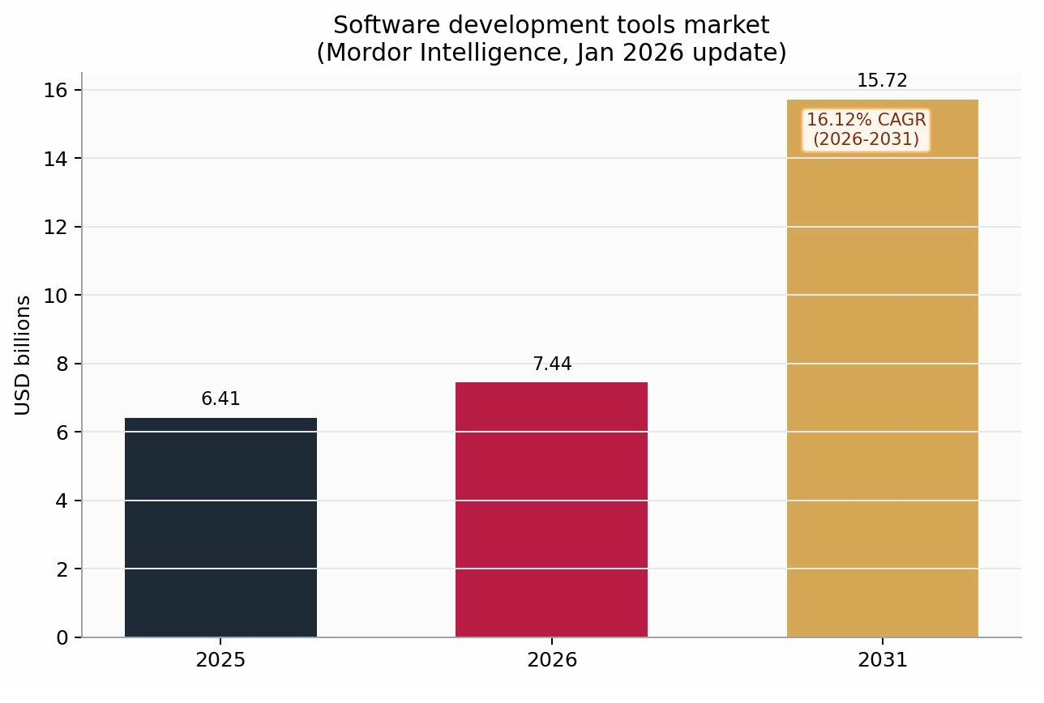
MARKET · 48
Dev tools market — the window is now
$6.41B (2025) → $7.44B (2026) → $15.72B (2031) · 16.12% CAGR
WHY NOW
Agent-native systems are crossing from research to revenue.
The harness layer is unbuilt. The language for it does not yet exist.
Garnet's window is the next 18 months — before the incumbents ossify around inadequate substrates.
48 / 50

Slide 49
CLOSE · 49
The Invitation
Builders. Researchers. Believers.
The harness is open. The Mini-Spec is in the corpus. The four-model consensus is bedrock. The engineering ladder is climbable.
What we need next is the next rung.
garnet-lang.org · Paper V (forthcoming) · github.com/garnet-lang
49 / 50

Slide 50
ANCHOR
"Where there is no vision,
the people perish."
— Proverbs 29:18
Garnet.
Safe by default. Fast when needed. Joyful always.
50 / 50

